Slide 1


Web automation testing
… for developers?

Slide 2
What is Automation Testing?
Definition
Test automation is the use of special software to control the execution of tests and the comparison of actual outcomes with predicted outcomes. It’s done through an automation tools which nowadays exist for almost every platform.
Notes:
test automation is using software to automatically run tests on your platform.
can be run on almost every operating systen nowadays

Slide 3
What is Automation Testing?
What can be automated?
Web UI testing
Desktop UI testing
CLI interface testing
API testing
Database testing
System stability testing
Notes:
your platform can be one of these

Slide 4
What is Automation Testing?
What does it fit for?
Smoke testing for production deploys
Regression testing (majorly happy flows)
Long run end-to-end workflows testing
Performance and load testing
Chaotic testing (micro-services)
Notes:
differs from team to team from company to company from requirement to requirement

Slide 5
What is Automation Testing?
What it doesn’t fit for?
Look and feel testing
100% coverage idea
Replace manual QA
Frequently changing/unstable application/modules

Slide 6
What is Automation Testing?
Automation vs. manual
Manual | Automation
Pros: Easy to set up and start with Consistent with life testing Suitable for look and feel check Suitable for exploratory testing Lower initial expenses and investments Expanded adaptability Cons: More assets and time required Not all things can be tried physically Low reusability Load and performing testing is not possible Not suitable for large projects with short deadlines | Pros: Time saving Eliminate the human factor High reusability Better ROI on long-term Transparency Cons: Expensive Lack of input on usability and UI Tools’ limitations and compatibility Cannot replace human intellectual skills Cannot be used as for exploratory testing Basic programming knowledge required
Notes:
manual: done by humans
most important
exploratory testing
look and feel testing
expanded adaptability
easy to move people from one project to another

Slide 7

What is Automation Testing?
Automation vs. manual
Manual + Automation =

Slide 8
Cypress Overview
General overview
Cypress is a front end testing tool built for the modern web. It address the key pain points developers and QA engineers face when testing applications.
It’s open source, but… With subscription for Dashboard Service.
Main characteristics:
UI end-to-end automation testing framework
Not based on Selenium
Runs directly in the browser
For QA engineers and developers
Easy to debug tests
Notes:
framework

Slide 9
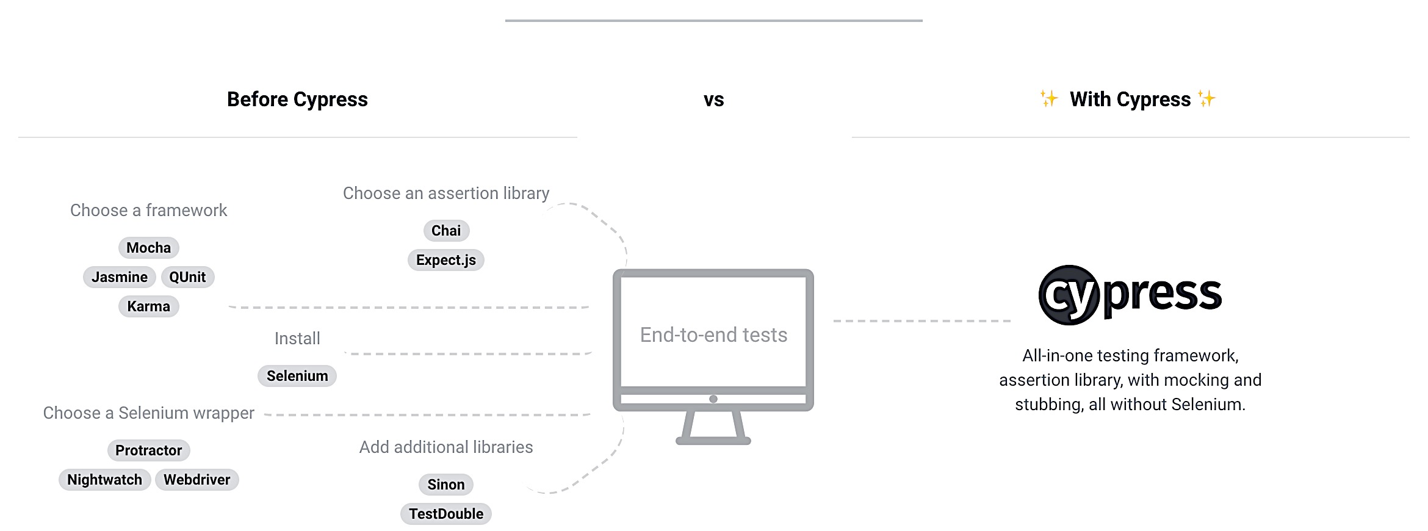
Cypress Overview
How it works

Slide 10
Cypress Overview
Features
Time Travel
Debuggability
Automatic Waiting
Spies, Stubs, and Clocks
Network Traffic Control
Screenshots and Videos

Slide 11
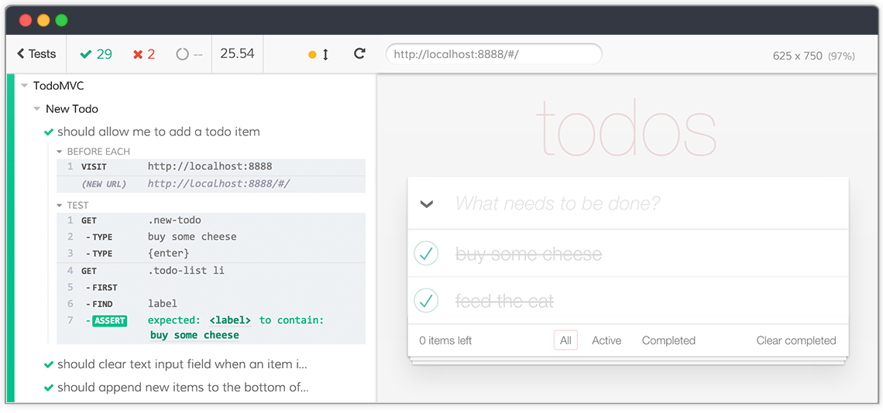
Cypress Overview
Example

Slide 12




WebDriver Overview
Selenium Projects
Selenium WebDriver
Selenium Remote Control
Selenium Grid
Selenium IDE

Slide 13
WebDriver Overview
General overview
Selenium WebDriver is a browser automation tool built for the modern web. Driving a browser natively as a user would either locally or on a remote machine using the Selenium Server it accepts commands and sends them to a browser. It is implemented through a browser-specific driver. It controls the browser by directly communicating with it.

Slide 14
WebDriver Overview
How it works
Selenium language bindings
Browser
drivers
Real
browsers
Java
FirefoxDriver
Firefox
Ruby
ChromeDriver
Chrome
JSON wire protocol
C#
SafariDriver
Safari
Python
OperaDriver
Opera
Javascript
EdgeDriver
Edge

Slide 15
WebDriver Overview
Features
Easy cross-browser testing
Support different languages
Easy framework development
Parallel testing

Slide 16
Cypress vs. WebDriver
Supported programming languages
WebDriver | Cypress
Java C# Ruby Python Javascript Perl, PHP, Haskell, Objective-C, R, Dart, Tcl, Elixir | Javascript

Slide 17
Cypress vs. WebDriver
Supported selectors
WebDriver | Cypress
Id Name Class name Tag name CSS XPath Link text Partial link text | jQuery style

Slide 18
Cypress vs. WebDriver
Supported browsers
WebDriver | Cypress
Chrome Firefox Safari Opera Edge IE | Chrome Firefox (coming soon…)

Slide 19
Automation Design Tips
Use Page Object pattern Page Object is a Design Pattern which has become popular in test automation for enhancing test maintenance and reducing code duplication. A page object is an object-oriented class that serves as an interface to a page of your AUT. The tests then use the methods of this page object class whenever they need to interact with the UI of that page.
Use custom attributes on elements A good practice is to use custom attributes for HTML elements location. Used attribute can be like: at-label=“<component-name>”.
Notes:
Say about the frameworks built upon Selenium Webdriver:
- Selenide
- Protractor
- Selendroid
- Appium

Slide 20
Demo

Slide 21
Q&A

Slide 22
Thanks!

