Slide 1


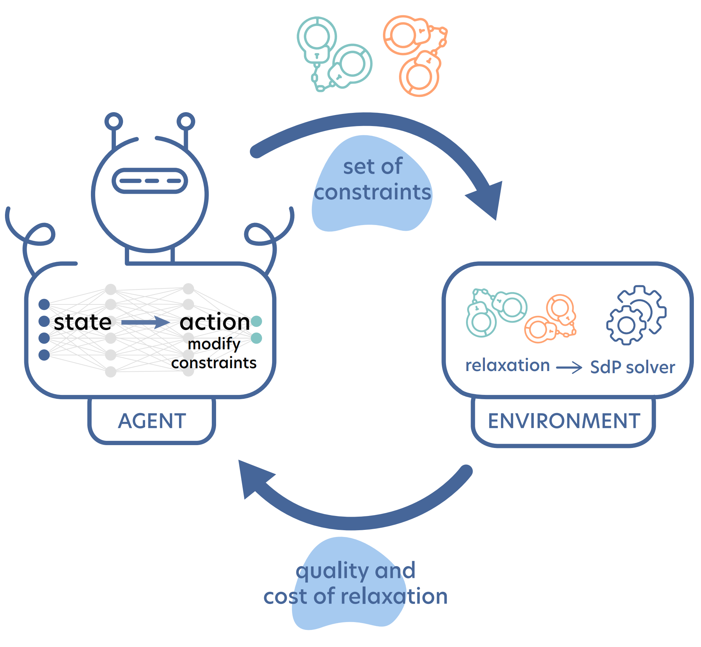
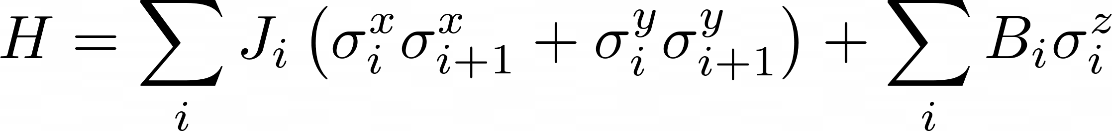
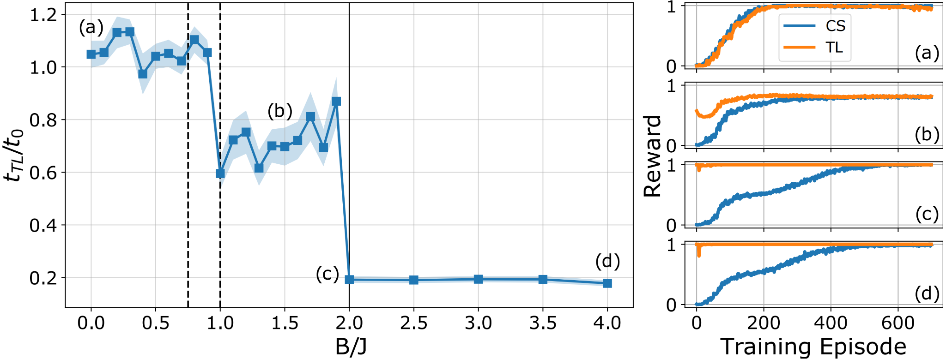
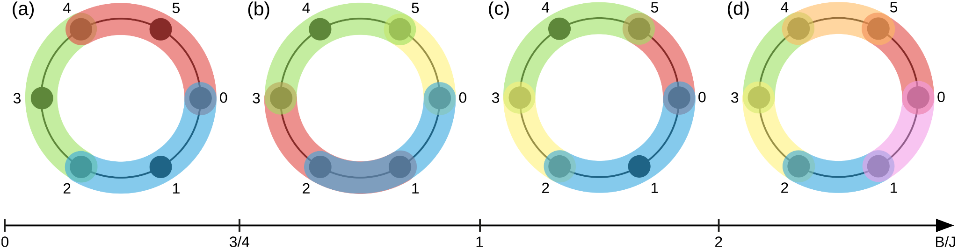
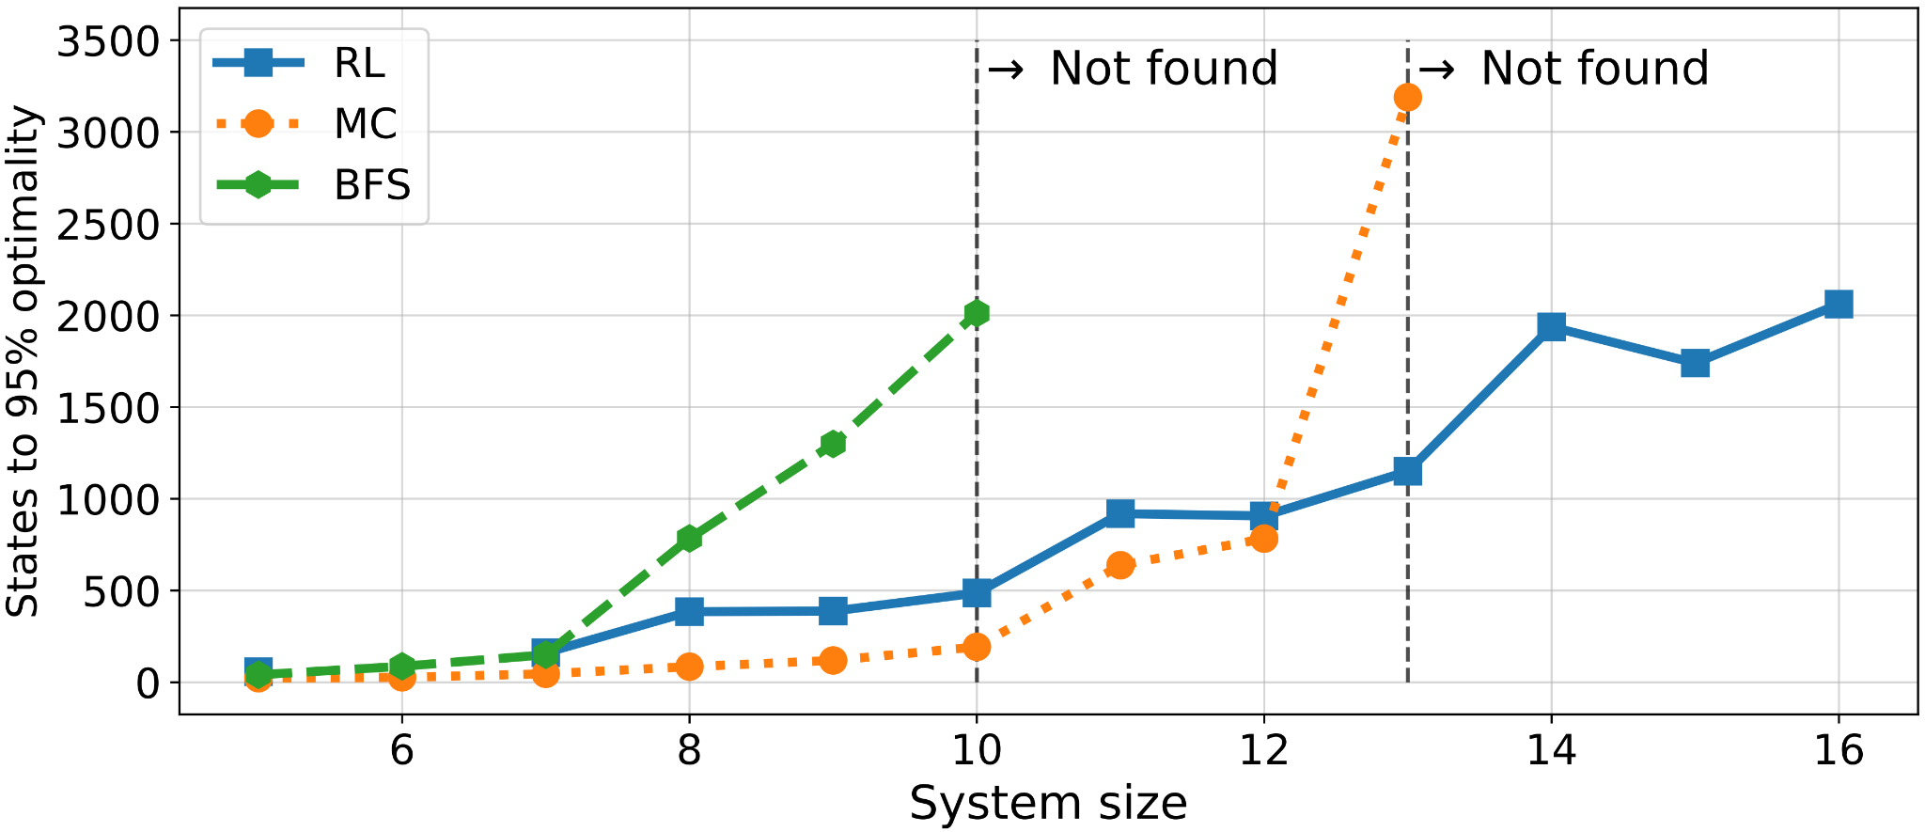
Certificates of quantum many-body properties assisted by machine learning
Borja Requena¹, Gorka Muñoz-Gil², Maciej Lewenstein^{1,3}, Vedran Dunjko⁴, Jordi Tura⁵
¹ ICFO (Spain), ² UIBK (Austria), ³ ICREA (Spain), ⁴ LIACS (Netherlands), ⁵ Instituut-Lorentz (Netherlands)
Computationally intractable tasks often comprise a cost function to be optimized over a so-called feasible set, which is specified by a set of constraints. This may yield, in general, to difficult and non-convex optimization tasks. Several standard methods are used to tackle such problems:
1) variational approaches focus on parameterizing a subclass of solutions within the feasible set;
2) relaxation techniques have been proposed to approximate it from outside, thus complementing the variational approach by providing ultimate bounds to the global optimal solution.
In this work [1], we propose a novel approach combining the power of relaxation techniques with deep reinforcement learning in order to find the best possible bounds within a limited computational budget. We tackle two paramount problems of quantum information and quantum physics:
i) finding the ground state energy;
ii) and finding entanglement witnesses of many-body quantum systems [2].
We also show how to leverage transfer learning as an indicative of phase transitions, with a completely autonomous approach. Finally, we provide tools to generalize the approach to other common applications in the field of quantum information processing.
variational
solution
relaxation
BUILDING OPTIMAL RELAXATIONS
Example problem: finding the ground state energy of many-body quantum Hamiltonians. We can build a relaxation for this problem with the following semidefinite program:
$$β=\min_{\left\{ρ_{i}\right\}} \sum_{i}{Tr\left[ρ_{i}H_{i}\right] s.t. ρ_{i}≥0 ∀ i }; Tr\left[ρ_{i}\right]=1; Compatibility ρ_{i} ∀ i$$
Solving this minimization problem, we obtain a lower bound for the ground state energy. The bound becomes tighter with stronger compatibility constraints, although it also becomes harder to compute. Given that we have finite computational resources, we must find the best bound within our computational capabilities.
Some relaxations may yield better bounds while incurring a lesser computational cost. However, they may be elusive and traditional methods rely on exploiting specific insight about the problem. We use Reinforcement Learning to systematically find the best possible relaxation of the problem within a computational budget.
We make use of Double Q-network and a reward function that accounts for both the value of the bound, as well as the computational complexity of chosen constraints.
RESULTS
We showcase our method by exploring the ground-state problem in the Heisenberg XX model
Furthermore, we autonomously explore the phase diagram of the system using transfer learning from one point in the phase space to the rest, hinting a phase transition.
which features a phase transition at B/J=2 from an entangled phase to a product state. We find a rich set of different optimal relaxations that would escape to current methods.
transfer learning
training point
To benchmark, we compare the reinforcement learning approach with other classical optimization methods: MonteCarlo (MC) and Breadth First Search (BFS)
CONCLUSIONS
We propose a novel method that combines reinforcement learning with semidefinite programming to build optimal relaxations.
The method allows us to find smart relaxations beyond what current methods can do. Its general nature allows us to apply it to multiple other optimization tasks in quantum information. Furthermore, we can use the method to gain information about the underlying systems, such as finding phase transitions or changes on the ground state.
[1] B. Requena, G. Muñoz-Gil, M. Lewenstein, V. Dunjko, J. Tura, arXiv:2103.03930
[2] G. Toth, arxiv:0406061

