Slide 1


Prevalence and
Positive Predictive Value
[Adopt an Unicorn edition]
Gorka Navarrete
Gorka Navarrete
www.cscn.uai.cl
gorkang@gmail.com
@gorkang
https://github.com/gorkang/

Slide 2

TL;DR
The Positive Predictive Value (PPV; how much can I trust a + result) of an almost perfect test can vary wildly^{(*)} depending on the Prevalence of the condition in the population tested.
(*) From 33% when the prevalence is 1 in 2000 [see here] to 100% when the prevalence is 1 in 1 [see here]

Slide 3
Unicorn Test
(almost extinct)
Hit rate: 100% (sensitivity)
False positives: 0,1% (1 - specificity)

Slide 4


Massive screening
Type 2 diabetes
Population A
1 out of 1000
Population B
500 out of 1000

Slide 5
Massive screening
Type 2 diabetes
Population A
1 out of 1000

Slide 6
Population A
Hit rate 100%
False positives
0,1%
Prevalence
1 out of 1000
p(Disease|+)?
How much can I trust a + result?
<25%
25-49%
50%
51-75%
>75%

Slide 7
Population A
Hit rate 100%
False positives
0,1%
Prevalence
1 out of 1000
p(Disease|+)?
How much can I trust a + result?
<25%
25-49%
50%
51-75%
>75%

Slide 8


Slide 10
Hit rate 100%
False positives
0,1%
1 out of 1000
TRUE +
=
TRUE +
+
FALSE +
+

Slide 11
Hit rate 100%
False positives
0,1%
1 out of 1000
PPV = 50%

Slide 12
Hit rate 100%
False positives
0,1%
1 out of 1000
PPV = 50%

Slide 13
Hit rate 100%
False positives
0,1%
1 out of 1000
0.1% . 100%
0.1% . 100%
+
99.9%. 0.1%
PPV = 50%

Slide 14
Massive screening
Type 2 diabetes
Population B
500 out of 1000

Slide 15
Population B
Hit rate 100%
False positives
0,1%
Prevalence
500 out of 1000
p(Disease|+)?
How much can I trust a + result?
<25%
25-49%
50%
51-75%
>75%

Slide 16
Population B
Hit rate 100%
False positives
0,1%
Prevalence
500 out of 1000
p(Disease|+)?
How much can I trust a + result?
<25%
25-49%
50%
51-75%
>75%
(99,8%)

Slide 19
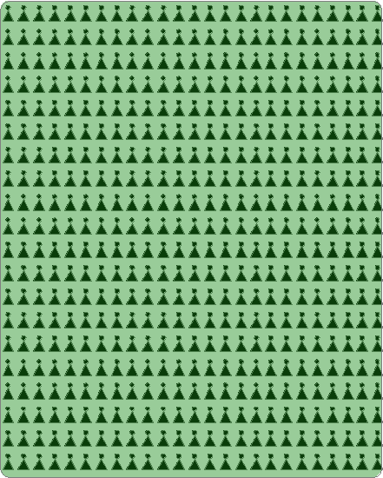
Hit rate 100%
False positives
0,1%
500 out of 1000
TRUE +
=
TRUE +
+
FALSE +
+

Slide 20
Population A
1 out of 1000
Population B
500 out of 1000
+
+

Slide 21
Adopt an Unicorn test, or they will go extinct!

Slide 22
Prevalence and
Positive Predictive Value
[Adopt an Unicorn edition]
Gorka Navarrete
Presentation in:
https://github.com/gorkang/presentations
PPV or NPV depending on Sensitivity, Specificity and Prevalence: https://gorkang.shinyapps.io/BayesianReasoning/
Gorka Navarrete
www.cscn.uai.cl
gorkang@gmail.com
@gorkang
https://github.com/gorkang/

