Slide 1
Advanced Programming
Prof. Shiqi Yu (于仕琪)
yusq@sustech.edu.cn
http://faculty.sustech.edu.cn/yusq/

Slide 2


About me
Prof. Shiqi Yu (于仕琪)
Department of Computer Science and Engineering in Southern University of Science and Technology(南方科技大学计算机科学与工程系)
Office : Room 312, South Tower, CoE Building
Email : yusq@sustech.edu.cn
Homepage: http://faculty.sustech.edu.cn/yusq/

Slide 3

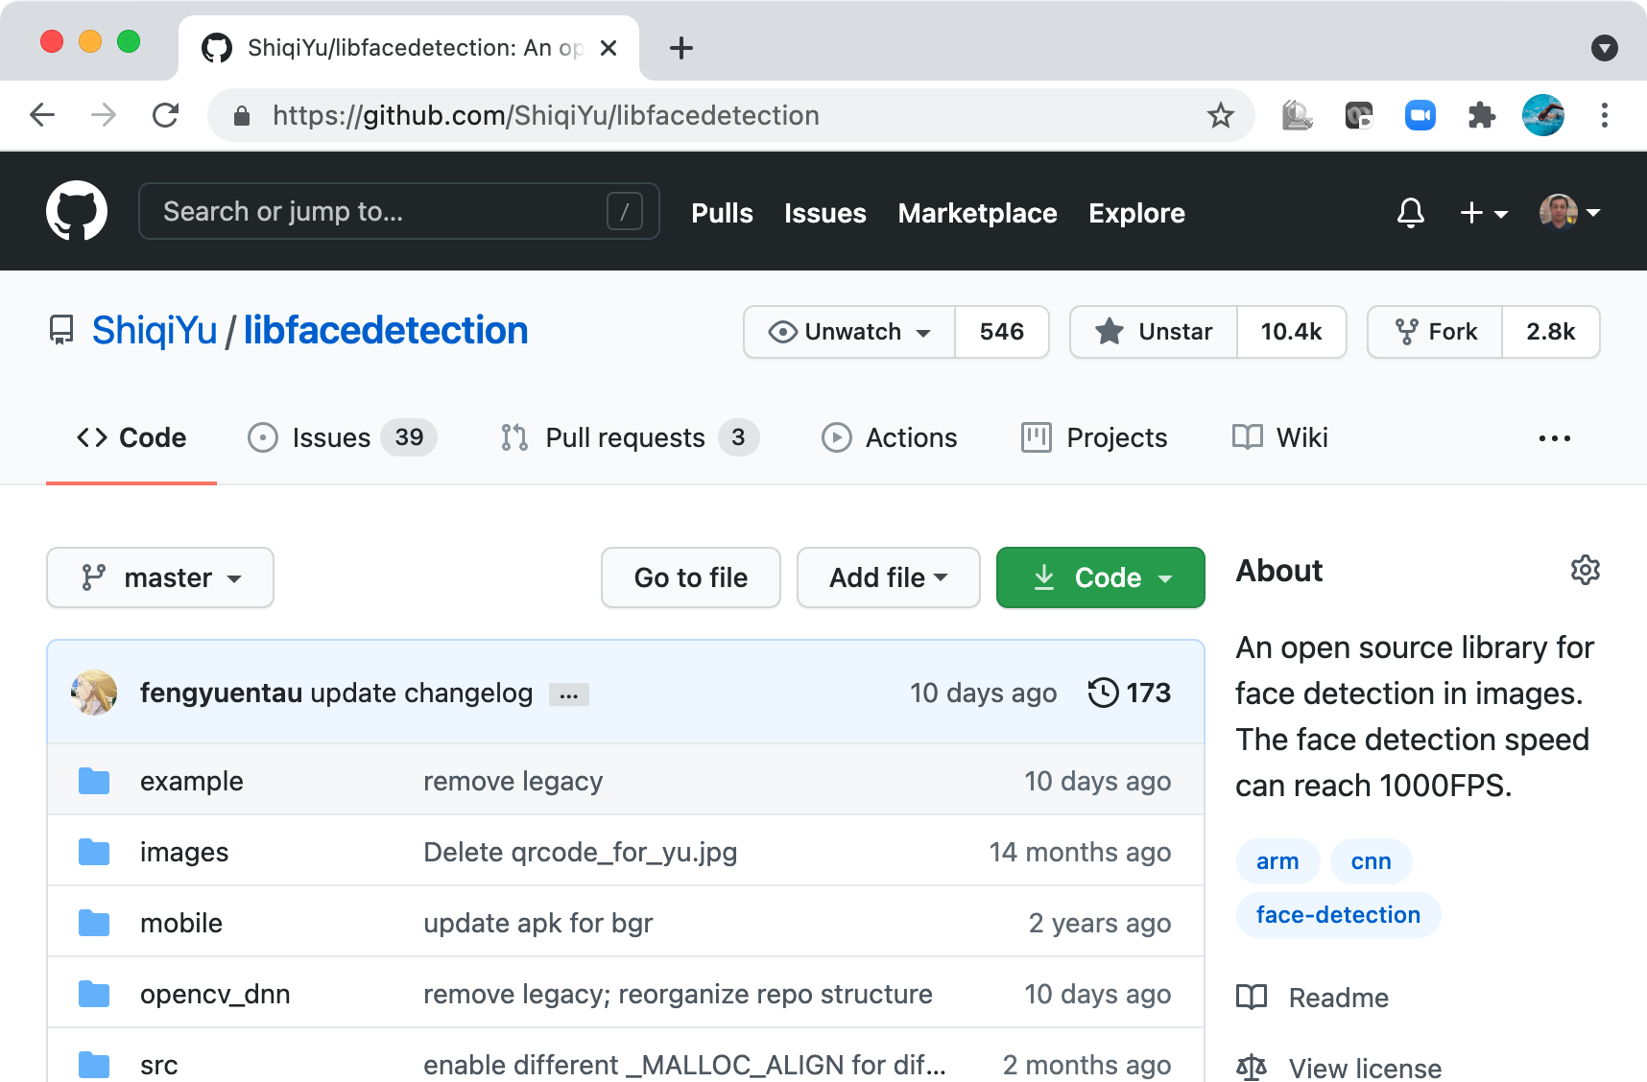
My Open Source Project

Slide 4
About the Course

Slide 5
The Challenges in 2026
Vibe Coding: quickly complete an assignment/project with AI tools
Difficult to understand programming languages and the software.
Vibe coding brought “False Prosperity”
Do I still need to learning a programming language well?
It's more important than ever.

Slide 6

Solution：古法Coding
古法 Coding，
匠心亲写；
根植逻辑，
不慕捷径。
不是陈旧，
亦非守成；
它是根基，
托起高峰。
It is the foundation on which heights are built.

Slide 7
Grade Components
Quiz: 5 points (average of the best N-1 scores)
  Lab attendance and exercise: 5 points (average of the best N-1 scores)
  Interview: 20 points (before the end of Week 16)
    Level 1 (5 points): Development tools (Linux command line, gcc, g++, make, CMake, etc.)
    Level 2 (5 points): Pointers and memory management
    Level 3 (5 points): Pixel-based image processing
    Level 4 (5 points): Basic contributions to OpenCV
    Level 5 (A+): Excellent contributions to OpenCV
  Project: 50 points
    ~5 projects, some are easy projects
    Grading standard (via code and report-based interview):
      90-100: Complete all tasks almost perfectly
      80-90: Complete all tasks well
      70-80: Complete all tasks
  Final exam: 30 points

Slide 8

Honesty
Get code from the internet for labs/assignments is perfectly OK
  When you borrow, just say it.
  You don't need to reinvent the wheel
DON’T pretend that you are the author of something that you didn‘t write. Otherwise, the score will be ZERO!

Slide 9
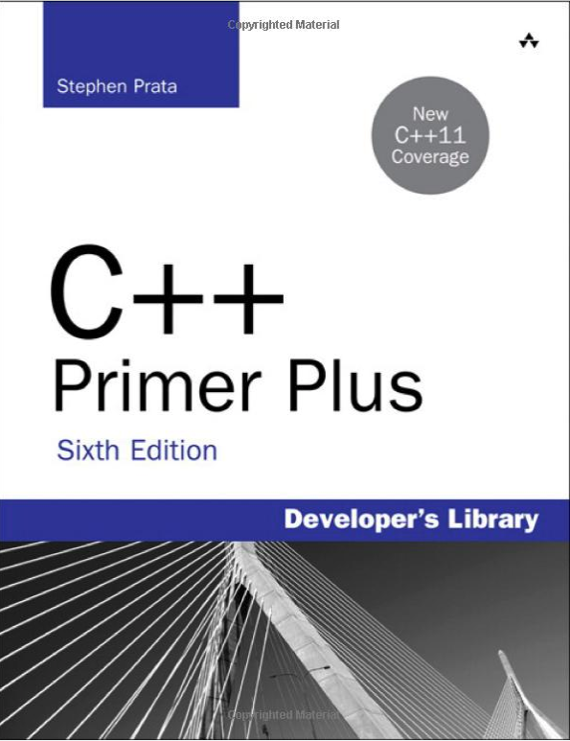
Resources
Blackboard:
  Advanced Programming
Useful Resources:
  ChatGPT, DeepSeek, etc.
  https://en.cppreference.com/w/
  https://www.w3schools.com/cpp/
  http://cpp.sh/
  https://www.onlinegdb.com/

Slide 10
The First Example

Slide 11
hello.cpp
//C++ example in C++11
#include <iostream>
#include <vector>
#include <string>
using namespace std;
int main()
{
vector<string> msg {"Hello", "C++", "World", "!"};
for (const string& word : msg)
{
cout << word << " ";
}
cout << endl;
}

Slide 12
Compile and run the program
Compile hello.cpp
g++ hello.cpp
Initialization of msg is a C++11 extension. We need
g++ hello.cpp --std=c++11
Executable file can be generated as a.out. Change the output filename by -o option
g++ hello.cpp --std=c++11 -o hello
Execute
./hello

Slide 13
Different Programming Languages

Slide 14


Binary Instructions for CPU
The instructions for CPU to run are binary.
  10110000 01100001
Programming on punched tapes
https://en.wikipedia.org/wiki/Punched_tape

Slide 15
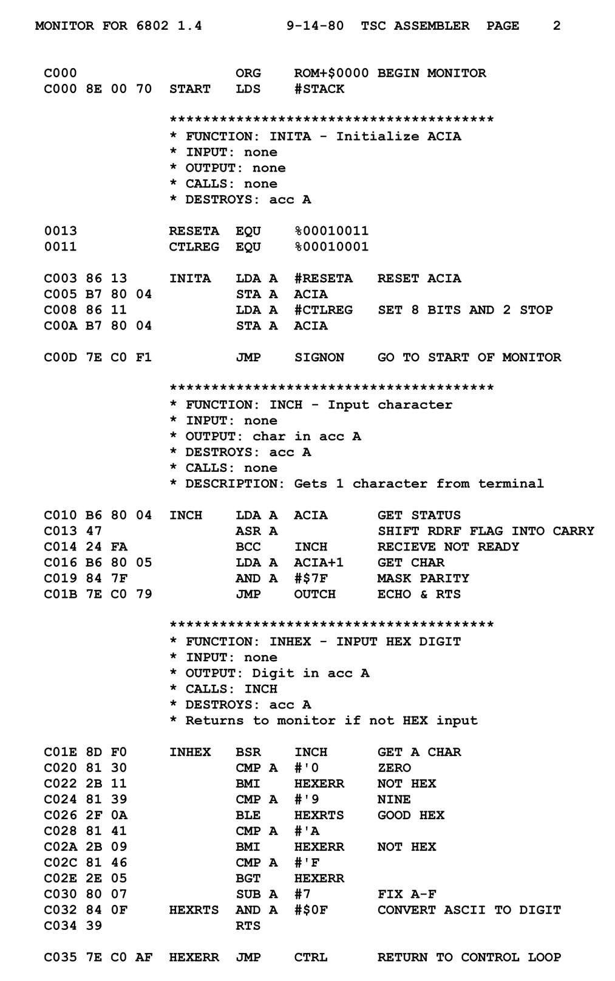
Assembly languages
Assembly languages are more human readable
10110000 01100001
MOV AL, 61h ; Load AL with 97 decimal (61 hex)
https://en.wikipedia.org/wiki/Assembly_language

Slide 16
High Level Languages
C: 1973
  Developed by Dennis Ritchie and Ken Thompson at Bell Labs between 1969 and 1973.
C++: 1979
  Created by Bjarne Stroustrup as an extension of the C programming language
  C with Classes
  Renamed to C++
  Now it’s C++++++++++

Slide 17


Higher Level Languages
Java: 1995
  I hate memory management in C/C++!
  I want "Write once, run anywhere”, not ”write once, compile anywhere”.
  Grammar is similar with C++.
  A Java compiler generates *.class files, not executable files.
Python: 1990
  I hate strict grammar!
  I hate too many data types!

Slide 18

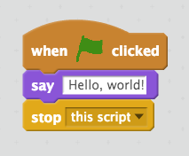
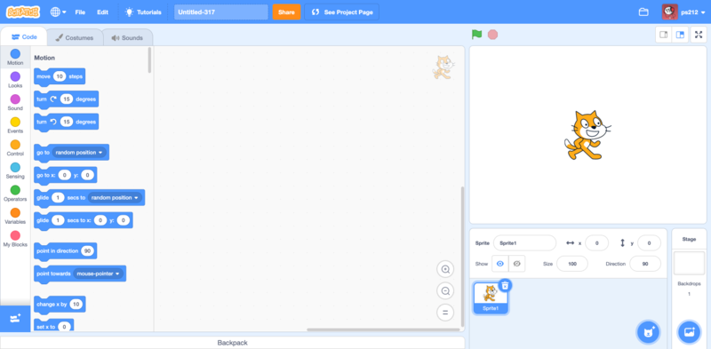
Even higher
Scratch: 2002
  I don’t like to type a keyboard

Slide 19

Something New
Rust: 2012
  Easier to manage memory than C/C++;
  Better performance than Java;
  Guarantee memory safety by static checking by the compiler.
  Concise syntax, rich type system, and modern programming paradigms.

Slide 20





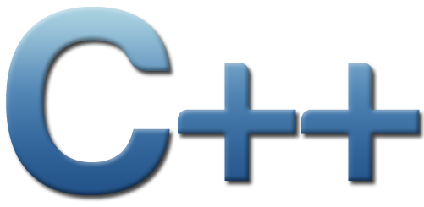
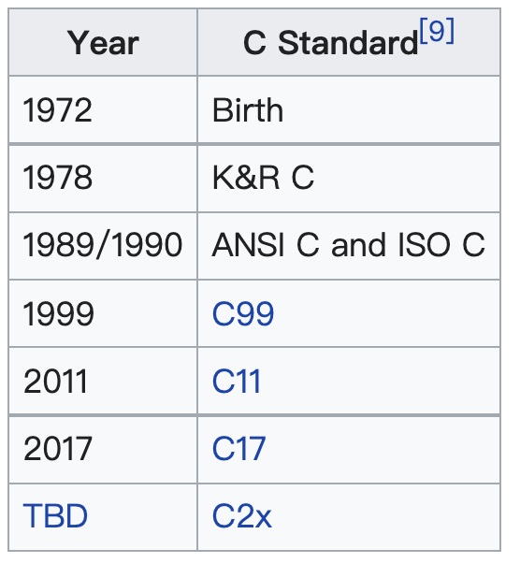
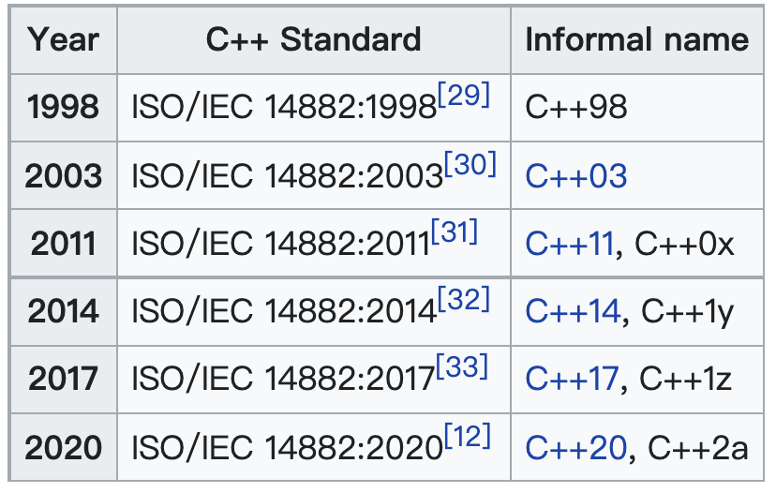
C and C++ are great! But...
and pointer ..
The grammar is complex,

Slide 21
Advantages of C/C++
Development language of most fundamental computer systems
  Linux
  MySQL
  OpenCV
  Backend of TensorFlow, PyTorch
  ...
High efficiency
  Widely optimized compilers
  Access memory directly
  Excellent on computing
  Important language for AI algorithm implementation

Slide 22
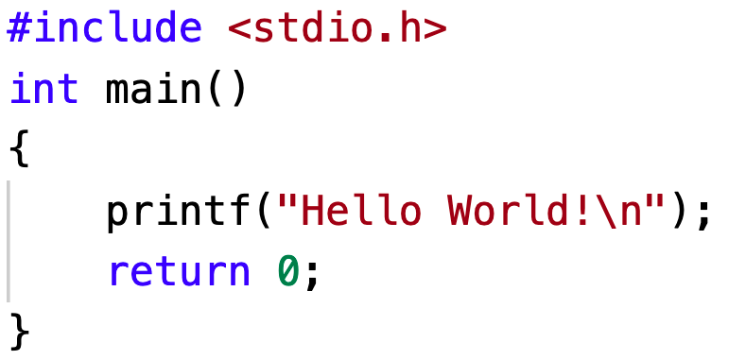
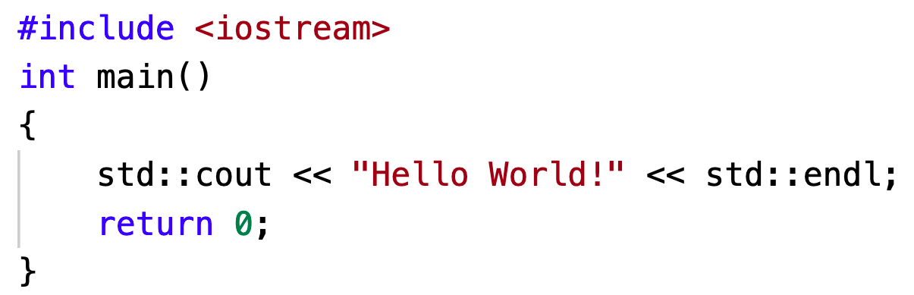
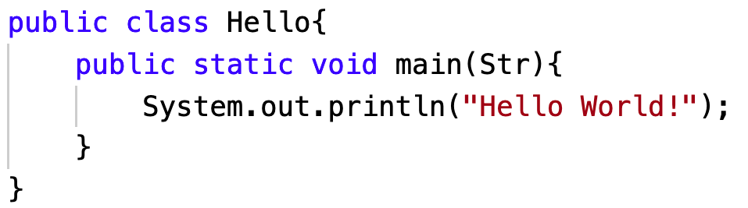
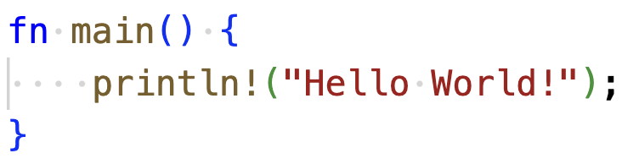
Similar languages
C, C++, Java, and Rust

Slide 23
Compile and Link

Slide 24
Two functions
#include <iostream>
using namespace std;
int mul(int a, int b)
{
return a * b;
}
int main()
{
int a, b;
int result;
cout << "Pick two integers:";
cin >> a;
cin >> b;
result = mul(a, b);
cout << "The result is " << result << endl;
return 0;
}
main(): called by startup code
mul() is called in main()

Slide 25
Function prototypes and definitions
function prototypes normally are put into head files (*.h; *.hpp)
int mul(int a, int b);
function definitions normally are in source files (*.c; *.cpp)
  int mul(int a, int b)
  {
  return a * b;
  }

Slide 26
Separate the source code into multiple files
main.cpp
mul.hpp
#include <iostream>
#include "mul.hpp"
using namespace std;
int main()
{
int a, b;
int result;
cout << "Pick two integers:";
cin >> a;
cin >> b;
result = mul(a, b);
cout << "The result is " << result << endl;
return 0;
}
#pragma once
int mul(int a, int b);
mul.cpp
#include "mul.hpp"
int mul(int a, int b)
{
return a * b;
}

Slide 27
Compile and link
Compile
Link
Source file
main.cpp
g++ -c main.cpp
Object file
main.o
g++ main.o mul.o -o mul
Executable file
mul
Source file
mul.cpp
g++ -c mul.cpp
Object file
mul.o

Slide 28
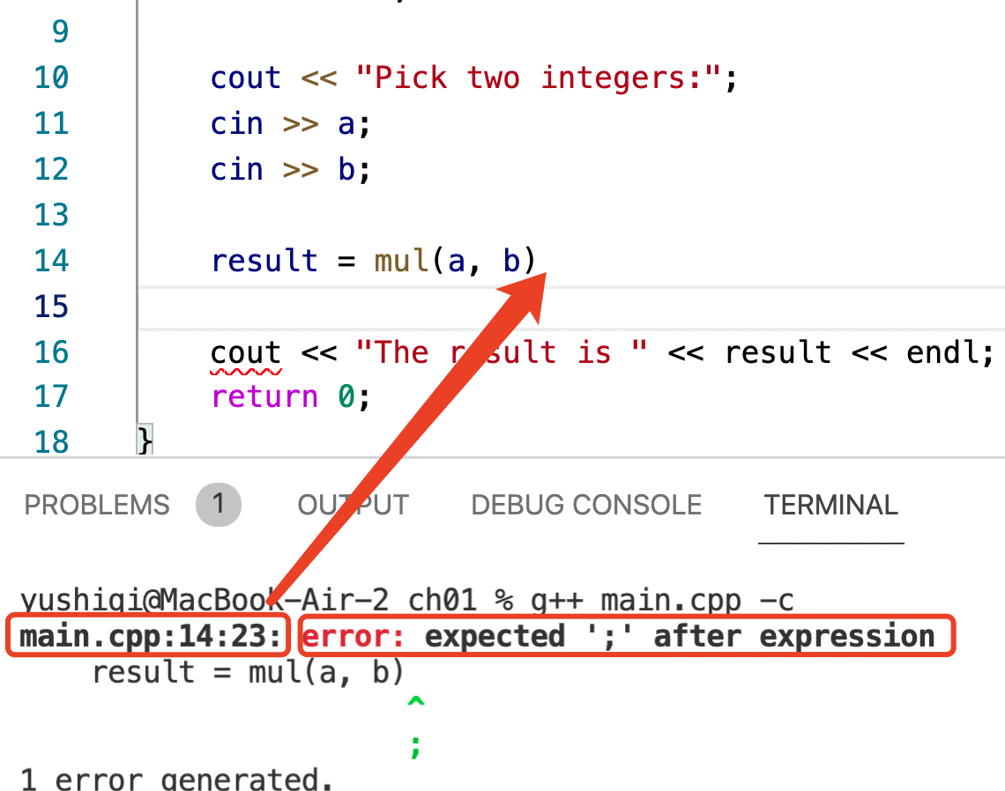
Compilation errors
Normally caused by grammar error
Please check the source code!

Slide 29
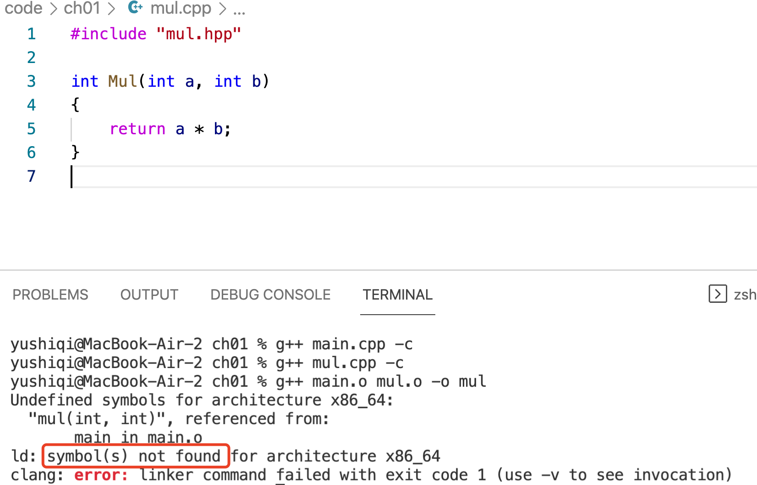
Link errors
"Symbol not found”
Function mul() is misspelled to Mul()

Slide 30
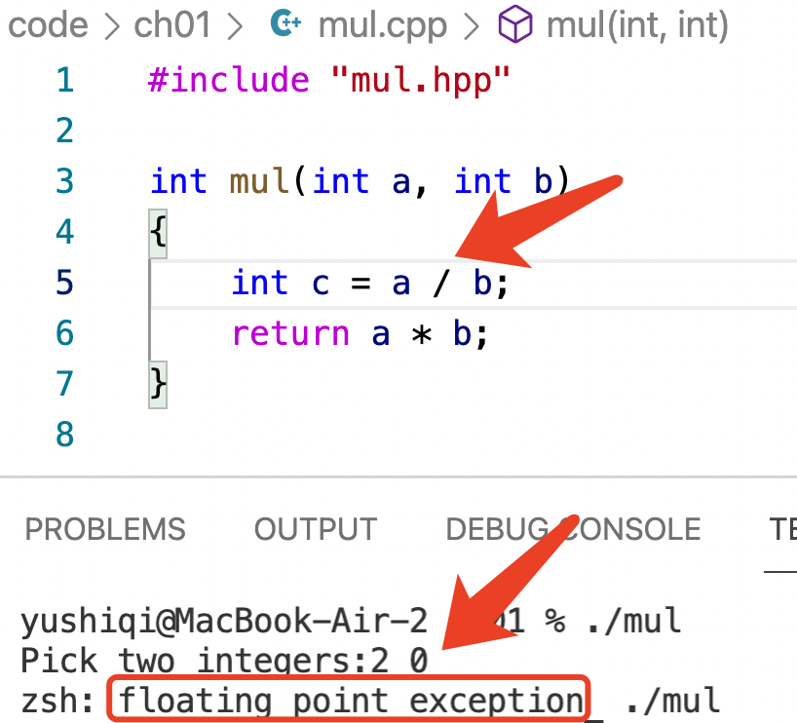
Runtime errors
The source code can be successfully compiled and linked.
The floating point exception (divided by 0) will kill the program.
It is a typical runtime error.

Slide 31
Preprocessor and Macros

Slide 32
Preprocessor
#include <iostream>
#define PI 3.1415926535
#if defined(_OPENMP)
#include <omp.h>
#endif
The preprocessor is executed before the compilation.
Preprocessing directives begin with a # character
Each directive occupies one line
preprocessing instruction (define, undef, include, if, ifdef, ifndef, else, elif, endif, line, error, pragma)

Slide 33
include directive
Preprocess
Compile
main.cpp
#include "mul.hpp"
int main()
{
//
}
int mul(int a, int b);
int main()
{
//
}
main.o
Binary object file

Slide 34
Macros
Preprocess
Compile
circle.cpp
#define PI 3.14
double len(double r)
{
return 2.0 * PI * r;
}
double len(double r)
{
return 2.0 * 3.14 * r;
}
circle.o
Binary object file

Slide 35
Simple Output and Input

Slide 36
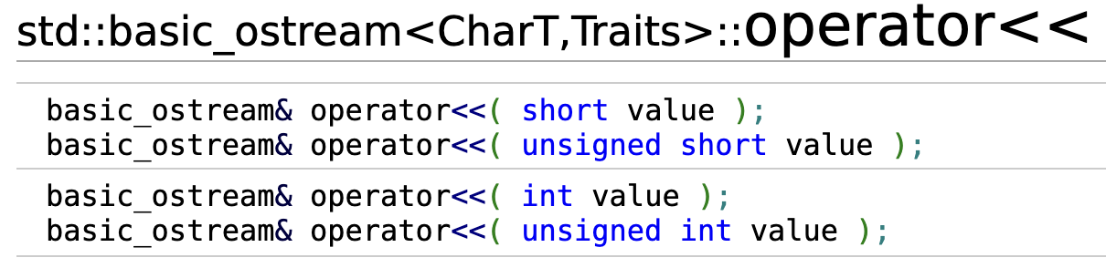
C++ Style Output
What is cout?
std::ostream cout;
cout is an object of data type ostream in namespace std.
cout << "hello." << endl;
<< is an operator which is defined as follows
endl, an output-only I/O manipulator. It will output a new line character and flushes.

Slide 37
C++ Style Input
int a;
float b;
cin >> a;
cin >> b;
Similarly, cin is an object of type std::istream.
>> is an operator

Slide 38
C Style Output
int v = 100;
printf("Hello, value = %d\n", v);
int printf( const char *format, ... ); is a function
format: a string specifying how to interpret the data
%d will let the function interpret v as an integer

Slide 39
C Style Input
int v;
int ret = scanf("%d", &v);
scanf reads data from stdin, and interpret the input as an integer and store it into v;

Slide 40
Why the examples have no GUI?
The programs I used all have GUI. Why the examples have no GUI?
GUI (graphical user interface) is not mandatory.
GUI is for human beings to interact with computers.
No all programs interact with human beings.
We can also interact with the program in a command line window.
We can call a GUI library to create a graphic window by many programming languages. Surely C/C++ can create a GUI window.

Slide 41
Command line arguments
Do you still remember?
g++ hello.cpp -o hello
g++ is an executable program/file
There are three command line arguments
int main()
{
/* ... */
}
int main(int argc, char *argv[])
{...
}
int main(int argc, char **argv)
{...
}

Slide 42
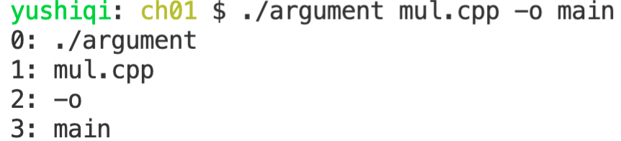
Command line arguments
argument.cpp
#include <iostream>
using namespace std;
int main(int argc, char * argv[])
{
for (int i = 0; i < argc; i++)
cout << i << ": " << argv[i] << endl;
}

Slide 43

But
I don’t like to compile a program in a command window
IDE: Integrated development environment
  Microsoft Visual Studio
  Apple Xcode
  Eclipes
  Clion
  ...
Visual Studio Code (VSCode) is an integrated development environment made by Microsoft for Windows, Linux and macOS

