Slide 1
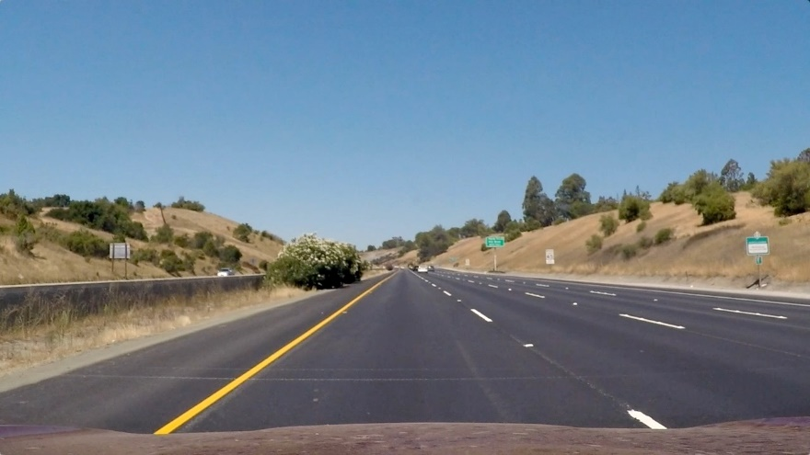
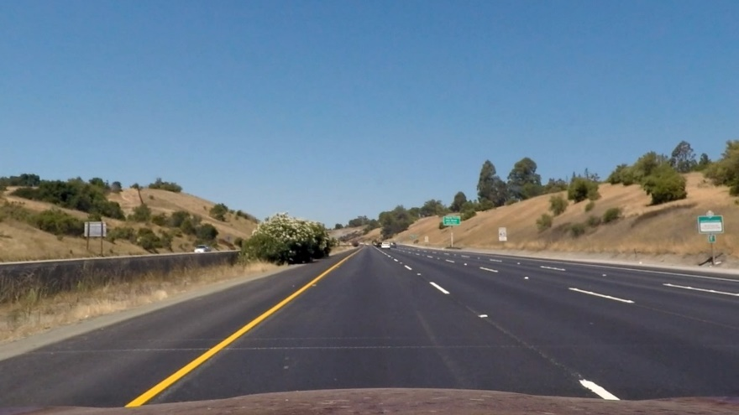
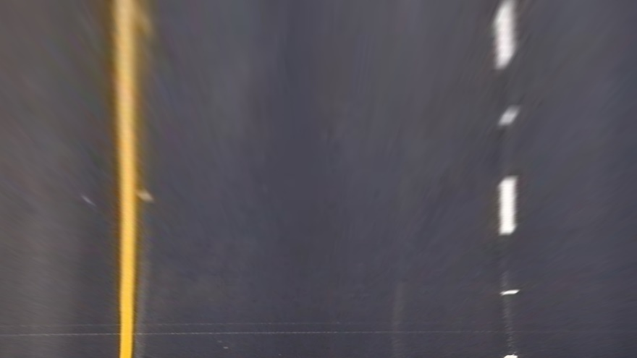
cv2.undistort
Original image
Undistorted image
2
3
1
Source points
4
2
3
cv2. warpPerspective
Destination Points
1
4
Warped image

Slide 2
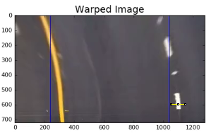
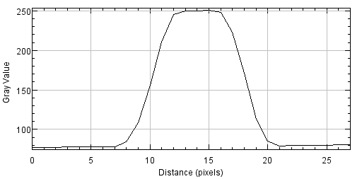
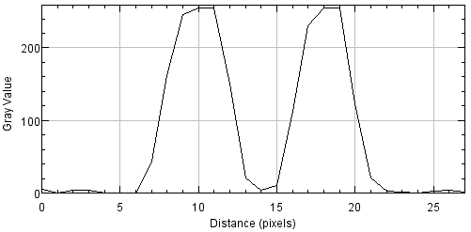




Grayscale Intensity
I_{Th} = 128
G_{Th} = 128
Gradient (Sobel Mag.)
DILATE
Intensity
AND
AND
Gradient
Less Detail
More Detail
DILATE

Slide 3
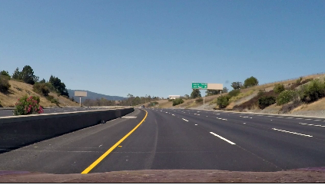
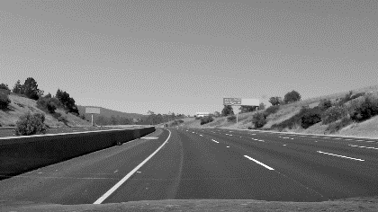
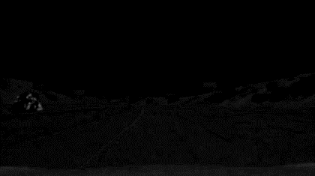
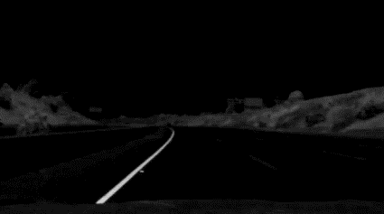
RGB Image
L* Channel
a* Channel
Yellow Lane Marking
White Lane Marking
b* Channel
Conversion of RGB to CIE L*a*b* Colorspace
Yellow and white lanes show in L* (intensity/lightness) channel
Yellow lines shows in a* (greens/reds) channel
No significant input in the b* (blues) channel

Slide 4
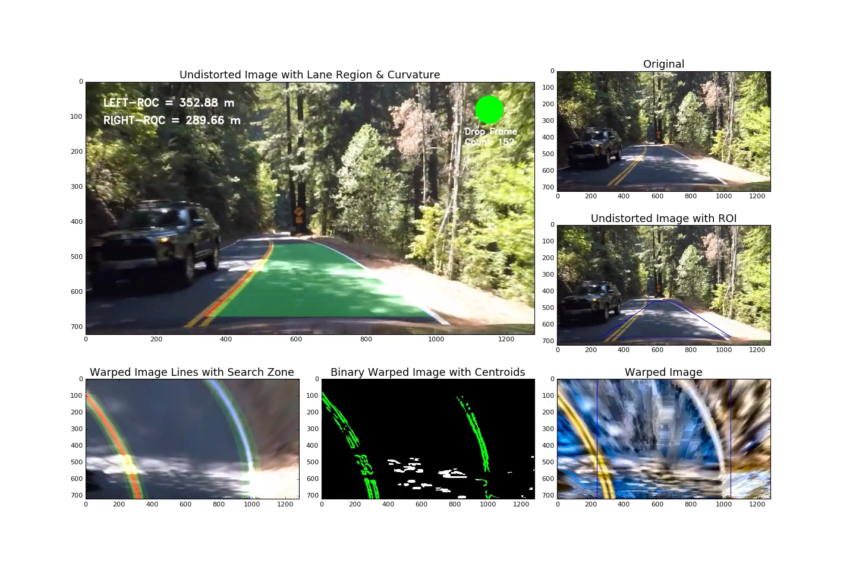
CLAHE
Illumination variation in ROI due to shadows
Threshold
Curve Fit

Slide 5
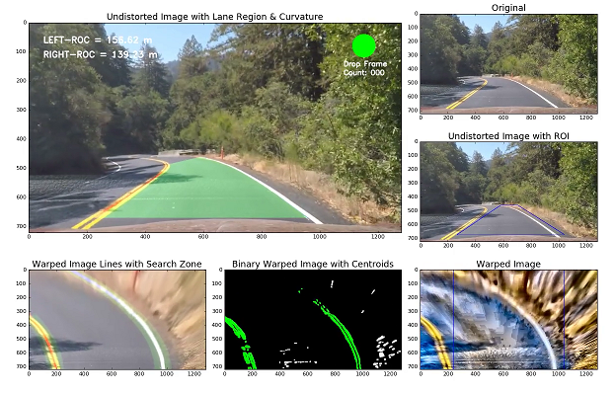
Original video frame with drivable region
overlay
Lane markings
superimposed
Left/right lane pixels identified for fitting
Warped ROI with CLAHE
Visualization in Perspective Transformed ROI

Slide 6
w
Center of new search zone extrapolated using previous two centroid locations
…
Search margin
h
Layer 2
Layer 1
0.1 h
Layer 0
Initial centroids from peaks of convolved signals using bottom 10% layer of image

Slide 7
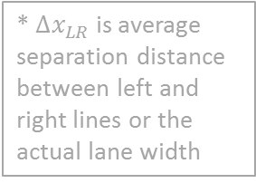

* $Δx_{LR}$ is average separation distance between left and right lines or the actual lane width
Image coordinates from lane identification for new frame
Empty array?
Set drop_frame flag and return best fits
Perform 2nd order polynomial fit on points
Set drop_frame flag to false and detect_flag to true
Update current and best fits
Return current fit
Perform sanity checks
Right line and left line do not intersect
$Δx_{LR}$* between previous and current frame is less than 2*margin
$Δx_{LR}$* in current frame is within 3 ft of regulation lane width (9 ft < $Δx_{LR}$ < 12 ft)
Set drop_frame flag to true and detect_flag to false and return
Is dropped frames > than max & sliding windows search?
Sanity Checks met?

