Slide 1
Heart disease ML
Cy, Sara, Gorkem, Mohamed, Jacqueline
M

Slide 2
Can We use ML to predict Heart disease?
Using a dataset of heart disease patients from Kaggle, we applied tensorflow to the data to find how medical parameters such as age, sex, blood pressure, and more to predict the chances someone will have a heart disease after they input their information given the parameters.
Attribute Information:
age
sex
chest pain type (4 values) - cp
resting blood pressure - trestbps
serum cholestoral in mg/dl - chol
fasting blood sugar > 120 mg/dl (1 = true; 0 = false) - fbs
resting electrocardiographic results (values 0,1,2) - restecg
maximum heart rate achieved - thalach
exercise induced angina (1 = yes; 0 = no) - exang
oldpeak = ST depression induced by exercise relative to rest - oldpeak
the slope of the peak exercise ST segment -
number of major vessels (0-3) colored by fluoroscopy
thal: 0 = normal; 1 = fixed defect; 2 = reversible defect
The names and social security numbers of the patients were recently removed from the database, replaced with dummy values.
J

Slide 3
Input form
Using a form html page, we took input parameters and applied the ML model to the inputs
G

Slide 4
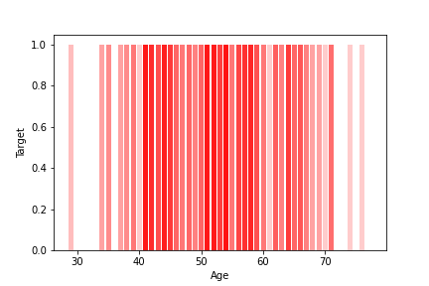
Matplotlib

Slide 5
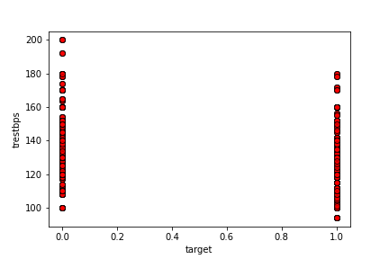

Slide 6
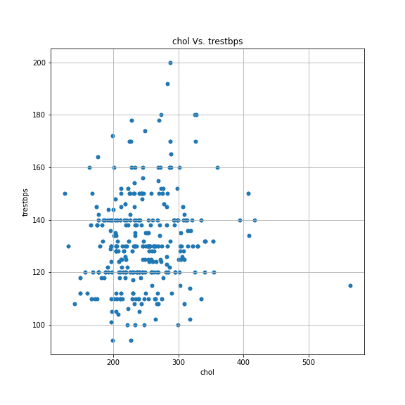

Slide 7
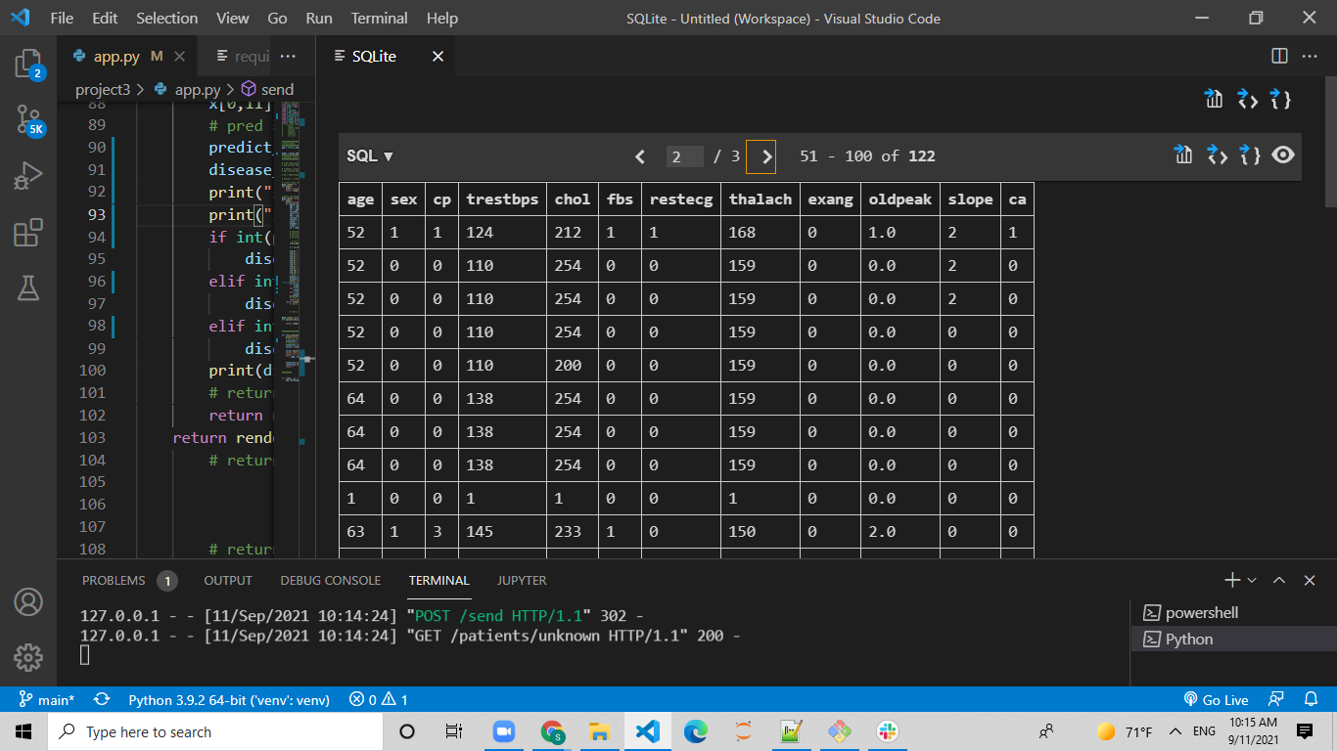
To DB
We then exported the form data to a DB, to be stored for future use
S

Slide 8
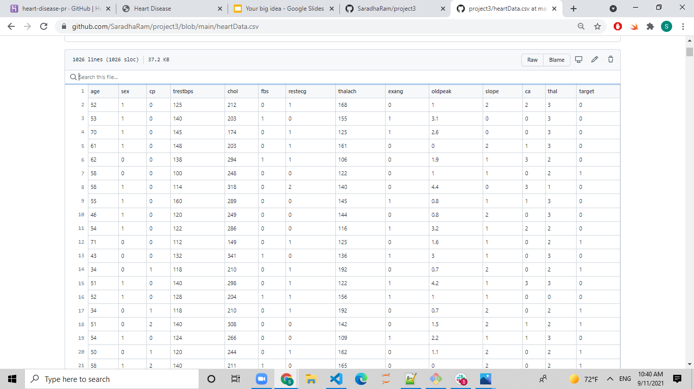
Dataset

Slide 9
Applying ML to the input
The ML model was then applied to the input form, and the webpage was redirected to an html page, which displays the models prediction
C

Slide 10
Demo
-ML model
-Flask app

Slide 11
Conclusion
-We could have done more to make the app visually pleasing
-The model works, but could have been made more effective by removing less relevant parameters
-The range of data could have been larger, it only consisted of people who had to go to the doctor due to medical issues, and didn’t have a large sample of healthy people
S

