Slide 1

Project 2
Books Collection
Project Members :
Cy Miller, Francis Duffy, Gorkem Varol, Mohamed Ismael, and Saradha Ramasamy
M

Slide 2
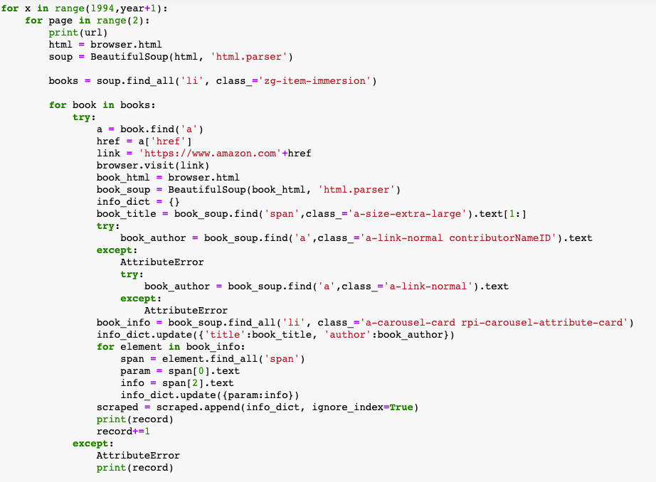
Extract
-We found a CSV containing New York Times bestseller data from the years 2011 to 2018 on data.world.com as a CSV
-We also scraped Amazon’s web page for the best selling 100 books per year from 1995 to 2021
- The Amazon data that was scraped was saved to
a dictionary, and appended to an empty df for
each book in the scraping loop
c

Slide 3
transform
Transformed the Amazon and NYT into dataframes.
Cleaning - Removing the unwanted columns using drop ( ) method
Renaming the column names using rename() method
Challenge - The ISBN column.
Starting letter should be lowercase in .to_sql() method
G

Slide 4
Load
-The Final set of data were the books within both data sets that had the same ISBN-10 ID, essentially the books that were bestsellers in the NYT and on Amazon
-We joined the table with inner join
Only 7 results were returned.
Some of the interesting queries:
- Best author by publisher data in NYT and Amazon.
- Top 5 Author data in NYT and Amazon
- To 10 Publisher data in NYT and Amazon
S

Slide 5
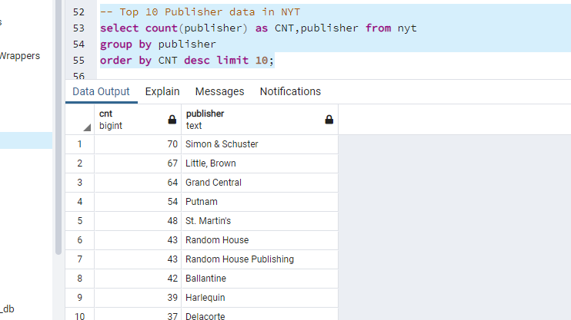
Load contn..
Top 10 Publisher data:

Slide 6
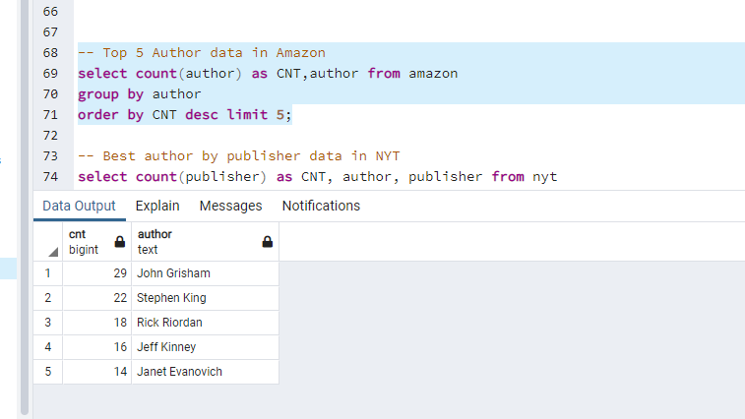
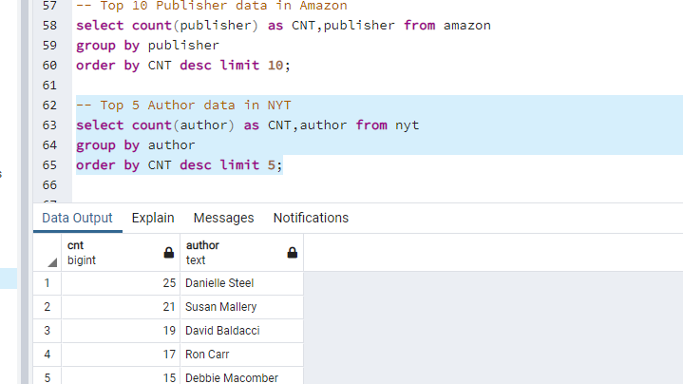
Load contn..Top 5 authors from NYT and Amazon

Slide 7

In Conclusion
-There was not much of an overlap. Only 7 titles were returned in the inner join query (of which Stephen King wrote two)
-We could have done more cleaning (eg. Random house vs. Random house Publishers)
F
Truly, some type of King.

