Slide 1
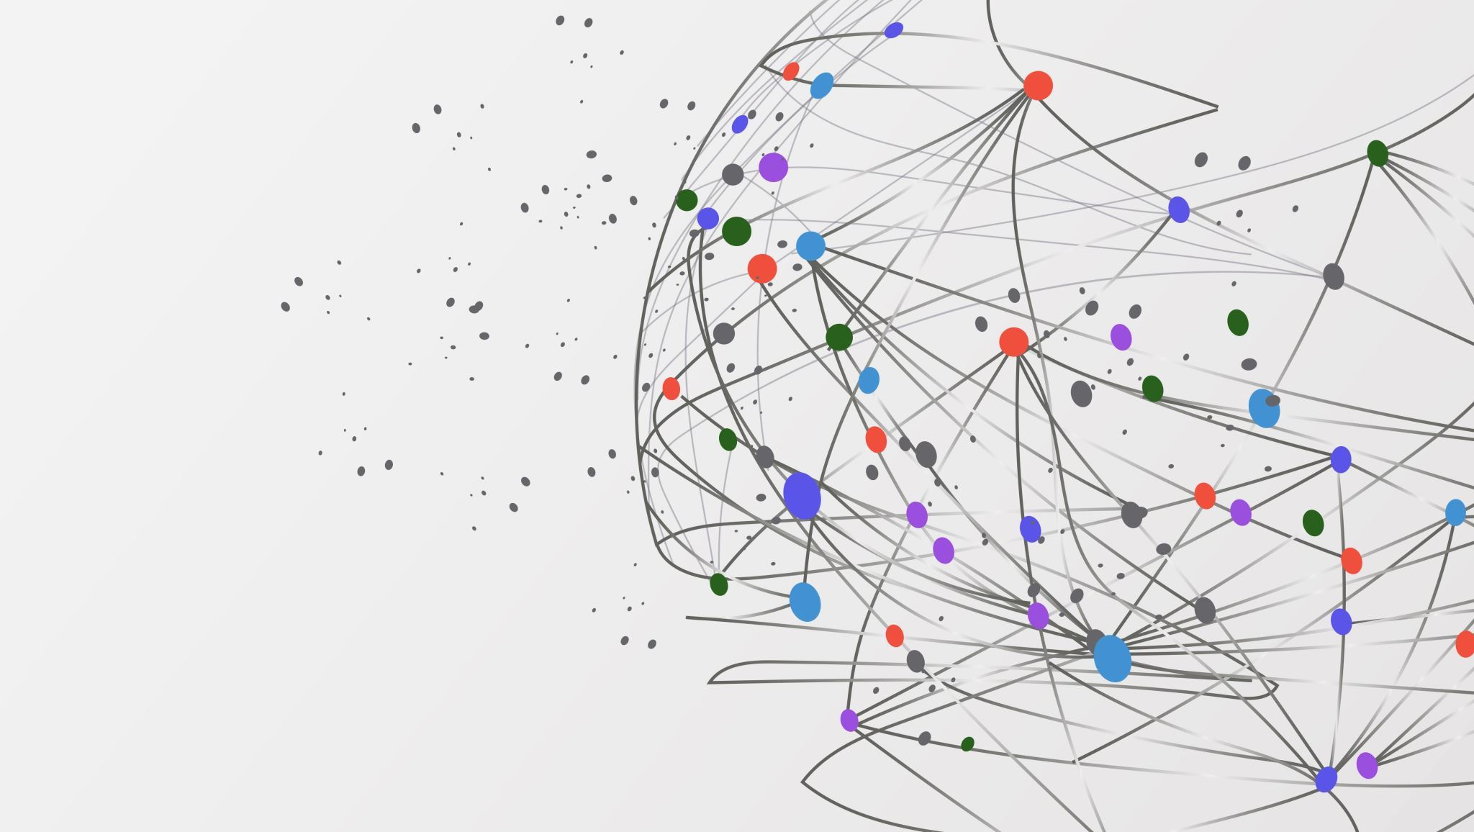
Graph Coloring / Exam Scheduling Project
Team Members:
Gorkem Yar
Nikolay Popov
Saurabh Singh
Ajay Krishna

Slide 2

What is Exam Scheduling?
Exam scheduling is a problem that every university needs to solve in the final period.
The problem as follows:
There is a fair amount of courses.
In each course, there are several students that takes the course.
A student can take multiple courses there is an upper threshold.
If two courses have taken by the same student, their exam schedule must be different.
This Photo by Unknown author is licensed under CC BY-NC-ND.

Slide 3
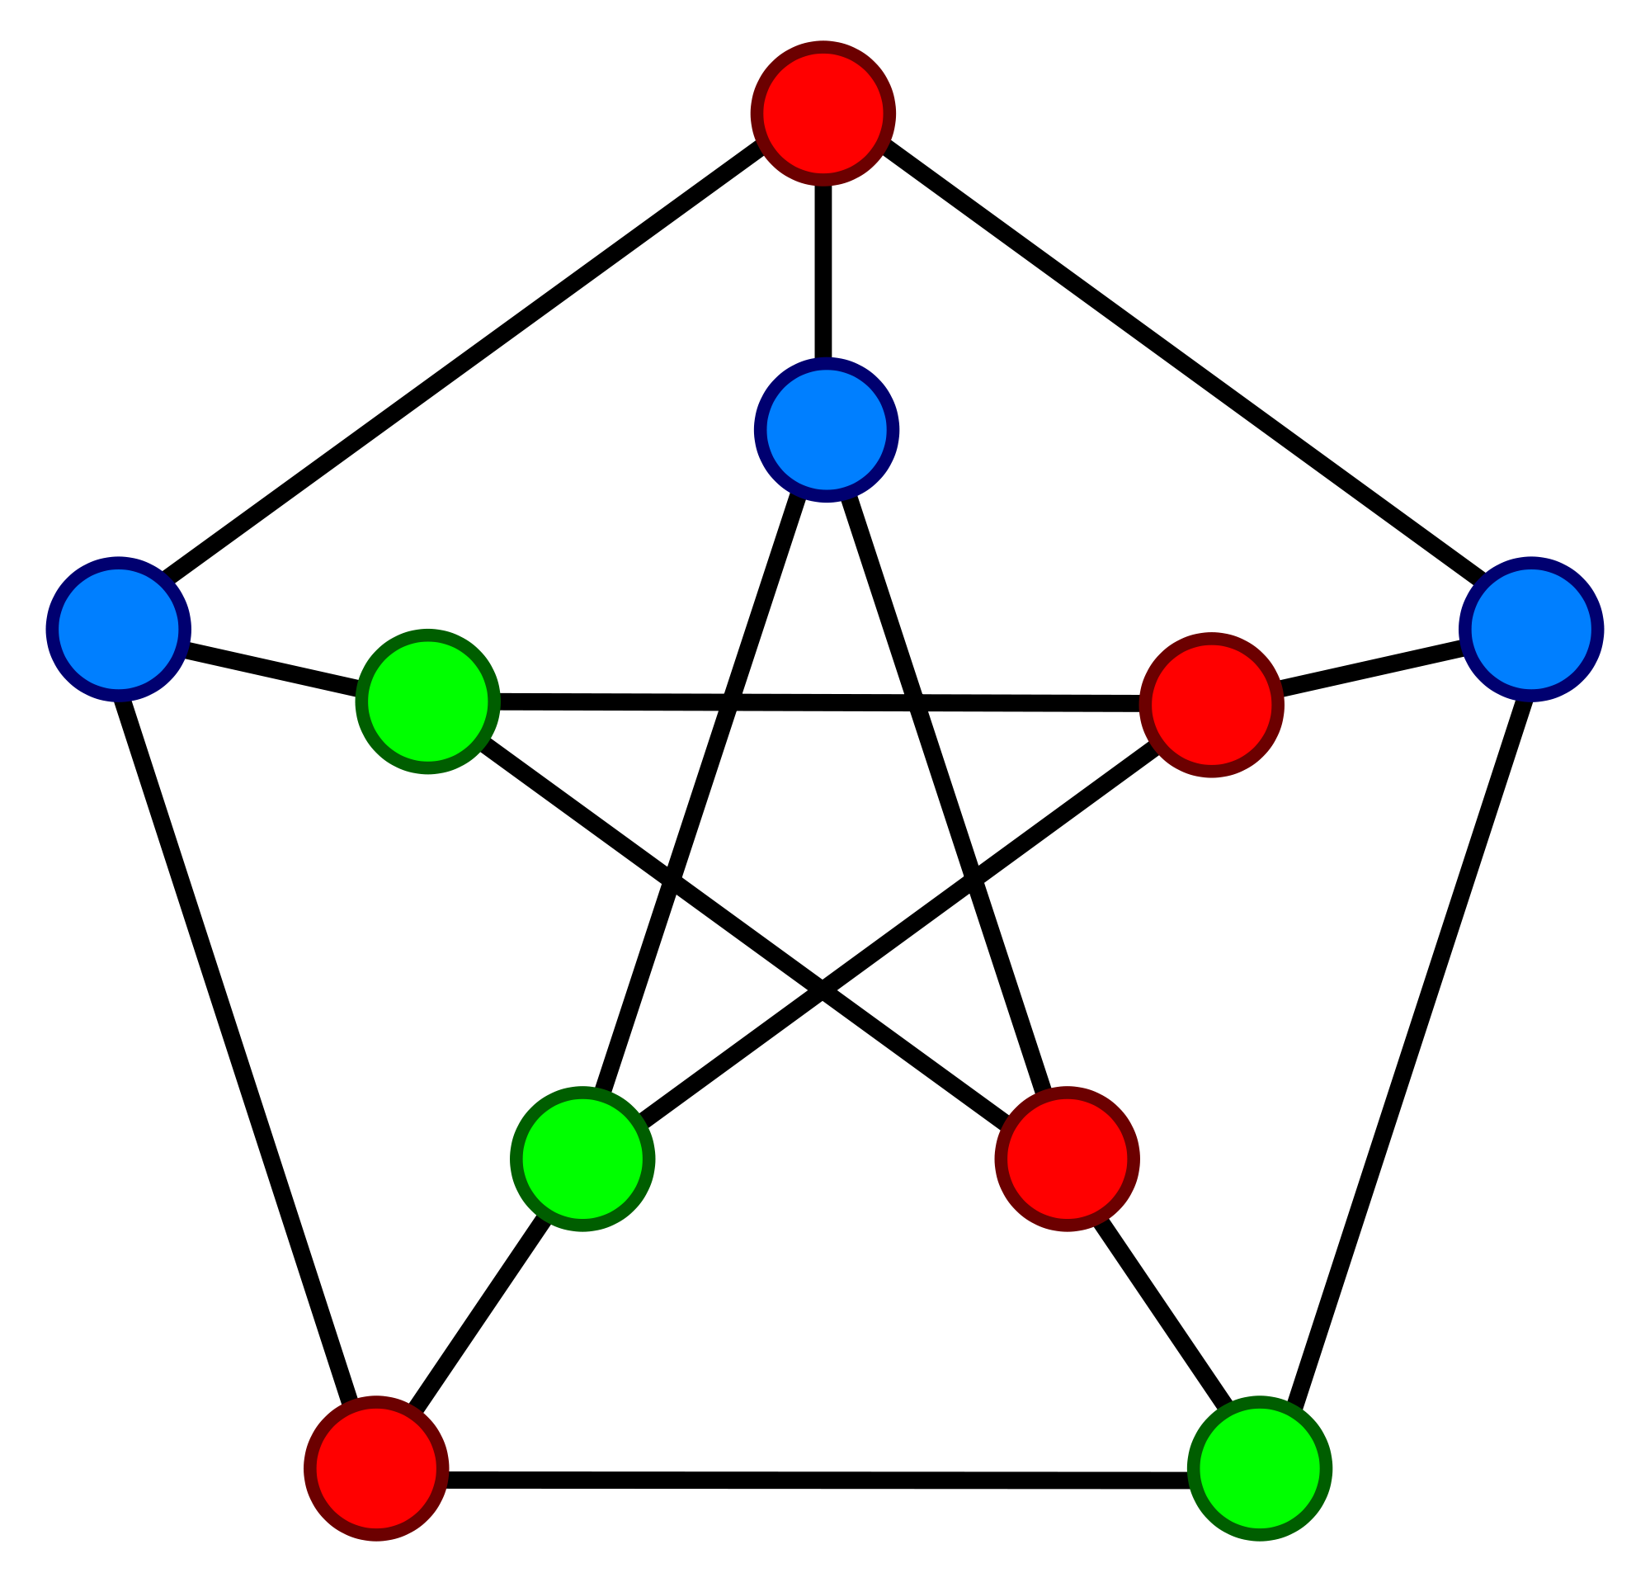
Graph Coloring & Exam Scheduling
In exam scheduling, each course represents a node.
If a student takes two courses than there is an edge between these courses/nodes.
After generating the graph, graph coloring algorithms will be used to find how many exam slots are needed.
In graph coloring, each color represents an exam slot.
Same colored courses/nodes can schedule their exam in the same slot.
This Photo by Unknown author is licensed under CC BY-SA.

Slide 4
Algorithms and Technologies To be Used
Graph Coloring Algorithms: Graph coloring problem is an NP-Complete Problem. As a result, two types algorithms will be used. Brute force algorithms to acquire a correct solution and Heuristic algorithms to solve it in polynomial time with a high probability to find a correct solution.
Technologies to be used: To generate algorithms, C++ will be used as a coding language for the representation part either Python or JavaScript will be used.

Slide 5
Optional Further Work
Map coloring is another application of graph coloring.
Map coloring is coloring every country/state so that no adjacent country/state will have the same color.
If time permits, map coloring algorithm will be implemented using 5 coloring algorithm.
The representation of the map coloring algorithm will be illustrated in a world map.

