Slide 1

WiscSort: External Sorting For Byte-Addressable Storage
Gorkem Yar 27970
Rebah Ozkoc 29207

Slide 2
Outline
Introduction to Problem & Background
External Sorting
Merge Sort & External Merge Sort
Problem Statement
WiscSort
BRAID Model
The Algorithm
Evaluations
References
BAS Devices
Conclusion
Q&A

Slide 3

What is External Sorting ?
It is a class of sorting algorithms that can handle massive amounts of data.
Data does not fit into the main memory.
Instead, it must reside in the slower external memory.
External Merge Sort
It is widely used in the modern data intensive applications.
web indexing
key-value stores
data analytics
relational databases, for instance MySQL use external sorting for the ORDER BY queries whose input exceeds the available memory.

Slide 4
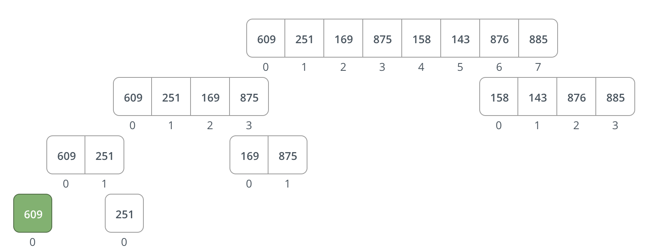
Reminder: Merge Sort

Slide 5
External Merge Sort
External merge sort consists of two phases: Run and Merge Phase.
Run Phase:
Divide the data into K=D/M chunks
D = The size of data
M = The size of main memory.
Sort each chunk using an internal sorting algorithm
Merge Phase:
Some proportion of the chunks read to the main memory.
Using K-Merge Algorithm this proportions are sorted.
Whenever a chunk’s proportion in the main memory fully sorted out, read more data from chunk.

Slide 6
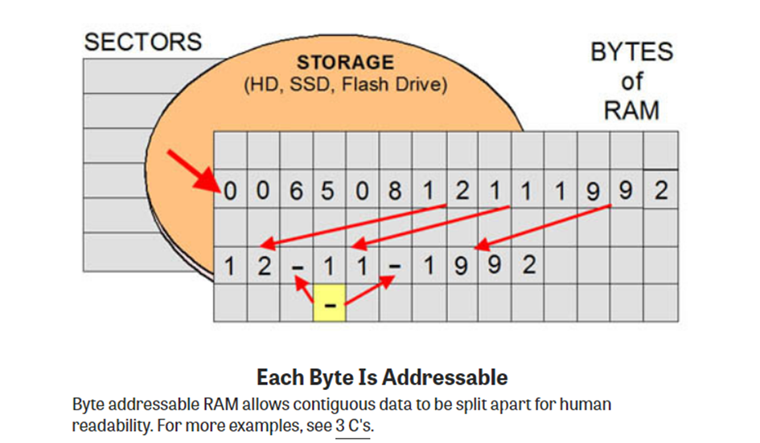
BAS Devices
Byte Addressable Storage
Enables the CPU to fetch each program instruction or single byte of data residing in memory.
A single numeric digit can be calculated, compared and copied independently of the data residing in the byte before or after it.
Blocks have been the traditional unit of I/O for mass storage systems, and data management systems (including the operating system) have been heavily optimized for block-based device characteristics .

Slide 7
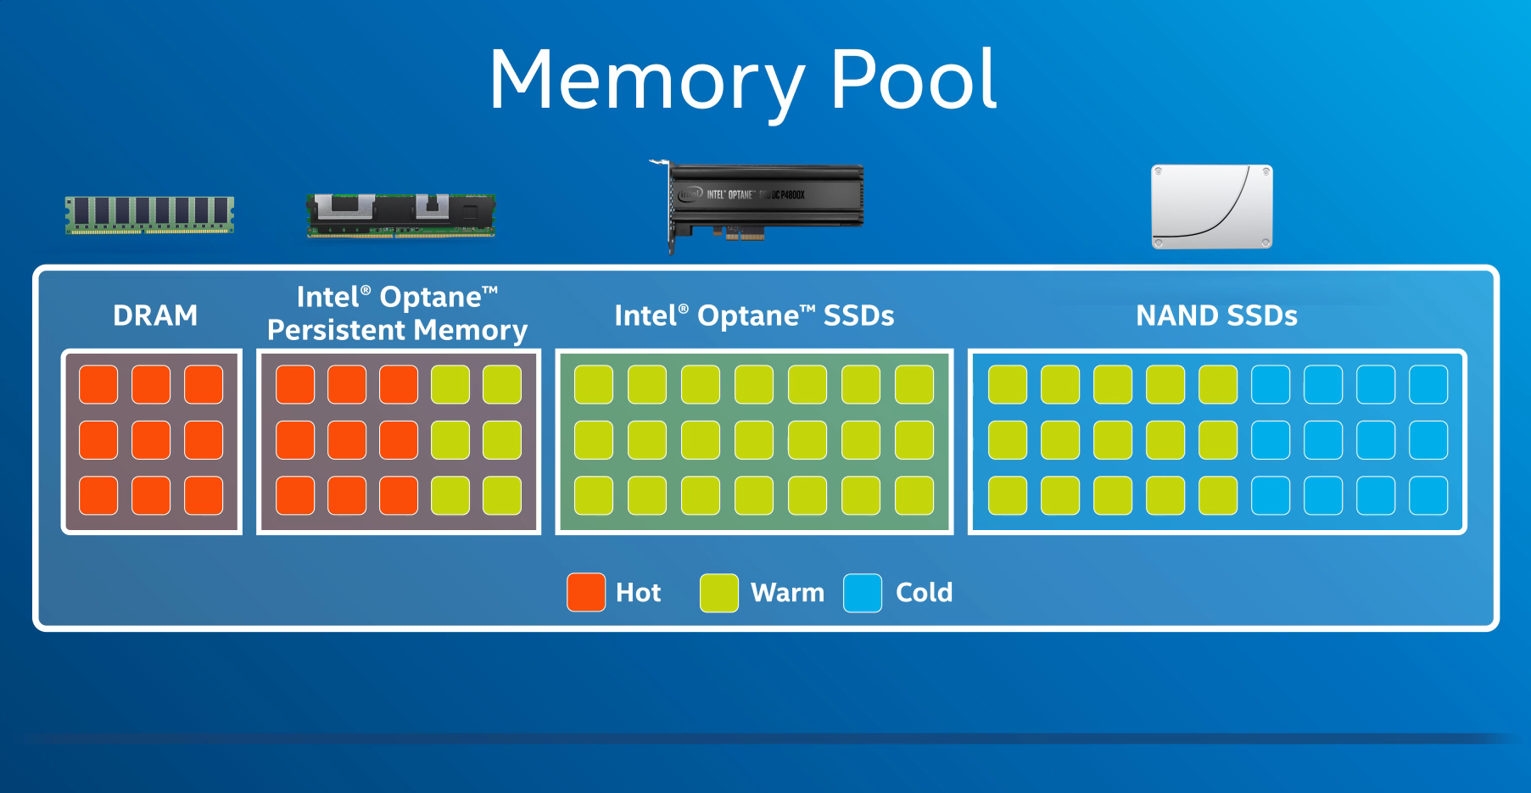
Intel Optane Persistent Memory (PMEM)

Slide 8
Problem Definition
External sorting is crucial for the datasets that cannot fit the main memory. Wiscsort’s objective is to make external sorting faster by exploiting the features of the byte-addressable storage (BAS) devices.
To make a faster external sorting algorithm, The WiscSort comes up with four algorithmic innovations.
Key-Value Separation: Separating the key from value which reduces the r/w cost.
Interference Aware Scheduler: In BAS devices the write operations reduce the efficiency of read so they should not simultaneously occur.
Thread Pool Controller: The number of read and write threads managed by a controller.
OnePass: Because of the separation of key-value pairs, the dataset might be sorted in a single pass.

Slide 9
The BRAID Model
A device model for byte-addressable storage
Specifies the properties of BAS that distinguishes from other storages devices (HDD/SSD/DRAM)
Enables the full potential of byte-addressable storage devices.
It constitutes a device with following features:
Byte Addressability
Higher Random-Read performance
Asymmetric Read-Write Cost
Read-Write Interference
Device-Constrained Concurrency

Slide 10
The BRAID Model
Byte Addressability: It, allows access to small data regions without the amplification of page granularity requests. This property reduces unnecessary data movements on the bus and it prevents waste in bandwidth.
Higher Random-Read performance: Random read performance on BAS is on par with sequential read performance for larger accesses. Concurrent random reads are only 18% slower than concurrent sequential reads for 256B accesses on PMEM (A BRAID device).

Slide 11
The BRAID Model
Asymmetric Read-Write Cost: The read and write performance is very asymmetric. Read is four times better than write. Other devices like HDDs and SSDs have also asymmetric read write performance but on different degrees.
Read-Write Interference: Read performance decreases when concurrent writes are issued on BAS. This decrement increases with an increased number of concurrent writes. The opposite effect is minimal.
Device-Constrained Concurrency: The BAS devices creates concurrency constraints on the read write threads.

Slide 12
Design Goals
Reduce I/O Amplification (B)
No longer needed.
Reduce I/O traffic by making byte-level accesses
Avoid Redundant Reads (R)
Not a concern anymore due to BRAID’s high random read bandwidth
Trade more reads for fewer writes (A)
Manage access concurrency (D)
Too few bad, too much can hurt BRAID Performance
Avoid Read-Write Interference (I)
ensure that reads and writes are not overlapped

Slide 13
Innovations of Wiscsort
Key-value Separation
Thread-pool controller
Interference-aware scheduler

Slide 14
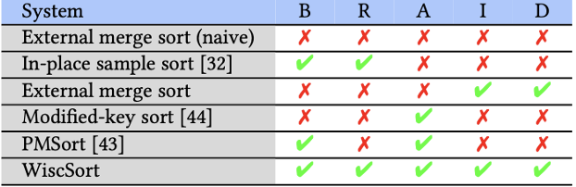
Key Value Separation
The separation of key value pairs.
Joining the keys with the address of the values.
List of key-pointers is called IndexMap.
A classic idea proposed in 1963.
Slow random reads on HDD
Convert random reads to sequential reads.
Excessive amount of read write operation related to value.
PMSort an approach proposed in 2021 performs key-value separation on a BAS device.
It mainly focuses on single thread.
It does not fully exploit BRAID properties.
It has problems with read and write interferance

Slide 15
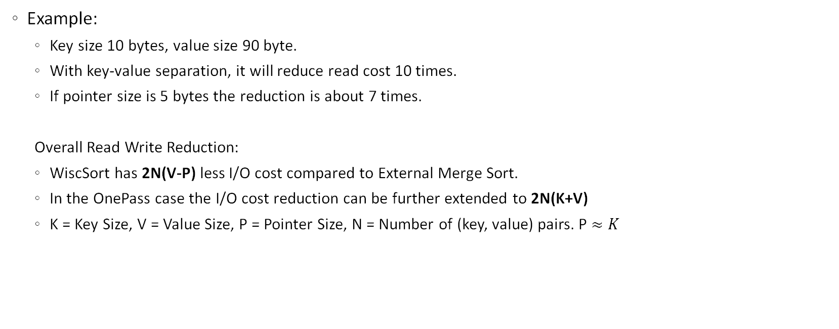
Key Value Separation
Example:
Key size 10 bytes, value size 90 byte.
With key-value separation, it will reduce read cost 10 times.
If pointer size is 5 bytes the reduction is about 7 times.
Overall Read Write Reduction:
WiscSort has 2N(V-P) less I/O cost compared to External Merge Sort.
In the OnePass case the I/O cost reduction can be further extended to 2N(K+V)
K = Key Size, V = Value Size, P = Pointer Size, N = Number of (key, value) pairs. P $≈K$

Slide 16
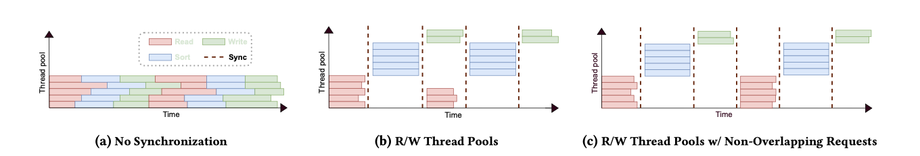
Thread-Pool Controller
Without a synchronization mechanism there is no way to control number of concurrent threads performing a particular operation.
Read and write operations can overlap in the concurrent threads.
Depending on the read and write bandwidth the controller determines the thread pool sizes.
The number of read threads is bigger than write threads.

Slide 17
Interference-aware Scheduling
Write operation during read operation slows down read operation significantly (BRAID).
Read and write operations should be isolated.
Majority of read operations occur at the start of the run and merge phases, with write operations primarily towards the end.
A write buffer temporarily holds sorted data during the run phase and isolates written data during the merge phase, acting as a control point.

Slide 18
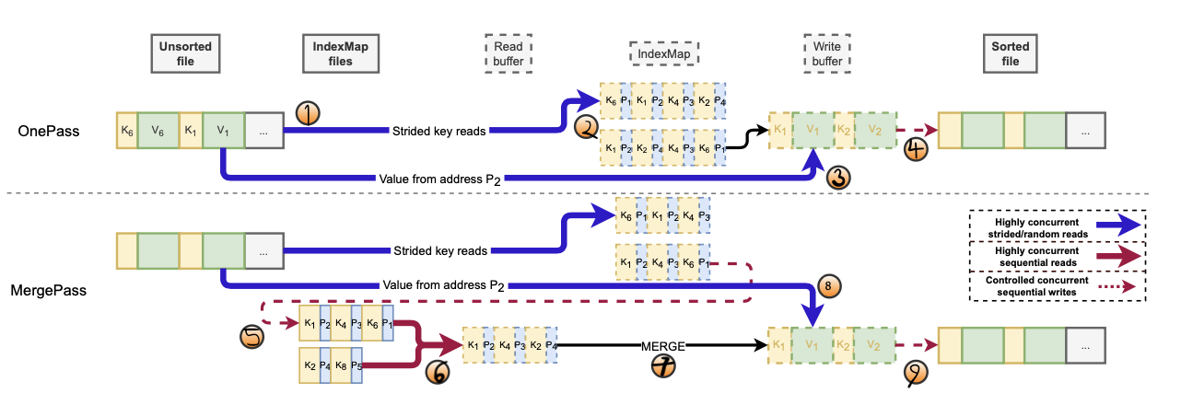
WiscSort’s Steps
Dashed Box: DRAM
Solid Box: BRAID
K: Key
P: Pointer
V: Value

Slide 19
WiscSort Step’s
Step 1 RUN Read: Determine the maximum IndexMap size that can fit into main memory. Partition the input file among the reader threads. Each thread fetches key, pointer values from file to main memory and forms the IndexMap.
Step 2 RUN Sort: Once all the reading from the threads finished, sort the IndexMap file according to keys. If all IndexMap fits into RAM it will perform OnePass otherwise MergePass. OnePass bypasses the creation of IndexMap.
One Pass:
Step 3 Record Read: The sorted IndexMap is partitioned among the read threads provided by the thread pool controller. Each thread performs a random read and places it into write buffer.
Step 4 Run Write: Whenever the write buffer is full, it is written sequentially to the output file.

Slide 20
WiscSort Merge Pass
Step 5 Run Write: Since a single IndexMap cannot always contain all the keys, it is temporarily written to a file on the BRAID. Step 1,2, and 5 repeated until all the keys are of the IndexMap files are sorted and saved.
Step 6 Merge Read: The read buffer is split evenly amongst the number of IndexMap files. Reader threads then sequentially load a chunk of each IndexMap to its appropriate area in the read buffer. Set a cursor for the starting and ending positions for each IndexMap.
Step 7 Merge Other: Find the minimum key by using the starting cursor of each IndexMap. Enqueue this minimum key offset queue to it’s value read into write buffer.
Step 8 Record Read: The size of the offset queue is determined by the size of the write buffer. Once the offset queue is full, WiscSort performs concurrent random reads of records to retrieve the values from the input file and update the write buffer.
Step 9 Merge Write: Like the step 4 sequentially write the result into output file.

Slide 21
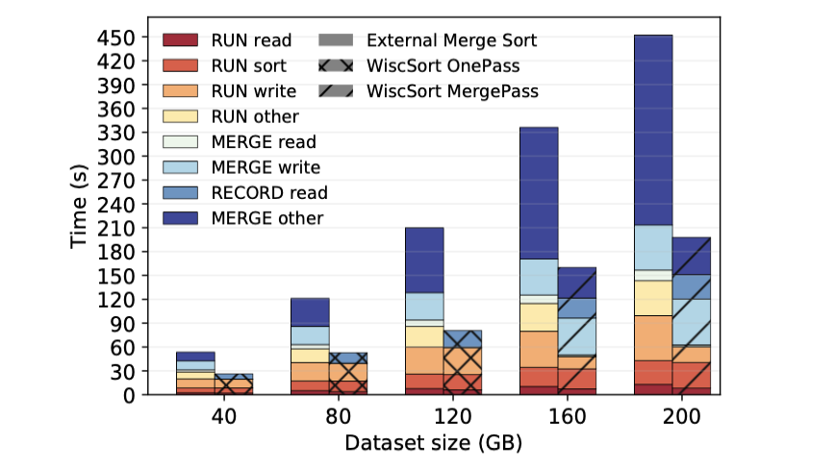
Evaluations
External Merge Sort vs WiscSort
Main memory set to 20 GB.
Pointer size is 5 byte.
OnePass 3x faster.
MergePass 2x faster.

Slide 22
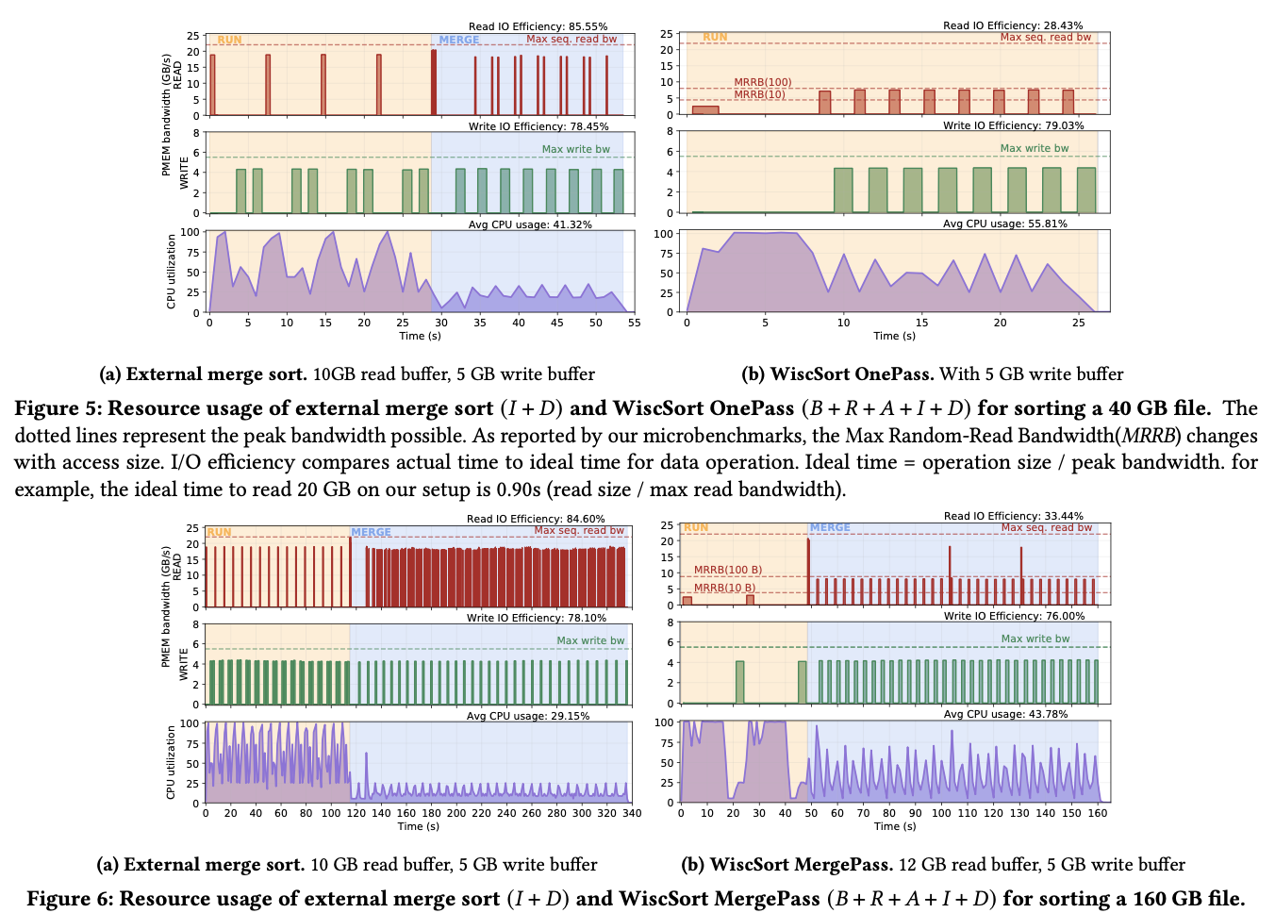

Slide 23
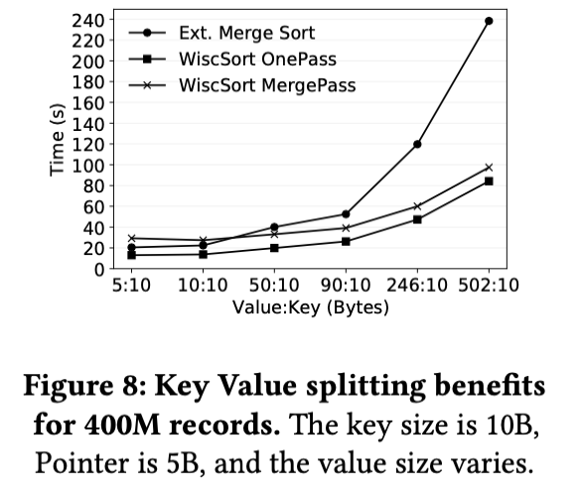
Evaluations
No IO overlap performs 25.7% faster than No Sync
The I/O overlap merge is 36% faster than No Sync

Slide 24
Conclusion
Byte-addressable storage needs application redesign for peak performance.
The BRAID model reveals the key principles for this redesign process.
WiscSort, a high-performance concurrent sorting system that complies BRAID.
WiscSort:
Key-value separation
Thread-pool control
Interference-aware scheduling

Slide 25
QUESTIONS & ANSWERS

Slide 26
References
Vinay Banakar, Kan Wu, Yuvraj Patel, Kimberly Keeton, Andrea C. Arpaci-Dusseau, and Remzi H. Arpaci-Dusseau. WiscSort: External Sorting For Byte-Addressable Storage. PVLDB, 16(9): 2103 - 2116, 2023. doi:10.14778/3598581.3598585
https://levelup.gitconnected.com/implement-an-external-memory-merge-sort-algorithm-373fada27c93
https://www.intel.com/content/www/us/en/products/details/memory-storage/optane-dc-persistent-memory.html

