Slide 1
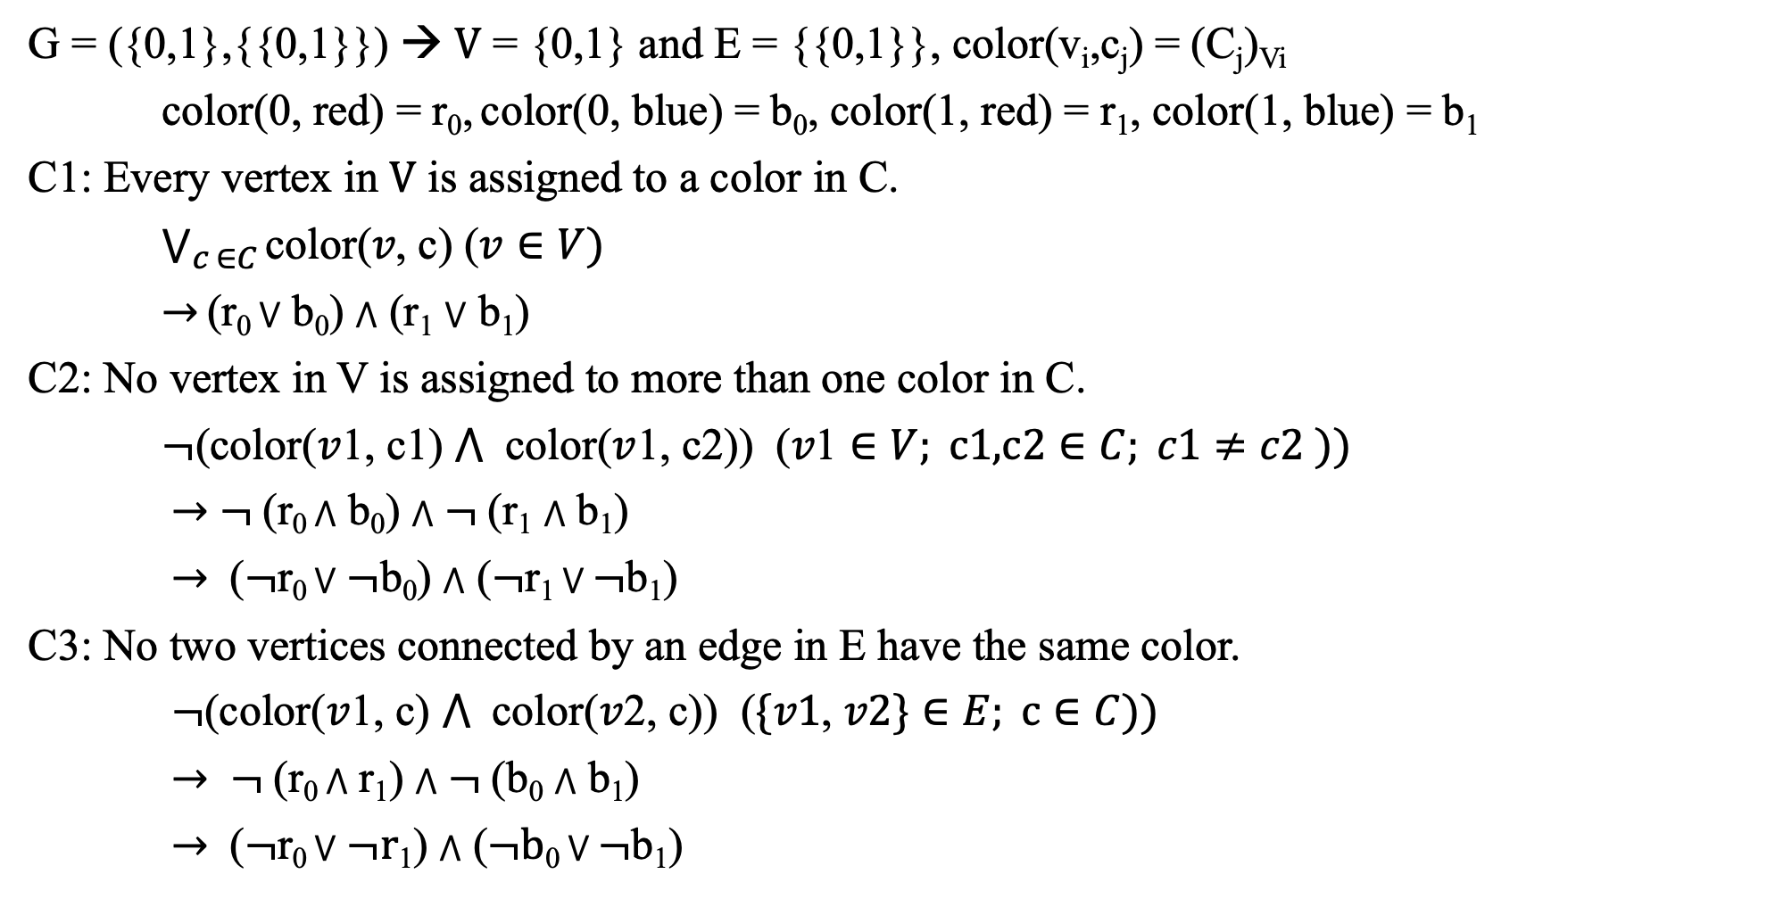
Propositional Logic Description of the Vertex Coloring Problem
G = ({0,1},{{0,1}}) → V = {0,1} and E = {{0,1}}, color(v_{i},c_{j}) = (C_{j})_{Vi}
color(0, red) = r₀, color(0, blue) = b₀, color(1, red) = r₁, color(1, blue) = b₁
C1: Every vertex in V is assigned to a color in C.
$\bigvee_{c ∈C}{\text{color}\text{(}v\text{, }\text{c}\text{) (}v∈V)}$
$→$(r₀ ⋁ b₀) $⋀$ (r₁ ⋁ b₁)
C2: No vertex in V is assigned to more than one color in C.
$¬$(color($v$1, c1) $⋀$ color($v$1, c2)) $\text{(}v\text{1}∈V; \text{c}\text{1,}\text{c}\text{2}∈C; c1≠c2 ))$
$→$ $¬$(r₀ $⋀$ b₀) $⋀$ $¬$(r₁ $⋀$ b₁)
$→$ ($¬$r₀ ⋁$¬$b₀) $⋀$ ($¬$r₁ ⋁ $¬$b₁)
C3: No two vertices connected by an edge in E have the same color.
$¬$(color($v$1, c) $⋀$ color($v$2, c)) $\text{(}\{v\text{1}\text{, }v2\}∈E; \text{c}∈C))$
$→ ¬$(r₀ $⋀$ r₁) $⋀$ $¬$(b₀ $⋀$ b₁)
$→$ ($¬$r₀ ⋁$¬r$₁) $⋀$ ($¬b$₀ ⋁ $¬$b₁)

Slide 2
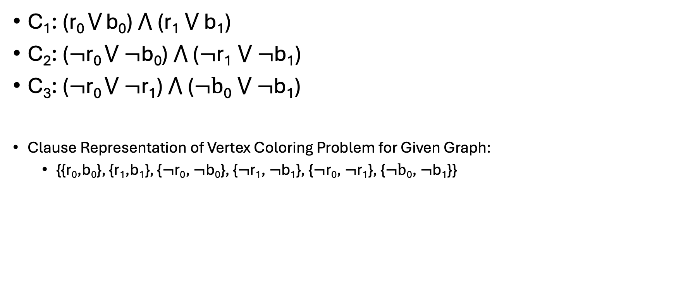
B) CNF Formats
C₁: (r₀ ⋁ b₀) $⋀$ (r₁ ⋁ b₁)
C₂: ($¬$r₀ ⋁ $¬$b₀) $⋀$ ($¬$r₁ ⋁ $¬$b₁)
C₃: ($¬$r₀ ⋁ $¬$r₁) $⋀$ ($¬b$₀ ⋁ $¬$b₁)
Clause Representation of Vertex Coloring Problem for Given Graph:
{{r₀,b₀}, {r₁,b₁}, {$¬$r₀, $¬$b₀}, {$¬$r₁, $¬$b₁}, {$¬$r₀, $¬$r₁}, {$¬b$₀, $¬$b₁}}

Slide 3

C) CNF to DIMACS CNF
{{r₀,b₀}, {r₁,b₁}, {$¬$r₀, $¬$b₀}, {$¬$r₁, $¬$b₁}, {$¬$r₀, $¬$r₁}, {$¬b$₀, $¬$b₁}}
# of clauses = 6, # of literals = 4, r₀ = 1, b₀ = 2, r₁ = 3, b₁ = 4
p cnf 4 6
1 2 0
3 4 0
-1 -2 0
-3 -4 0
-1 -3 0
-2 -4 0

