Slide 1
CS 406 Project
Permanent Computation on Sparse Matrices
Görkem Yar 27970, Kaan Bilgili 27983, İsmail Berat Düzenli 28037

Slide 2
Contents
Problem
Skipper with SkipOrd
Optimizations
ParSpaRyser with SortOrd
Optimizations
Parallelism
Results and discussion

Slide 3
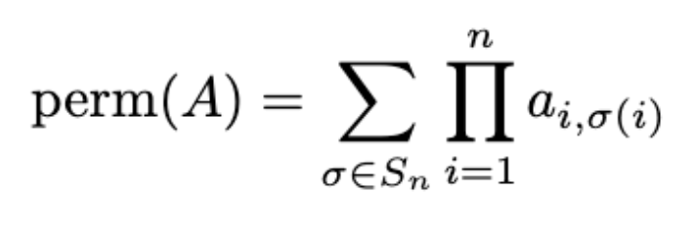
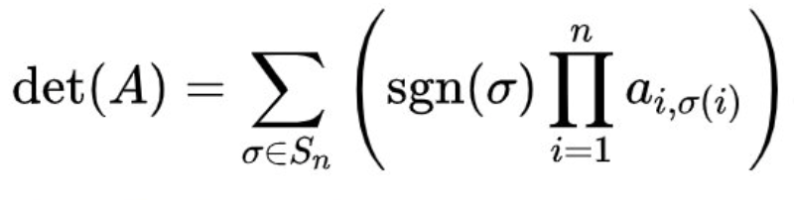
Matrix Permanent Calculation
The permanent of a square matrix (nxn matrix) is defined as:
where the summation is done on the set of all permutations of numbers 1 to n.
It resembles the computation of determinant:
The difference between two algorithms is the sign's of the summations. This difference leads to a complexity difference. Determinant Complexity: O(N^3) while permanent is an NP-Hard problem.

Slide 4
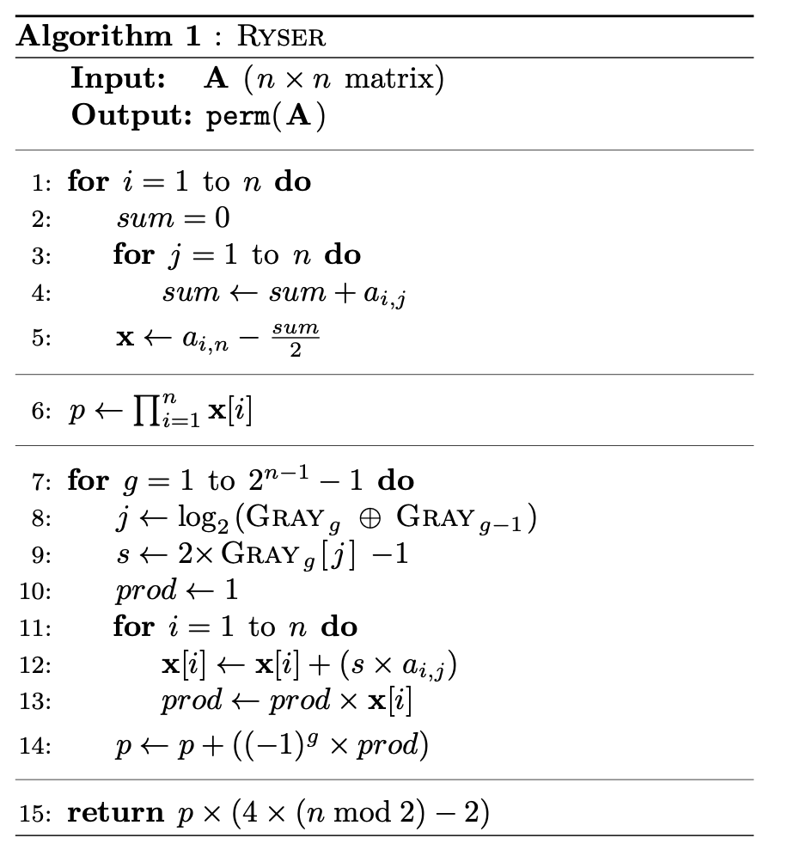
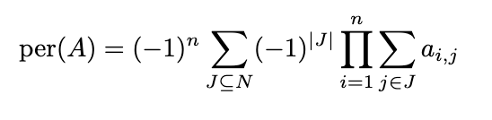
Ryser's Algorithm
(a+b+c)(d+e+f)(g+h+i)
- (a+b)(d+e)(g+h)
- (a+c)(d+f)(g+i)
- (b+c)(e+f)(h+i)
+ adg + beh + cfi
per [
]
a b c
d e f
g h i
aei + afh + bfg + bdi + cdh + ceg
Generalize

Slide 5
Skipper
Skip iterations to exploit sparsity.
nextg(.) -> next gray code that would contribute to the calculation of the permanent
Computations 1 .... 2^(N-1)
nextg
Graycode = 1010 -> 1001 jump
Row 1 | Row2 | Row 3 | Row 4
12 | 6 | 0 | 3
X =

Slide 6
Skipper Parallelization
Computation is divided to number of threads. Every thread computes single chunk.
Thread 2
Thread k
Computations [1 … 2^(N-1)]
Thread 1
Thread 3

Slide 7
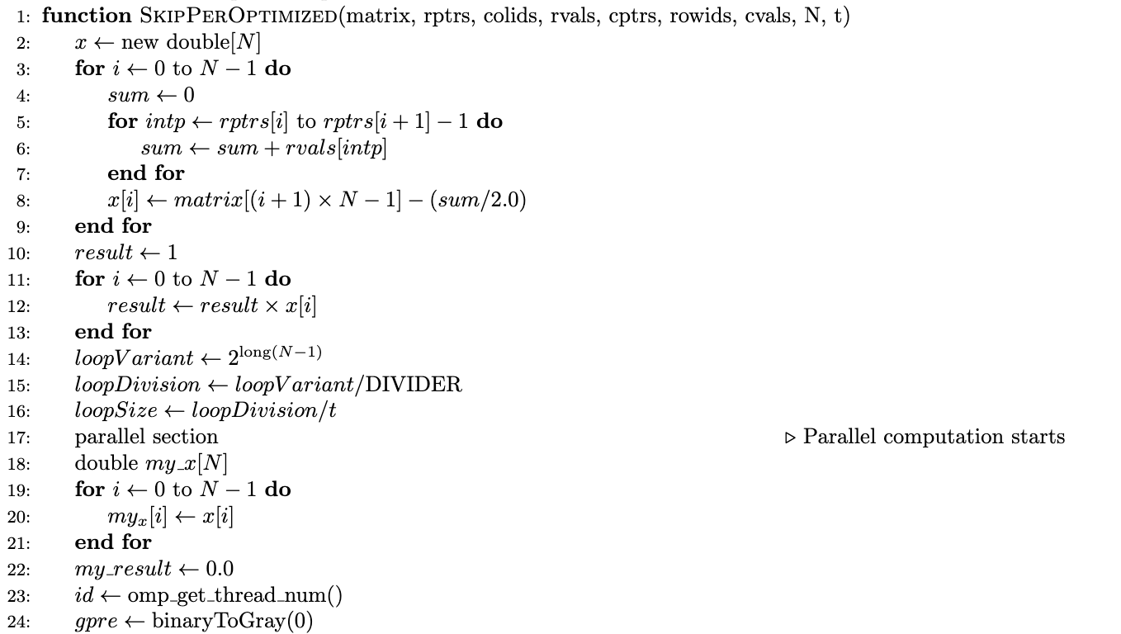
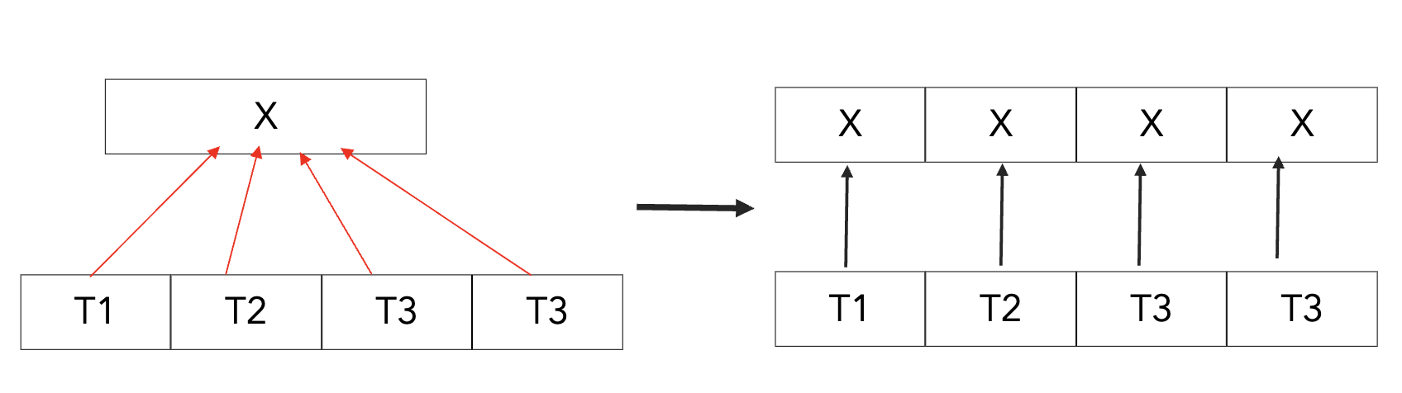
Our SkipPer Implementation
Handle memory access overhead of threads by copying array x.

Slide 8
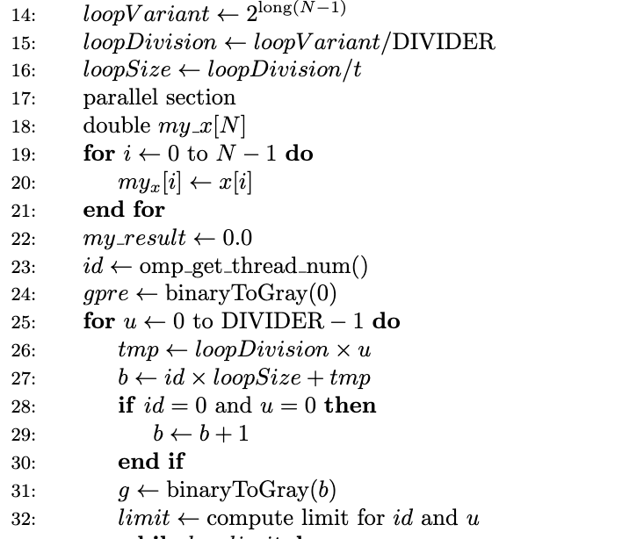
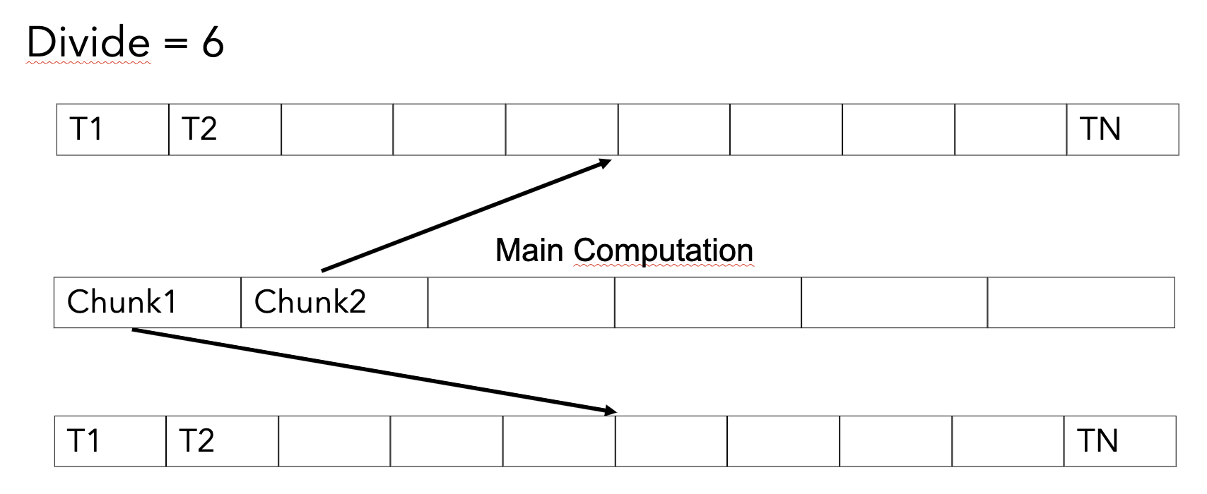
Computation divided into k chunks.
Every chunk is divided to every thread.
Skip actions becomes more balanced.

Slide 9
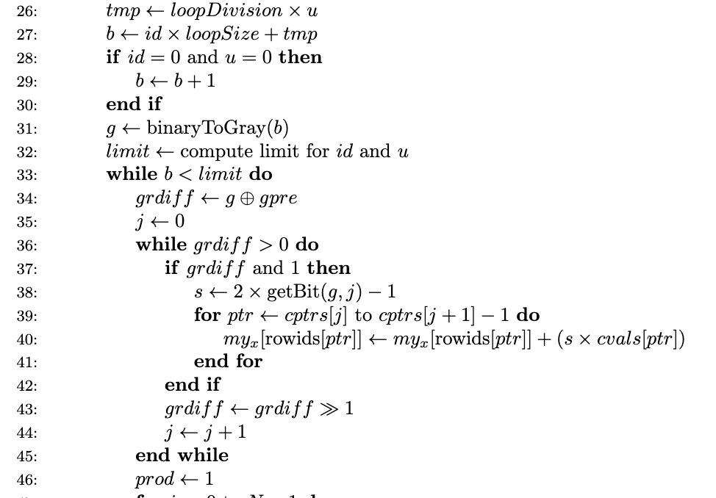
Before: iterate over every bit
0 | 0 | 0 | 1 | 1 | 0 | 1 | 0
After: shift & compute necessary bits
0 | 0 | 0 | 1 | 1 | 0 | 1 | 0

Slide 10
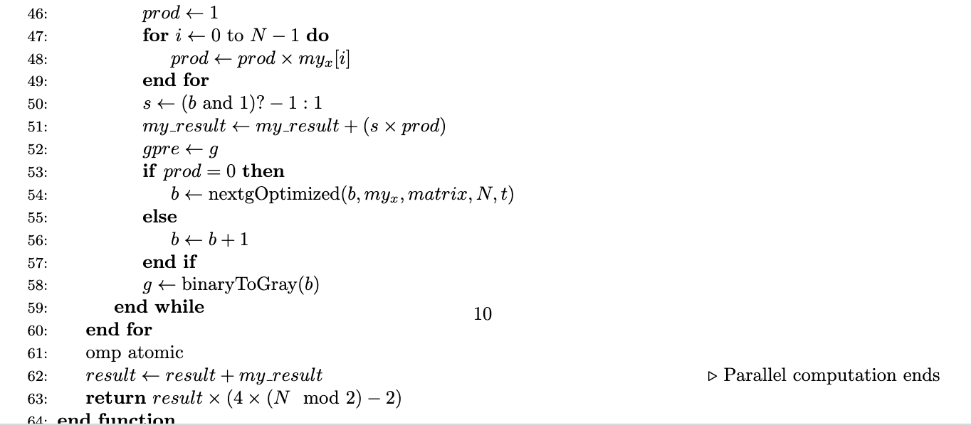
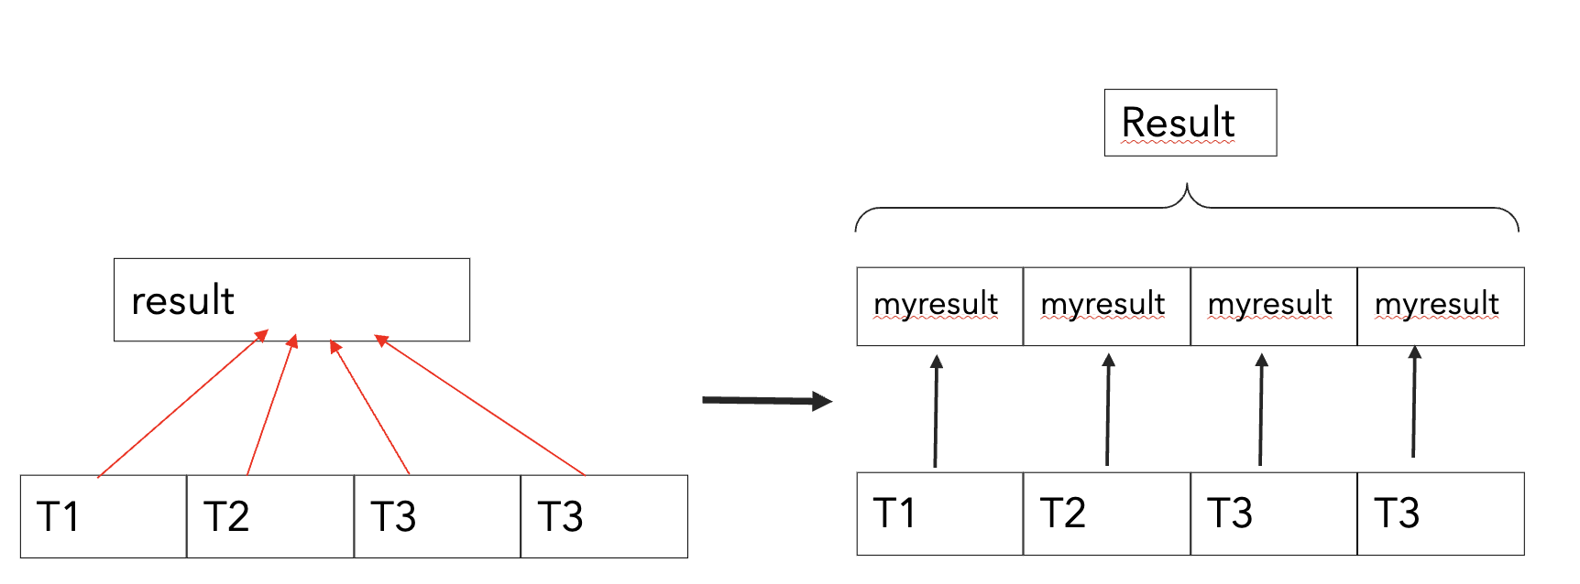
Nextg jumps when x_i = 0 for some x;
some x_i == 0 => prod = 0

Slide 11
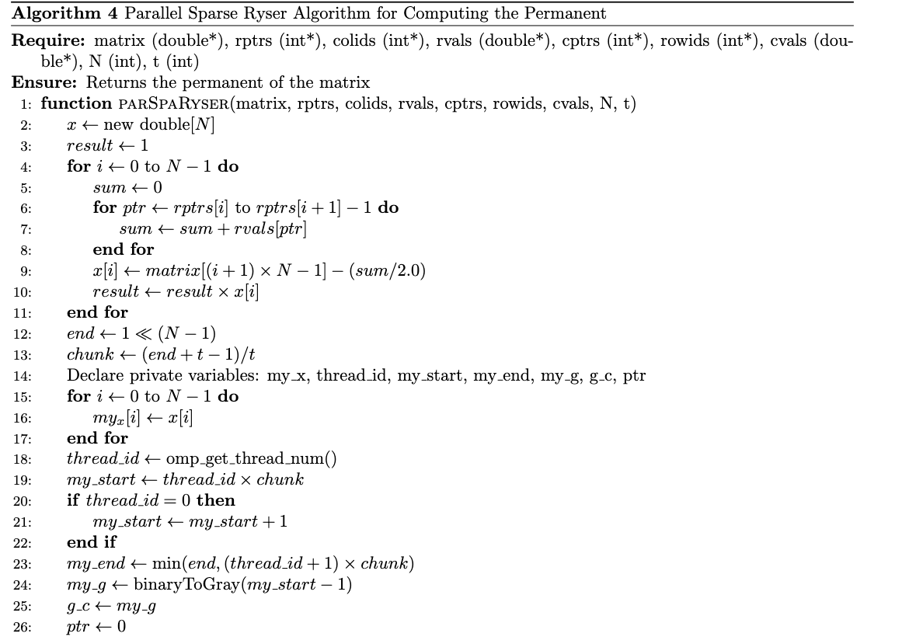
ParSpaRyser
Each thread works with its own rowSum array.

Slide 12
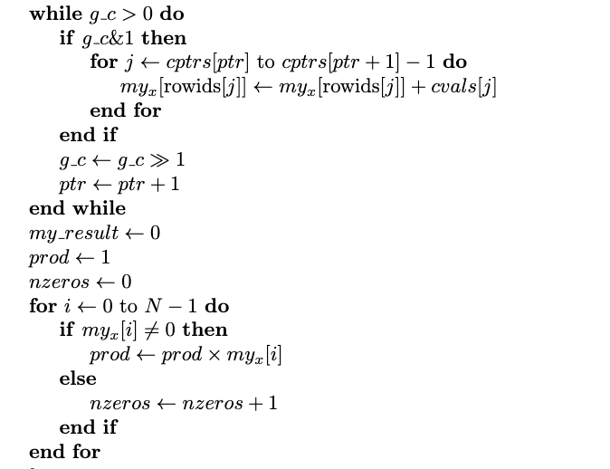
ParSpaRyser Parallelization
Before: iterate over every bit
0 | 0 | 0 | 1 | 1 | 0 | 1 | 0
After: shift&computenecessary bits
0 | 0 | 0 | 1 | 1 | 0 | 1 | 0

Slide 13
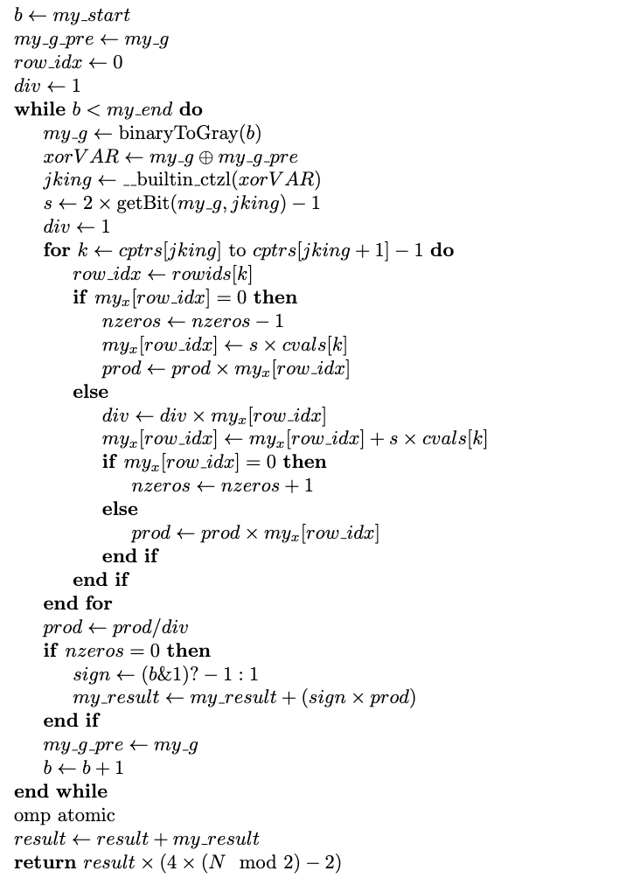
ParSpaRyser Parallelization
Each thread works on its own domain.
Using a built-in function instead of using log for faster calculation. The change from log to _built_ctzl improved the algorithm 1.5 times.
Dividing can take up to 30 clock cycles. If we divide and wait for the result to be written into the prod. It would cost many clock cycles. Instead of dividing at each iteration, multiplying the divisors and dividing at the end once achieves a speed-up of 1.6 times.

Slide 14
GPU Skipper & ParSpaRyser
Computation 1.... 2^(N-1)
Device 1 : [1 .... 2^(N-2)]
Device 2 : [ 2^(N-2)+1 …. 2^(N-1)]
In device, thread parallelisation is like CPU ???????
In Block Shared Memory: cptrs, rowids, cvals
Instead of local myx arrays -> united single shared x array
All_X_Arr =
myx1 | myx2 | myx3 |  |  |  |  | myxn
Coalescing: The indexes of the united myx arrays arranged based on coaslescing to improve memory accesses and bandwidth.

Slide 15
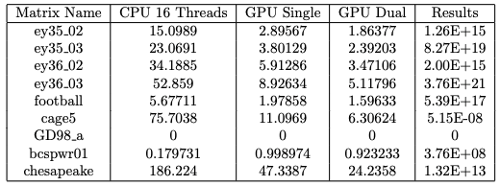
Results
We implemented both versions of the GPU's accurately. Furthermore, we get a performence 6-8 times improvement on our single GPU implementation compared to CPU.
Also, almost in all the matrices, double GPU performed 2 times better than single GPU.
For the CPU version of GD98_a, bcspwr01, cheasapeake matrices SkipPer algorithm is used. For the other results the versions of the ParSpaRyser is used.

