Slide 1
AI FOR ALL
The Evolution of AI Cognitive Architectures
A Comparative Analysis of SLMs vs. Frontier Systems (2024-2030)
AI FOR ALL | Research Desk

Slide 2
The Core Paradigm Shift
AI FOR ALL
From Cloud-Bound Behemoths to Edge-First, Tiered Intelligence
The assumption that larger models are universally better has been overturned by physical, economic, and infrastructure constraints. Rising data-center power demands and uneven broadband access are accelerating the need for more efficient,
locally deployable intelligence..
Frontier Models (Closed-Source): Massive, cloud-dependent architectures that dominate absolute benchmark ceilings but face latency, privacy, and cost hurdles in day-to-day deployment.
Small Language Models (SLMs): Compact, efficient models designed for practical deployment across modern AI systems, enabling responsive and cost-effective intelligence in real-world settings.
The Economics: Serving highly optimized SLMs can be dramatically cheaper than routing the same routine traffic to large frontier systems, especially at production scale.
Orchestrated unit economics will shift AI toward edge-first deployments, with cloud support used selectively where complexity justifies it.
AI FOR ALL | Research Desk

Slide 3
Key Reasoning Metrics and Deployment Implications
AI FOR ALL
How math, science, and fluid intelligence inform practical deployment
These benchmarks are best understood as deployment signals: many tasks can run locally, some benefit from a secondary reasoning tier, and only a narrow set justify frontier escalation.
1
AIME 2025 (Advanced Mathematical
Logic)
2
GPQA Diamond (PhD-Level Science)
Frontier: GPT-5.2 and Gemini 3.1 Pro achieve perfect or near-perfect scores (100%).
SLMs: DeepSeek-R1-Distill-Qwen-7B achieves 55.5%, while OpenThinker3-7B hits 53.3%.
Frontier: Gemini 3.1 Pro leads at 94.3%, with GPT-5.4 at 92.8%.
SLMs: OpenThinker3-7B scores 53.7%, and DeepSeek 7B hits 49.1%.
3
ARC-AGI-1 (Basic Abstract Reasoning)
4
ARC-AGI-2 (Complex Fluid Intelligence –
The "Reasoning Wall")
Frontier: Claude Opus 4.6 achieves 94.0%.
SLMs: Distilled SLMs reliably score between 30% and 50%, handling basic compositional patterns with high efficiency.
Frontier: Gemini Deep Think hits 84.6%, Gemini 3.1 Pro hits 77.1%, and Claude Opus 4.6 falls to 68.8%.
SLMs: Without massive Test-Time Compute (TTC), base SLMs struggle heavily here, often scoring in the single digits, highlighting a clear boundary in the current fluid-reasoning performance .
AI FOR ALL | Research Desk

Slide 4
Breaking the "Reasoning Wall"
AI FOR ALL
How SLMs Improve Through Algorithmic Efficiency, Not Just Scale
To bridge the gap with frontier models, the open-source community has shifted from brute-force pre-training to advanced
algorithmic efficiency to break through reasoning walls like ARC-AGI-2:
Scaling Test-Time Compute (TTC): Instead of relying solely on memorized data, architectures are now designed to generate thousands of internal Chain-of-Thought (CoT) tokens, allowing the model to explicitly "think" through and verify sub-steps before responding.
Large-Scale Reinforcement Learning (RL): The introduction of models like DeepSeek-R1-Zero proved that deep reasoning behaviors can emerge naturally by applying RL directly to base models, bypassing the need for traditional supervised fine-tuning.
Iterative Refinement Loops: The defining breakthrough of 2025 was the "refinement loop" where an AI iteratively critiques and improves its own outputs. This allowed remarkably small networks (even down to 7M parameters) to achieve competitive reasoning scores on fluid intelligence tasks.
Synthetic Distillation: Using massive frontier models as "teachers" to generate highly curated synthetic datasets, distilling complex logic into dense low range parameters.
The reasoning wall is not a failure point; it marks where algorithmic refinement and selective escalation become useful.
AI FOR ALL | Research Desk

Slide 5
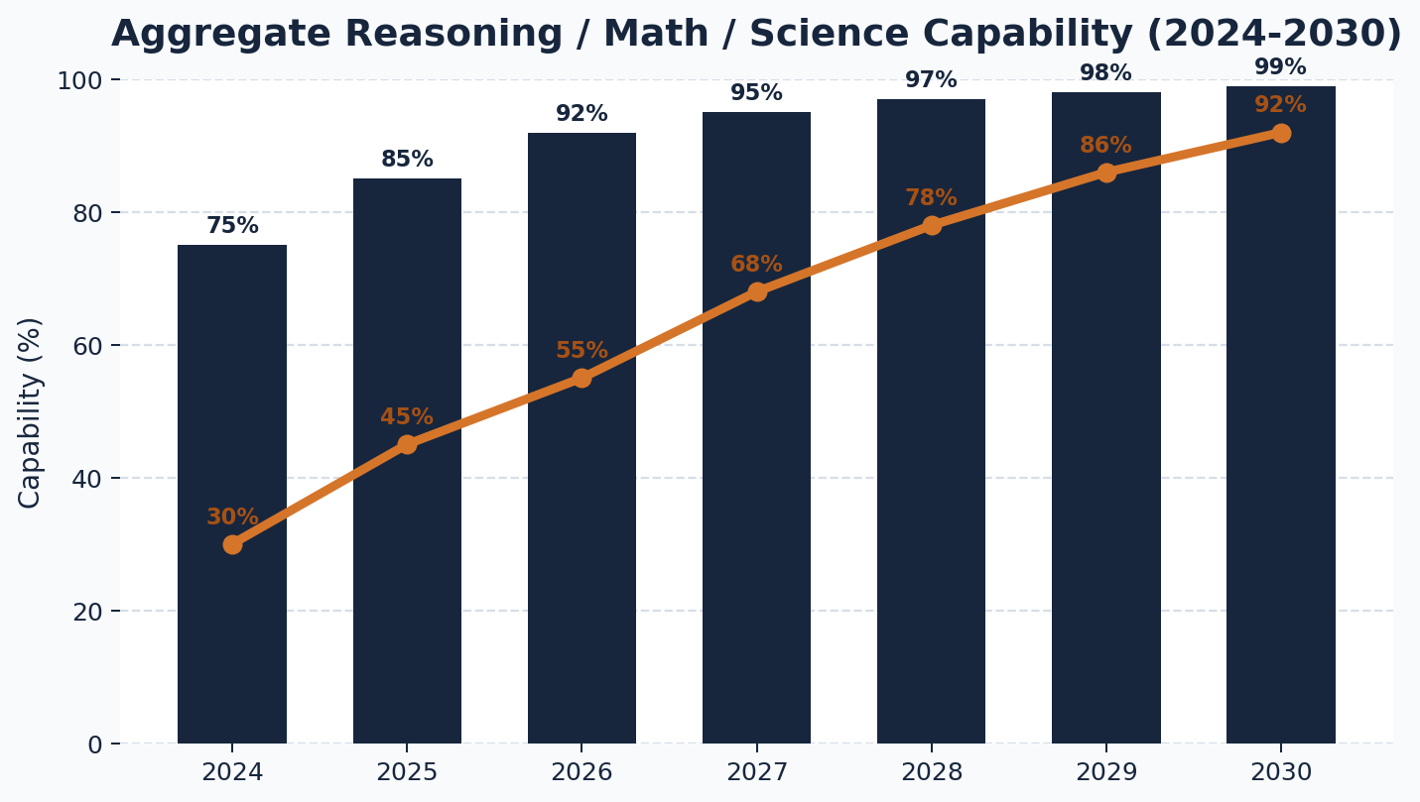
2024-2030 Capability Outlook
AI FOR ALL
Closing the Practical Deployment Gap
The chart below maps estimated aggregate capability across Reasoning (ARC-AGI 1 & 2), Math (AIME), and Science (GPQA).
Quantitative Matrix-
Estimated
2024 | 75.0% | 30.0%
2025 | 85.0% | 45.0%
2026 | 92.0% | 55.0%
2027 | 95.0% | 68.0%
2028 | 97.0% | 78.0%
2029 | 98.0% | 86.0%
2030 | 99.0% | 92.0%
Frontier Models = Bar Small Language Models = Line
Estimates based on current benchmark trends, deployment economics, and internal scenario modeling.
2030 outlook: SLMs may approach frontier-level usefulness for a broad share of real-world tasks, especially in edge-first deployments.
AI FOR ALL | Research Desk

Slide 6
What to Expect by 2030 (Emerging Outlook)
AI FOR ALL
The Future of Edge Orchestration and Democratization
By 2030, the artificial intelligence landscape is likely to be shaped by Small Language Models operating primarily on-device,
with lightweight coordination across specialized capabilities.
1. Shift away from single-model dependence: Everyday AI is likely to rely less on a single large cloud model and more on coordinated on-device intelligence, where specialized capabilities work together locally to deliver faster, more private responses.
2. Seamless hardware co-design: Advances in mobile NPUs and model optimization will make local reasoning more practical, energy-efficient, and widely accessible across everyday devices.
3. Bridging the global digital divide: Because these systems can operate with limited connectivity, they can reduce dependence on broadband and subscriptions. By 2030, low-cost smartphones in underserved regions could unlock medical, educational, and agricultural support with far greater local autonomy.
Most everyday intelligence is likely to run locally, with coordination happening at the edge and external support remaining selective.
AI FOR ALL | Research Desk | 2030
Scenario-based projections derived from current architectural and hardware trends.

Slide 7
Sources and Methodology
AI FOR ALL
Public benchmark references + scenario-based deployment synthesis
OpenAI: GPT-series developer documentation and benchmark disclosures relevant to AIME 2025 and GPQA Diamond.
Google DeepMind: Gemini benchmark references for AIME 2025, GPQA Diamond, and ARC-AGI-2 related reporting.
Anthropic and ARC references: Claude benchmark documentation and ARC Prize benchmark context.
Methodology note: Forecast sections reflect scenario-based synthesis grounded in benchmark trends, deployment economics, and edge hardware progress.
AI FOR ALL | Research Desk |

