Slide 1

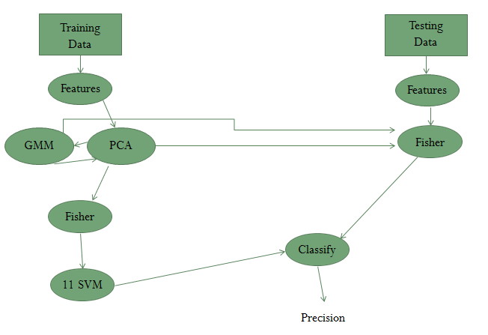
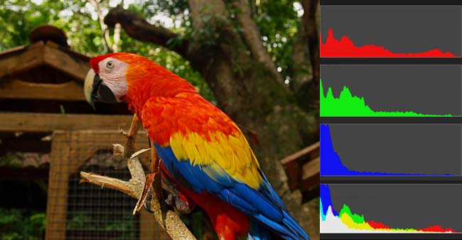
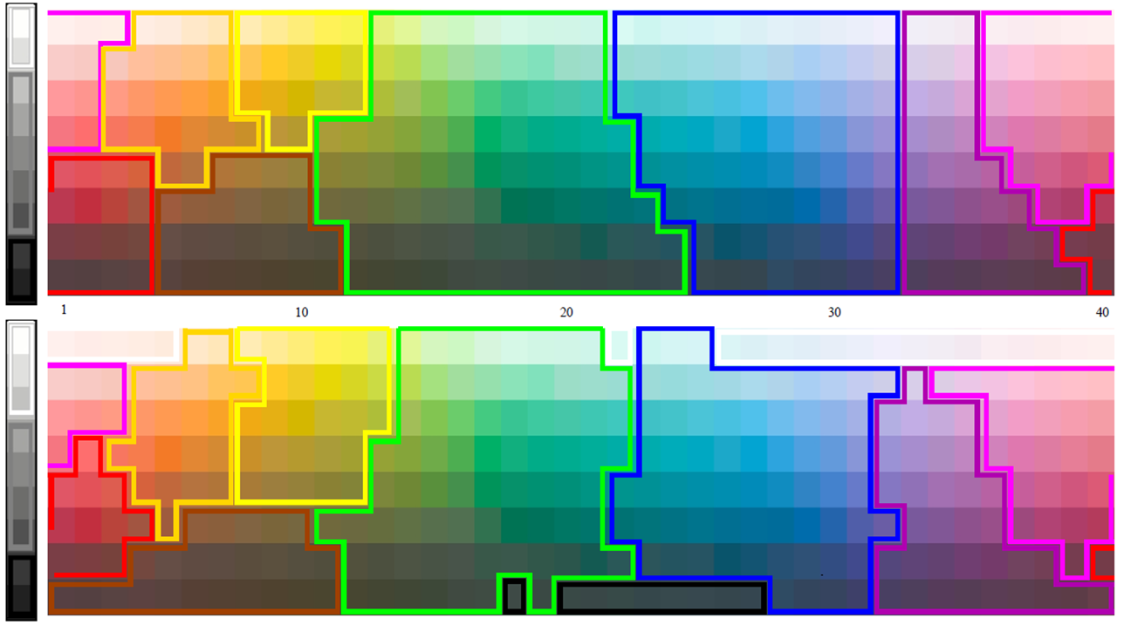
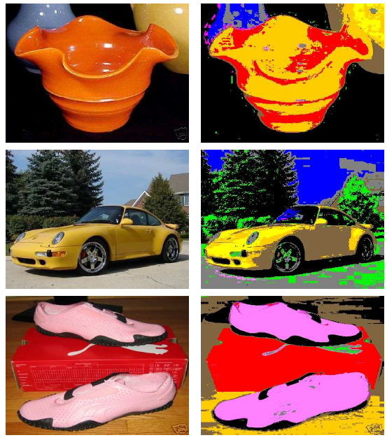
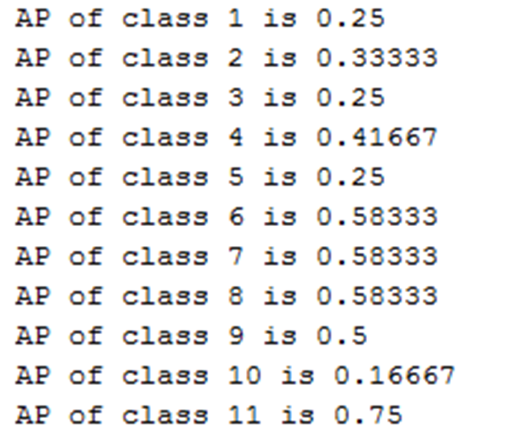
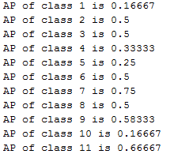
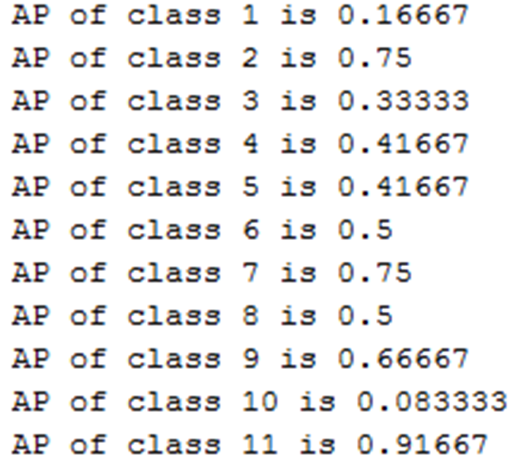
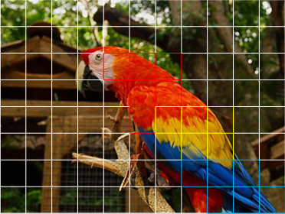
Dense Color Moment: A New Discriminative Color Descriptor
Kylie Gorman, Mentors: Dr. Andrea Salgian (TCNJ) and Yang Zhang (UCF)
University of Central Florida
Problem:
Color description is a challenging problem to overcome due to scene accidental events such as shadows, shading, or differing perspectives
Create a Blockwise Color Descriptor which is robust to changes in illumination
Combine color descriptor with shape descriptor Dense SIFT to improve accuracy
IV. Pipeline:
V. Experiments:
Color Moment
Training Data
Google Data Set: 1,100 images
Testing Data
EBay Data Set: 4 categories
12 images per color, 132 images
per category
MATLAB
Our Functions
Blockwise Color Moment Calculation
Included Functions
PCA
GMM
Fisher
SVM
II. Previous Methods:
Color Histogram
Color Mapping
Color Moments calculated on the entire image
Color Moment and Dense SIFT
Birds 200 (20 classes)
200 species/categories with 11,788 images total
Color Histogram Method
Training Steps
Calculate feature matrix for each image based on Color Moments
Matrix sizes are the number of blocks by the nine calculations per block
Concatenate feature matrices
Calculate Principal Component Analysis (PCA)
PCA reduces the number of dimensions of the data set to reduce processing time
Calculate Gaussian Mixture Model (GMM) based on PCA results
GMM clusters similar data points to create a visual library of possible features contained in each image in the dataset
Multiply individual feature matrices by coefficient matrix obtained from GMM
Use GMM results to calculate Fisher Vectors
Fisher Vectors record how often a feature occurs within an image
All fisher vectors are the same size because they record the same number of features per image
Train Support Vector Machines (SVM’s)
Linear SVM treats each vector as a point in space and determines a line that will separate the images that are matches from the other images, while keeping the most room for error.
V. Results:
Classification using Color Moment performance on Google and EBay Datasets
Lightness
CIELAB: 42% Accuracy HSV: 45% Accuracy RGB: 50% Accuracy
Hue
Color Mapping Methods
III. Our Approach:
Classification using Color Moment vs. Dense SIFT on Birds 200 Dataset
Our Color Descriptor: Accuracy = 21.3592% (110/515)
Dense SIFT: Accuracy = 21.7476% (112/515)
Color Moment and Dense SIFT Combined: Accuracy: 25.44%
Blockwise Color Moment Feature
Incorporate the spatial context information by first breaking up the image into 8 pixel by 8 pixel blocks
We use three moments per channel of every block to describe mean, variance and degree of asymmetry of a color distribution.
Color Moment Calculations:
VI. Conclusions:
Our Color Descriptor showed the same accuracy as the Dense SIFT and therefore possesses the same discriminative ability
When both features were fused, accuracy increased by 4%. This indicates that color moment representation and shape representation, like SIFT, are complementary.
Future Work
Complete Color Moment and Dense SIFT with all 200 classes
Increase/ Decrease Block Size
Incorporate Object Detection and Image Retrieval
Testing Steps
Calculate feature matrix of each image, isolating the object first using binary images
Use PCA and GMM results from training data to calculate fisher vectors
Apply Fisher Vector to each individual result to obtain vectors that are the same size
Classify images using SVM’s from the training data
Calculate precision of results
Mean Standard Deviation Skew
Acknowledgments:
Thanks to Dr. Shah, and Dr. Lobo for their guidance and support.
Presented at Celebration of Computing, Fall 2014

