Slide 1
Human Activity Recognition using Smartphone
Gordana Neskovic
(https://github.com/gornes)

Slide 2
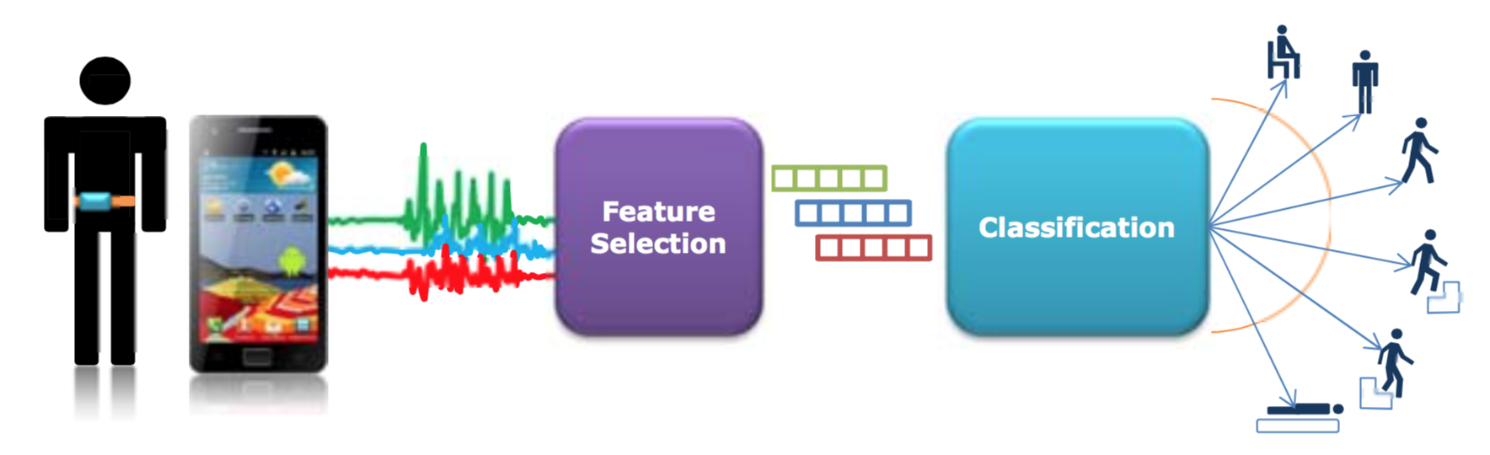
Problem Statement
Classify Human Activity from Smartphone Data

Slide 3
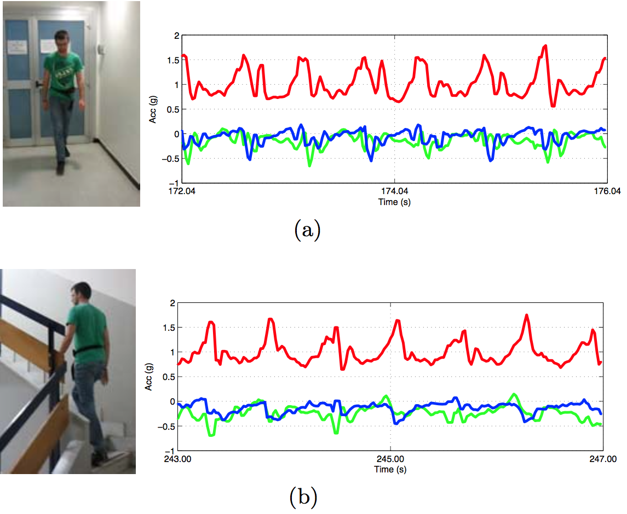
Data
Data Set: 10299 Samples,651 Features
30 people, 6 activities
Sensor Data: Accelerometer & Gyro
Signal Domain: Time & Frequency

Slide 4
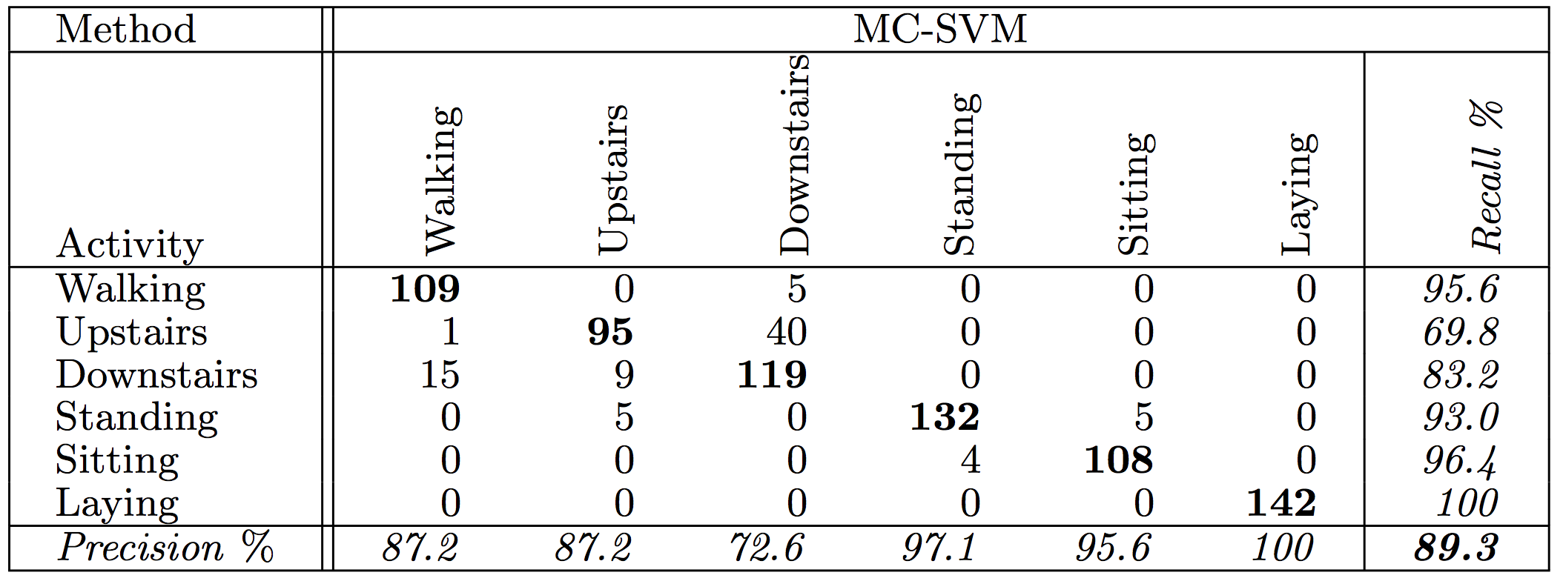
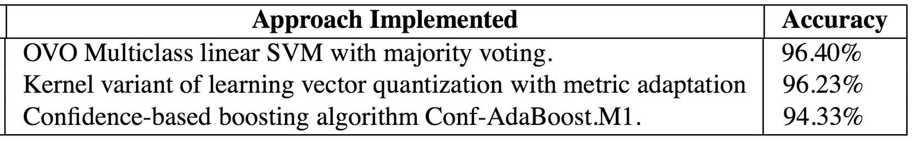
Previous Approaches
SVM Accuracy: 89.3%
Linear SVM Accuracy: 96.40%

Slide 5
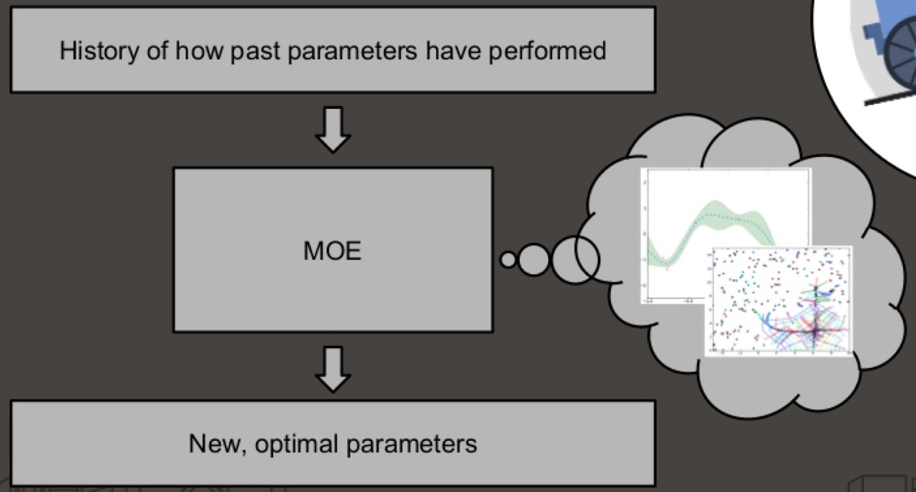
Applied Approach
Parameter Optimization:
  Grid Search
  Yelp MOE
Models / Classifiers:
  Support Vector Machine
  Random Forrest
  AdaBoost
  XGBoost
  Ensemble

Slide 6
Results
Approach | Accuracy [%]
SVM | 96.50
XGBoost | 95.76
Ensemble | 94.77
RF | 92.84
AdaBoost | 91.55

Slide 7
Next Steps
Confusion Matrix
Activity | Walk | Walk Up | Walk Dawn | Stand | Sit | Lay | Recall %
Walk | 487 | 6 | 3 | 0 | 0 | 0 | 98.2
Walk Up | 12 | 457 | 2 | 0 | 0 | 0 | 97.0
Walk Dawn | 5 | 26 | 399 | 0 | 0 | 0 | 92.6
Stand | 0 | 0 | 0 | 449 | 40 | 0 | 91.4
Sit | 0 | 0 | 0 | 7 | 525 | 0 | 98.7
Lay | 0 | 0 | 0 | 0 | 0 | 537 | 100
Precision % | 96.6 | 93.1 | 98.7 | 98.5 | 92.9 | 100 | 96.5
Improving Dynamic & Static Classification

Slide 8
Thanks!
gordana.neskovic@gmail.com

