Slide 1
Chapter 4
Common Mistakes, Debugging, and Error Handling

Slide 2
Chapter 4 Objectives
What are the seven most common JavaScript mistakes?
How do you use a debugger?
What’s available in JavaScript for error handling?

Slide 3
What are the seven most common JavaScript mistakes?
1. Undefined variables
If a variable is used before it has been defined, an error will arise.
Notes:
You don’t have to assign a value to a variable before you use it, but you do need to declare it before you use it.
What can be confusing with this type of error is that although the browser may tell us the error is on one line, in fact, the source of the error may be on some other line.

Slide 4
What are the seven most common JavaScript mistakes?
2. Case sensitivity
JavaScript is case-sensitive. Mistakes in case are a major source of errors that can be difficult to spot.
If (myName =="paul") {
Notes:
(Code sample equivalent to book)
In this case, the error is the capital I used in the If.
JavaScript won't tell you that the error is an incorrect use of case. Instead, IE will tell you “Object expected,” and Firefox will tell you that “If is not defined.” Although error messages give you some idea of what's gone wrong, they often do so in an oblique way. In this case IE thinks you are trying to use an object called an If object, and Firefox thinks you are trying to use an undefined variable called If.

Slide 5
What are the seven most common JavaScript mistakes?
3. Incorrect number of closing braces
It's easy to have too few or too many closing braces, especially if you're using a lot of if, for, or do while statements.
Notes:
If you properly format the code, it makes it much easier to spot where the error is.
If you use Dreamweaver, the Balance Braces feature will help you detect this type of mistake.

Slide 6
What are the seven most common JavaScript mistakes?
4. Missing + signs when concatenating
A + is required for every piece of code you want to concatenate with another piece of code.
Notes:
Although easy to spot in just a few lines of code, this kind of mistake can be harder to spot in large chunks of code. Also, the error message that a mistake like this causes can be misleading. Load this code into a browser, and you'll be told “Error : Expected” by IE and “Missing ; before statement” by Firefox.
It's surprising how often this error crops up.

Slide 7
What are the seven most common JavaScript mistakes?
5. Equals rather than is equal to
This is a classic error in JavaScript where the assignment operator (=) is used rather than the equality operator (==).
if (myNumber = 101) {
Notes:
In this case, 101 has been assigned to the variable myNumber, so the if condition will always evaluate to true.
What makes it even trickier is that no error message will be raised; it is just your data and logic that will suffer. Assigning a variable a value in an if statement may be perverse, but it's perfectly legal so there will be no complaints from JavaScript. When embedded in a large chunk of code, a mistake like this is easily overlooked.

Slide 8
What are the seven most common JavaScript mistakes?
6. Incorrect number of closing parentheses
For each parenthesis opened, there must be a corresponding closing parenthesis.
Notes:
When you have lots of opening and closing parentheses, it's very easy to miss one or have one too many.

Slide 9
What are the seven most common JavaScript mistakes?
7. Using a method as a property and vice versa
It's common to forget to put parentheses after a method with no parameters, or to use a property and put parentheses after it.
Notes:
When calling a method you must always have parentheses following its name; otherwise, JavaScript thinks that it must be a property.

Slide 10
How do you use a debugger?
A debugger is a tool for helping you see how your code works.
You can halt the execution of your script and then step through the code line by line to see exactly what is happening.

Slide 11
How do you use a debugger?
Microsoft Script Debugger is a debugger for use with IE.
Venkman is a debugger for Mozilla-based browsers; however, there have been some issues with using Venkman and the Firefox browser.
The Firebug extension to Firefox is also a debugger and works similarly to the Microsoft Script Debugger.
Notes:
The Microsoft script debugger is excellent for debugging pages so that they will work in IE. However, it won't help you spot errors due to cross-browser incompatibility. For example, what works in FF might throw an error in IE, and a page that you’ve debugged successfully in IE could easily throw an error in FF. Aside from this problem, the debugger is a great help for spotting logic errors in your code.
The following slides are based on the basic version of the Microsoft Script Debugger. The basic concepts of stepping through code, using breakpoints, and using a call stack are common to Microsoft Script Debugger, the Venkman debugger, and Firebug.

Slide 12
How do you use a debugger?
Opening a Page in the Debugger:
If the debugger is enabled, the script debugger will be activated automatically if there is an error in your code.

Slide 13
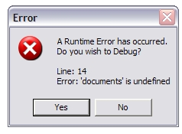
How do you use a debugger?
Opening a Page in the Debugger:

Slide 14
How do you use a debugger?
Opening a Page in the Debugger:
A second method is to load the page you want to debug into your browser and then use the Break at Next Statement menu option in the debugger.
Notes:
Note that with some setups of the script debugger, the browser brings up a dialog box saying that an exception of type “Runtime Error” was not handled. This does not mean that there is an error in the code, but simply is the way Break at Next Statement works.

Slide 15
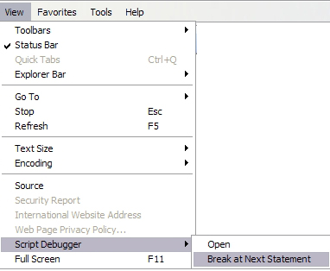
How do you use a debugger?
Opening a Page in the Debugger:

Slide 16
How do you use a debugger?
Opening a Page in the Debugger:
You can add the keyword debugger to your script, which will stop the execution at that point and open the debugger.

Slide 17
How do you use a debugger?
Stepping Through Code
One way is to step into the code. This simply means that every line of code is executed on a line-by-line basis.
Notes:
Stepping into the code simply means that every line of code is executed on a line-by-line basis. If a function is called, you step into that function and start executing the code inside the function statement by statement, before stepping out again at the end and returning to the calling line. To do this you use the Step Into icon.
Rather than clicking the Step Into icon, you can also press the F8 key to step into the code.

Slide 18
How do you use a debugger?
Stepping Through Code
You can also step out of a function and continue executing the code line by line from the point at which the function was called.
Notes:
You may find that having stepped into a function you get half way through and decide the function is not the source of the bug and you want to execute the remaining lines of code in the function, then continue step-by-step from the point at which the function was called. This is called stepping out of the function, and uses the Step Out icon.
Rather than clicking the Step Out icon, you can also press the Ctrl + Shift + F8 key to step out of a function.

Slide 19
How do you use a debugger?
Stepping Through Code
If you have a number of functions and you know some of them are bug free, you can step over the code so that the code within a function is executed without having to go through it line by line.
Notes:
There may also be times when you have some code with a bug in it that calls a number of functions. If you know that some of the functions are bug free, then you may want to just execute them and not actually step into them and see them being executed line by line. For this the debugger has the Step Over icon, which executes the code within a function but without us having to go through it line by line.
Rather than clicking the Step Over icon, you can also press the Shift + F8 key to step over a function.
If you've finished debugging, you can run the rest of the code without stepping through each line by clicking the Run icon on the Script Debugger toolbar.

Slide 20
How do you use a debugger?
Breakpoints
Breakpoints are markers you can set in the debugger that force code execution to stop at that point and start single-stepping through the code.
Notes:
When the breakpoint is reached, code execution will stop and you can start single-stepping if you want.
To set the breakpoint, you need to scroll up the code window in the debugger until you can see the line on which you want to put the breakpoint. Click that line and then click the Toggle Breakpoint icon on the toolbar.
To unset a breakpoint you just click the relevant line of code, click the Toggle Breakpoint icon again, and that toggles it off.
You can set as many breakpoints as you want.

Slide 21
How do you use a debugger?
Call Stack
When you are single-stepping through the code, the call stack keeps a running list of which functions have been called to get to the current point of execution in the code.
Notes:
Every time a function is called, the debugger adds the function to the top of the call stack.
If you want to see where each function was first entered, you just need to double-click the function name in the call stack window.
The call stack can prove very useful for tracking where you are, where you have been, and how you got there.

Slide 22
Error Handling
Preventing Errors:
- Check pages thoroughly on as many different platforms and browsers as possible.
- Validate your data
Notes:
The best way to handle errors is to stop them from occurring in the first place.

Slide 23
Error Handling
Using try...catch statements:
You use a try statement to define a block of code you want to try to execute.
You use a catch statement to define a block of code that will execute if an exception to the normal running of the code occurs in the block of code in the try statement.
Notes:
The try…catch statements work as a pair; you can't have one without the other.
The term exception is key here: It means a circumstance that is extraordinary and unpredictable. Compare that with an error, which is something in the code that has been written incorrectly. If no exception occurs, the code inside the catch statement is never executed. The catch statement also enables us to get the contents of the exception message that would have been shown to the user had you not caught it first.

Slide 24
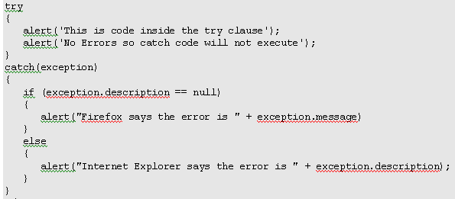
Error Handling
Notes:
First you define the try statement; you mark out which block of code is within the try statement by enclosing it in curly braces.
Next comes the catch statement. You've included exception in parentheses right after the catch statement. This exception is simply a variable name. It will store an Exception object containing information about any exception thrown during execution of code inside the try code block. Although you've used exception, you could use any valid variable name.
Within the curly braces after the catch statement is the code block that will execute if and only if an error occurs.
The Exception object contains two properties that provide information about the exception that occurred. The bad news is that while both IE and FF support the Exception object and both have two properties, the names of these properties differ.
IE's version of the Exception object has the number and description properties. The number property is a unique number for that error type. The description property is the error message the user would normally see.
With FF, the properties of the Exception object are name and message. The name property is a unique name for that type of error, and the message property is much like IE's description property in that it gives a more detailed explanation of what went wrong.
By checking to see whether the exception.description property is null, you can tell whether the description property is supported, and therefore whether the browser is one of those supporting the property such as IE. If it is equal to null, the property is not supported by the browser, so you need to display the message property of the Exception object instead. If it is not null, the description property has a value and therefore does exist and can be used.
Before executing any code, JavaScript goes through all the code and checks for syntax errors or code that breaches JavaScript's rules. If a syntax error is found, the browser deals with it as normal; your try clause never runs and therefore cannot handle syntax errors.

Slide 25
Error Handling
Using throw statements:
A throw statement can be used within a try block of code to create your own runtime errors.
This can be useful for indicating problems such as invalid user input.
Notes:
You can use throw to stop code execution in its tracks and cause the error-catching code in the catch block of code to take over. In the catch clause, you can determine whether the error is user input–based, in which case you can notify the user what went wrong and how to correct it. Alternatively, if it's an unexpected error, you can handle it more gracefully than lots of JavaScript errors.
To use throw, you type throw and include the error message after it:
throw "This is my error message";

Slide 26
Error Handling
Using finally clauses:
A finally clause can be used to define a block of code that will execute whether or not an exception is thrown.
Notes:
The finally clause can't appear on its own; it must be after a try block.
The finally part is a good place to put any clean-up code that needs to be executed regardless of any errors that occurred previously.

Slide 27
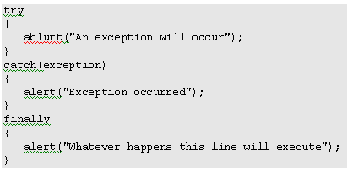
Error Handling
Using finally clauses:

