Slide 1
Chapter 5
JavaScript—An Object-Based Language

Slide 2
Chapter 5 Objectives
What are JavaScript objects?
How do you create a JavaScript object?
What are some of the useful built-in JavaScript objects?

Slide 3
What are JavaScript objects?
A JavaScript object is a collection of properties and methods that are grouped together with a single name.
An object is used to gather together everything needed for a particular task.
Notes:
Let's take a car as an example to explore what an object really is.
How would you define our car? You might say it's a blue car with four-wheel drive. You might specify the speed at which it's traveling. When you do this, you are specifying properties of the object. For example, the car has a color property, which in this instance has the value blue.
How do you use our car? You turn the ignition key, press the gas pedal, beep the horn, change the gear (that is, choose between 1, 2, 3, 4, and reverse on a manual car, or drive and reverse on an automatic), and so on. When you do this, you are using methods of the object.
Each of the JavaScript objects has a collection of related properties and methods that can be used to manipulate a certain kind of data. For example, the Array object consists of methods to manipulate arrays and properties to find out information from them. In most cases, to make use of these methods and properties you need to define your data as one of these objects.

Slide 4
How do you create a JavaScript object?
var myArray = new Array();
- the new keyword tells JavaScript that you want to create a new object
- the Array() constructor function tells JavaScript what kind of object you want to create
- a reference to the new object is stored in a variable named myArray
Notes:
Using the new keyword and a constructor function is one way to create a JavaScript object.

Slide 5
Primitive Data
Primitive data, such as text and numbers, is the most basic data possible in JavaScript.
With primitive data, the variable holds the data’s actual value:
var myNumber = 23;

Slide 6
Reference Data
A variable assigned to an object holds a reference to the memory address where the data can be found, not the actual data itself.
var myArray = new Array(“Paul”, “Jeremy”, “Nick”);
Notes:
When it comes to objects, it’s a reference to the object and not the object stored in a variable.

Slide 7
Accessing an object’s properties
To access the value of a property of an object:
- name of the variable referencing the object
- dot
- name of the property
myArray.length
Notes:
What can you do with this property now that you have it? You can use this property as you would any other piece of data and store it in a variable
var myVariable = myArray.length;
or show it to the user
alert(myArray.length);
In some cases, you can even change the value of the property, such as
myArray.length = 12;
Unlike variables, some properties are read-only—you can get information from them, but you can't change information inside them.

Slide 8
Calling an object’s methods
To call the methods of an object:
- name of the variable referencing the object
- dot
- name of the method
myArray.sort();
Notes:
Just like functions, you can pass parameters to some methods, where the parameters are placed between the parentheses following the method's name. However, whether or not a method takes parameters, you must still put parentheses after the method's name, just as you did with functions. As a general rule, anywhere you can use a function, you can use a method of an object.

Slide 9
JavaScript Native Objects
String
Math
Array
Date
Notes:
These are not all of the native JavaScript objects, just some of the more commonly used ones, namely the String object, the Math object, the Array object, and the Date object.

Slide 10
String Object
A String is just a series of individual characters.
Each character has a position, or index.
The first position or index is 0.
Notes:
To create a String object, you can write
var string1 = new String("Hello");
You can also declare a string primitive and use it as if it were a String object, letting JavaScript do the conversion to an object for you behind the scenes. For example,
var string1 = "Hello";
The advantages to doing it this way are that there is no need to create a String object itself and that you avoid the troubles with comparing String objects. When trying to compare them with primitive string values, the actual values are compared, but with String objects, it's the object references that are compared.

Slide 11
String Object
Properties and Methods:
- vast number of properties and methods
- most common and least complex are covered in this chapter

Slide 12
String Object
Property:
length – the number of characters in the string
var myName = new String(“Jeremy");
document.write(myName.length);
Notes:
The length property simply returns the number of characters in the string.
var myName = new String("Paul");
document.write(myName.length);
will write the length of the string "Paul" (that is, 4) to the page.

Slide 13
String Object
Method:
charCodeAt() – returns the Unicode character code for the character at a specific position in the string
var myName = new String("Paul");
var firstChar = myName.charCodeAt(0);
alert(firstChar);
Notes:
The charCodeAt() method is similar in use to the charAt() method, but instead of returning the character itself, it returns a number that represents the decimal character code in the Unicode character set for that character. Recall that computers only understand numbers—to the computer, all your strings are just number data. When you request text rather than numbers, the computer does a conversion based on its internal understanding of each number and provides the respective character.
Lowercase letters start at 97 (a is 97, b is 98, and so on). Digits go from 48 (for the number 0) to 57 (for the number 9).

Slide 14
String Object
Method:
fromCharCodeAt() – converts Unicode character codes to characters to create a string
var myString;
myString = String.fromCharCode(65,66,67);
alert(myString);
Notes:
The fromCharCode() method is unusual in that it's a static method—you don't need to have created a String object to use it with. It's always available to you.
The example code puts the string "ABC" into the variable myString.

Slide 15
String Object
Method:
indexOf() – finds the index position of a substring inside a string
var myString = "Paul";
var found =
myString.indexOf("a" );
Notes:
The methods indexOf() and lastIndexOf() are used for searching for the occurrence of one string inside another. A string contained inside another is usually termed a substring. They are useful when you have a string of information, but only want a small part of it.
indexOf() takes two parameters:
* The string you want to find
* The character position you want to start searching from (optional)
If you don't include the second parameter, searching starts from the beginning of the string.
The return value of indexOf() is the character position in the string at which the substring was found. Again, it's zero-based, so if the substring is found at the start of the string, then 0 is returned. If there is no match, then the value -1 is returned.

Slide 16
String Object
Method:
lastIndexOf() – finds the index position of a substring inside a string
var myString = "Paul";
var found =
myString.lastIndexOf("u" );
Notes:
lastIndexOf() takes two parameters:
* The string you want to find
* The character position you want to start searching from (optional)
If you don't include the second parameter, searching starts from the end of the string.
The return value of lastIndexOf() is the character position in the string at which the substring was found, starting from the end, or the position specified in the 2nd parameter, and working toward the beginning of the string.
The indexOf() and lastIndexOf() methods are more useful when coupled with the substr() and substring() methods. Using a combination of these methods allows you to cut substrings out of a string.

Slide 17
String Object
Methods:
substr() and substring()– both methods copy part of a string, but they differ in the parameters used
var myString = "JavaScript";
var mySubString = myString.substring(0,4);
Notes:
The method substring() takes two parameters: the character start position and the character end position of the part of the string you want. The second parameter is optional; if you don't include it, all characters from the start position to the end of the string are included.
This method is a little confusing because the end character is the end marker; it's not included in the substring that is cut out. It helps to think of the parameters as specifying the length of the string being returned: the parameters 0 and 4 will return (4 - 0) characters starting at and including the character at position 0.
Like substring(), the method substr() again takes two parameters, the first being the start position of the first character you want included in your substring. However, this time the second parameter specifies the length of the string of characters that you want to cut out of the longer string.
The main reason for using one method rather than the other is that the substring() method is supported by IE 3+ and by NN 2+ browsers. However, the substr() method only works with version 4 (and later) browsers.

Slide 18
String Object
Methods:
toLowerCase() and toUpperCase()– both methods return a string converted either to lowercase or to uppercase
var myString = "JAVASCRIPT";
var myString = myString.toLowerCase();
Notes:
(Code sample equivalent to book)

Slide 19
Array Object
An array is an object that can contain more than one item of data at the same time

Slide 20
Array Object
Property:
length – the number of items in an array
var myNumber = new Array(2,4);
alert (myNumber.length);
Notes:
(Code sample equivalent to book)
Sometimes you know exactly how long the array is, but there are situations where you may have been adding new elements to an array with no easy way of keeping track of how many have been added.

Slide 21
Array Object
Method:
concat() – concatenates two arrays
var myNumber = new Array(2,4);
var myNumberA = new Array(3,5);
var concatArray = myNumber.concat(myNumberA);
Notes:
(Code sample equivalent to book)

Slide 22
Array Object
Method:
slice() – copy part of an array
var names = new Array("Paul","Sarah","Louise","Adam","Bob");
var slicedArray = names.slice(1,3);
Notes:
(Code sample equivalent to book)
When you just want to copy a portion of an array, you can use the slice() method. Using the slice() method, you can slice out a portion of the array and assign that to a new variable name. The slice() method has two parameters:
* The index of the first element you want to be copied
* The index of the element marking the end of the portion you are slicing out (optional)
Just like string copying with substr() and substring(), the start point is included in the copy, but the end point is not. Again, if you don't include the second parameter, all elements from the start index onward are copied.

Slide 23
Array Object
Method:
join() – convert an array to a string
var names = new Array("Paul","Sarah","Louise","Adam","Bob");
var nameList = names.join(,);
Notes:
(Code sample equivalent to book)
The join() method concatenates all the elements in an array and returns them as a string. It also allows you to specify any characters you want to insert between each element as they are joined together. The method has only one parameter, and that's the string you want between each element.

Slide 24
Array Object
Method:
sort() – put array in ascending order
var names = new Array("Paul","Sarah","Louise","Adam","Bob");
names.sort();
Notes:
(Code sample equivalent to book)
Don't forget that sorting is case sensitive.

Slide 25
Array Object
Method:
reverse() – put array in descending order
var names = new Array("Paul","Sarah","Louise","Adam","Bob");
names.reverse();
Notes:
(Code sample equivalent to book)

Slide 26
Math Object
The Math object provides a number of useful mathematical functions and number manipulation methods.
Notes:
The Math object is a little unusual in that JavaScript automatically creates it for you. There's no need to declare a variable as a Math object or define a new Math object before being able to use it.

Slide 27
Math Object
Property:
PI – the value of the mathematical constant PI (3.14159… and so on)
var myPi = Math.PI;
alert (myPi);
Notes:
(Code sample equivalent to book)

Slide 28
Math Object
Method:
abs() – returns the absolute value of the number passed as a parameter
var myNumber = Math.abs(-2);
alert (myNumber);
Notes:
(Code sample equivalent to book)
The absolute value of the number essentially means the positive value of the number.

Slide 29
Math Object
Method:
ceil() – rounds up to the next largest number
var myNumber = Math.ceil(103.1);
alert (myNumber);
Notes:
(Code sample equivalent to book)
Using ceil() is different from using parseInt(), because parseInt() simply chops off any numbers after the decimal point to leave a whole number, whereas ceil() rounds the number up.

Slide 30
Math Object
Method:
floor() – removes any numbers after a decimal point and then rounds down
var myNumber = Math.floor(103.1);
alert (myNumber);
Notes:
(Code sample equivalent to book)

Slide 31
Math Object
Method:
round() – rounds up if decimal part is 0.5 or greater, otherwise rounds down
var myNumber = Math.round(103.1);
alert (myNumber);
Notes:
(Code sample equivalent to book)

Slide 32
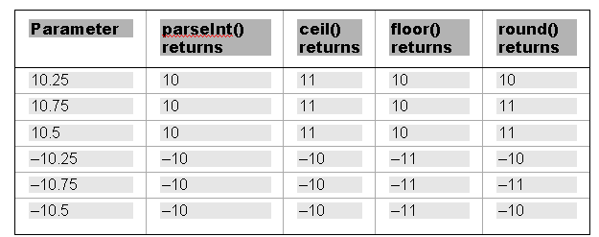
Math Object
Summary of Rounding Methods:
Notes:
The ceil(), floor(), and round() methods all remove the numbers after a decimal point and return just a whole number. However, which whole number they return depends on the method used: floor() returns the smallest, ceil() the highest, and round() the nearest equivalent integer.

Slide 33
Math Object
Method:
random() – returns a random floating-point number in the range between 0 and 1
var myNumber = Math.random() * 7;
alert (myNumber);
Notes:
(Code sample equivalent to book)
The random() method returns a random floating-point number in the range between 0 and 1, where 0 is included and 1 is not. This can be very useful for displaying random banner images or for writing a JavaScript game.

Slide 34
Math Object
Method:
pow() – raises a number to a specific power
var myNumber = Math.pow(2,4);
alert (myNumber);
Notes:
(Code sample equivalent to book)
It takes two parameters, the first being the number you want raised to a power and the second being the power itself.

Slide 35
Date Object
The Date object handles everything to do with date and time in JavaScript.
Notes:
Using the Date object, you can find out the date and time now, store your own dates and times, do calculations with these dates, and convert the dates into strings.

Slide 36
Date Object
Creating a Date object:
var myDate = new Date();
Notes:
You can declare and initialize a Date object in four ways.
In the first method, shown on the slide, you just declare a new Date object without initializing its value. In this case, the date and time value will be set to the current date and time on the computer on which the script is run.
Secondly, you can define a Date object by passing the number of milliseconds since January 1, 1970, at 00:00:00 GMT.
var theDate2 = new Date(949278000000);
Thirdly, you can pass a string representing a date, or a date and time.
var theDate3 = new Date("31 January 2010");
In the fourth and final way, you initialize the Date object by passing the following parameters separated by commas: year, month, day, hours, minutes, seconds, and milliseconds.
For example:
var theDate4 = new Date(2010,0,31,15,35,20,20);

Slide 37
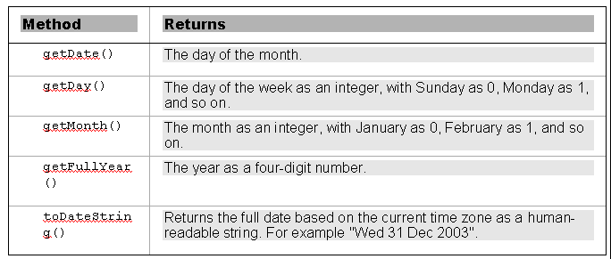
Date Object
Getting Date Values:
Notes:
All of the methods work in a very similar way, and all values returned are based on local time, that is, local to the machine the code is running on.

Slide 38
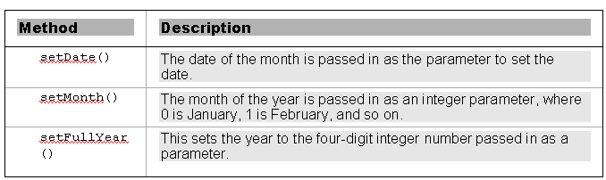
Date Object
Setting Date Values:
Notes:
Note that for security reasons, there is no way for web-based JavaScript to change the current date and time on a user's computer.

Slide 39
Date Object
Getting Time Values:
* getHours()
* getMinutes()
* getSeconds()
* getMilliseconds()
* toTimeString()
Notes:
These methods return, respectively, the hours, minutes, seconds, milliseconds, and full time of the specified Date object, where the time is based on the 24-hour clock: 0 for midnight and 23 for 11 p.m.

Slide 40
Date Object
Setting Time Values:
* setHours()
* setMinutes()
* setSeconds()
* setMilliseconds()
Notes:
These work in a similar way to setting the date, in that if you set any of the time parameters to an illegal value, JavaScript assumes you mean the next or previous time boundary. If it's 9:57 and you set minutes to 64, the time will be set to 10:04, that is, 64 minutes from 9:00.

