Slide 1
Chapter 12
Introduction to Dynamic HTML

Slide 2
Chapter 12 Objectives
What are Web standards?
What are DOM standards?
What is the DOM tree structure?
How do you navigate a document using the DOM tree structure?

Slide 3
What are DOM standards?
The W3C has provided a generic set of objects, properties, and methods that should be available in all scripting languages, in the form of the DOM standard.
Notes:
The Document Object Model (DOM) is a way of representing the document in a browser-independent way. It allows a user to access the document via a common set of objects, properties, methods, and events, and alter the contents of the Web page dynamically, using script.
There are three levels of the DOM standard: Level 1, 2, and 3.
Almost no browser has 100% compliance to any standard, although some, such as Firefox and Opera, come pretty close with the DOM. Therefore, there is no guarantee that all of the objects, properties, and methods of the DOM standard will be available in a given version of a browser, although a few level 1 and level 2 objects, properties, and methods have been available in all the browsers for some time. However, IE6++ and Firefox offer by far the closest compliance so far, with Opera and Safari catching up.
Although the standards might still not be fully implemented, they do provide a guideline as to how a particular property or method should be implemented and a guideline for all browser manufacturers to agree to work toward in later versions of their browsers.

Slide 4
What is the DOM tree structure?
The way that the DOM works is to have a uniform representation of the HTML document. This is achieved by representing the entire HTML document/Web page as a tree structure.
Notes:
It is possible to represent any HTML document as a tree structure. The only precondition is that the HTML document should be well-formed.
While different browsers might be tolerant, to a greater or lesser extent, of quirks such as unclosed tags, or HTML form controls not being enclosed within a <form> element, for the structure of the HTML document to be accurately depicted, you need to be able to always predict the structure of the document. Abuses of the structure, such as unclosed tags, stop you from depicting the structure as a true hierarchy. Accessing elements via the DOM depends on the ability to represent the page as a hierarchy.

Slide 5
What is the DOM tree structure?
The rules for creating trees are simple. You start at the top of the tree with the document and the element that contains all the other elements in the page.
The document is the root node, which contains all other nodes.
The root element in an HTML document should always be the <html > element.
Notes:
A node is just a point on the tree representing a particular element or attribute of an element or even the text that an element contains.
Typically an HTML page will have <head> and <body> elements inside the <html> element. These elements are represented as nodes underneath the root element's node, which itself is underneath the root node at the top of the tree.
The two nodes representing the <head> and <body/> elements are examples of child nodes, and the <html/> element's node above them is a parent node. Since the <head/> and <body/> elements are both child nodes of the <html/> element, they both go on the same level underneath the parent node/<html/> element. The <head/> and <body/> elements in turn contain other child nodes/HTML elements, which will appear at a level underneath their nodes. So, child nodes can also be parent nodes. Each time you encounter a set of HTML elements within another element, they each form a separate node at the same level on the tree.
When you reach an item, such as text, an image, or an element, that contains no others, the tree-structure will terminate at that node. Such a node is termed a leaf node.

Slide 6
How do you navigate a document using the DOM tree structure?
The DOM provides a concrete set of objects, properties, and methods accessible through JavaScript to navigate the tree structure of the DOM.

Slide 7
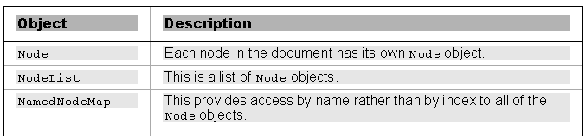
How do you navigate a document using the DOM tree structure?
Base DOM Objects:
Notes:
To move around from HTML element to element, or element to attribute, you have to go from node to node. This also means you can add, replace, or remove parts of your Web page without affecting the structure as a whole, as you're just changing nodes. This is why you have three rather obscure sounding objects that represent your tree structure.

Slide 8
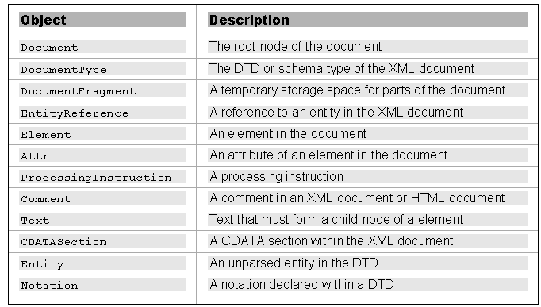
How do you navigate a document using the DOM tree structure?
High-Level DOM Objects:
Notes:
The top of your tree structure is the root node, and that the root node contains the XML declaration, the DTD, and the root element.
The table shows a complete list of all the different node type objects that can be accessed via the DOM. A lot of them may not concern you because they pertain to only XML documents and not HTML documents, but you should notice that your three main types of node, namely element, attribute, and text, are all included.
Each of these objects inherits all the properties and methods of the Node object, but also has some properties and methods of its own.

Slide 9
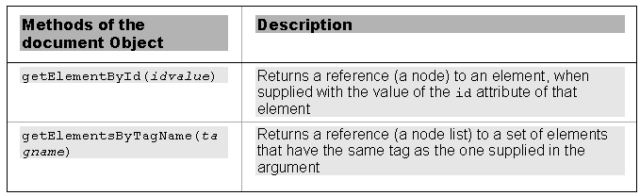
How do you navigate a document using the DOM tree structure?
Useful methods of the document object:

Slide 10
How do you navigate a document using the DOM tree structure?
var H1Element = document.getElementById("Heading1");
H1Element.style.fontFamily = "Arial";
Notes:
The getElementById() method requires you to ensure that every element you want to access in the page uses an id attribute; otherwise, a null value (a word indicating a missing or unknown value) will be returned by this method.
What getElementById() is actually returning is a reference to the element that contains the specified id attribute value.

Slide 11
How do you navigate a document using the DOM tree structure?
var TDElement = document.getElementsByTagName("td").item(0);
TDElement.style.fontFamily = "arial";
Notes:
getElementsByTagName() works similarly to getElementById(), but as its name implies, it can return more than one element.
If more than one element is returned, this object would be a collection of elements. To reference a particular element in the collection, you need to specify an index number, which you do using the item() method.
Like arrays, collections are zero-based, so the first element in the table would correspond to the index number zero.

Slide 12
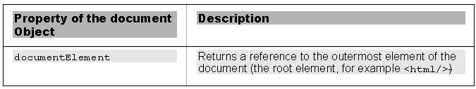
How do you navigate a document using the DOM tree structure?
Useful property of the document object:
Notes:
The tree structure encompasses all of the elements and nodes on the page and gives them a hierarchical structure. If you want to reference that, you need a particular property of the document object that returns the outermost element of your document. In HTML, this should always be the <html/> element. The property that does this is documentElement.

Slide 13
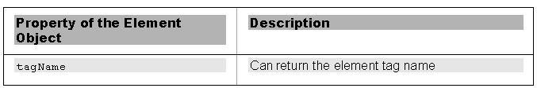
How do you navigate a document using the DOM tree structure?
The one property of the element object:
Notes:
The tagName property of the Element object can be used to return the tag name of an element stored in a variable, e.g.,
var Container = document.documentElement;
alert(Container.tagName);

Slide 14
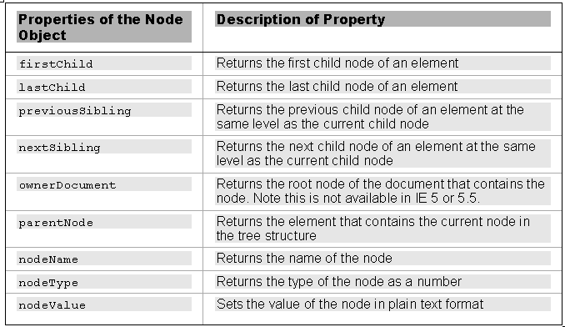
How do you navigate a document using the DOM tree structure?
Useful properties of the Node object:
Notes:
If you want to move through your page systematically, you have to move between nodes in your tree structure.
The table lists some common properties of the Node object that provide information about the node, whether it is an element, attribute, or text, and allow you to move from one node to another.

Slide 15
How do you navigate a document using the DOM tree structure?
var PElement = H1Element.nextSibling;
PElement.style.fontFamily = "Arial";
Notes:
This code uses H1Element to navigate the tree structure, access the contents of the text, and change it.
Note that Firefox, Opera, and Safari count all whitespace as text nodes; therefore, this example won't work in them. In these browsers, any whitespace – tabs, returns, spaces, and so forth – is considered a text node.

Slide 16
How do you navigate a document using the DOM tree structure?
You can navigate through a document's nodes in a cross-browser compatible way by creating a code branch that checks whether a node has a nodeType of 3 (text node) and then moving along to the next node if it does.

Slide 17
How do you navigate a document using the DOM tree structure?
if (headingElement.nextSibling.nodeType == 3)
{
bodyElement = headingElement.nextSibling.nextSibling;
}
else
{
bodyElement = headingElement.nextSibling;
}
Notes:
This code checks to see what the nodeType of the nextSibling of headingElement is.
If it returns 3, it sets bodyElement to be the nextSibling of the nextSibling of headingElement; otherwise, you just set it to the nextSibling of headingElement.
Why do you do this? The answer lies with the implementation of the DOM in Firefox, Opera, and Safari. You would think that the next sibling of the <head/> element in the tree would be the <body/> element, and indeed it is in IE 6+. However, Firefox, Opera, and Safari count all whitespace as nodes in the document. To navigate through the tree in a way that works in both browsers, you check to see whether the next sibling has a nodeType of 3. If it does, it is a text node, and you need to move along to the next node.

Slide 18
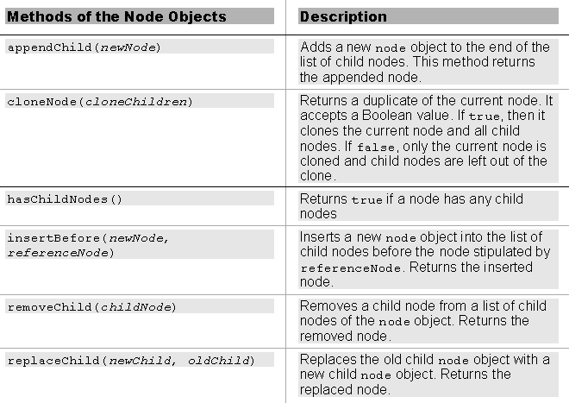
How do you navigate a document using the DOM tree structure?
Useful methods of the Node object:
Notes:
These methods allow you to alter the structure of an HTML document by creating new nodes and adding them to your tree,

Slide 19
Using the DOM
While sticking to the standards provides the best method for manipulating the contents of the web page, none of the main browsers yet implements it in its entirety.

Slide 20
What is DHTML?
DHTML involves one basic concept: dynamically changing a Web page after it is loaded in a browser.
Notes:
There is no DHTML language per se. DHTML is a combination of JavaScript and CSS.

Slide 21
What are the cross-browser issues when using DHTML?
Today's browsers are much more consistent in DHTML support.
The main remaining cross-browser issue when using DHTML are differences in the browser event models.

Slide 22
Events
Events are an important part of DHTML since interactivity is created by responding to events.
For example, a text color change can be displayed in response to the user moving the mouse over a block of text.
Notes:
Most of the time, DHTML code reacts to something that the user did: the content's color changed when they moved their mouse over certain content, a hidden element showed itself when they clicked a specific link, or you popped up a list of words that match the keystrokes the user made.

Slide 23
Events
The main difference in event models is between IE and other modern non-IE browsers.
IE uses a global object called event (or window.event) that keeps track of events.
Non-IE browsers don't have a global event object like window.event; their event object (called event) is a predefined attribute that is passed to the event handlers when the event fires.

Slide 24
IE Events
var myEvent = window.event;
Notes:
When an event fires in IE, the browser populates a global object called event with the data associated with the fired event.
This object has a variety of properties, each containing a specific piece of information that you can use.

Slide 25
IE Events
The type property returns the name of the event, for example, click or mouseover.
if (window.event.type =='click') {
Notes:
Unlike event handlers, the names of events do not have the "on" prefix

Slide 26
IE Events
The srcElement property returns the name of the HTML element that receives the event.
<a href="myPage.htm" onclick="myFunction()">Click Me</a>
Notes:
In this code sample, the <a> element receives the click event.

Slide 27
Non-IE Events
<p onmouseover="myHandler(event)">
My paragraph.</p>
function myHandler(evt) {
Notes:
Even though the implementation between the IE and the non-IE browsers differ, the basic principles are the same. Unlike IE, however, non-IE browsers do not have a global event object that keeps track of the events. Instead, it is in the hands of developers to access the event.
In first code sample, the event is explicitly passed to myHandler( ). event contains a reference to the current event object and is an attribute that's used only with event handlers connected through HTML attributes, e.g., onmouseover.
The event object passed to the event handlers must be named event; otherwise, the code will not work.
It is important not to confuse this event object with IE's event object. They may share the same name, but the similarities almost end there. Non-IE browsers do not have a global event object like window.event; their event object is a predefined attribute that is passed to the event handlers when the event fires.
Because the event object is now being passed to the myHandler() function, the function definition must accommodate this functionality:
function myHandler(evt) {
This code simply adds an argument, called evt, to the function, which allows easy access to the event object passed to the function.

Slide 28
Non-IE Events
if (evt.type=='click') {
Notes:
Not many differences separate this code from the code used previously in the IE-specific example. The only difference is how the type property is accessed. IE uses the window.event object, and the non-IE browsers use the implicit event object that is passed to the event handler.

Slide 29
Non-IE Events
The target property retrieves the HTML element that received the event.
function image_eventHandler(evt) {
var eventTarget = evt.target;
eventTarget.src = "o.gif";
}
Notes:
When an event fires, it is useful to know what element the event fired on. IE grants developers access to this information with the srcElement property. The other browsers' event object does not support this specific property, but it does have the target property.

