Slide 1
NodeJS
Info 6150
Source: TutorialPoint

Slide 2
Introduction
Node.js is a server-side platform built on Google Chrome's JavaScript Engine (V8 Engine). Node.js was developed by Ryan Dahl in 2009.
Node.js applications are written in JavaScript, and can be run within the Node.js runtime on OS X, Microsoft Windows, and Linux.
Node.js = Runtime Environment + JavaScript Library

Slide 3

Features of Node JS
Asynchronous and Event Driven − All APIs of Node.js library are asynchronous, that is, non-blocking. It essentially means a Node.js based server never waits for an API to return data. The server moves to the next API after calling it and a notification mechanism of Events of Node.js helps the server to get a response from the previous API call.
Very Fast − Being built on Google Chrome's V8 JavaScript Engine, Node.js library is very fast in code execution.
Single Threaded but Highly Scalable − Node.js uses a single threaded model with event looping. Event mechanism helps the server to respond in a non-blocking way and makes the server highly scalable as opposed to traditional servers which create limited threads to handle requests. Node.js uses a single threaded program and the same program can provide service to a much larger number of requests than traditional servers like Apache HTTP Server.
No Buffering − Node.js applications never buffer any data. These applications simply output the data in chunks.
License − Node.js is released under the MIT license.

Slide 4

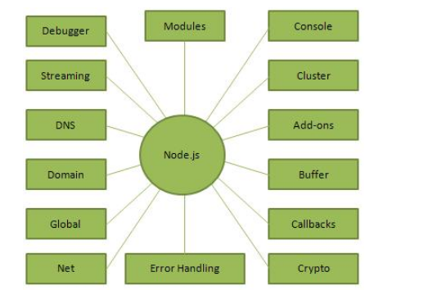
Overview
The diagram depicts some important parts of Node.js

Slide 5
Where to Use Node.js?
I/O bound Applications
Data Streaming Applications
Data Intensive Real-time Applications (DIRT)
JSON APIs based Applications
Single Page Applications
Where Not to Use Node.js?
It is not advisable to use Node.js for CPU intensive applications.

Slide 6
NodeJS Installation
https://nodejs.org/download/
Use the MSI file and follow the prompts to install the Node.js. By default, the installer uses the Node.js distribution in C:\Program Files\nodejs. The installer should set the C:\Program Files\nodejs\bin directory in window's PATH environment variable.

Slide 7
Testing the Installation
Create a js file named main.js on your machine (Windows or Linux) having the following code.
/* Hello, World! program in node.js */
console.log("Hello, World!")
node main.js

Slide 8
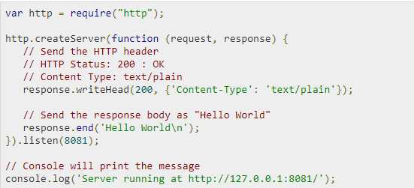
NodeJS application component
Import required modules − We use the require directive to load Node.js modules.
Create server − A server which will listen to client's requests similar to Apache HTTP Server.
Read request and return response − The server created in an earlier step will read the HTTP request made by the client which can be a browser or a console and return the response.

Slide 9
REPL
REPL stands for Read Eval Print Loop and it represents a computer environment like a Windows console or Unix/Linux shell where a command is entered and the system responds with an output in an interactive mode. Node.js or Node comes bundled with a REPL environment. It performs the following tasks −
Read − Reads user's input, parses the input into JavaScript data-structure, and stores in memory.
Eval − Takes and evaluates the data structure.
Print − Prints the result.
Loop − Loops the above command until the user presses ctrl-c twice.
The REPL feature of Node is very useful in experimenting with Node.js codes and to debug JavaScript codes.

