Slide 1

S1 Corporation, Korea
A Pixel-Weighting Method for Discriminating Objects of Different Sizes in an Image Captured from a Single Camera
Mookyung Park, Namsu Moon, Sangrim Ryu,
Jeongpyo Kong, Yongjin Lee and Wangjin Mun

Slide 2

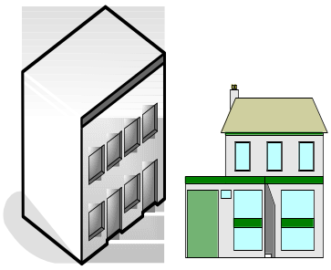

Security Service Flow
Alarm signal
Customer site
Centralized control office
Instruction
Visit
Security agent
Cost ∝ Number of visits

Slide 3
Objectives
PIR sensor
( Passive Infra-Red )
Lacks intelligence
False alarm
Cost ￪
Vision sensor + Image processing
More Intelligence
Stereo : expensive
Single : cost-effective
Single : cost-effective
Object size
← useful feature for discriminating objects
This talk is on a method of how to calculate the size of objects in an image captured from a single camera

Slide 4







Objects in the images
C
C
Object
Object
B
B
Proper weight of pixel
→ Real size of objects
A
B
C
A
B
C
A
A
< Image >
< Surveillance space >
< Image >
< Surveillance space >

Slide 5
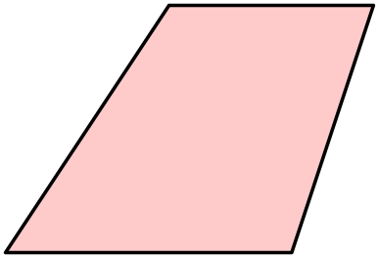
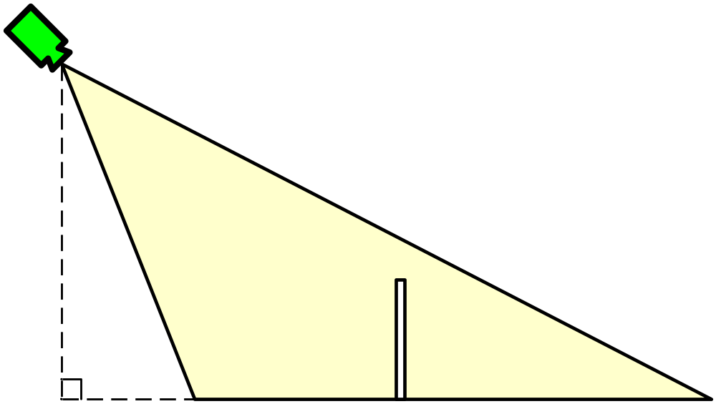
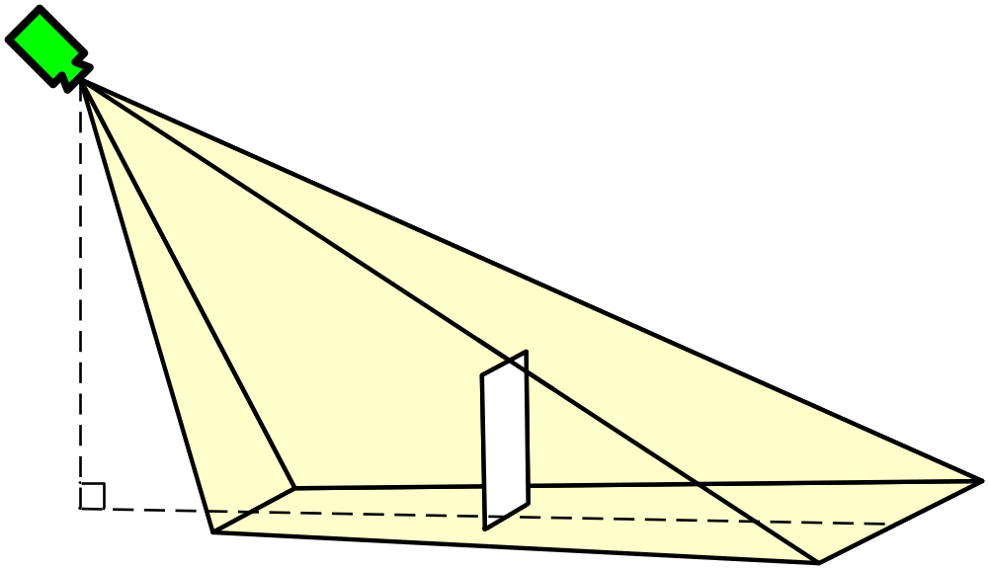
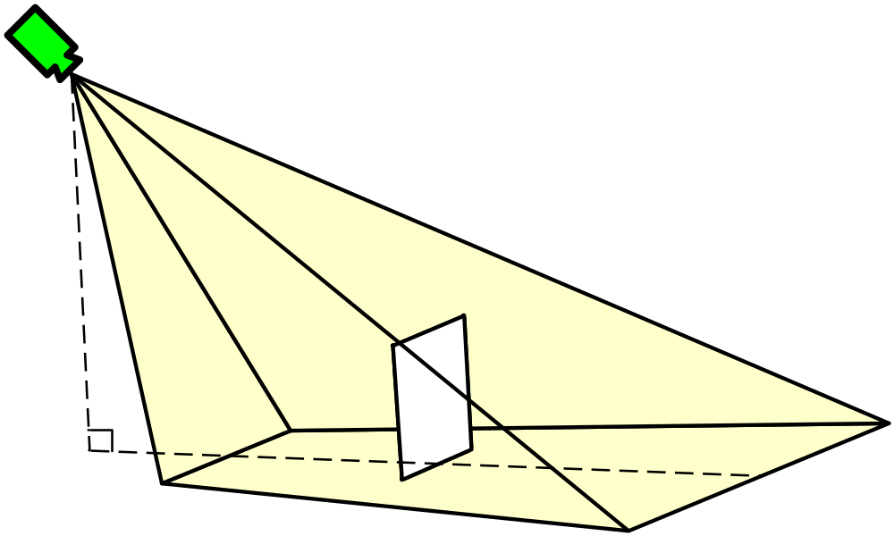
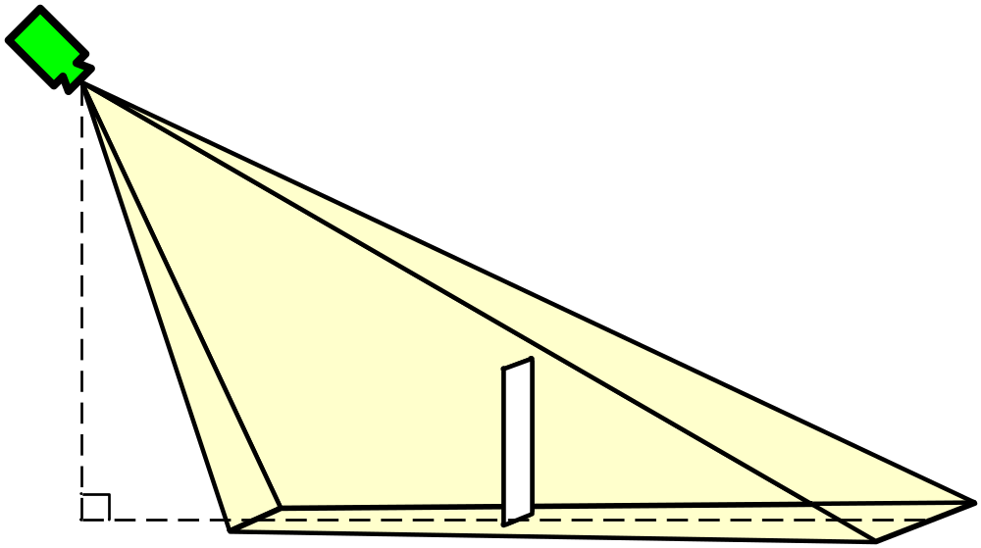
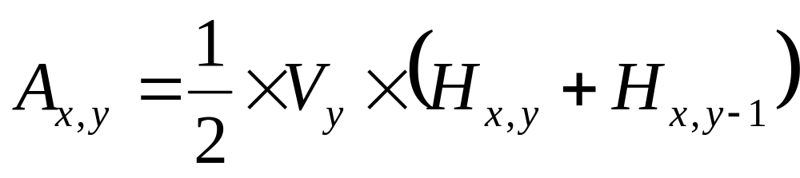

Overview of Calculation
H_{x,y}
V_{y}
H_{x,y-1}
pixel(x,y)
trapezoid
< Surveillance space >
< Image >
< Surveillance space >
< Surveillance space >
< Surveillance space >

Slide 6
Assumptions
1st.
The object is standing perpendicularly to the ground and is not floating in the air.
2nd.
The camera is installed at high location looking down objects like humans.
3rd.
The camera kept in a horizontal position, not tilting to the right of the left.
4th.
The effect of radial distortion of lens does not appear in the image.

Slide 7
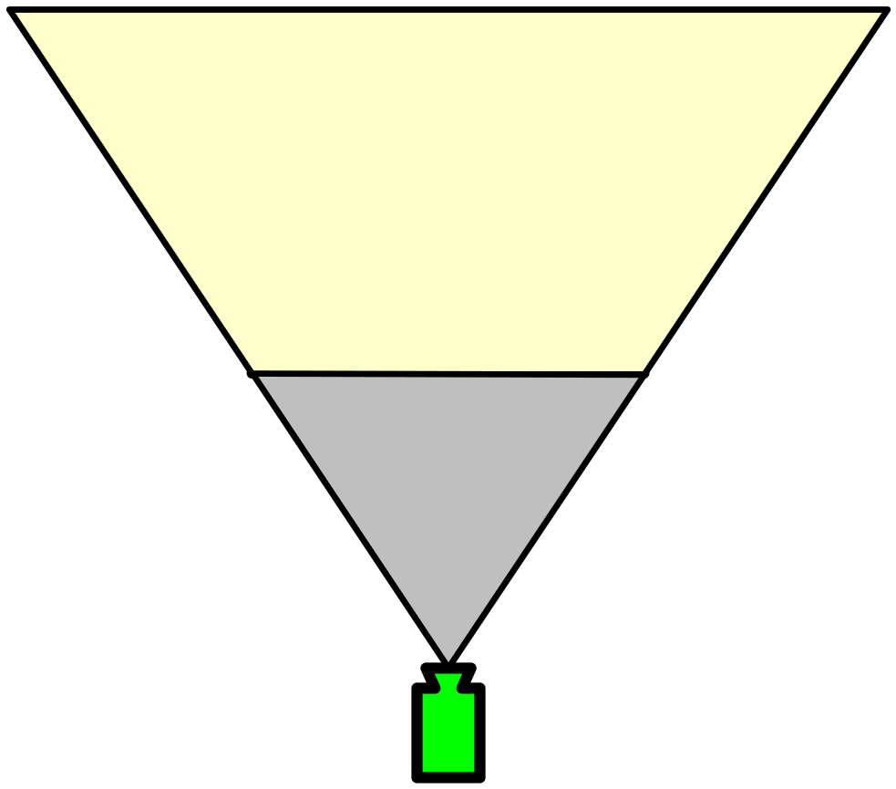
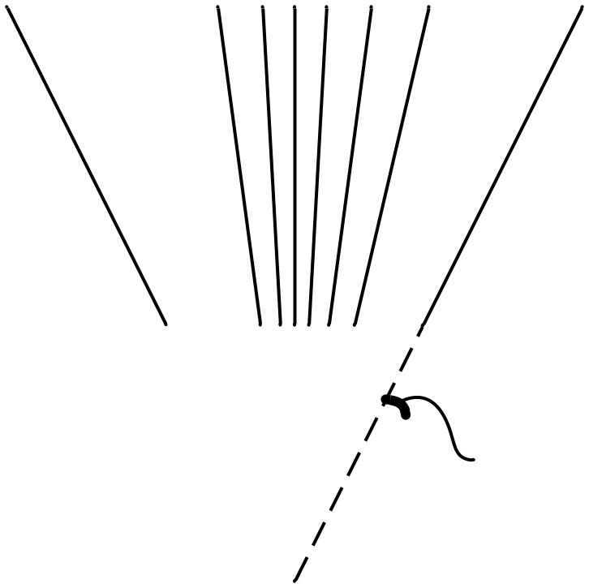
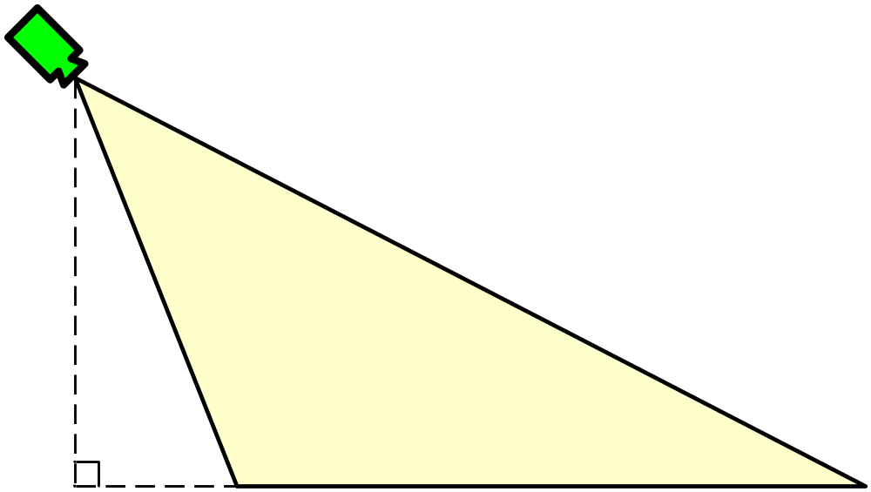
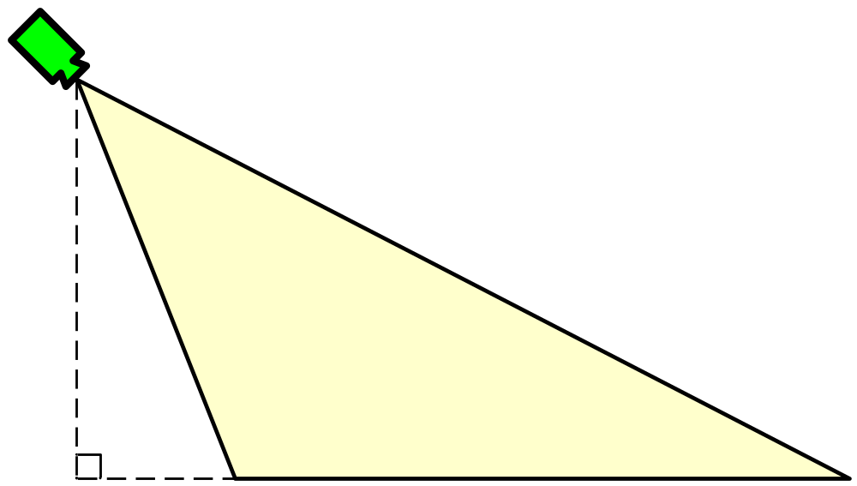
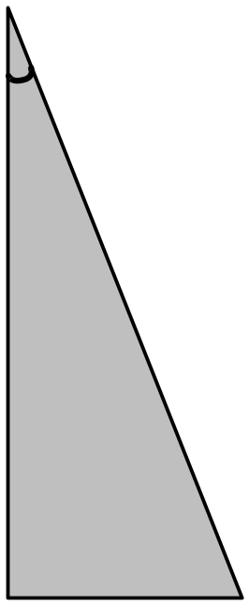
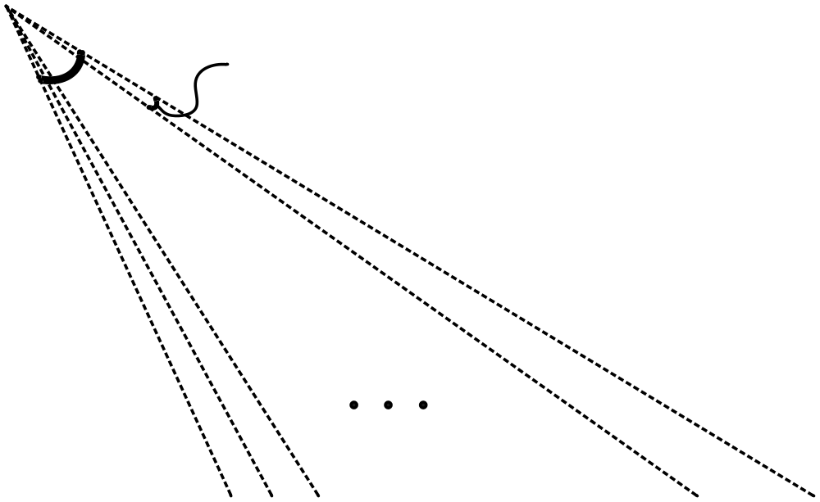

Parameters Required
Even symmetry
W2
W2
W2
2
1
W2
1
2
1
2
3
1
2
3
Blind zone
Vertical angle of view
A_{V}H
A_{V}H
A_{V}
A_{V}
< Top view of the surveillance space >
A_{B}
H
A_{B}
< Parameters >
Blind zone angle
H-1
h_{e}
Camera lens | Horizontal angle of view | A_{H}
 | Vertical angle of view | A_{V}
Installation | Blind zone angle | A_{B}
 | Height of Installation | h_{e}
Image size | Horizontal pixel number | W
 | Vertical pixel number | H
h_{e}
Height of Installation
Vertical pixel number
Blind zone
W2
W2
Blind zone
2
1
1
H
2
3
A_{H}
A_{H}W
A_{H}
Horizontal angle of view
A_{H}W
3
2
1
Blind zone
Horizontal pixel number
W
Blind zone
1
< Image >
1
2
2
3
3
H-1
H-1
H
H
< Top view of the surveillance space >
< Top view of the surveillance space >
< Side view of the surveillance space >
< Side view of the surveillance space >

Slide 8
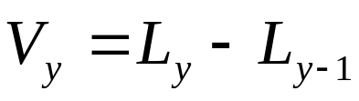
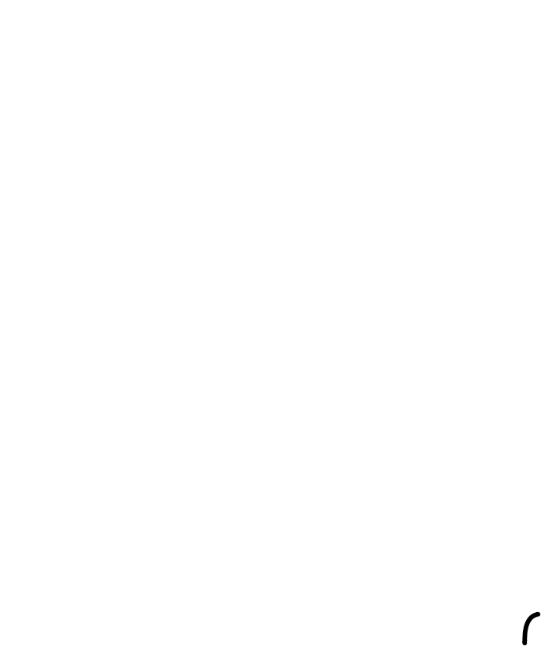
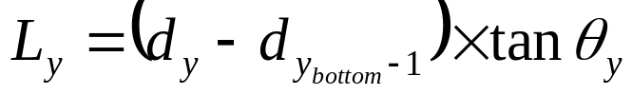
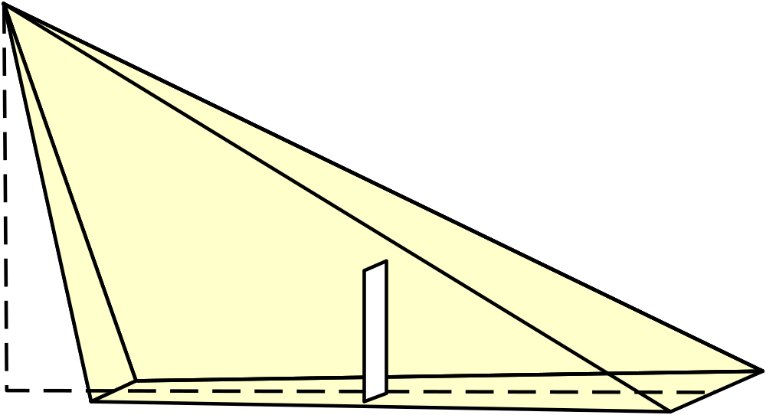
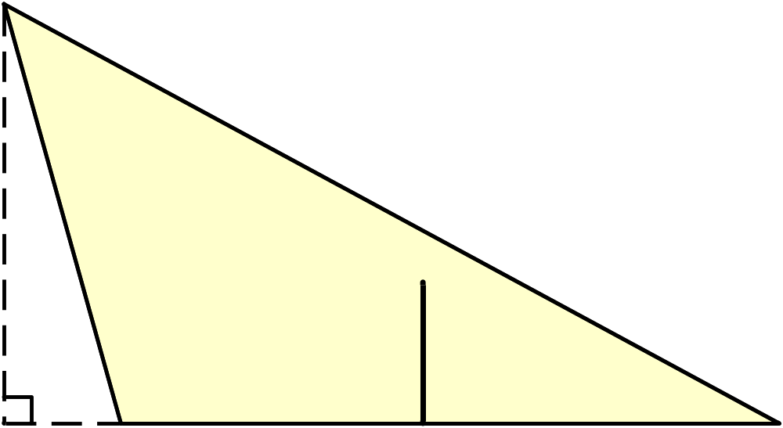
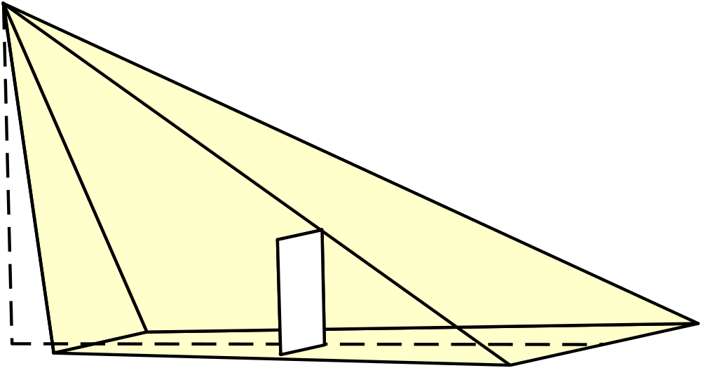
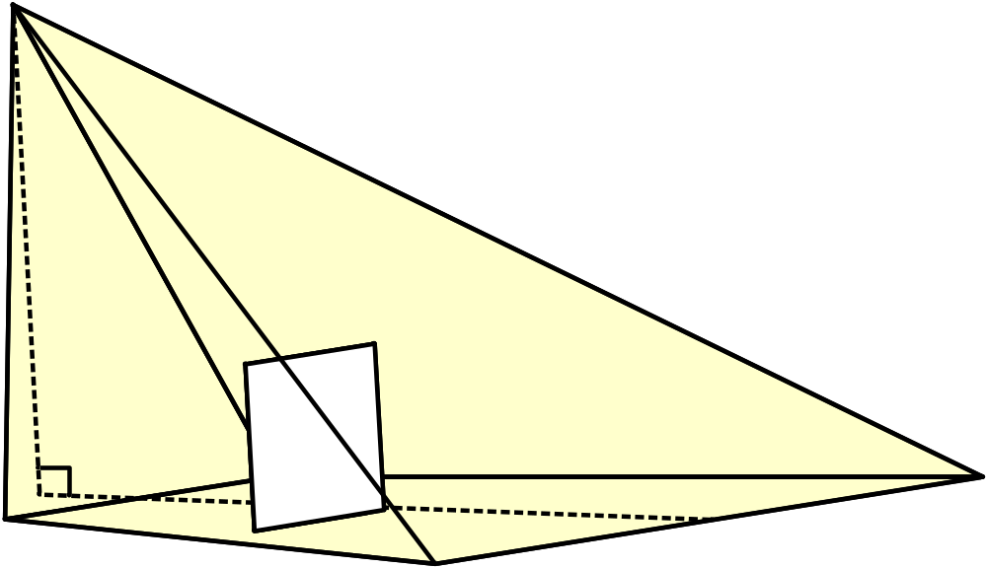
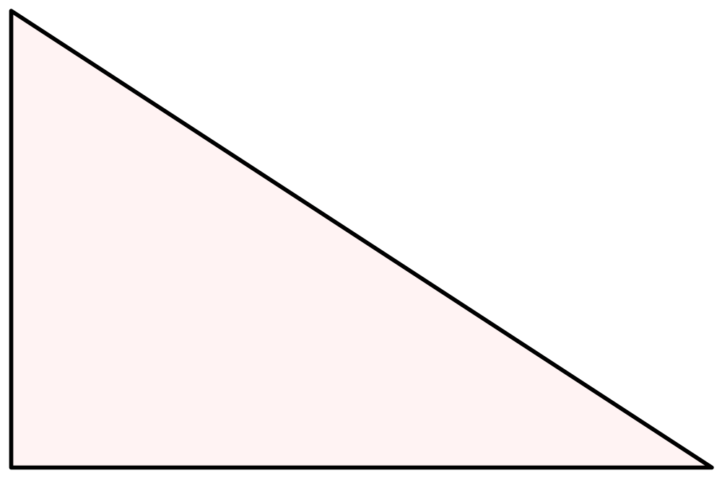
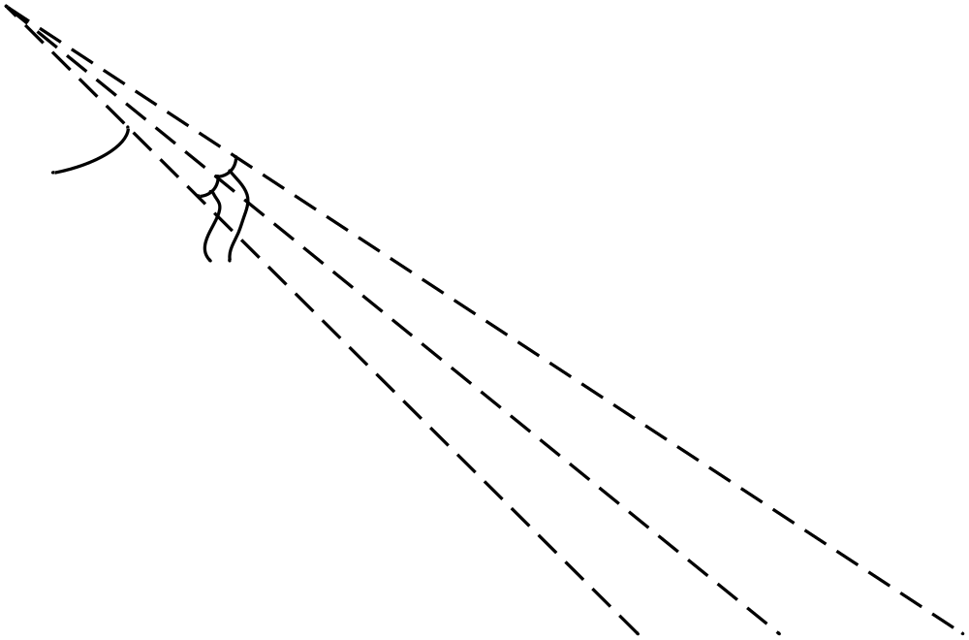
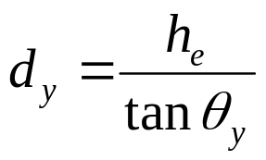

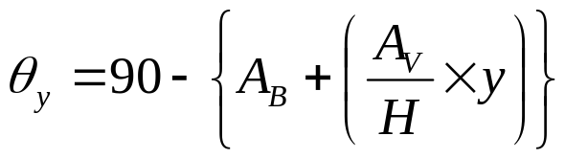
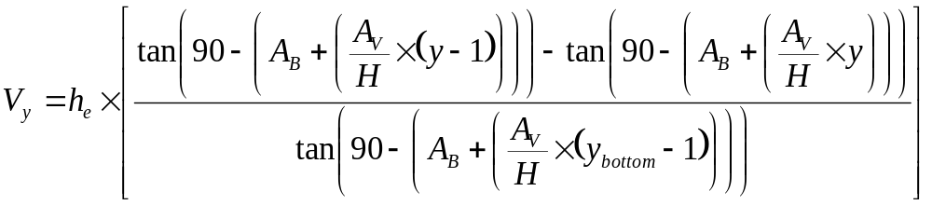
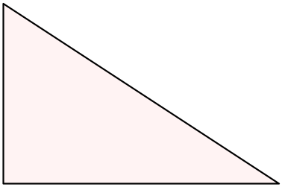





A_{x,y} = ×V_{y} × ( H_{x,y} + H_{x,y-1} )
12
H
y
H
y_{bottom}
A_{V}
2
1
A_{B}
A_{V}H
W
X
y
< Image >
A_{V}H
C_{y}
h_{e}
v_{y}
L_{y}
L_{y-1}
θ_{y}
θ_{y}
θ_{y}

Slide 9
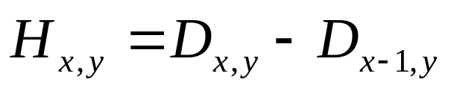
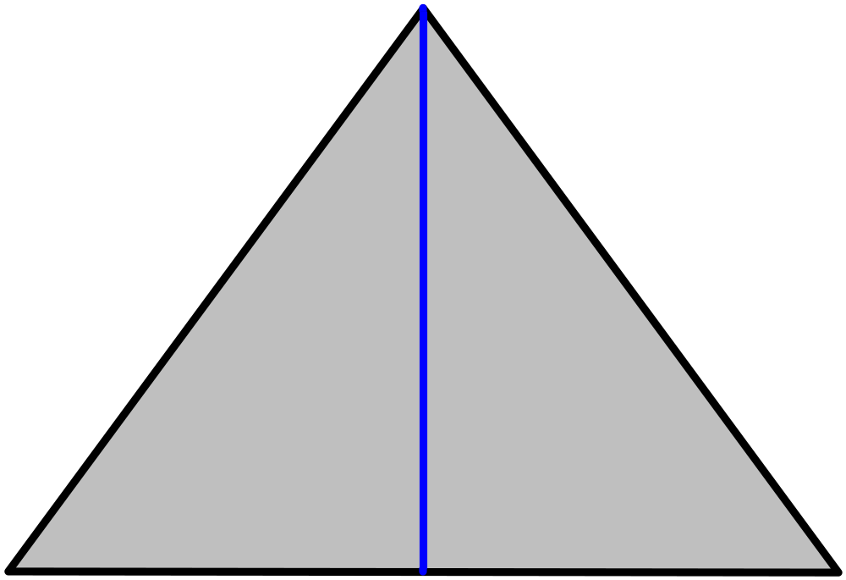
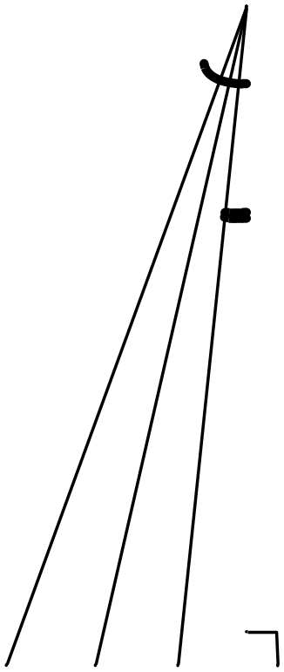
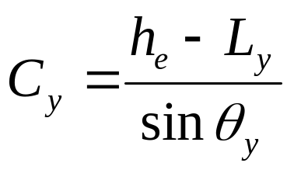
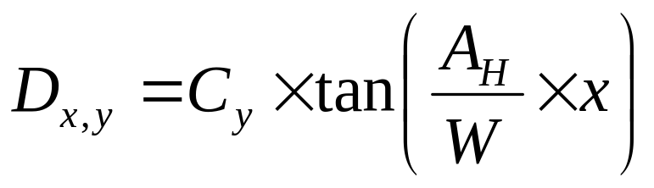
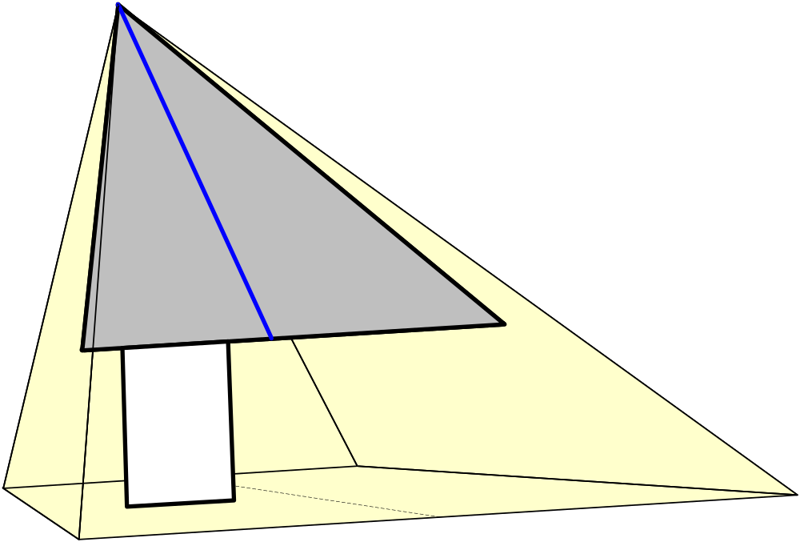
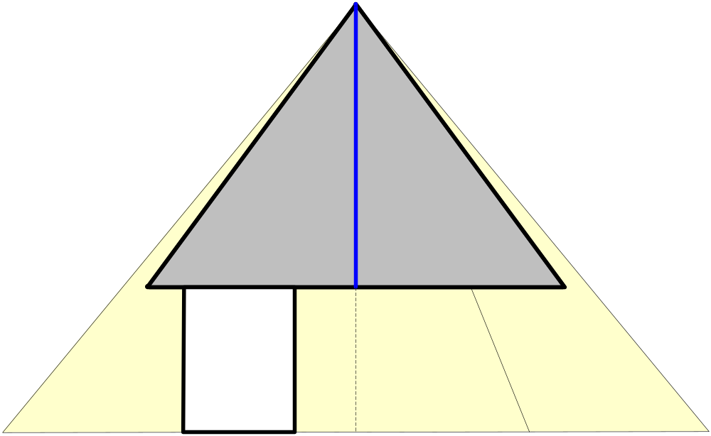
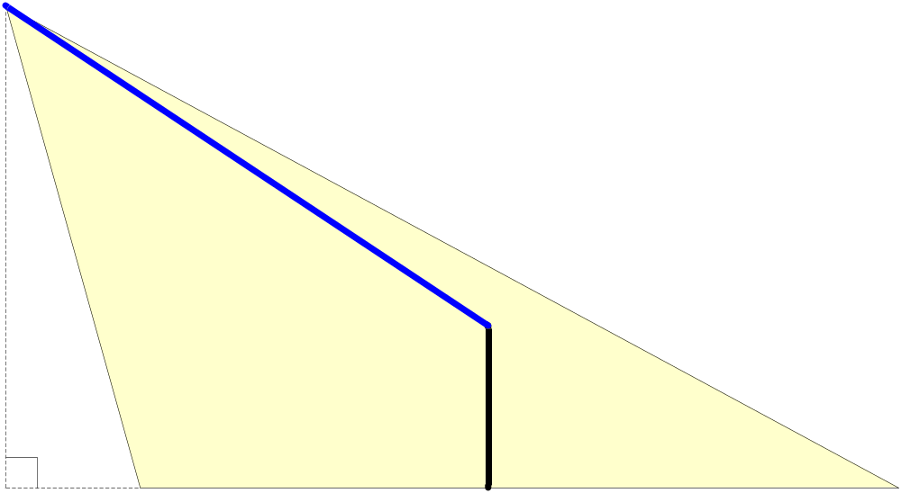
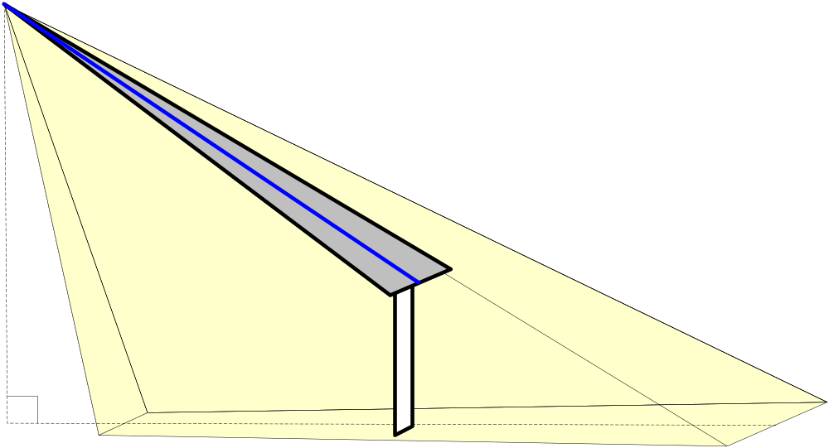
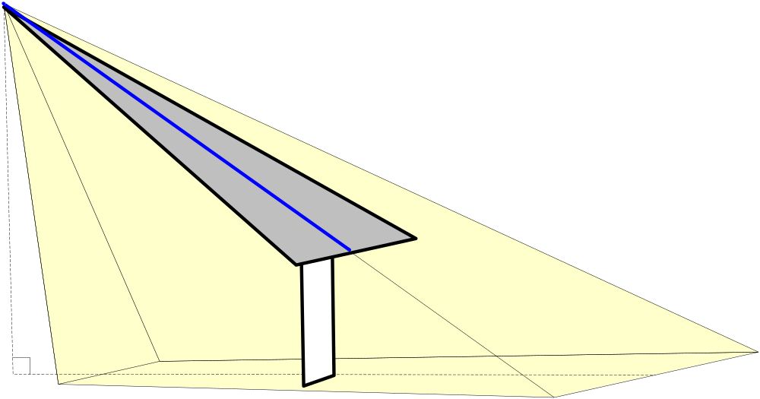
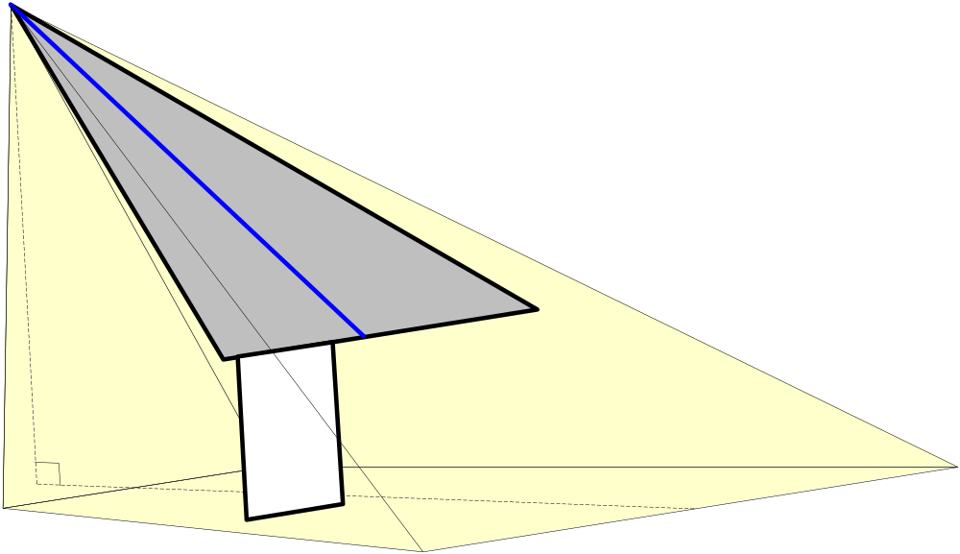
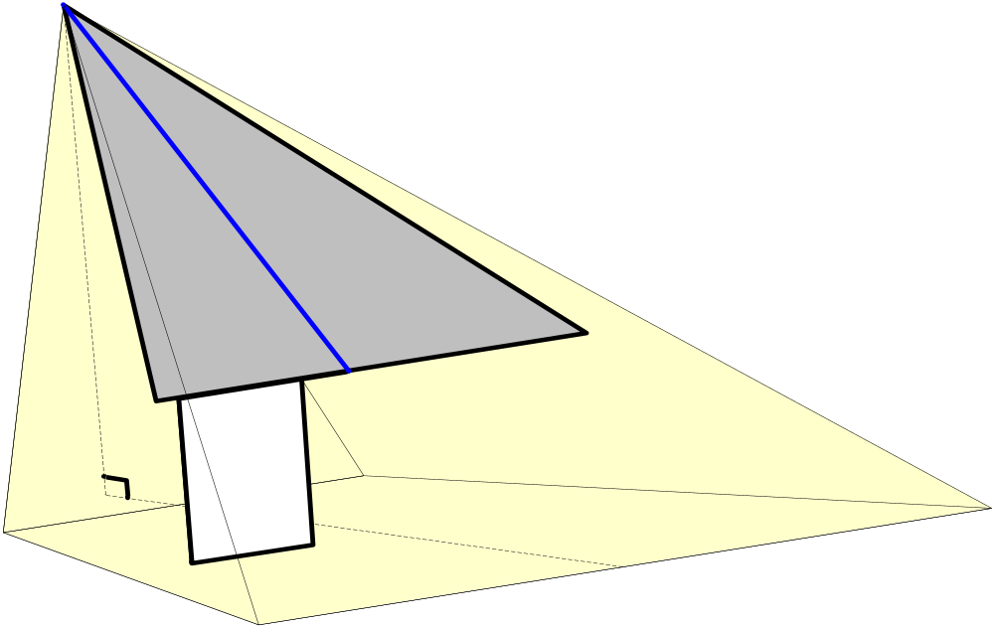
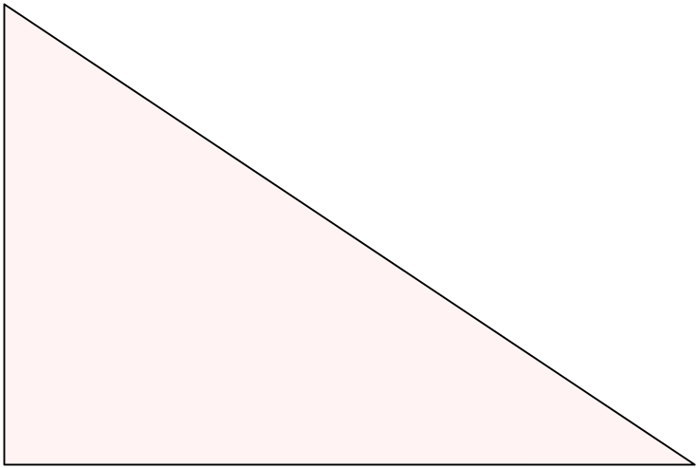
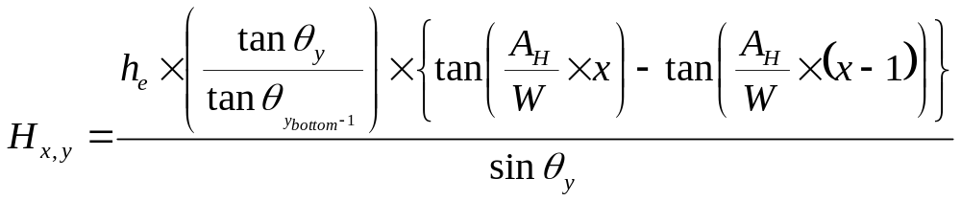

12
A_{x,y} = ×V_{y} × ( H_{x,y} + H_{x,y-1} )
A_{H}2
A_{H}W
C_{y}
C_{y}
C_{y}
C_{y}
C_{y}
C_{y}
C_{y}
h_{e}
C_{y}
θ_{y}
Pixel (x,y)
D_{x,y}
L_{y}
H_{x,y}
D_{x-1,y}
V_{y}
< Image >
H_{x,y-1}

Slide 10
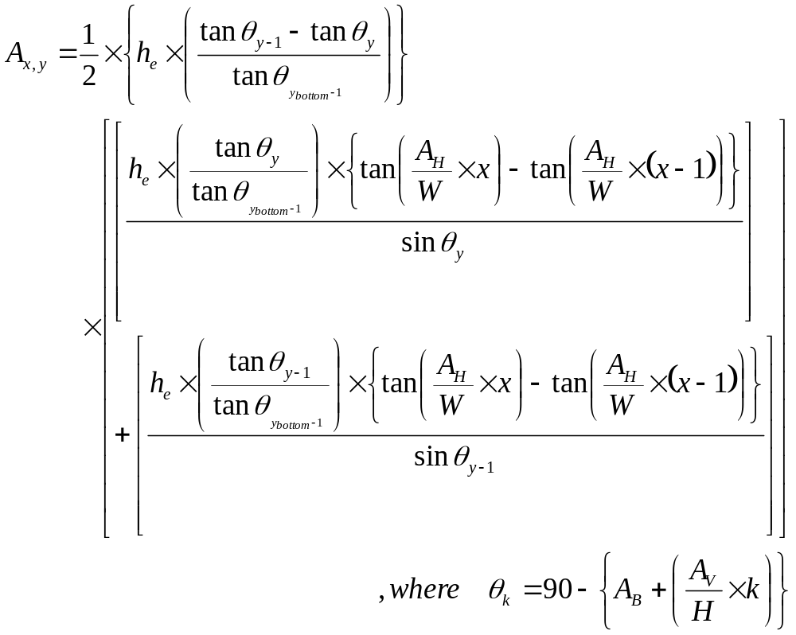
Final Formula Representing the Weight

Slide 11




Experimental Verification
Experimental set-up
Current
image
Reference
image
Difference
Binarization
Labeling
Noise Filter
Weighting

Slide 12










Experimental Results (1)
For the same object
with different locations
a
b
Distance
Pixels
Weight sum
a
2
234
5241
b
3
156
5574
c
c
4
108
5454
d
5
78
5306
d
e
6
62
5821
e

Slide 13





Experimental Results (2)
For objects of different sizes
Human
a
Small animal
Pixels
Weight sum
Small
animal
Human
Small
animal
Human
b
a
88
88
2628
5761
b
56
186
2144
5682
c
35
339
2243
5919
c

Slide 14
Summary
Operational cost caused by false alarms can be significantly suppressed by adopting intelligent vision-based sensors in our security service business
Considering cost-effectiveness, we proposed a method of calculating the size of the object in the image captured from single camera
The calculation of object size requires parameters which are obtained when installing the vision sensor (camera)
Experimental results show that the proposed method produces a useful feature for distinguishing objects of different sizes

Slide 15


