Slide 1
Multiple-Sensor Indoor Surveillance System
Valery A. Petrushin ¹⁾, Omer Shakil ²⁾, Damian Roqueiro ³⁾, Gang Wei ¹⁾, Anatole V. Gershman ¹⁾
Accenture Technology Labs
¹⁾ Accenture Technology Labs, Chicago, IL, USA
²⁾ University of Texas at Austin, Austin, TX, USA
³⁾ University of Illinois at Chicago, Chicago, IL, USA
valery.a.petrushin@accenture.com

Slide 2
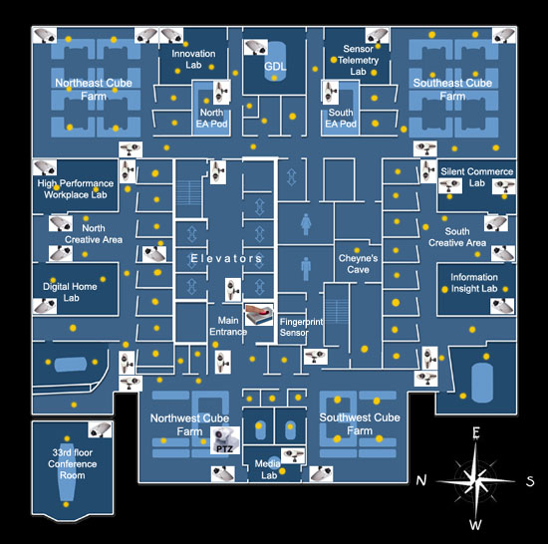
Environment
The whole ATL floor
  Area covered ~18,000 ft² (1,670 m²)
32 AXIS-2100 webcams
  ~ 3-7 Hz sampling rate
Infrared badge system
  91 IR readers
PTZ camera
Fingerprint reader

Slide 3
Multiple Sensor Indoor Surveillance Project
MSIS Objectives:
    Search and browsing the Event Repository database
    Event Classification, Clustering and Visualization
      How to visualize events captured by 32 cameras for 24 hours?
      How to find rare events?
    People Counting
    People Localization -> Awareness Map
    Real-time People Tracking
    People recognition -> Interaction
    Behavior and Activity Understanding

Slide 4
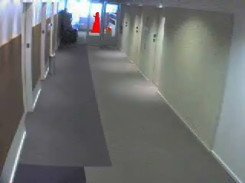
What does a camera see?

Slide 5
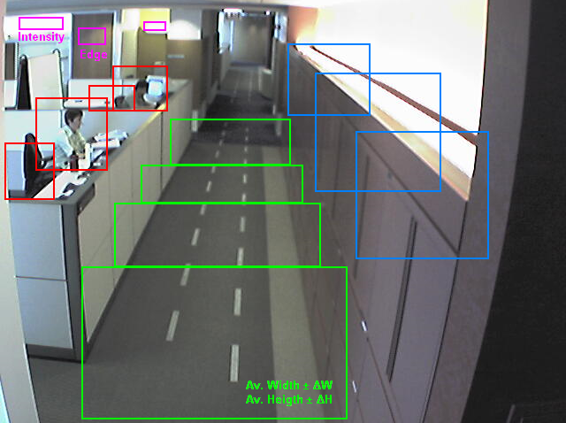
Camera Specification
Operating Zone
BG Model Type
  Single Frame
  Median Filter
Important Areas
Unimportant Areas
Camera Calibration
  Walking Zones
Indicators
  Edge/Intensity/Color

Slide 6
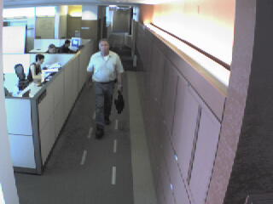
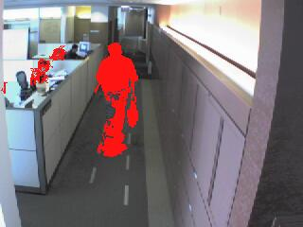
People Localization: Feature Extraction
Features
  Geometric features
  Color-based Appearance Model
    Color Histograms (RGB, YCrCb, etc.)
    Gaussian (Mixture) Models
Blob Extraction
  Merging vertically
  Separating horizontally
Top Model
10%
35%
25%
35%
15%
Bottom Model

Slide 7
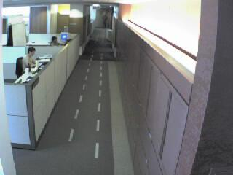
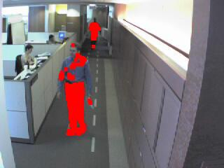
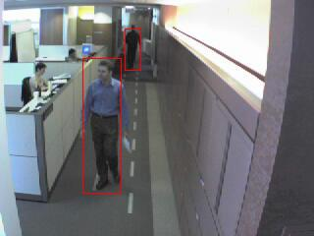
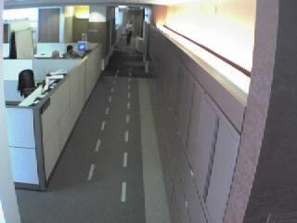
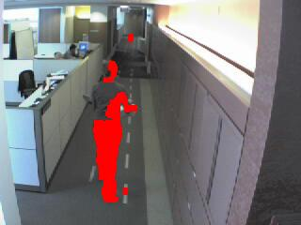
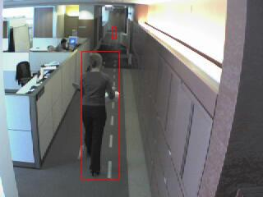
People Localization: Blob extraction
BG Model
→ FG Pixels
→ Merge Vertically

Slide 8
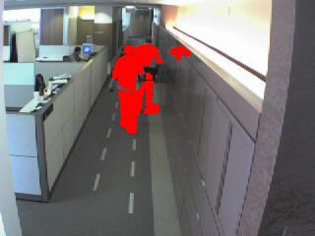
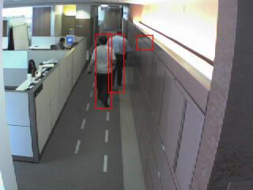
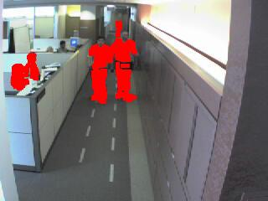
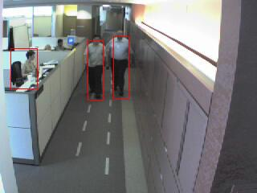
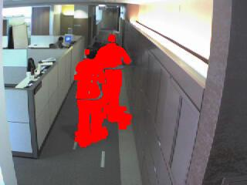
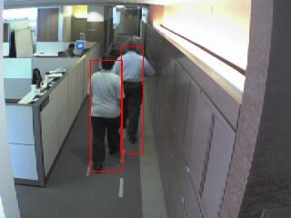
People Localization: Blob separation

Slide 9
Sources of Sensorial Data
Video cameras
    Cover large area
    Relatively reliable
IR badge system
    Covers large area
    Rather precise
    Unreliable
Fingerprint station
    Very precise
    Rare available
Face recognition
    Moderately precise
    Rare available
Human intervention
    Precise
    Expensive
HL₁
IR₁
L₂
L₁
HL₂
L₃
L₅
L₄
HL₃
IR₂

Slide 10

People Localization: Algorithm
- probability H_{i} located at L_{j}
T_{ij}(H_{k}) – transition probability from L_{i} to L_{j} for H_{k}
M (H_{k}, L_{i} , C_{m}) – model for H_{k} at L_{i} and camera C_{m}
Step 1. Map regions (blobs) into locations for each camera
  R_{q} -> < C, x, y, L, e_{q} = { P(R_{q}| M (H_{k}, L , C) } >
Step 2. Merge blobs from different cameras
  E(R_{q} ) = {e_{q1} , e_{q2} , …, e_{qQ} }
Step 3. Get related IR data, estimate likelihood function, map IR location into camera-based locations, add evidence to related objects
  O = {O_{r} }, W= {w_{kr} } k=1,K, r=1,M₀,
  S_{r}={ P(R_{j},L_{k},C_{q}|H_{i},)}

Slide 11
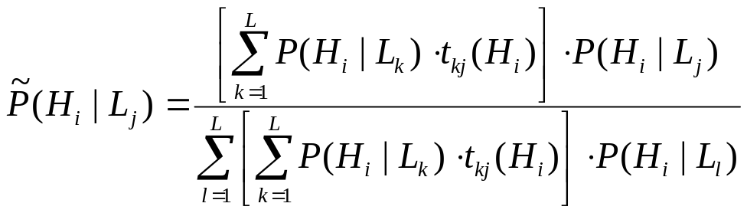
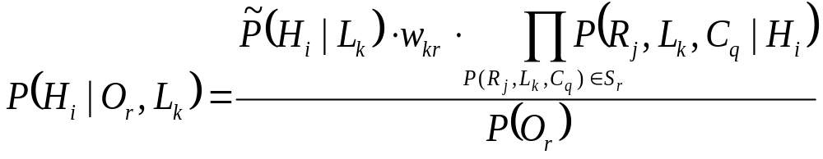
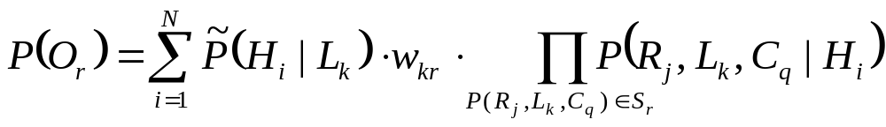
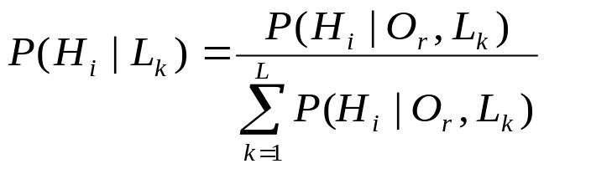
People Localization: Algorithm (cont.)
Step 4. Motion estimation
Step 5. Calculate posterior probability
Step 6. Normalize over locations

Slide 12
People Localization: Experimental Results
Experiments
  4 hours
  15 cameras
  44 IR sensors
  Close set
    15 “known” people
      7 with IR badges
  Open Set
    15 “known” (7 with IR)
    10 “unknown”
Person ID | Closed Set Accuracy |  |  | Open Set Accuracy
 | Single | Cameras and IR badge | Difference | Single | Cameras and IR badge | Difference
 | Camera |  |  | Camera
1000 | 82.14% | 87.56% | 5.42% | 71.39% | 77.31% | 5.92%
1002 | 99.27% | 99.51% | 0.24% | 94.54% | 95.81% | 1.27%
*1003 | 86.88% | 91.07% | 4.19% | 81.91% | 86.10% | 4.19%
1005 | 74.32% | 81.69% | 7.37% | 62.73% | 70.59% | 7.86%
*1006 | 45.98% | 69.68% | 23.70% | 43.78% | 58.58% | 14.80%
*1015 | 44.08% | 41.12% | -2.96% | 26.32% | 26.58% | 0.26%
1020 | 67.03% | 76.71% | 9.68% | 60.75% | 69.24% | 8.49%
*1023 | 64.43% | 60.77% | -3.66% | 59.82% | 58.49% | -1.33%
1024 | 41.26% | 50.72% | 9.46% | 25.08% | 32.78% | 7.70%
*1025 | 69.26% | 78.29% | 9.03% | 57.88% | 66.81% | 8.93%
1026 | 71.06% | 73.66% | 2.60% | 41.34% | 46.19% | 4.85%
*1027 | 62.04% | 73.41% | 11.37% | 58.13% | 67.08% | 8.95%
*1029 | 51.21% | 57.88% | 6.67% | 51.50% | 57.21% | 5.71%
1064 | 77.81% | 83.42% | 5.61% | 44.69% | 51.69% | 7.00%
1072 | 66.07% | 74.49% | 8.42% | 52.53% | 59.67% | 7.14%
Average | 66.86% | 73.33% | 6.47% | 55.49% | 61.61% | 6.12%

Slide 13
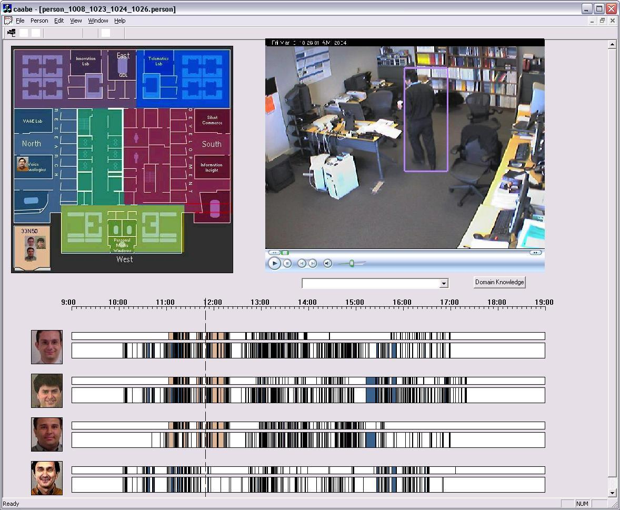
People Localization: Visualization Tool

Slide 14
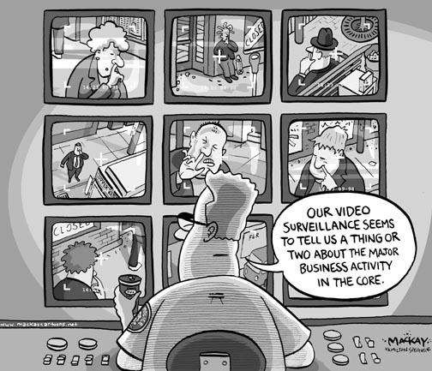
Summary
People Localization
    Multiple sensor integration
      Video cameras
      IR badge ID
      Fingerprint reader
    Camera specification
      Interactive tool
    Bayesian framework
    Visualization tool

Slide 15
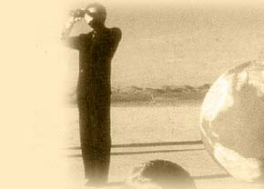
MSIS Future Work
Counting people on the floor
People Tracking
Merging different sensors for people localization
People Recognition and Interaction
Behavior and Activity understanding
  Ontology of video events
  Rare Behavior detection
  Working place statistics
  Instant Event Reminder

Slide 16
Any questions?
Eh???
Merci beaucoup!

