Slide 1

Your watch says 58.
It doesn't tell you why.
58
Wearable tech like Apple watches, Garmins and Oura rings rarely dive deeper into the actual reasons behind their summarized health and sleep scores.
Sleep score / 100
Notes:
The Wearables market has a significant gap today where millions of people wake up to a sleep score but do not get insights as to why the score is as it is
We aim to solve this

Slide 2

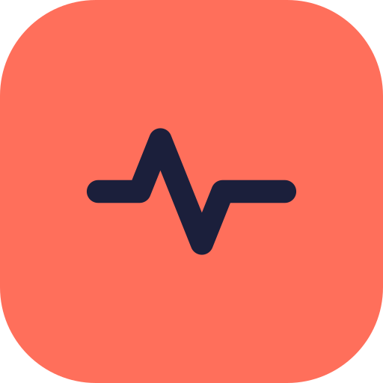

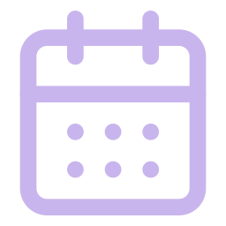


Maps
ROADMAP
Live Location + History
We are StressLess.
Wearable
Health, Training and Sleep Metrics
EVERY MORNING
The wearables measures, and we help you make sense of it
Output
Explaining the reasons for the score with evidence and confidence
Calendar
Gives Context for your day
Millions of people check a sleep score every morning and learn nothing from it. We turn that score into a reason and a fix by reading it next to the day they actually had.
Phone
Screen Time + App Usage
Media
Music & Media Consumption
Notes:
So basically we are stressless and we take different sources of data points such as your data from your wearbale, calendar, phone and media and bundle the data and use statistical methods and LLMS to both calculate a sleep score and give a reasoning behind it

Slide 3



Wearable users wonder what their day does to their sleep, but can’t check it.
PROBLEM AND SOLUTION
THE PROBLEM
WHAT WE HEARD IN OUR INTERVIEWS
HOW STRESSLESS SOLVES IT
“Towards the end of the quarter I get much worse sleep. I can see it on my Oura Ring, the scores just drop.”
Connect
The score never says why
Reads wearable, calendar and phone automatically. No daily logging.
Initial hypothesis
Sales, Oura Ring
Explain and act
“Whether it’s the flight, the late dinner or the 7 am prep call. They all come together on Monday.”
Up to four likely causes, plus one change you control.
Too many causes to untangle
Initial hypothesis
Strategy consultant, Apple Watch
Finds correlations
AI writes your report
“Everyone has a different ring or watch, so the comparison is unfair.”
Compare
Comparisons are unfair
Score calculated based on raw data, so every device is fair.
New finding from interviews
Business developer who runs office health challenges
StressLess
5
Notes:
Basically there are three reasons that current solutions in the market do not address the gaps that we have identified through our market research
The first gap is as I mentioned that the score never says why and how we solve this is by connecting to your various data sources in order to provide an explanation
The second gap is there are essentially too many factors that can affect your sleep score and no solution focuses on this. What we do is to identify four likely causes during your day and give you one suggestion that you can implement into your schedule
The third gap is that comparisons are unfair across different devices, so you essentially cannot compare scores across different brand. And we solve this by using internal methods to score based on the raw data so that every device is fair and comparable

Slide 4
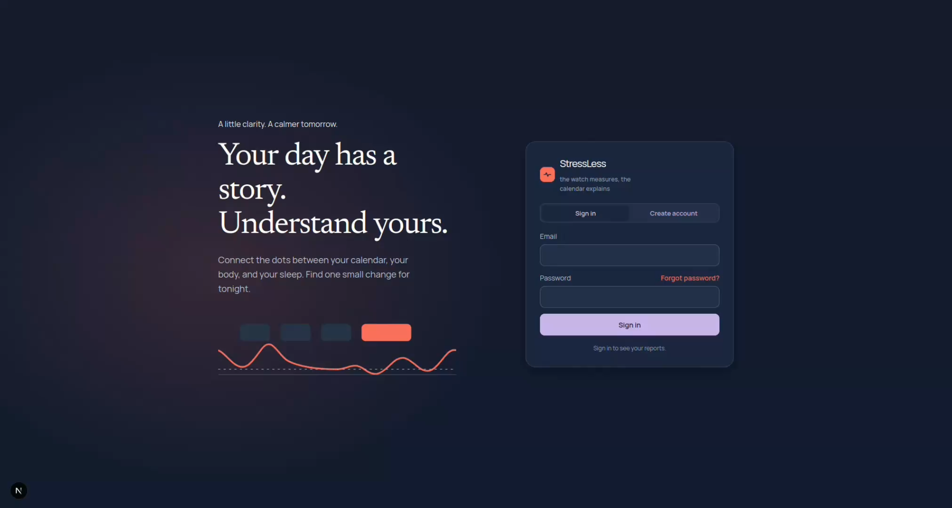
Demo
LIVE DEMO
Notes:
HUGO:
First we arrive at the login page, where you access your account. Next, you need to connect your various data sources, which you do here.
Then we arrive at the daily report page, where you can see the insights from the last 24 hours. Here you can enter some information for your coffee and alcohol consumption, which can then also be used to generate your report.
DAILY:
The report can look something like this, and provide specific insights, such as these, with leadership presentations showing a spike in heart rate, and listening to Metallica correlating with a higher resting heart rate during sleep.
Next we also offer some identified patterns and the sleep stages. And then comes the bpm and calendar events over the last 24 hours.
Finally when the platform can't use location data to verify certain calendar events, it might ask you to confirm if they actually happened.
WEEKLY:
The weekly report will give similar insights, but for the past week as a whole instead of just the last 24 hours.
The first section here will combine your heart rate data with various different sources to see which kinds of events, songs or apps had the biggest effect on your heart rate, and can even check which kinds of meetings seemed to affect you the most.
Next we can generate a corresponding weekly report, that will present the most prominent insights from the past week, which might show that days with certain kinds of meetings affected your heart rate or sleep, or that you are affected in your sleep score by deviating from your normal sleep schedule.
Next we show some historical sleep scores, as well as the past weeks sleep scores with the calendar events provided for context.
Finally we present some of the recurring patterns that are identified, which can show for instance that evening workouts has a negative effect on your sleep, while calm workdays correlate with better sleep.

Slide 5

The calendar-dense high performer
TARGET CUSTOMER
WHO THEY ARE
TODAY’S TOOLS FALL SHORT
WHY STRESSLESS FITS BEST
High performers who are interested in tracking their personal data and health
Uses what they already have
Wearables take in no context
Their calendar, wearable and phone. No new hardware.
20–30 meetings a week, often travelling
Works across every brand
Logs a lot of events in their online calendar
A whole office can join, whatever device each person wears.
Owns a wearable and checks their scores daily
Logging apps need daily input
Built for packed weeks
One change they control each morning, from their own data.
Source: interviews with 9 target users, Sep to Nov 2026.
StressLess
7
Notes:
As you can guess our target customer are people who live by their calendars, people who already have all of their meetings booked, scheduled in lunch, dinner, gym, family time etc
And fortunately for us, the current solutions in the market do not take advantage of this as the wearables take in no context from calendars to give out scores
This is why Stressless fits best for this customer segment, for three reasons: 1. we use what they already have, their calendar, wearable and phone so no new hardware is needed
Works acrross every brand, does not matter if you have an apple watch, garmin, oura etc
And it is optimised and designed with users who have packed weeks in mind

Slide 6
Real insights provided to testers. Their feedback guides our plan.
CUSTOMER FEEDBACK
9 early testers · their own wearable and calendar data
WHAT WE FOUND
FEEDBACK | WHAT WE’RE BUILDING
Keep it clean | Only the top four causes
Privacy is paramount | No model training, EU hosting, one-tap delete
Let us compete | Opt-in leaderboard vs. own baseline
Media is fun, not core | Optional fun layer, never required
Work calendars hide details | Employers unlock calendars: our B2B channel
9/9
testers slept worse after meeting-heavy days
6/9
tied worse sleep to specific clients or deadlines
3
wearable brands tested:
Apple Watch, Oura, Garmin
Notes:
So we have tested our product with 9 people and gotten some insights and feedback regarding our product.
We showed for all 9 people that they slep worse after meeting-heavy days and showed evidence that pilot users have worse sleep tied to specific clients or dealdines. With this we gave suggestions on concrete changes they could implement into their schedule over stuff they control over
Feedback we received that we want to highlight as they are important to the customer were: Keep the UX clean and privacy will be key as we handle sensitive data
But an interesting point that we found is that these people are competitive by nature, they wanted to be able to compete with peers and colleagues and against their own baseline which they are not able today
Media feature they found amusing but not core to the experience they were looking for
A challenge that we stumbled upon were that some work calendars were behind a firewall and thus we could get limited context from their calendars, however we have a solution to this issue with out GTM strategy which we will introduce soon

Slide 7
What makes StressLess special?
COMPETITION
Multi-brand support
Context from calendar and phone
No daily logging
Integration simplicity
Why a giant can’t just copy it
Oura Advisor
58 SEK / month
—
—
Neutral across brands
Users have a mixture of products. Apple won’t support Samsung watch.
WHOOP Coach
from 1,940 SEK / year
—
—
Need exclusive access to work context
Most work phones are firewalled so work context such as calendars shows up as “busy” in non-trusted third parties
Garmin Connect+
68 SEK / month
—
—
Original and creative
Bearable, Gyroscope
from 68 SEK / month
partly
partly
—
We mix in-depth health reports with fun and interesting functionalities.
Apple, Google
included
—
—
History that compounds
Every day gives the model more data to improve it’s performance.
StressLess
not yet
Prices are public list prices, checked October 2026.
Notes:
Other platforms do provide subscription based solutions for user to get more insights into their health data
However, they don't offer the same multi-brand support, or provide further context through calendar integration
Another big question is why the giants of Apple and Google etc. can't just copy this product. Come back to the multi-brand support.
Also the mentioned work context issue will apply to them as well, so even if they can produce a software easily, they will still have to manage this issue.

Slide 8

Land with the employer, spread through the industry
GO-TO-MARKET
01
02
03
04
Target employers
Free for 6 months
Word of mouth
More partners
We go to companies whose staff are high performers with dense calendars.
Every employee can use it, at no cost to the employer.
Employees tell peers at similar companies in the same industry, and they want it too.
We sign partnerships with more and more employers in the same industry.
After 6 months
59 SEK per employee a month
IN FOCUS
WHERE WE GO
Tech start-ups
Scale-ups
Stockholm
Nordics
EU + UK
Later
US
Consultancies
Home market
Closest markets first
Country by country
Gradually, once the employer offer is proven
Same profile in every market
GDPR is pivotal: built in from day one, reused across Europe
StressLess
8
Notes:
So the way we will solve this is by partnering with key employers to get past the firewall. This will be empliyers who fit our ideal target customer
Then we will pilot it for free for a period of 6 months to build a business case and showcase that their employees are enjoying the product and are seeing real health-benefits and productivity levesls
If we partner with certain employers and get their employees using this, they will see that they enjoy this product. They will talk to their friends, and this will spread to other businesses, where they will also ask their employers or show interest to their employers that this is something they want.
And this in turn will lead to more partners

Slide 9


Available for everyone. Focus on employees.
BUSINESS MODEL
1 · Individuals
2 · Employers
99 SEK
59 SEK
for individuals
per employee / month
Regular daily and weekly reports.
Work calendar allowed on managed devices.
COST OF REVENUE
COMPETITOR PRICING
~36 000 SEK
≈ 60 to 290 SEK
per month, including hosting of LLM, backend, payment services etc.
per month our users already pay for device subscriptions
GROSS MARGIN
60%
improves
StressLess
10
Notes:
We will also have a business model that incentivizes this by allowing discounts so that companies can easily offer this as part of their benefits package for well-being

Slide 10
A promising market
MARKET SIZE
TAM
≈ 360 BSEK
TAM
All wearable users globally, approximately 500 million (Omdia, 2025) with a 720 SEK health app subscription as well
SAM
≈ 36 BSEK / year
SAM
About 50M wearable-owning knowledge workers worldwide with full calendars, at 720 SEK a year.
SOM
≈ 360 MSEK
SOM
1% of SAM
StressLess
9
Notes:
We have done some market sizing research for this as well, and have found there to be roughly half a billion wearables users in the world.
We also estimate that roughly 10% of these people also heavily use their calendars, and we will aim to reach 1% of these people.
By applying current market pricing standards, we can estimate this market at 360 MSEK.

Slide 11

Upcoming months
ROADMAP
Months 1–2
Months 1–4
Months 5–6
Months 7–12
After 12 months
Prove it
Build
Grow
Scale
Expand
Field pilot, 5–10 users
iOS app with HealthKit
+100 active users
First paying employers
Training optimization
Second interview round
Outlook calendars
First employer pilot with work calendars
First Nordic offices
EU + UK, then US
Data protection review
Company board, tested
Maps, live location and history
UPCOMING CHALLENGES
Rely on wearables syncing to the phone
Gain trust from partner employers
Dependent on e.g Garmin to sync watch data with the user's phone
Must convince employers and users that we should be trusted with their data
Media connections
Health data is sensitive (GDPR Art. 9)
Media connection still requires manual requesting and importing of data
Explicit consent, impact assessment, EU tenant, zero retention at the AI vendor.
StressLess
12
Notes:
HUGO:
The next 12 months will start off trialing the product with more pilot users, and reaching out to target employers for potential partnerships.
We will also spend these first months building a full platform, where we will deal with the technical challenges that remain.
These will relate to getting a seamless experience with all of the various data sources working right, as well as dealing with the identified data issues.
Next the focus will shift on growth and attracting more users, with the first paying customers arriving in month 7

Slide 12
5.5 MSEK allows us to capture the market
THE ASK
Team: 2.5 FTE + founders
3.67 63%
Privacy and security
0.69 12%
5.5 MSEK
seed ask
Buffer, 15%
0.70 12%
Operations and equipment
0.38 7%
Go-to-market
0.33 6%
12-month spend 5.8 − revenue 0.9 = net burn 4.8 + buffer 0.7 (≈3.6 months) = 5.5 MSEK ask
Notes:
HUGO:
In order to realize this 12-month plan, we are looking for a seed investment of 5.5 MSEK, based on our financial plan, most of which will cover payroll during this development phase, as well as the technological infrastructure needed to meet the data needs.

Slide 13
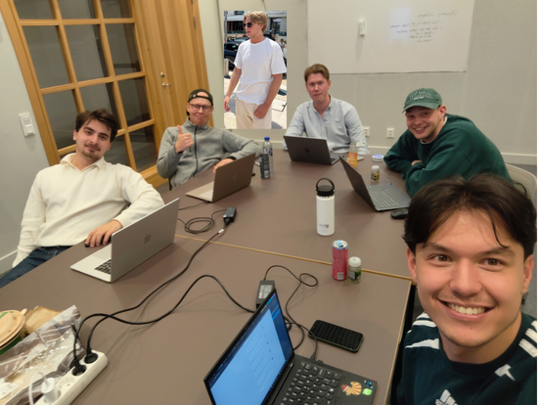


StressLess
Thank you.
Gustaf Salenius
Hugo Ankarcrona
Team photo
Hugo Wigh
Knut Ovesjö
Marcus Pramborg
Nima Tehranchi
contact@stressless.com · stressless-ruddy.vercel.app

Slide 14
Appendix
StressLess
9
Notes:
[~40 s] Wearables are a roughly 900 billion SEK market, growing about 12% a year, and smart rings, the most data-literate users, are the fastest-growing part. Our serviceable market is narrower: wearable owners who are knowledge workers and live in a. Around 50 million people; at 600 SEK a year that's about 30 billion SEK. For serviceable obtainable market we hope to achieve 1% of the serviceable addressable market

Slide 15
5.5 MSEK takes us to 3,200 paying users
THE ASK
Team: 2.5 FTE + founders
3.67 63%
What this buys
Paid launch in month seven
Privacy and security
0.69 12%
M5 First employer pilot live, security review passed
M7 Paid launch: 99 SEK a month, 59 SEK per employee
M12 ≈3,200 paying users and 5 employers
M12 ≈300k SEK MRR at 84% gross margin
5.5 MSEK
seed ask
Buffer, 15%
0.70 12%
Operations and equipment
0.38 7%
Go-to-market
0.33 6%
12-month spend 5.8 − revenue 0.9 = net burn 4.8 + buffer 0.7 (≈3.6 months) = 5.5 MSEK ask
Notes:
HUGO:

