Slide 1
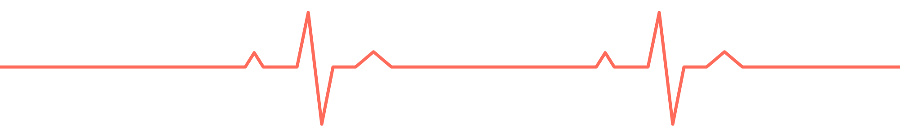
StressLess
A wearables app that connects Google Calendar to the biometric data your watch already collects, to show what in your day is shaping your body and your sleep
Notes:
About 15 seconds. One sentence: your calendar knows what you did, your watch knows how your body responded, nobody connects the two. That is what we want to build. Total pitch target: 5 minutes, then the rest of the slot is for your reactions.

Slide 2
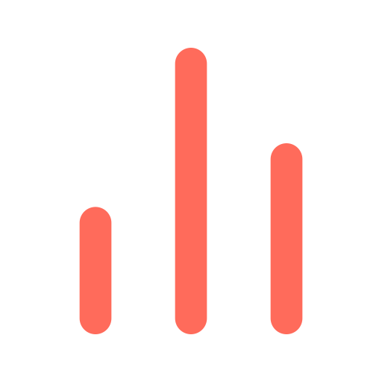

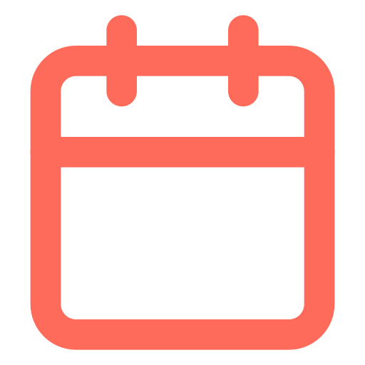
Wearables give you a score. They don't tell you why.
A score without an explanation
45 %
Sleep score 62 this morning. Why? The watch knows how the night went, not what happened yesterday.
Manual journaling doesn't stick
of adults in Sweden report sleep problems
Whoop Journal and Oura tags rely on you filling things in every day. That friction is exactly why people stop.
Public Health Agency of Sweden (Folkhälsomyndigheten), National Public Health Survey 2024. Most report mild problems, but it is almost every second adult.
The context already exists, in your calendar
Meetings, workouts, travel and late dinners are already there with timestamps. Nobody uses them to explain the night.
2
Notes:
About 45 seconds. The number: 45 percent of adults in Sweden report sleep problems in the Public Health Agency's 2024 national survey, mostly mild. The point is not that people lack data. Wearables hand us a score every morning. What is missing is the explanation, and that already sits in the calendar.

Slide 3



The idea: let your calendar explain your body
StressLess connects Google Calendar and Google Maps with the biometric data an Apple Watch already collects, with the user's permission.
Built for people who live by their calendar: every meeting, workout and dinner is booked, and they like it that way.
+
+
+
=
Calendar
what you did
Wearables
how your body reacted
Maps
where you were
Reasoning AI
works out why
Stressless
the explanation
Matches every calendar event to the body's response the same day and the night after.
Checks the calendar against reality: Google Maps location and the body's response show whether the event happened. When they disagree, the app asks: "Did you actually do this?"
Learns over weeks which patterns reoccur: good habits and bad habits, ranked by effect.
Suggests concrete changes you can put straight into the calendar, like protecting 45 minutes before bed.
No logging. The watch measures, the calendar explains.
Why now
Apple Watch now ships a native Sleep Score (watchOS 26). Biometrics are collected passively. The calendar is the richest log of what we actually do.
3
Notes:
About 60 seconds. Two data sources the user already has, connected with their permission. Stress that it is not only heart rate: HRV, sleep stages, respiration, temperature, activity, whatever HealthKit exposes. No new hardware and no journaling. Why now: Apple added a native Sleep Score in watchOS 26, so the score exists, the explanation does not.

Slide 4
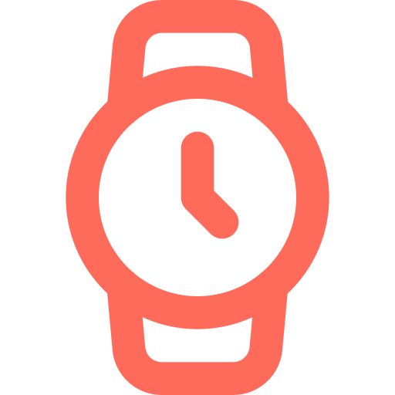
What we connect
From the calendar
From the watch
From Google Maps
Reasoning AI
Meeting density and back-to-back blocks
Early starts and late finishes
Evening social events
Workouts and when in the day they happen
Travel and time zones
Recurring events, in other words your habits
Heart rate during and after events
Resting heart rate and overnight HRV
Respiratory rate and wrist temperature
Blood oxygen, where available
Sleep stages, bedtime and interruptions
Steps, activity and workouts
Sleep score: Apple's, or ours from the same inputs
Where you actually were, event by event
Whether a booked event really happened
Time at the office, at home and in transit
Late nights out and when you got home
Commute length and travel days
When calendar and location disagree, the app asks you
Uses the calendar as context for every change in your biometrics
Reasons about whether the event caused the change, or something else did
Cross-checks with Maps: did the event really happen?
Asks you when the signals disagree: "Did you actually do this?"
Ranks your habits by their effect over weeks
+
+
+
First outcome we explain: your sleep score the next night.
Then recovery markers such as overnight HRV and resting heart rate.
4
Notes:
About 45 seconds. Left: signals we can compute from an ordinary calendar without reading meeting content. Right: everything the watch already measures, not only pulse. We start with the sleep score as the outcome because it is one clear number every morning, then widen to recovery markers like overnight HRV.

Slide 5
What it could look like
MORNING REPORT
WEEKLY INSIGHT
68
sleep score
Three likely causes
Meeting until 20:30. Heart rate 12 bpm above your evening norm until 22:00.
Six back-to-back meetings 13:00 to 17:00. Overnight HRV 14 % below average.
Bedtime 55 minutes later than usual.
Suggestion: protect 21:00 to 22:00 tonight. Add to calendar
Days with five or more meetings scored 14 points lower than calm days. Biggest single factor: meetings ending after 19:00.
Illustrative mock-up with made-up numbers, not measured data.
5
Notes:
About 60 seconds. Two surfaces. The morning report answers why the night went the way it did, with three causes and one suggestion that lands in the calendar. The weekly insight shows the pattern over time. Say clearly that every number here is invented to show the format.

Slide 6



Where we are
So far
Next four weeks
Open challenges
Problem framed, first outcome chosen: sleep score
Mapped what HealthKit can give us beyond heart rate
Two routes to the calendar identified: Google Calendar API or EventKit
Nearest existing apps found: StressFace, Welltory, Whoop and Oura tags
Collect our own data: watch plus calendar, one person each
Interview wearables users about what they would want explained
Decide the calendar route and sketch the morning report
First script that matches events to overnight biometrics
Correlation is not causation, especially with one person's data
The calendar misses coffee, alcohol, screens and unbooked stress
Cold start: value shows up only after weeks of data
Health plus calendar data is a sensitive combination
The watch must be worn as much as possible, limits charging possibilities.
6
Notes:
About 45 seconds. Honest status: we are at the idea stage. Say what is done, what the next four weeks look like, and the challenges we already see. Then invite the room to add to the challenge list. Adjust this slide to the team's actual status before presenting.

