Slide 1
Measurement and Architecture
for a Middleboxed Internet
Introducing the H2020 MAMI project
Özgü Alay, Simula Research Lab
FIRE Forum, Brussels, 9 December 2015

Slide 2
Goals
transport
innovation
Fundamental tension in further development of the Internet architecture:
Necessity of in-network functionality impairs innovation of the protocol stack
Increased encryption obsoletes in-network functionality
New applications need new transports to function efficiently
Approach: develop explicit cooperation between applications and these in-network functions
But first: develop a deeper understanding of the nature of this tension as deployed in the Internet
crypto
network functions

Slide 3
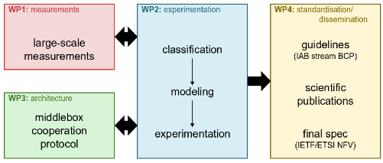
Project
30 months (Jan 2016 - Jun 2018), seven partners, three broad areas of work
Measure prevalence and character of middlebox interference
Develop an architecture and protocols for explicit cooperation between middleboxes and endpoints
Experiment with pilot implementations of this architecture
Strong interaction with relevant standards organizations for impact on deployment
FIRE testbed (MONROE) support for measurement as well as experimentation, especially on mobile broadband access networks
Learn more at http://mami-project.eu/

Slide 4

Consortium
Swiss Federal Institute of Technology (ETH) Zürich, Switzerland (Coordinator)
Telefonica R&D (TID) Barcelona, Spain (Technical Coordinator)
Alcatel-Lucent, Cambridge, England
Simula Research Laboratory, Oslo, Norway
University of Aberdeen, Scotland
University of Liege, Belgium
Zürich University of Applied Sciences Winterthur, Switzerland
https://www.mami-project.eu

