Slide 1
Alexa Lambda Linux (ALL)
Reference Design

Slide 2
Overview
ALL is a HW/SW reference design meant to enable quick prototyping and realization of the control and monitoring of things using Amazon Alexa Voice Services

Slide 3
Features and Benefits
Integrated with Lambda and ASK
Real-time Linux / user space app dev model
Raspberry PI, open source, AWS services
End to end SSL/TLS integration
Quick bring-up of new voice controls
Low effort to control fast real-world events
Low cost and quick deployment
Customer data security

Slide 5
Prototype Output to Terminal
index:39476,Undefined command from panel data: 0x63 0x00 0x00 0x00 0x00 0x00 0x31 0x80
index:39477,LED Status Ready, data: 0x05 0x40 0x80 0xc0 0xe3 0x80 0x00 0x00
index:39478,Undefined command from panel data: 0x5d 0x00 0x00 0x00 0x00 0x00 0x2e 0x80
index:39479,LED Status Ready, data: 0x05 0x40 0x80 0xc0 0xe3 0x80 0x00 0x00
index:39480,Keypad query data: 0x11 0x55 0x55 0x55 0x45 0x55 0x54 0x00
index:39481,From Keypad unknown keypad msg data: 0xff 0x87 0xff 0x80 0x01 0xff 0xfe 0x00
index:39482,LED Status Ready, data: 0x05 0x40 0x80 0xc0 0xe3 0x80 0x00 0x00
index:39483,From Keypad idle data: 0xff 0xff 0xff 0xff 0xff 0xe0 0x00 0x00
server: connection requested from (ec2-54-165-125-70.compute-1.amazonaws.com, 42928)
index:39484,Undefined command from panel data: 0x63 0x00 0x00 0x00 0x00 0x00 0x31 0x80
index:39485,LED Status Ready, data: 0x05 0x40 0x80 0xc0 0xe3 0x80 0x00 0x00
server: client 54.165.125.70 connected with AES256-GCM-SHA384 encryption
server: panel received command pound
index:39486,From Keypad button # pressed data: 0xff 0x96 0xff 0xff 0xff 0xe0 0x00 0x00
index:39487,Undefined command from panel data: 0x5d 0x00 0x00 0x00 0x00 0x00 0x2e 0x80
index:39488,From Keypad idle data: 0xff 0xff 0xff 0xff 0xff 0xff 0xff 0xc0
index:39489,LED Status Ready, data: 0x05 0x40 0x80 0xc0 0xe3 0x80 0x00 0x00
server: connection requested from (ec2-54-165-125-70.compute-1.amazonaws.com, 42929)
server: client 54.165.125.70 connected with AES256-GCM-SHA384 encryption
server: panel received command idle
index:39490,From Keypad unknown keypad msg data: 0xff 0xff 0xff 0xf7 0xff 0xe0 0x00 0x00
index:39491,Undefined command from panel data: 0x39 0x7f 0xff 0xf8 0xbf 0xf8 0x00 0x00
index:39492,Zone4 14, data: 0x3e 0x40 0x80 0xc0 0xe3 0x90 0x14 0x00
index:39493,From Keypad idle data: 0xff 0xff 0xff 0xff 0xff 0xff 0xff 0xc0
index:39494,LED Status Not Ready, data: 0x05 0x40 0x01 0xc0 0xe3 0x80 0x00 0x00
index:39495,From Keypad unknown keypad msg data: 0xff 0xff 0xff 0xf7 0xff 0xe0 0x00 0x00
index:39496,Undefined command from panel data: 0x39 0x7f 0xff 0xff 0xff 0xff 0x80 0x00
Note connections to AWS Lambda triggered by Alexa

Slide 6
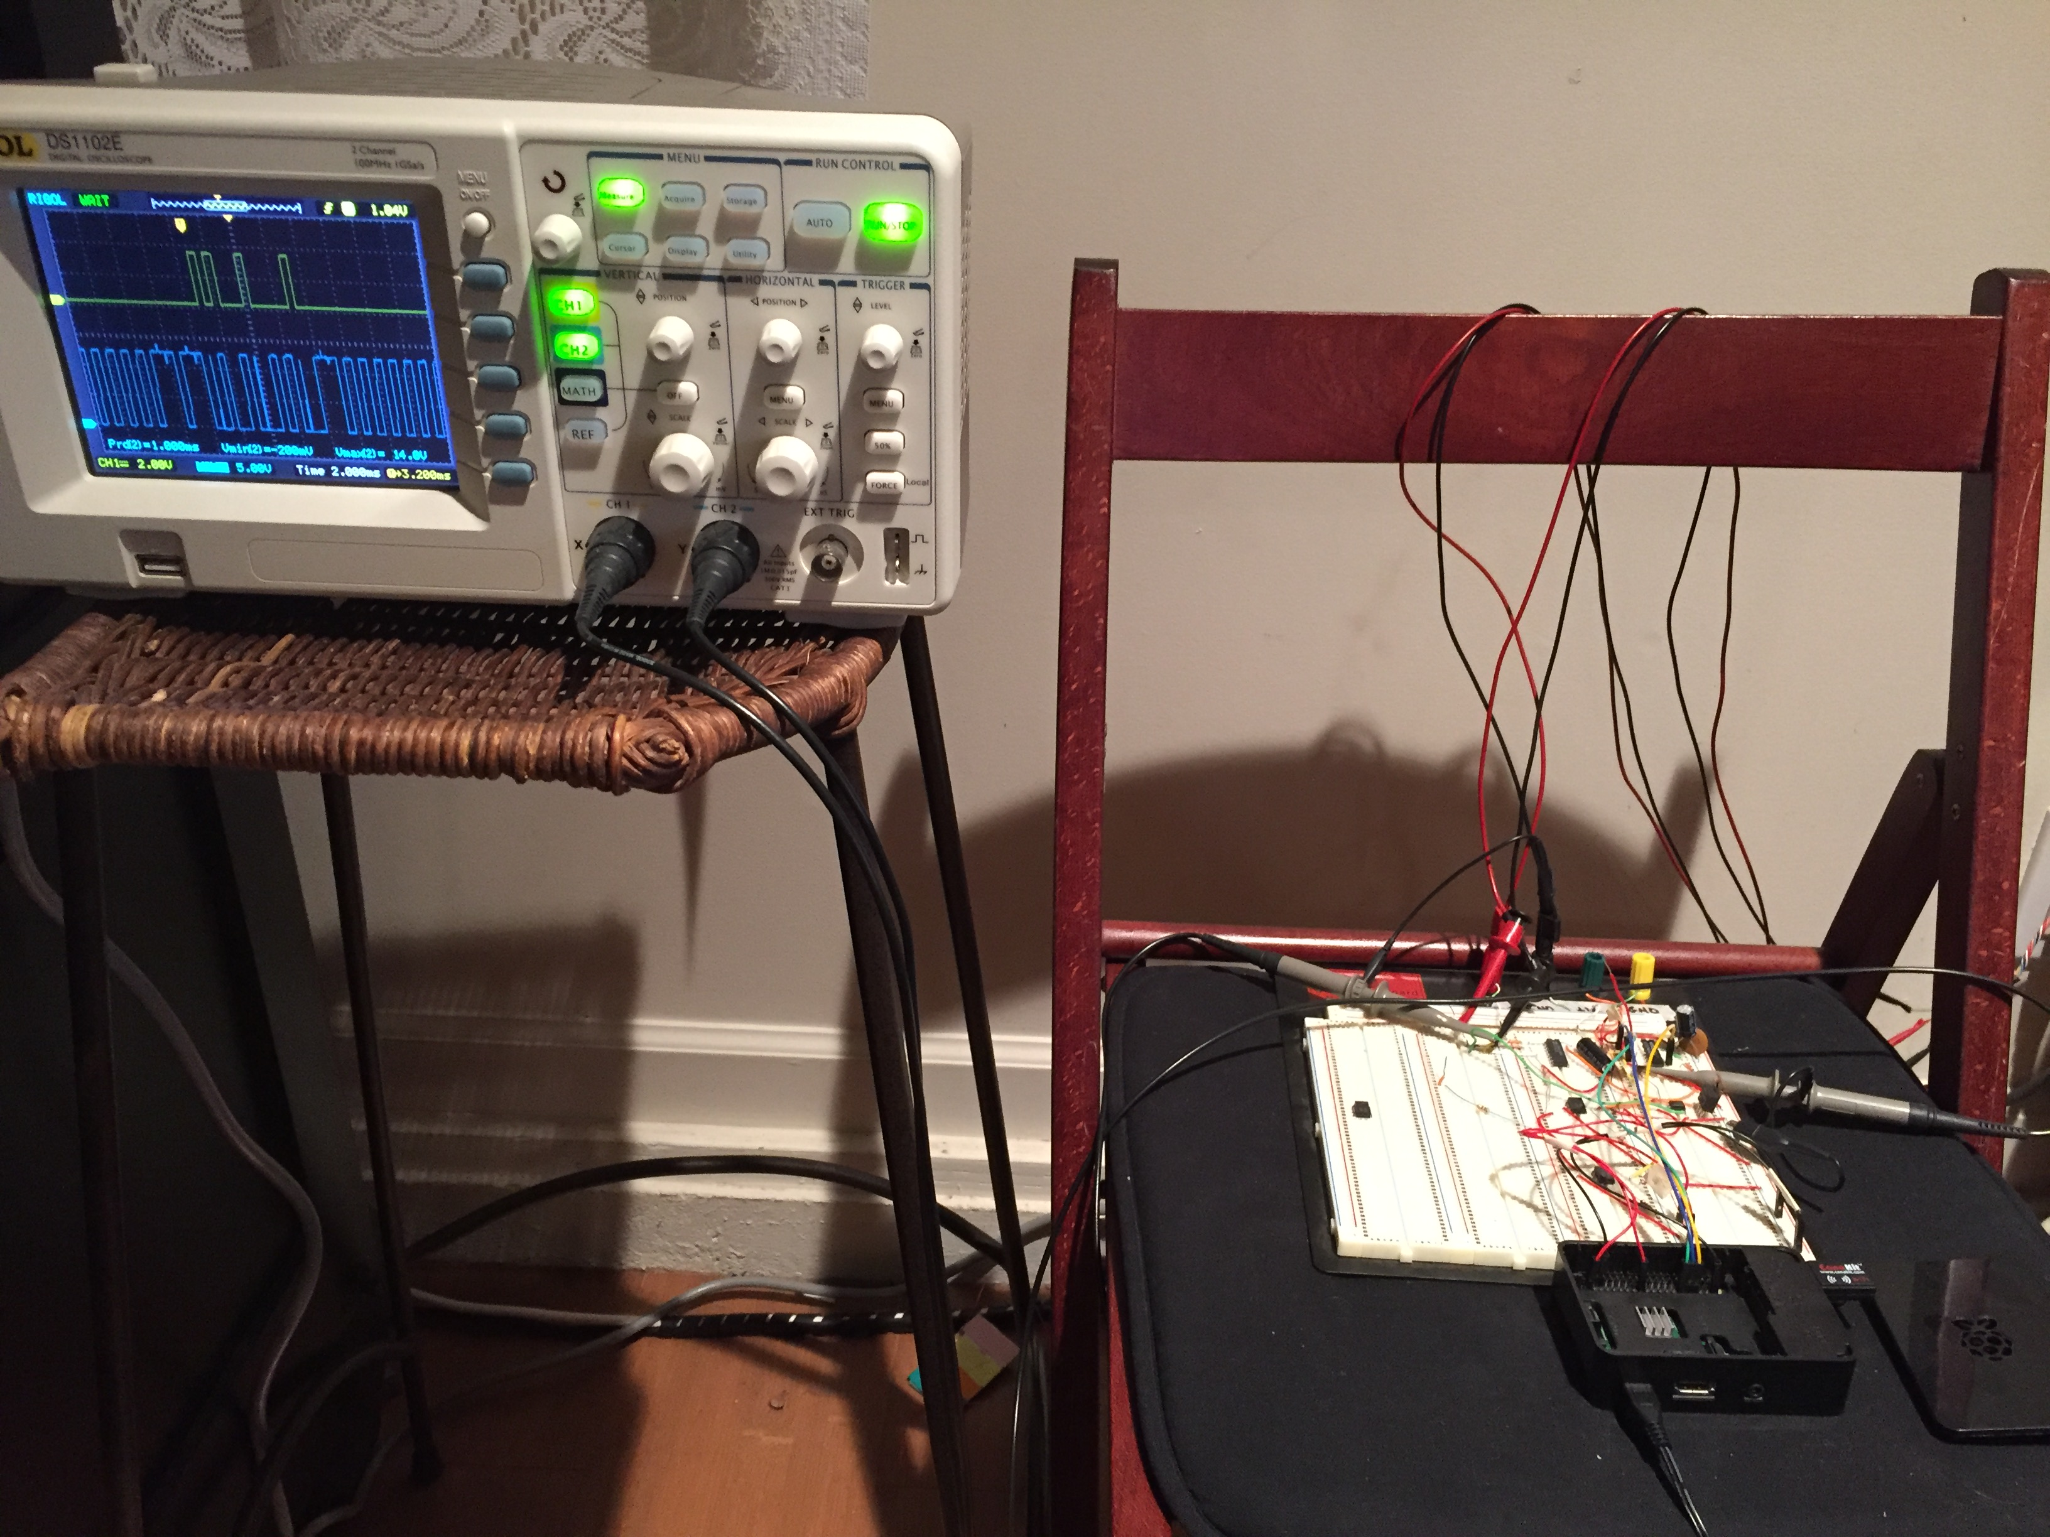
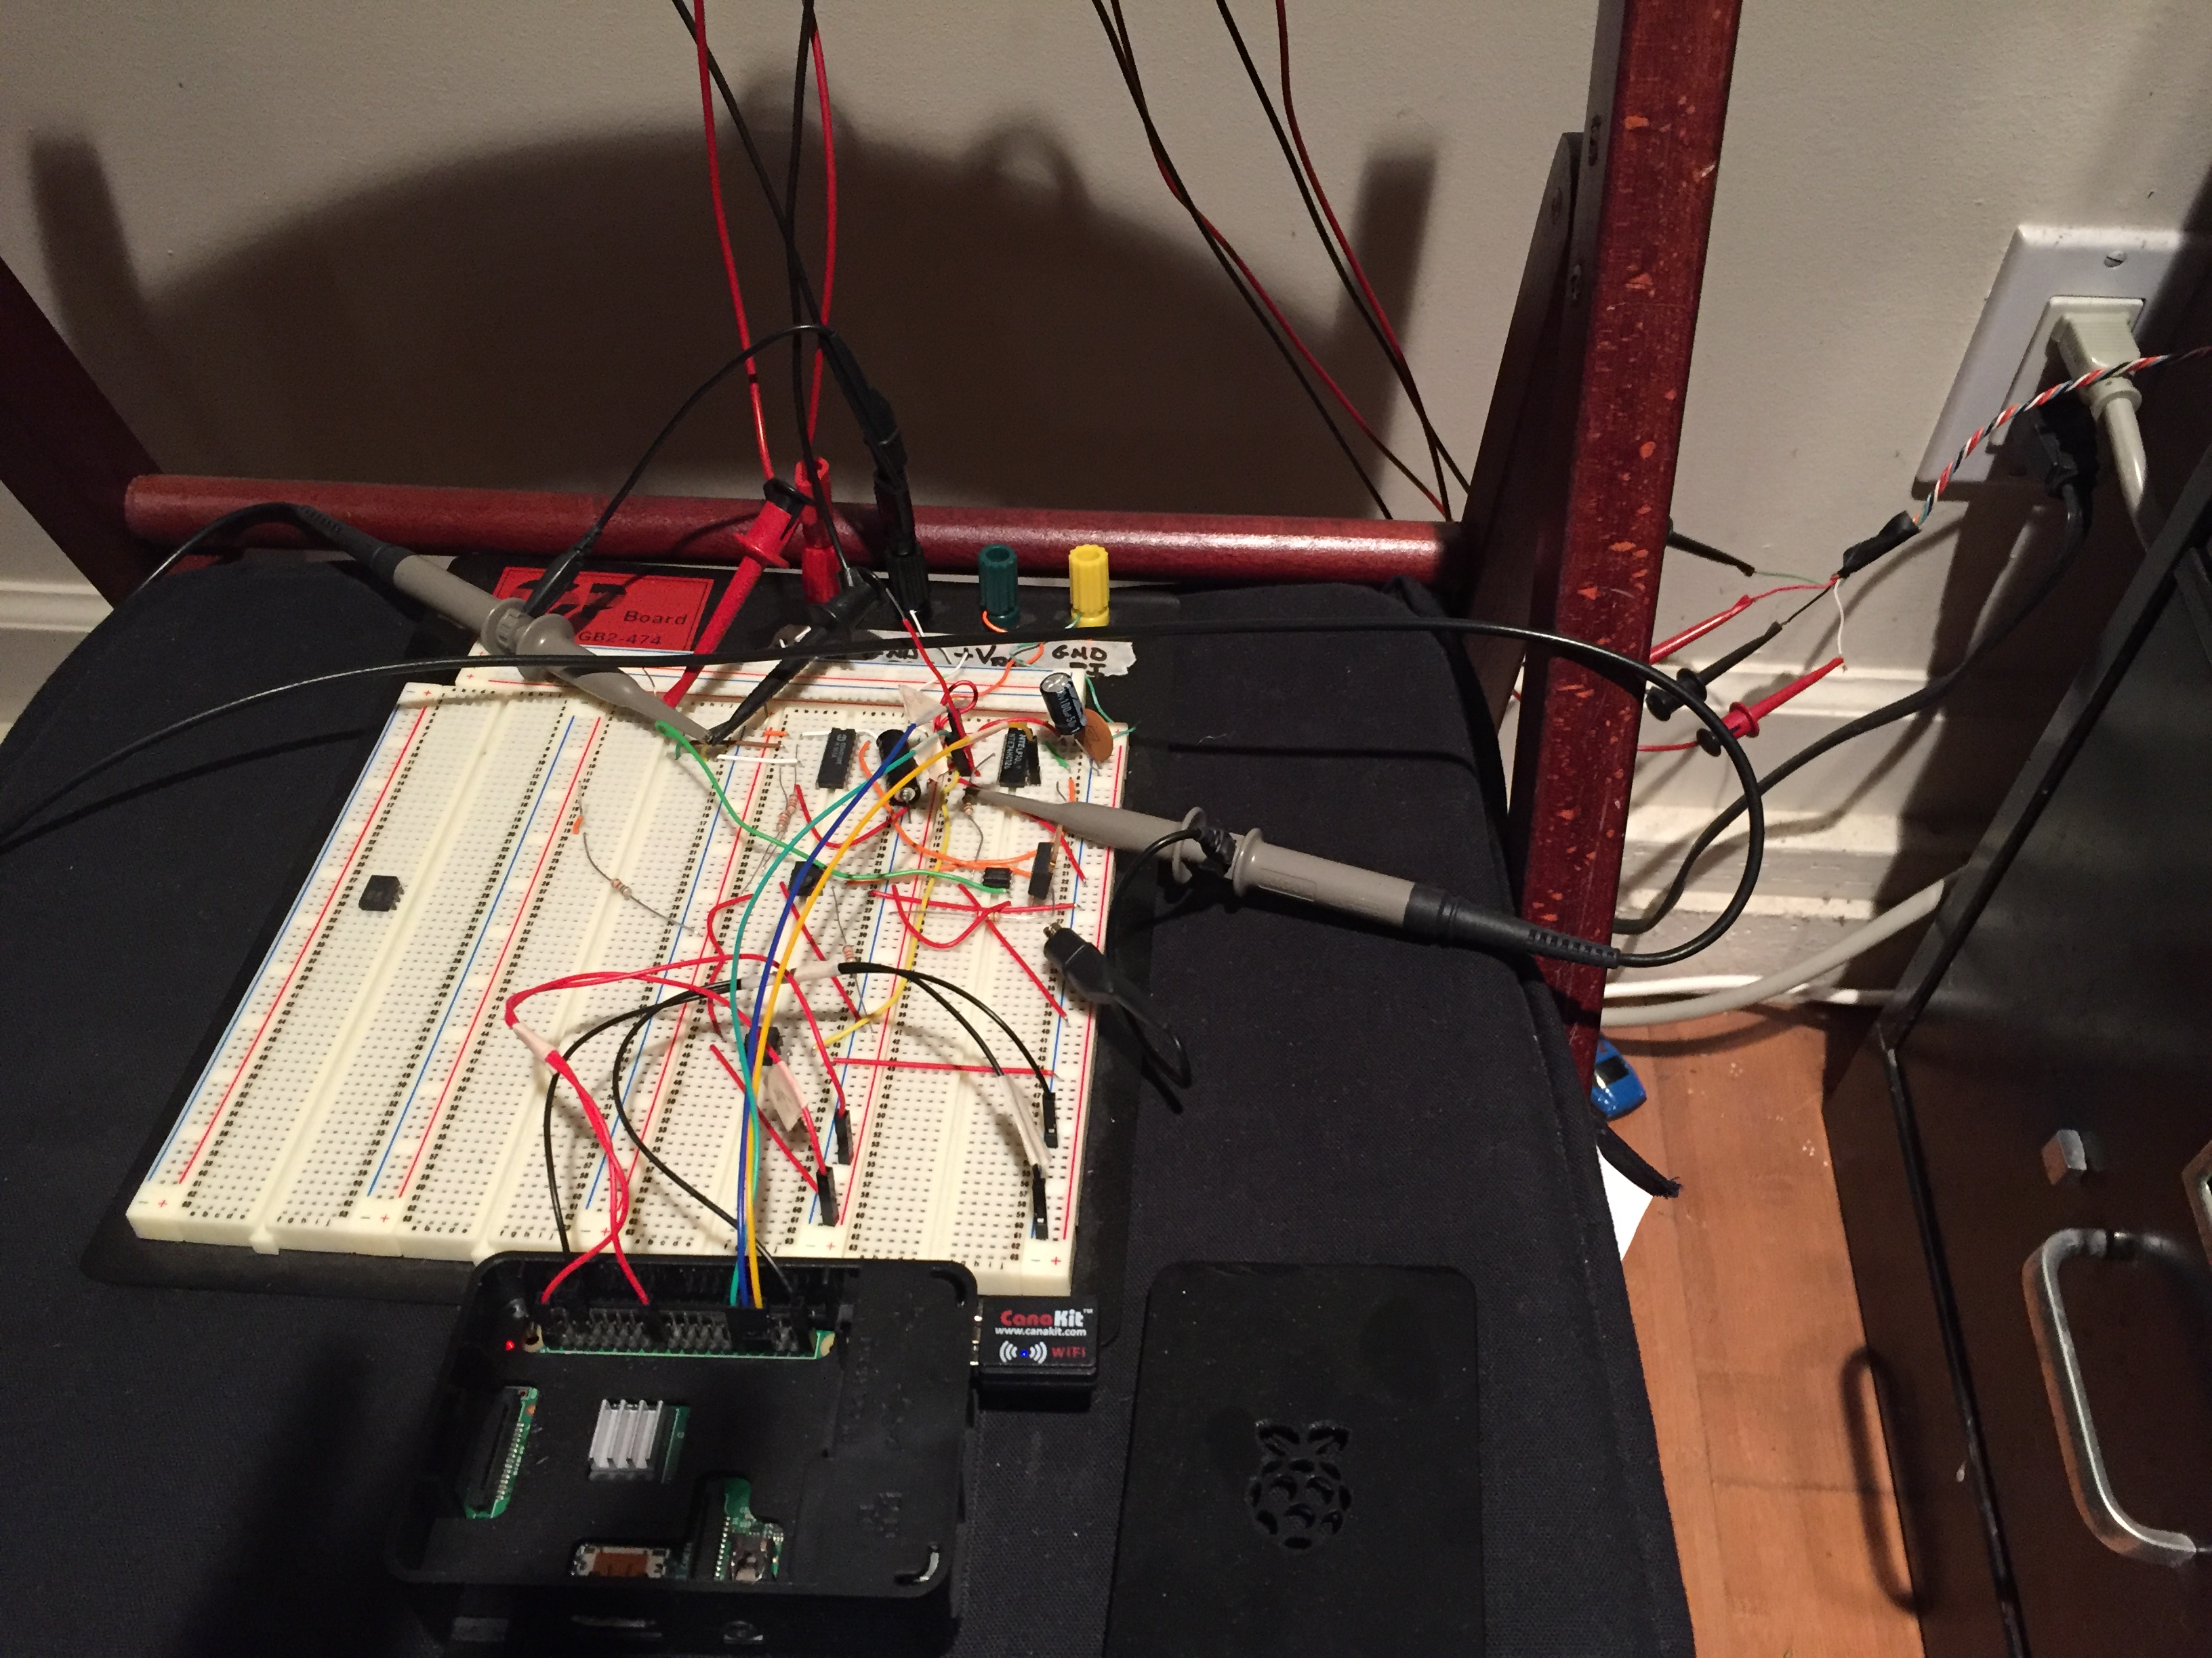
Prototype Current State
Planning to move interface circuits from breadboard to board that fits in Raspberry PI housing

Slide 7
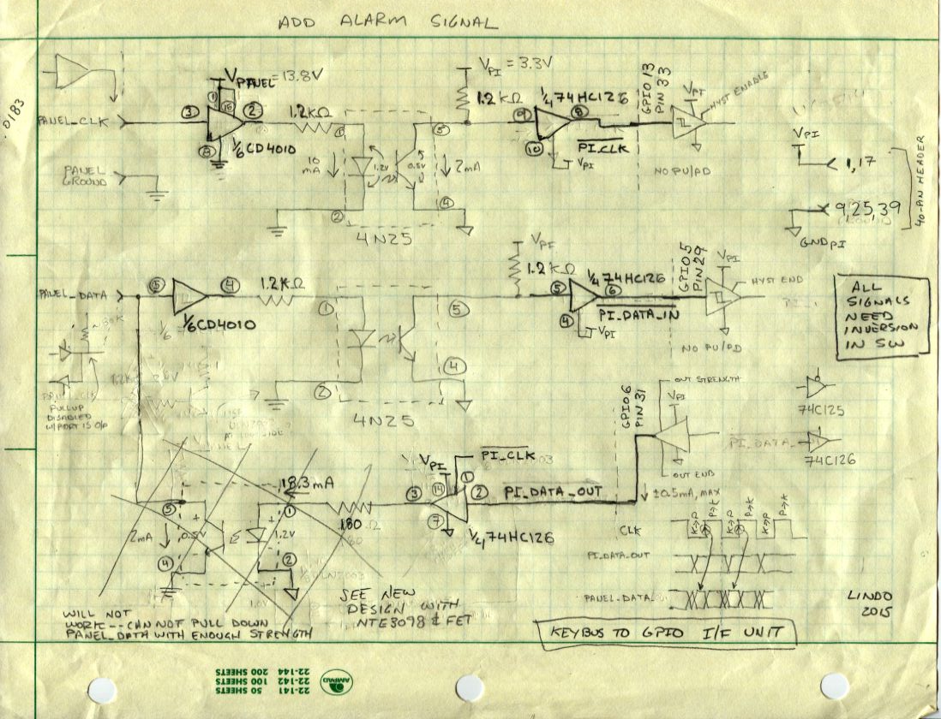
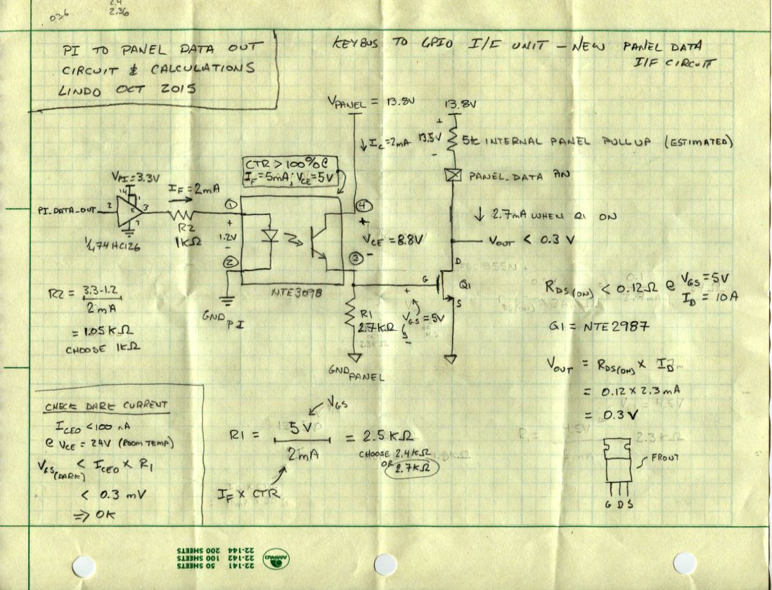
Netbus to GPIO I/F Unit

Slide 8
Source code, schematics and documentation at
https://github.com/goruck/all

