Slide 1

Organization Name :Government of Bihar (DOA)
PSD :PK416
Krishi-Money
App Name:
By team Algorithm Unlockers
K.K.Wagh Institute Of Engineering,Education And Research, Nashik, Maharashtra

Slide 2
Tasks Completed by Day 1
For model improvement:
Dynamic dataset updation
Daily prices representation instead of weekly
Set minimum support price at real time and calculate price stabilization fund
For User Friendly GUI:
Login page
Instead of buttons on home screen for main functionality i.e. (crop price prediction, arrival forecasting and PSF), use bottom navigation

Slide 3
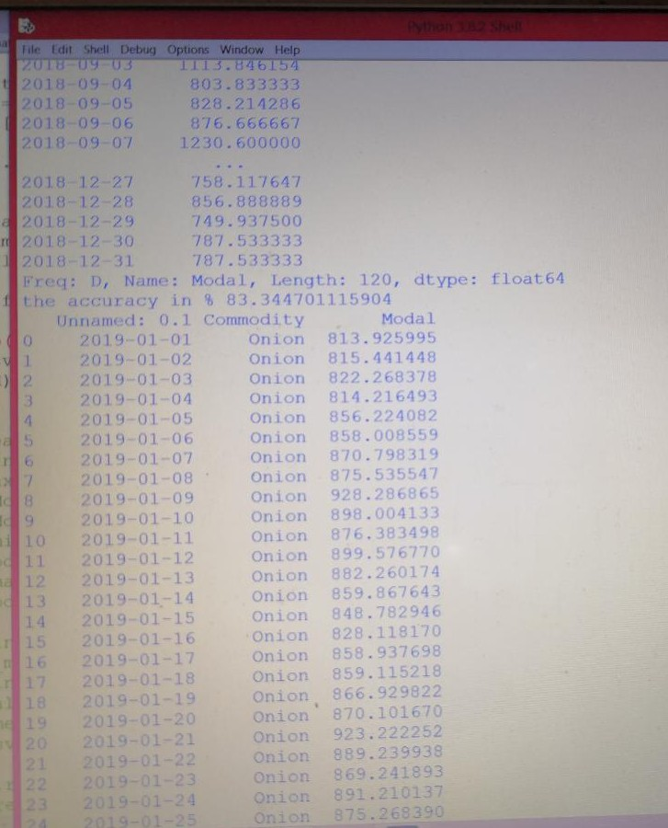
Daily Price Prediction with accuracy 83%

Slide 4
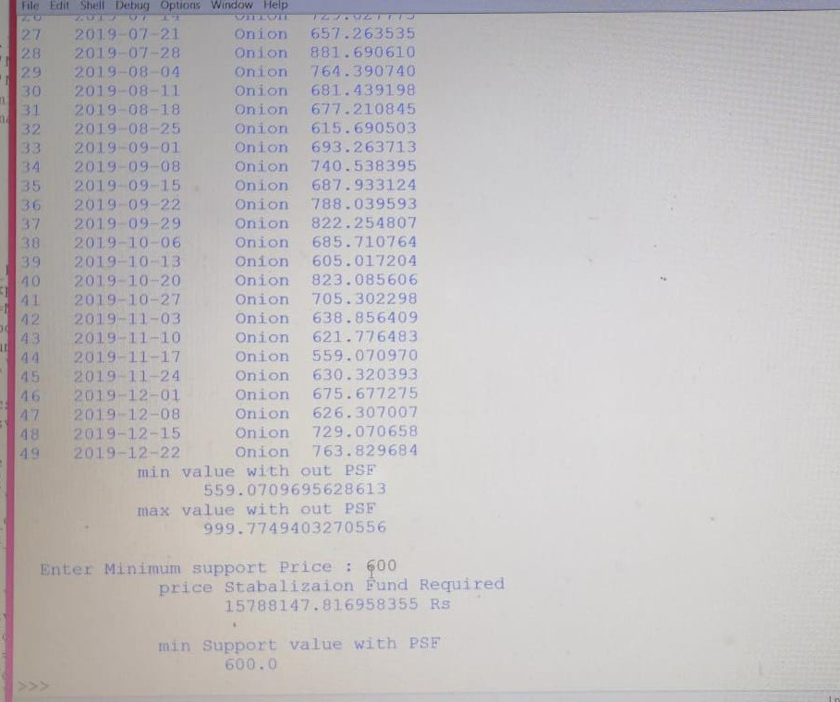
Minimum support price can be set dyanamically and PSF can be calculated accordingly

Slide 5
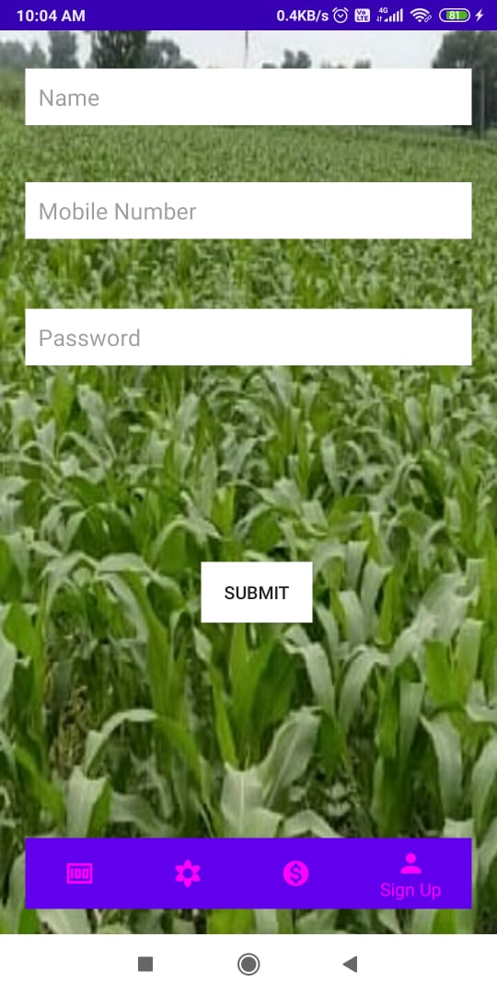
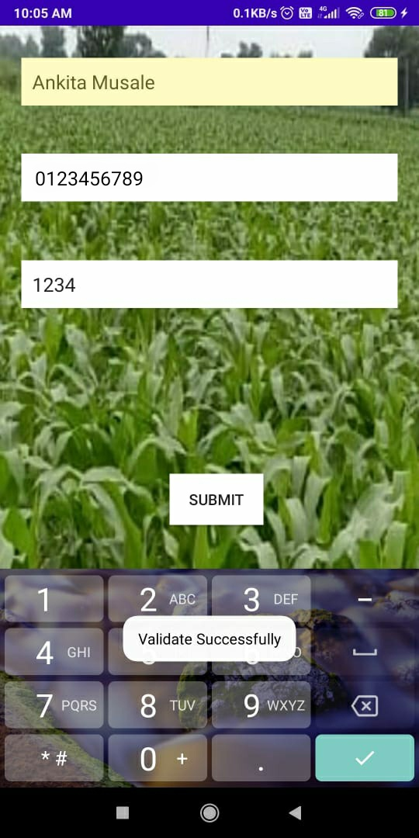
Login Page

Slide 6
