Slide 1

Organization Name :Government of Bihar (DOA)
PSD :PK416
Krishi-Money
App Name:
By team Algorithm Unlockers
K.K.Wagh Institute Of Engineering,Education And Research, Nashik, Maharashtra

Slide 2
CONTENTS
Introduction
Problem Statement
Proposed Solution
Prediction of crop prices
Forecasting of crop arrival
Features
Technology Stack
Conclusion
References

Slide 3
INTRODUCTION
India is an agricultural country
61.5% population in India is dependent on agricultural sector
Contributes 18% of India’s GDP
Are the farmers rich ?
Need for price stabilization.

Slide 4
PROBLEM STATEMENT
Enabling transparent price discovery and forecasting of crop arrival along with management and utilization of price stabilization funds in the case of agri-commodities.

Slide 5
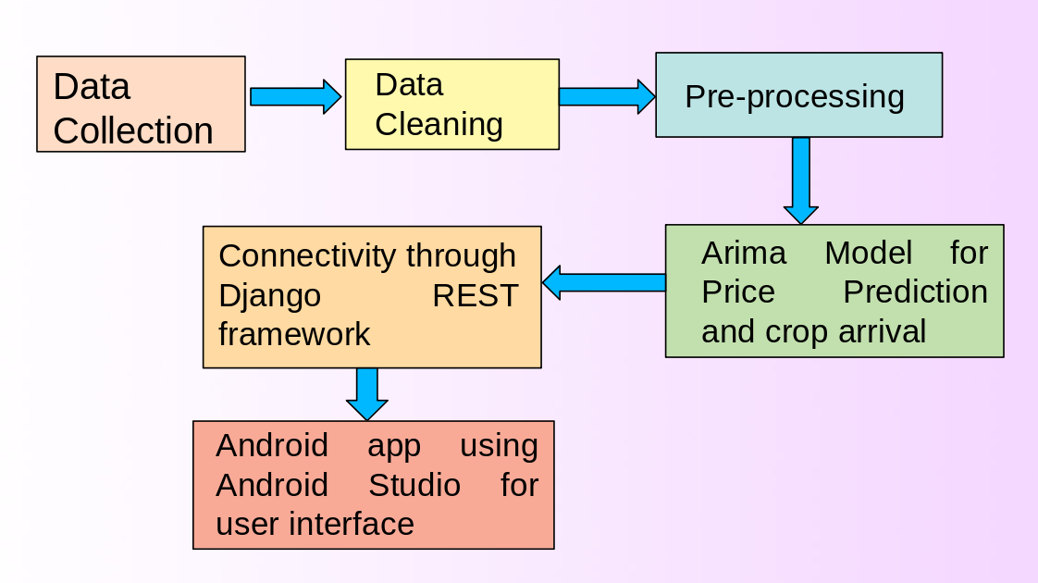
WORK FLOW

Slide 6
CROP PRICE PREDICTION
Production and productivity data of Karnataka
We have used time series model i.e. ARIMA Model. the forcast is based on the historical pattern of datapoints collected over time and comparing it with current trend.
Model gives accuracy between 80% to 95%
This will help Farmers for Selection of crop.
It will connect cash, forward and future markets

Slide 7
FORECASTING OF CROP ARRIVAL
Forecasting quantity arrival at market
We are forecasting time required for crop lifecycle and its probable Yields after harvesting.
APMC’s can increase pool of buyers
Manage import export of goods in advance
Farmers can manage storage policies

Slide 8
PRICE STABLIZATION FUND
PSF is comprehensive scheme aimed at enhancing affordability of such coomodities
It will ensure farmers do not end up dumping products on highways due to low pricess
5 Range Distribution and Respective PSF amount is displayed, which will help government to declareappropriate help in term of PSF.

Slide 9
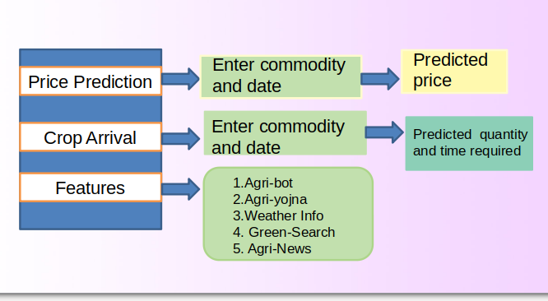
ANDROID APP FLOW

Slide 10
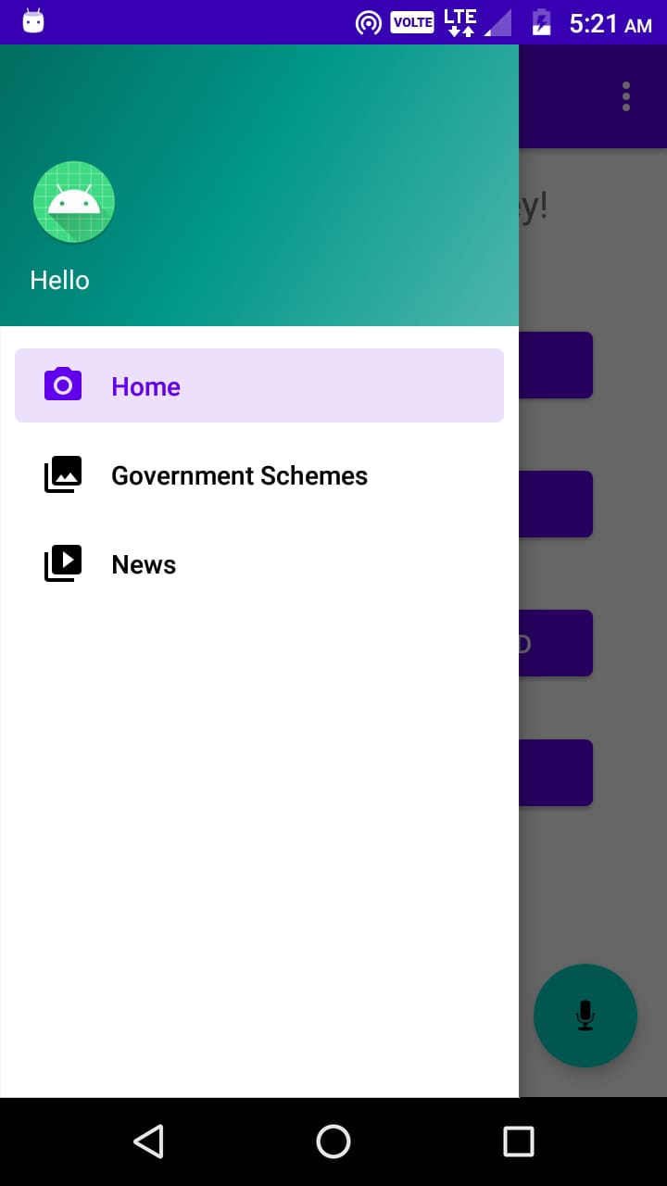
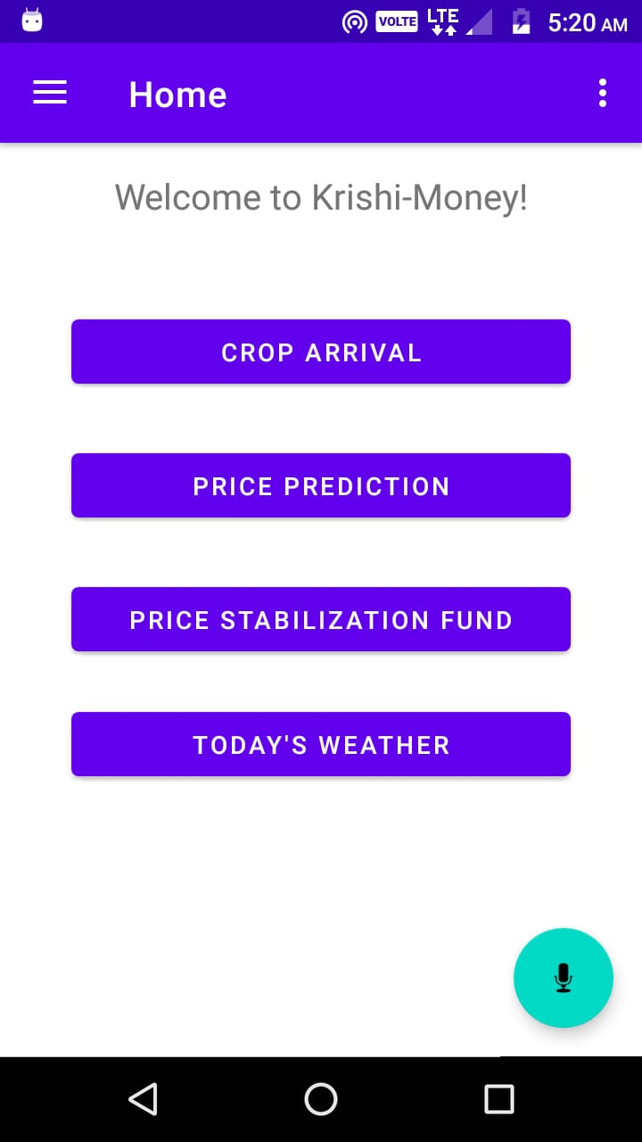

Slide 11
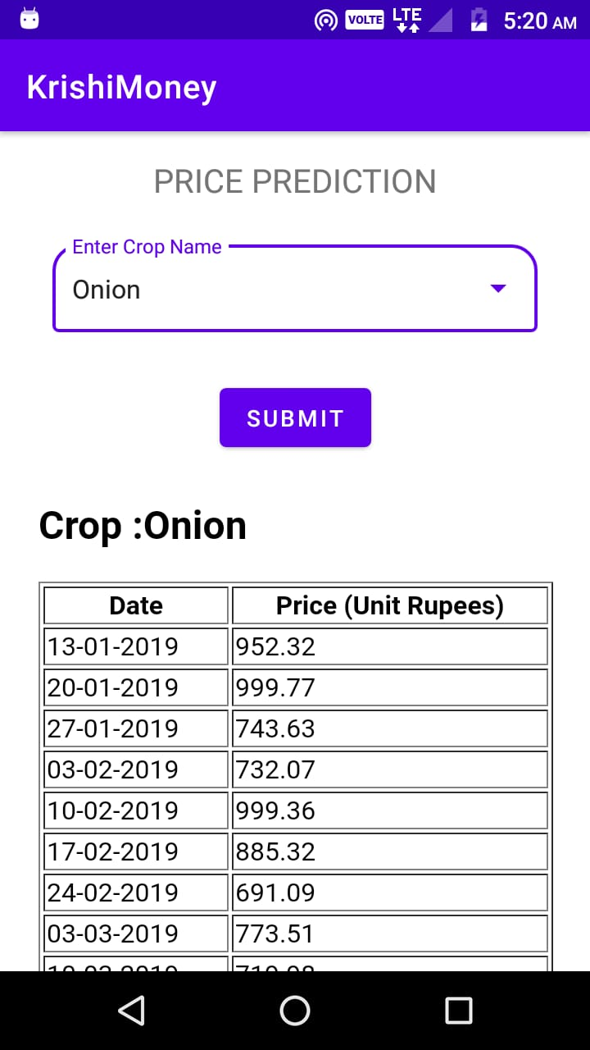
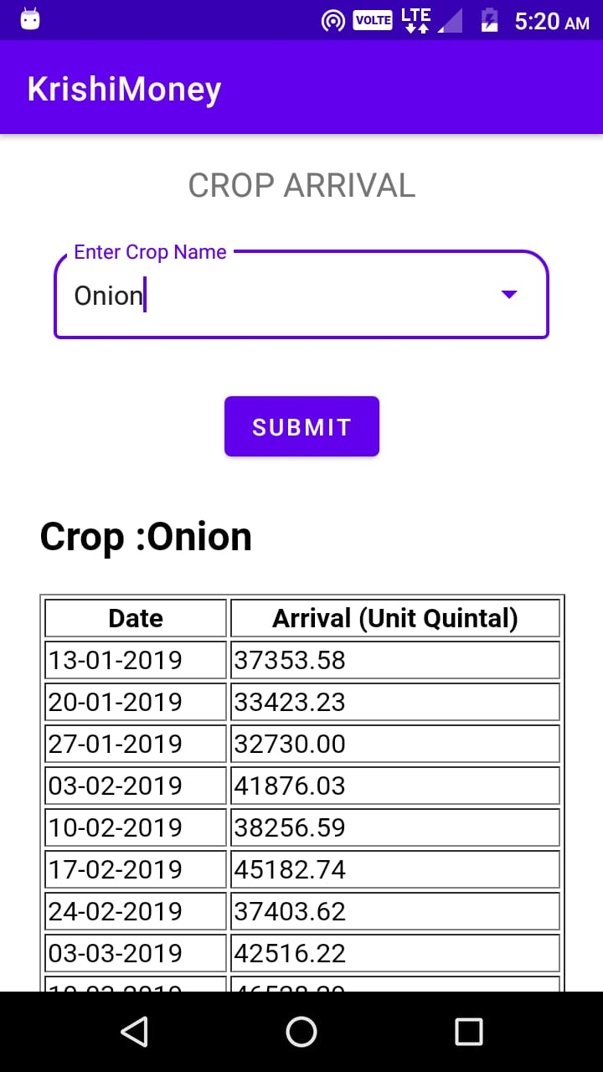

Slide 12





FEATURES
Agri-BOT
Agri- Yojna
Weather Info
Green-Search
Agri-News

Slide 13
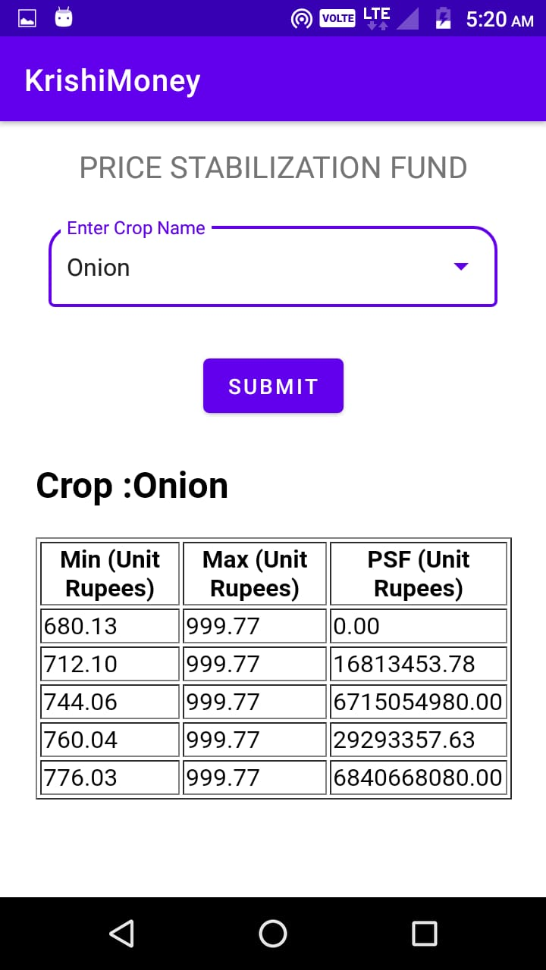
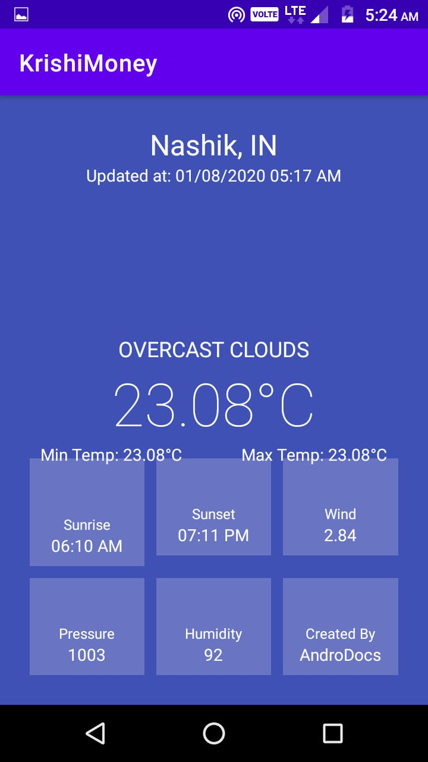

Slide 14
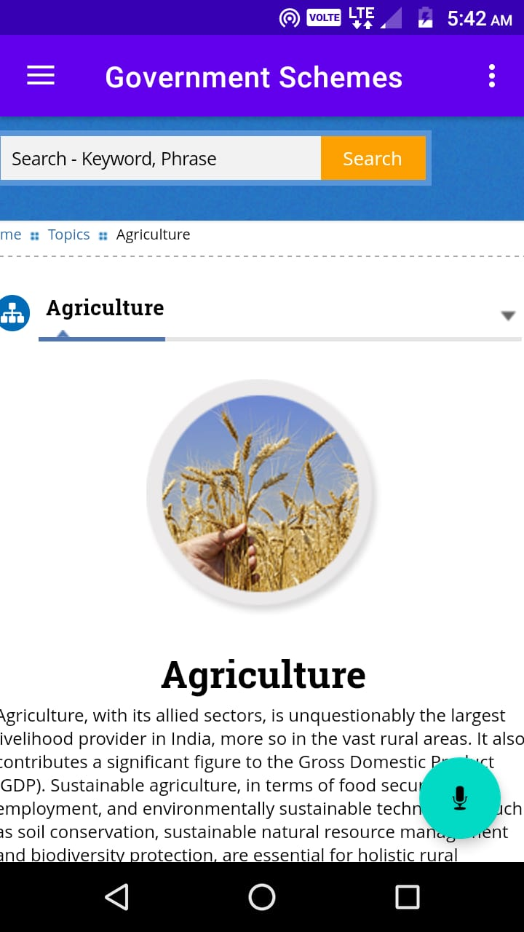
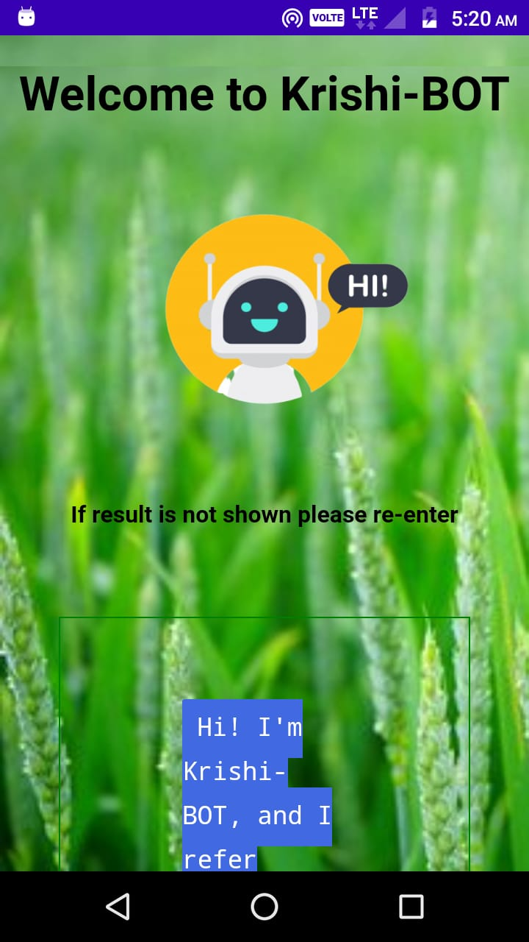

Slide 15


TECHNOLOGY STACK
Android Studio:
Android Studio is Android's official IDE.
Fast and feature rich emulator.
Testing Tools and framework
Django:
As an open source web framework
Written in Python
Allows developers to use libraries like Django REST framework etc

Slide 16
CONCLUSION
This application predicts the future price accurately and precisely and in how much quantity crop will yield and also include features krishibot, Agri yojna, Weather Info, Agri-News.

Slide 17
REFERENCES
Data Collection(1 January 2015 to 31 December 2018): Commoditiwise daily market report from krishimarathavahini
Jadhav, V. & B V Reddy, Chinnappa & Gaddi, G.M.. (2017). Application of ARIMA model for forecasting agricultural prices. Journal of Agricultural Science and Technology. 19. 981-992.
Biswas, Barun & Dhaliwal, Lakhvir & Singh, Som Pal & Chahal, Sarabjot. (2014). Forecasting wheat production using ARIMA model in Punjab. International Journal of Agricultural Sciences. 10. 158-61.

Slide 18
THANK YOU

