Slide 1
Computer Vision
Term Project Presentation
Seongje Woo
School of integrated technology Program of Intelligent Robot Technology Gwangju Institute of Science and Technology (GIST)
Notes:
1

Slide 2
Contents
Introduction
Data
Model
Train
Summary

Slide 3
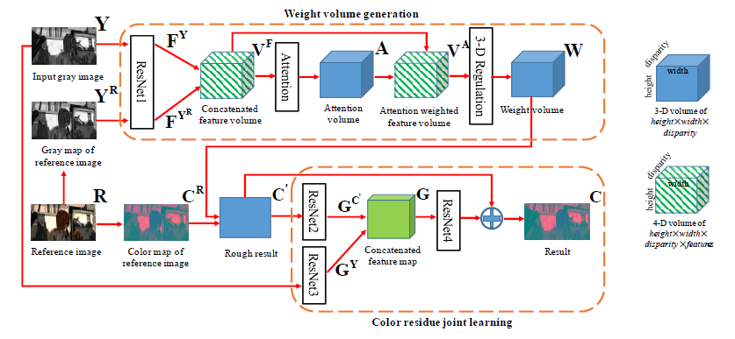
Introduction
Learning a Deep Convolutional Network for Colorization in Monochrome-Color
Dual-Lens System(Xuan Dong et, al. Association for the Advancement of Artificial Intelligence 2019)
Notes:
3

Slide 4
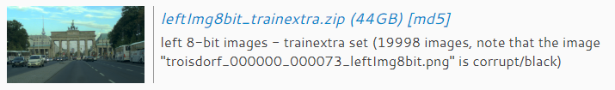

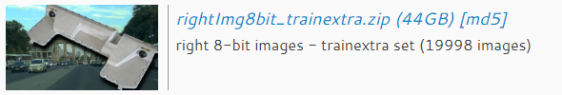
Data
./dataset.py
Cityscapes dataset for training
Left images for Input gray images and ground truth
Right images for gray map of reference images
Add Gaussian noises
Notes:
4

Slide 5
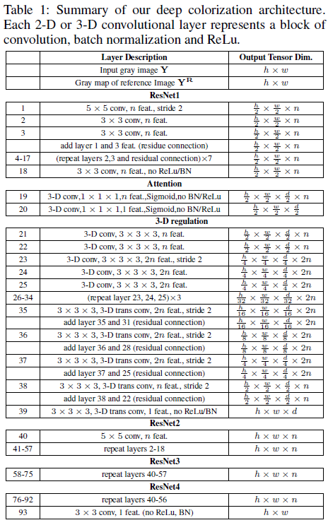
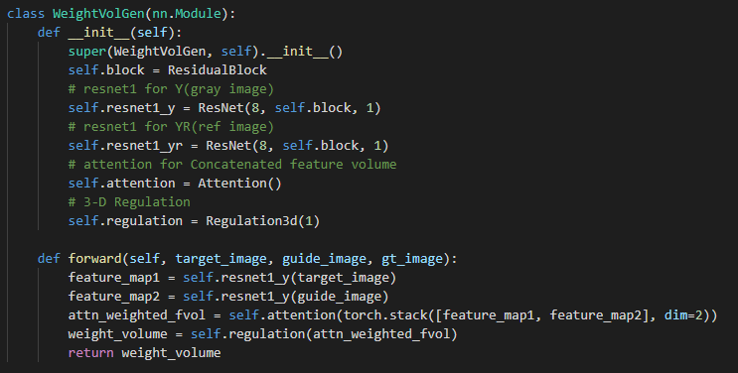
Model
./models.py
Define networks(ResNet1-4, Attention, 3D-regulation)
Implement model structure for Weight volume generation
Notes:
5

Slide 6
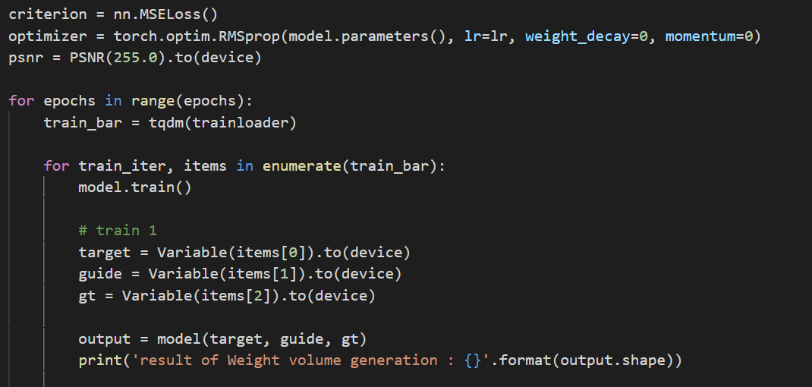

Train
Implemented with PyTorch
Model optimizer : RMSProp
Batch size : 256 x 512 randomly located crop
Learning late : 0.001
Loss : Mean Squared Error
Notes:
6

Slide 7
Summary
Stereo datasets preprocessing
Implement each networks structure
Define model
Extract concatenated feature map
Extract attention volume
Extract weight volume
Rough colorization
Color residue joint learning
Notes:
7

Slide 8
Thank you
for your Attention.
Notes:
8

