Slide 1

Running and Optimizing Quantum Circuits
Seonggeun Park
Korea University

Slide 2
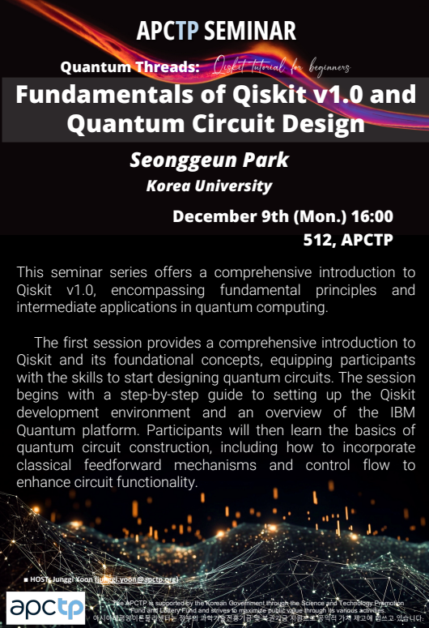
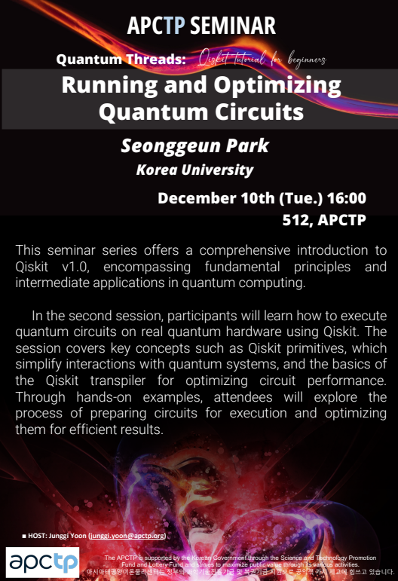
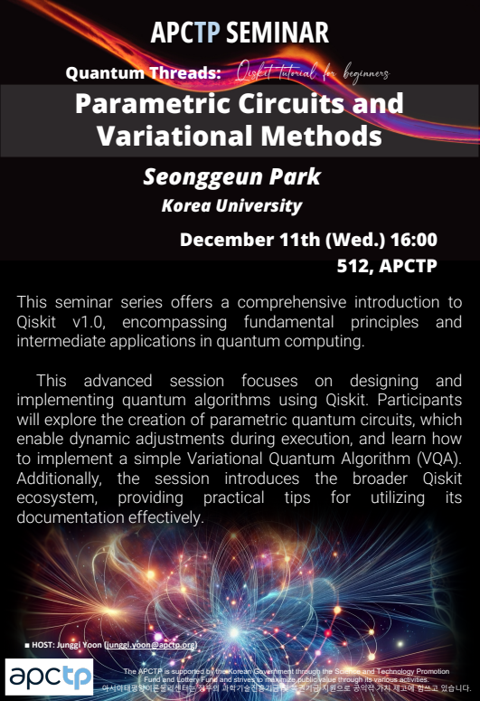
Qiskit Tutorial for Beginner Series at APCTP

Slide 3
Qiskit Tutorial for Beginner Series at APCTP
Overview of Basic Quantum Information
Introduction to Qiskit & IBM Quantum Platform
Setting Up the Qiskit Development Environment
Designing Quantum Circuits
Implementing Classical Feedforward and Control Flow
Exploring Qiskit Runtime Service
Executing Quantum Circuits using Qiskit Primitives
Transpiling Quantum Circuits
Implementing Parametric Quantum Circuits & VQA
Browsing the Qiskit Ecosystem

Slide 4
Qiskit Tutorial for Beginner Series at APCTP
Overview of Basic Quantum Information
Introduction to Qiskit & IBM Quantum Platform
Setting Up the Qiskit Development Environment
Designing Quantum Circuits
Implementing Classical Feedforward and Control Flow
Exploring Qiskit Runtime Service
Executing Quantum Circuits using Qiskit Primitives
Transpiling Quantum Circuits
Implementing Parametric Quantum Circuits & VQA
Browsing the Qiskit Ecosystem

Slide 5


Contents
Exploring Qiskit Runtime Service
Executing Quantum Circuits using Qiskit Primitives
Transpiling Quantum Circuits

