Slide 1
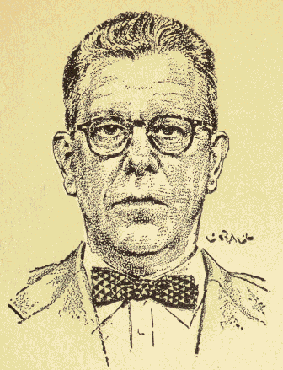
Investigating Science Radar to Microwave Ovens
The Journey of Percy Spencer

Slide 2
Radar to Microwave Ovens
Today’s topics:
Historical Context for Spencer’s work in WWII
Economic and Industrial factors in Science
Deviations from the linear model of science
Transition of military to civilian applications of technology

Slide 3
Serendipity Leads to the Microwave Oven?
"Spencer was in one of the Raytheon laboratories when he approached a magnetron and noticed that the chocolate bar in his pocket had started to melt/ He didn’t notice at the time that this was due to the radar’s microwaves. He decided to experiment with un-popped popcorn. He held the bag next to the magnetron and watched as the kernels turned into hardened, miniature white clouds.”[1]
Raytheon is a large US Defence Contractor - what exactly was Spencer’s role?
What exactly is a magnetron and why were the parts left out in the open?
We need to investigate.
https://lemelson.mit.edu/resources/percy-spencer

Slide 4
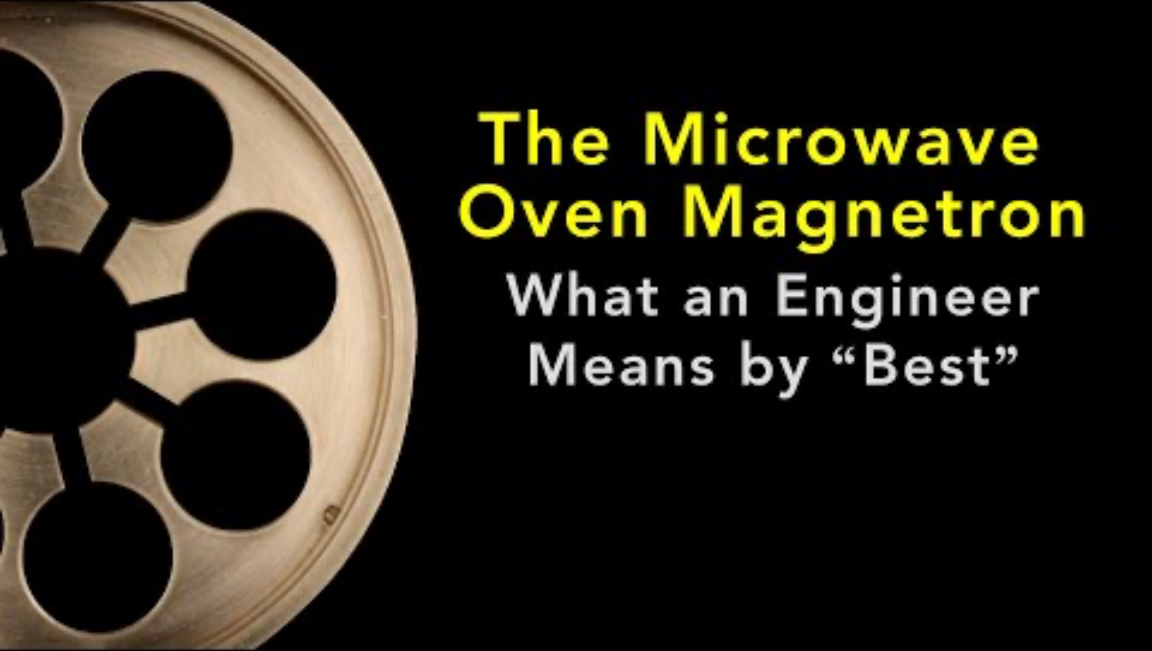
The Magnetron

Slide 5
Percy Spencer
From 1939 to the end War II:
Grew a team of 15 people to 5,000
A conventional military career path
Hands on shop floor, to exec lounge
Significant success in accelerating manufacture of radar critical to the war effort.
Responsible for Raytheon winning the radar contract in the first place
Mr Spencer was not an individual contributor

Slide 6
An Alternate Narrative
As WWII came to a close Raytheon’s radar business would likely slow.
Raytheon had 5,000 employees and needed to diversify.
Some other employee stories suggest that microwaves as a source of cooking energy may have been known to Mr Spencer and chocolate bar story may just be a fun story.

Slide 7
Team One: Historical Time Line
Raytheon’s growth 1939-1950
Key events in Percy Spencer’s career
Technical advancements in microwave research

Slide 8
Team Two: Hypothesis Analysis
Validity of the chocolate bar story
Economic factors in scientific discovery
Spencer’s position influenced the development of the microwave oven
What set of activities occurred from the initial chocolate bar story through to manufacture of microwave ovens?

Slide 9
Group Summary and Analysis
Each group presents brief
What happened?
A story of serendipity; or pragmaticly directed commercial research?

