Slide 1
Slack API – Sign in
Slack API – Sign in

Slide 2
Slack API – Sign in
SLACK Server 에서 Access Token 가져오기
Browser
WAS
Slack Server
※ Slack Server Resource Owner,
Authorization Server,
Resource Server
를 모두 편의상
Slack Server 로 통칭함
redirect
/auth/slack/proxy/grant
https//slack.com/oauth/authorize? scope=xxxx& client_id=xxxxx
/auth/slack/proxy/redirected? code=xxx& state=xxx
http://slack.com/api/oauth.access? code=xxx& client_id=xxx& client_secret=xxx
{ access_token: “xoxp-xxxx”,
scope: “identity.basic”,
ok : true
user : { name : “playmymind”, id : “XXXX”
}
}
Do What?
Ex. Jwt token,……, etc
또는
{"ok":false,"error":"code_already_used"}

Slide 3
Slack API – Sign in
Access Token을 Browser 에게 JWT로 발급해주기
Browser
WAS
Slack Server
※ Slack Server Resource Owner,
Authorization Server,
Resource Server
를 모두 편의상
Slack Server 로 통칭함
redirect
/auth/slack/proxy/grant
https//slack.com/oauth/authorize? scope=xxxx& client_id=xxxxx
/auth/slack/proxy/redirected? code=xxx& state=xxx
http://slack.com/api/oauth.access? code=xxx& client_id=xxx& client_secret=xxx
{ access_token: “xoxp-xxxx”,
scope: “identity.basic”,
ok : true
user : { name : “playmymind”, id : “XXXX”
}
}
Do What?
Ex. Jwt token,……, etc
또는
{"ok":false,"error":"code_already_used"}

Slide 4
JWT
JWT

Slide 5
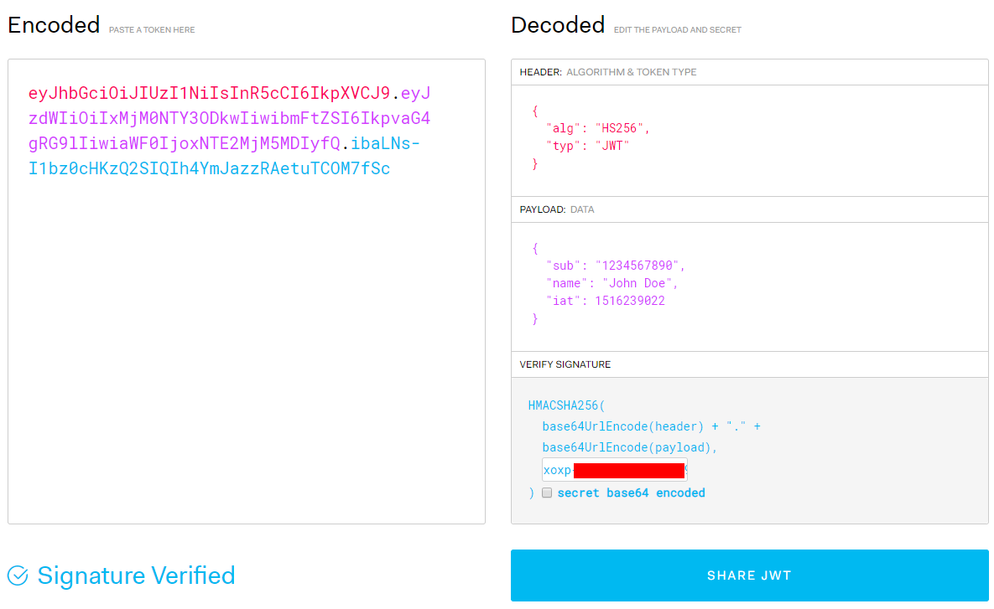
JWT
JWT ??
https://jwt.io/

Slide 6
SESSION & COOKIE
Let’s remind this…
SESSION & COOKIE
Let’s remind this…

Slide 7
SESSION & COOKIE
Let’s remind this…

