Slide 1


Introduction to Tidyverse Session 4: Data wrangling and visualisations using ggplot and plotly
Lydia Briggs
November 2022

Slide 2








Tidyverse Recap
library(tidyverse)
The tidyverse is an R package which includes a collection of R packages popular for data analyses.
As of version 1.3.0, tidyverse contains 8 packages which cover data load, wrangling, programming and visualisation.
They all follow the same grammar, design philosophy and data structure.
This workshop will focus on ggplot2 to create graphs and visualisations of data.
https://www.tidyverse.org/packages/

Slide 3
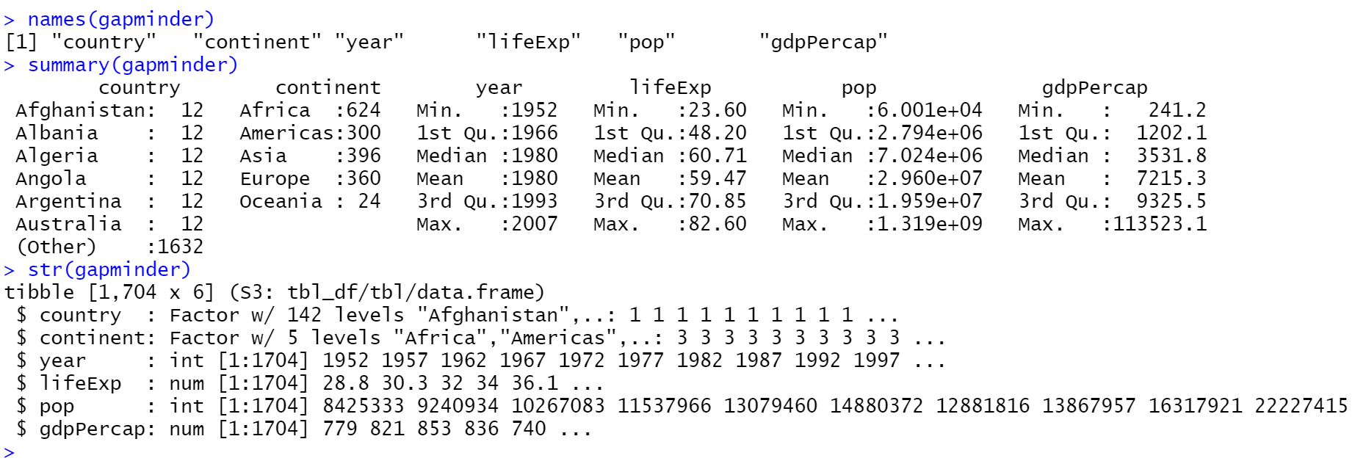
gapminder recap
names(gapminder) – functions to get or set the names of an object
LifeExp - life expectancy at birth
Pop - total population
gdpPercap - per-capita GDP (Gross domestic product given in units of international dollars)
summary(gapminder) - generic function used to produce result summaries of the results of various model fitting functions.
str(gapminder) - Compactly display the internal structure of an R object
Notes:
You see it has generated a canvas here – it’s recognised the axes

Slide 4
Visualisations with ggplot2
R package for producing statistical/ data graphics.
Based on ‘The Grammar of Graphics’.
Designed to work iteratively to build up the graphic from ‘layers’.
Theme
Labels
Coordinates
Facets
Statistics
Geometries
Aesthetics
Data
ggplot() – initializes a ggplot object.
ggplot(data, aes(x, y, other aesthetics))
Notes:
Grammar of graphics – a set of rules for structuring mathematics and aesthetic elements in to a meaningful graph.

Slide 5
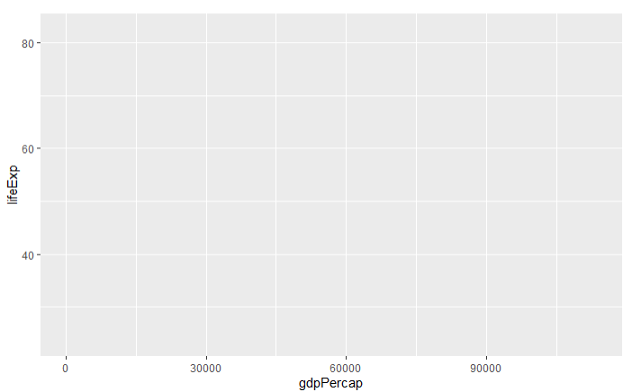
Building up a plot Scatter plot
ggplot(data = gapminder, aes(x = gdpPerCap, y = lifeExp)) +
NULL
Theme
Labels
Coordinates
Facets
Statistics
Geometries
Aesthetics
Data
Notes:
You see it has generated a canvas here – it’s recognised the axes

Slide 6
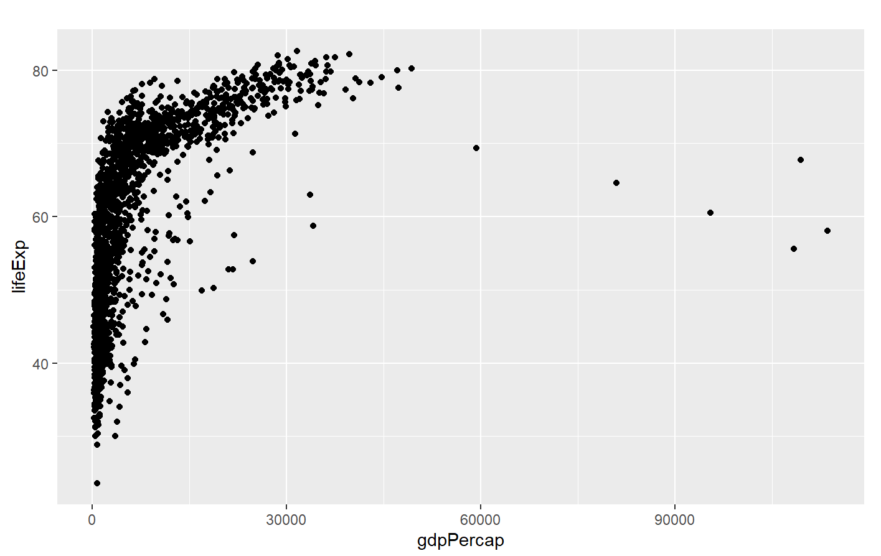
Building up a plot Scatter plot
ggplot(data = gapminder, aes(x = gdpPerCap, y = lifeExp)) +
geom_point() +
NULL
Theme
Labels
Coordinates
Facets
Statistics
Geometries
Aesthetics
Data
Notes:
You see it has generated a canvas here – it’s recognised the axes

Slide 7
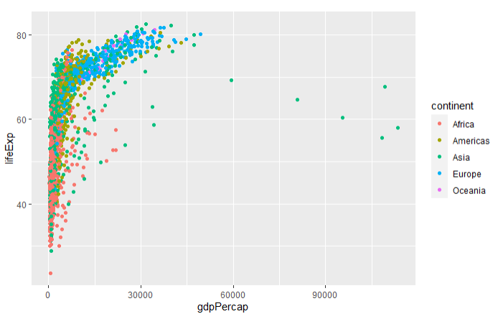
Building up a plot Scatter plot
ggplot(data = gapminder, aes(x = gdpPerCap, y = lifeExp)) +
geom_point(aes(colour = continent)) +
NULL
Theme
Labels
Coordinates
Facets
Statistics
Geometries
Aesthetics
Data
Notes:
Add in components to the geom_point() – this has picked up the different groupings with the continent column.

Slide 8
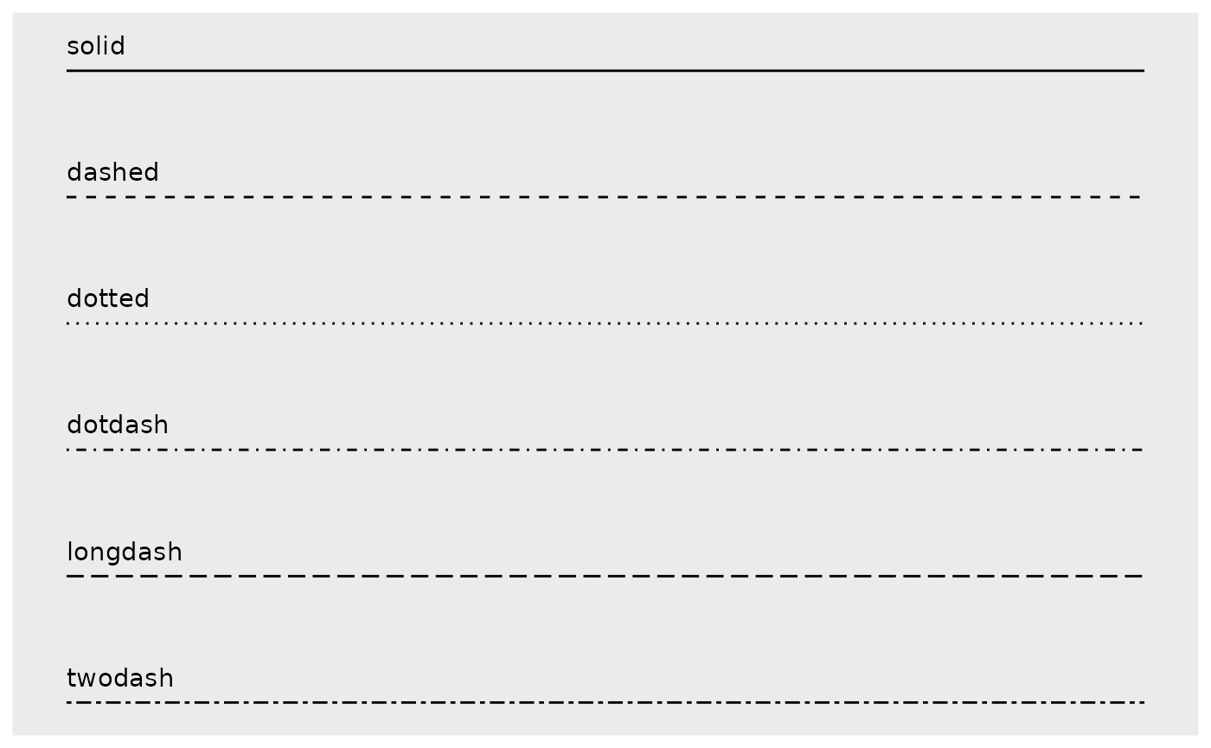
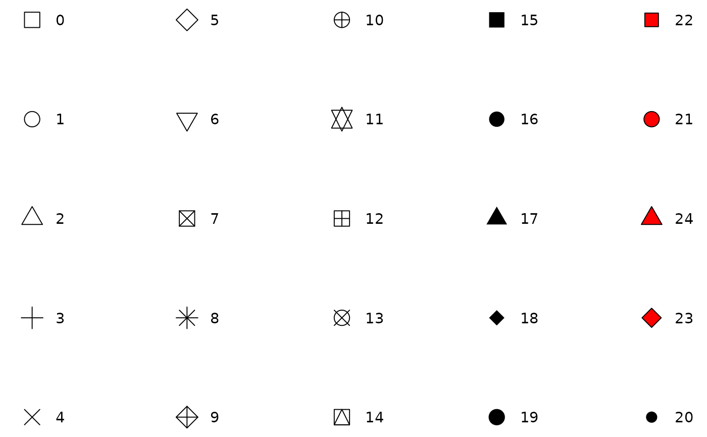
Building up a plot Scatter plot
Aesthetic specifications
Colour and fill
Almost every geom has either colour, fill, or both
Can use named colours “red” or rgb_specification “#RRGGBB”
Lines – line type, linewidth, line end/join parameters
Polygons
The border of the polygon is controlled by colour, linetype and linewidth
The inside of the polygon is controlled by fill
Point – shape, colour and fill
Text – font face, font size, justification
Theme
Labels
Coordinates
Facets
Statistics
Geometries
Aesthetics
Data
Notes:
Add in components to the geom_point() – this has picked up the different groupings with the continent column.

Slide 9

Building up a plot Scatter plot
ggplot(data = gapminder, aes(x = gdpPerCap, y = lifeExp)) +
geom_point(aes(colour = continent), size = 3)) +
NULL
Theme
Labels
Coordinates
Facets
Statistics
Geometries
Aesthetics
Data
Notes:
Additional aesthetics
Add in components to the geom_point() – this has picked up the different groupings with the continent column.

Slide 10
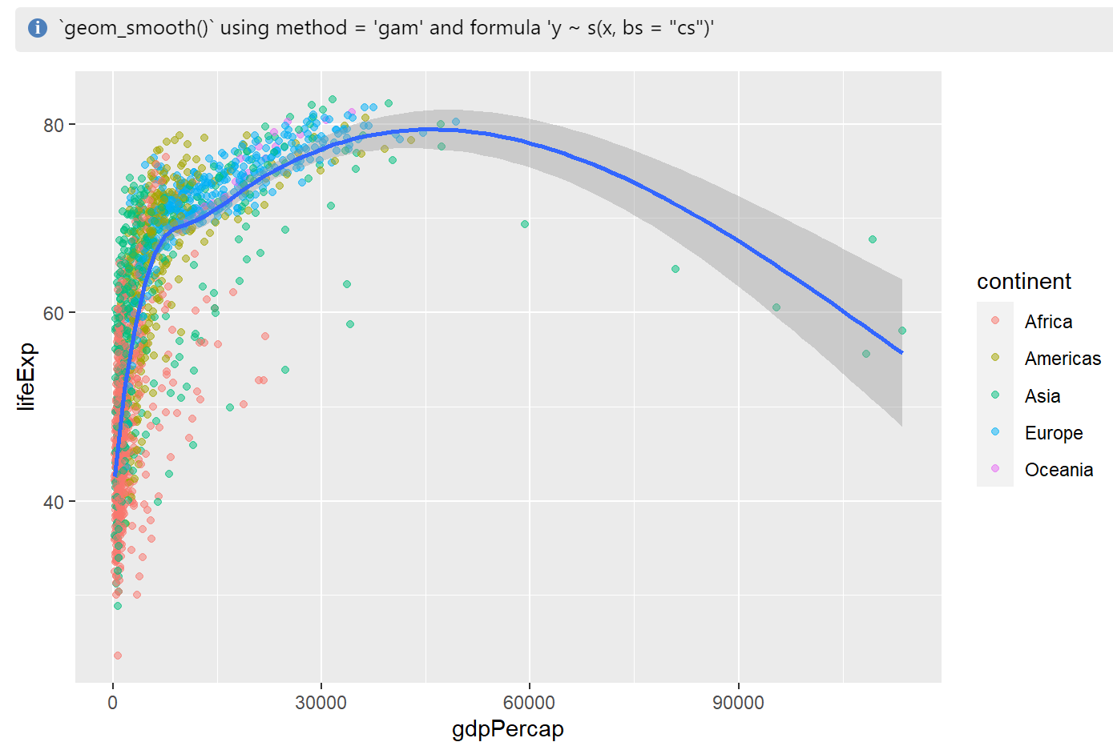
Building up a plot Scatter plot
ggplot(data = gapminder, aes(x = gdpPerCap, y = lifeExp)) +
geom_point(aes(colour = continent), alpha = 0.5) +
geom_smooth(method = NULL, se = T) +
NULL
Theme
Labels
Coordinates
Facets
Statistics
Geometries
Aesthetics
Data
Notes:
Add in components to the geom_point() – this has picked up the different groupings with the continent column.

Slide 11
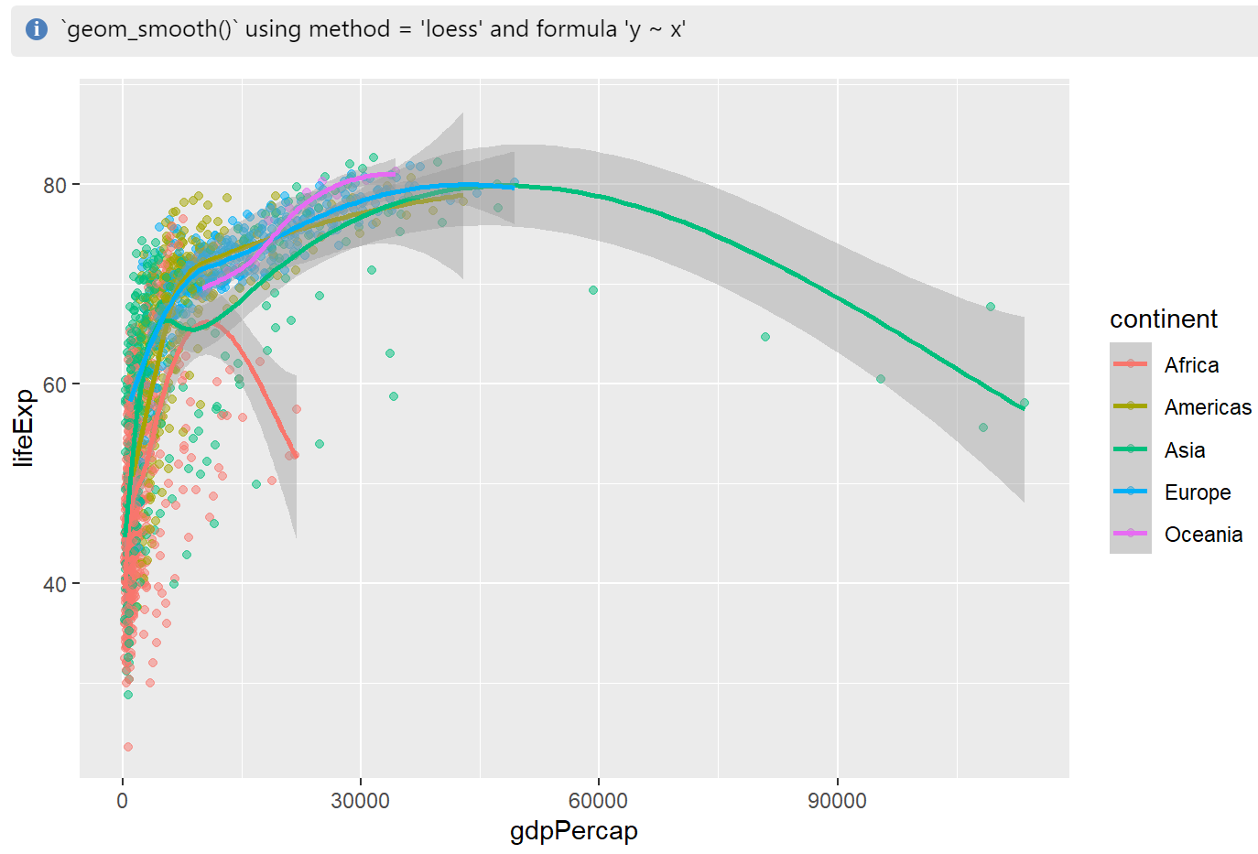
Building up a plot Scatter plot
ggplot(data = gapminder, aes(x = gdpPerCap, y = lifeExp, colour = continent)) +
geom_point(alpha = 0.5)) +
geom_smooth(method = NULL, se = T) +
NULL
Theme
Labels
Coordinates
Facets
Statistics
Geometries
Aesthetics
Data
Note!
If you include aesthetics/ groupings in the core ggplot() call, it will apply to all layers
Notes:
Add in components to the geom_point() – this has picked up the different groupings with the continent column.

Slide 12
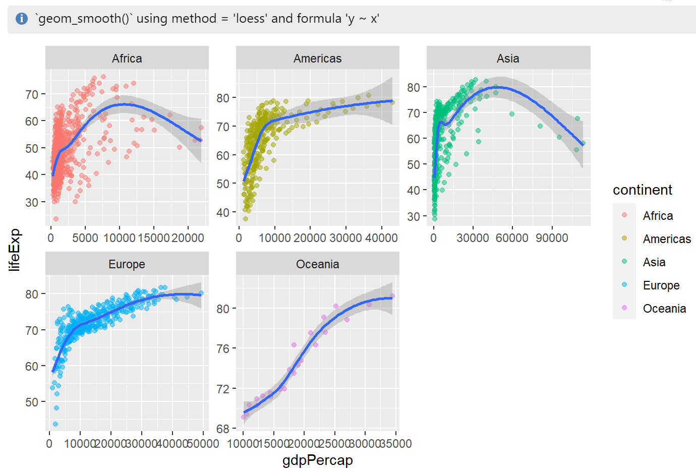
Building up a plot Scatter plot
ggplot(data = gapminder, aes(x = gdpPerCap, y = lifeExp, colour = continent)) +
geom_point(alpha = 0.5) +
geom_smooth() +
facet_wrap(~continent) +
NULL
Theme
Labels
Coordinates
Facets
Statistics
Geometries
Aesthetics
Data
Notes:
Add in components to the geom_point() – this has picked up the different groupings with the continent column.

Slide 13
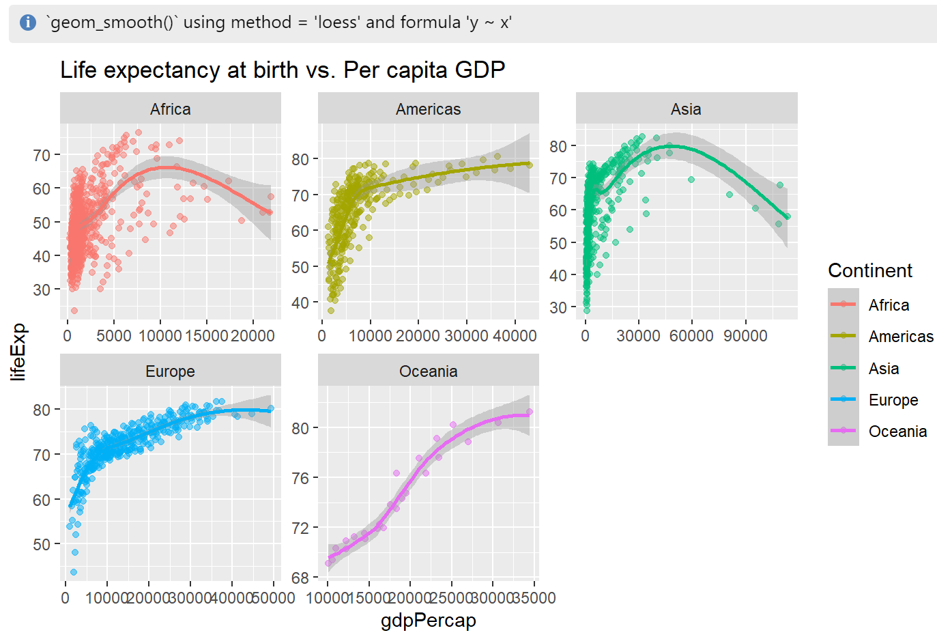
Building up a plot Scatter plot
ggplot(data = gapminder, aes(x = gdpPerCap, y = lifeExp, colour = continent)) +
geom_point(alpha = 0.5) +
geom_smooth() +
facet_wrap(~continent) +
labs(title = “Life expectancy at birth vs. Per capita GDP“, x = “gdpPercap",
y = “lifeExp”, fill = “Continent") +
NULL
Theme
Labels
Coordinates
Facets
Statistics
Geometries
Aesthetics
Data
Notes:
Add in components to the geom_point() – this has picked up the different groupings with the continent column.

Slide 14
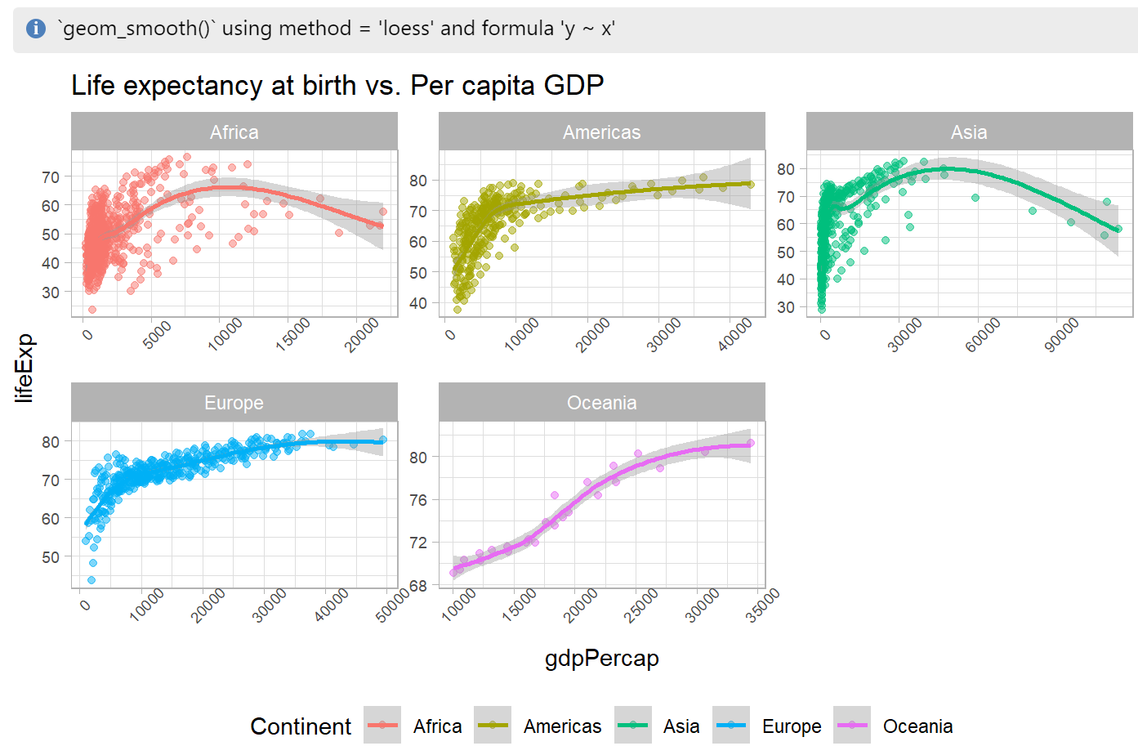
Building up a plot Scatter plot
ggplot(data = gapminder, aes(x = gdpPerCap, y = lifeExp, colour = continent)) +
geom_point(alpha = 0.5) +
geom_smooth() +
facet_wrap(~continent) +
labs(title = “Life expectancy at birth vs. Per capita GDP“, x = “gdpPercap",
y = “lifeExp”, fill = “Continent") +
theme_light() +
theme(axis.text.x = element_text(angle = 45),
axis.text = element_text(size = 7),
legend.position = "bottom") +
NULL
Theme
Labels
Coordinates
Facets
Statistics
Geometries
Aesthetics
Data
Notes:
Add in components to the geom_point() – this has picked up the different groupings with the continent column.

Slide 15
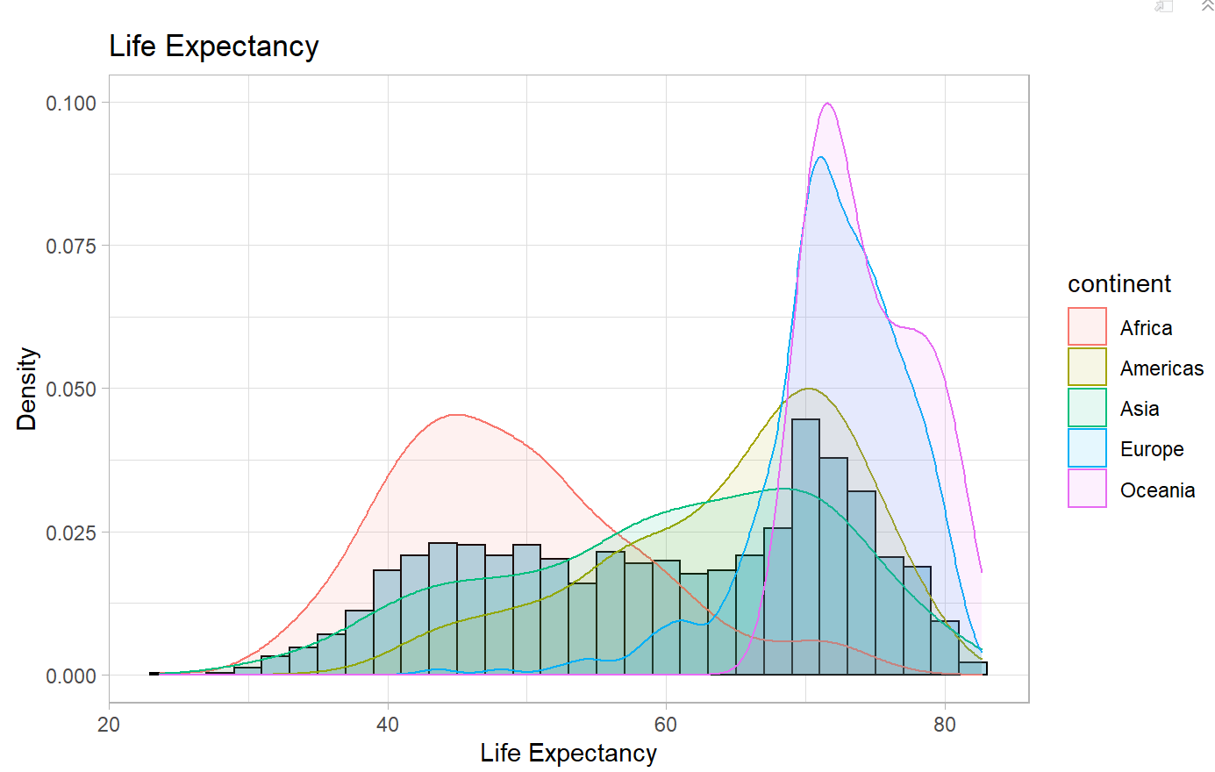
Visualisations and Tables in R Histograms
ggplot(data = gapminder, aes(x = lifeExp)) +
geom_histogram(aes(y = ..density..), binwidth = 2, colour = "black", fill = "lightblue") +
geom_density(aes(colour = continent, fill = continent), alpha = 0.1) +
labs(title = "Life Expectancy", x = "Life Expectancy", y = "Density") +
theme_light() +
NULL
Theme
Labels
Coordinates
Facets
Statistics
Geometries
Aesthetics
Data

Slide 16
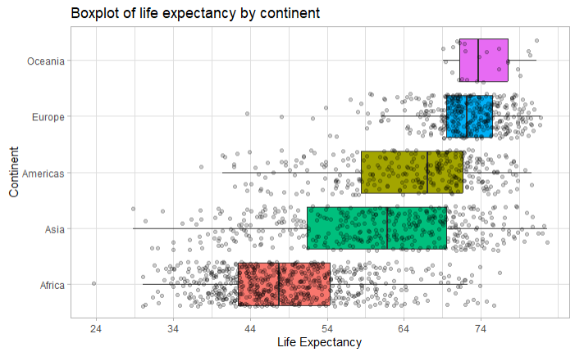
Visualisations and Tables in R Box plots
ggplot(data = gapminder, aes(x = fct_reorder(continent, lifeExp), y = lifeExp, fill = continent)) +
geom_boxplot(outlier.color = NA) +
geom_jitter(alpha = 0.2) +
scale_y_continuous(breaks = round(seq(min(gapminder$lifeExp), max(gapminder$lifeExp), by = 10),0)) +
coord_flip() +
labs(title = "Boxplot of life expectancy by continent", x = "Life Expectancy", y = "Continent") +
theme_light() +
theme(legend.position = "none") +
NULL
Theme
Labels
Coordinates
Facets
Statistics
Geometries
Aesthetics
Data

Slide 17
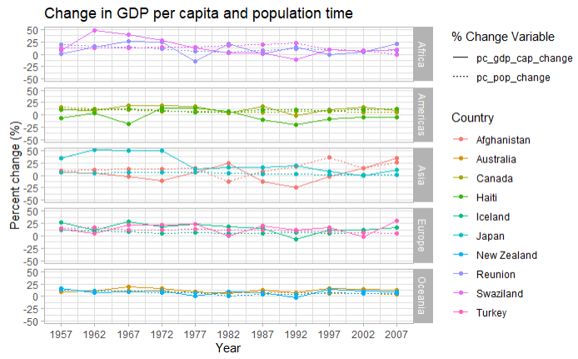
Visualisations and Tables in R Plotting additional features
See workbook for developing this plot by wrangling new features based on the gapminder dataset.

Slide 18
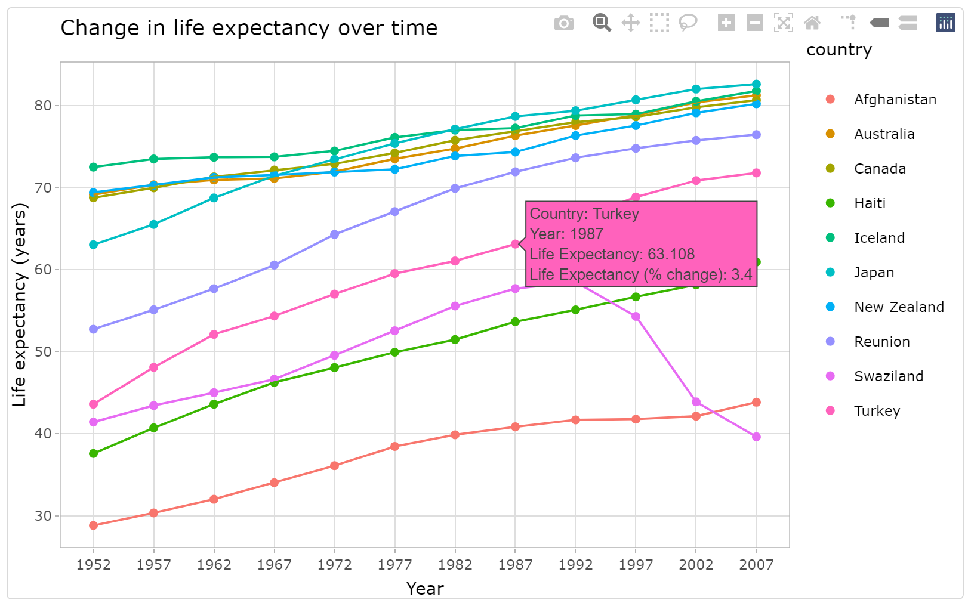
Visualisations and Tables in R Interactive graphs using {plotly}
Can pass ggplot objects to ggplotly() functions in the {plotly} library
ggp_for_plotly <- ggplot(data = df_rate_change %>%
filter(country %in% countries_to_plot), aes(x = year, y = life_exp, colour = country)) +
geom_point(aes(text = paste0("Country: ",country,
"<br>Year: ",year,
"<br>Life Expectancy: ",life_exp,
"<br>Life Expectancy (% change): ", pc_lifeexp_change))) +
geom_line() +
scale_x_continuous(breaks = seq(min(df_rate_change$year), max(df_rate_change$year), by = 5)) +
labs(title = "Change in life expectancy over time", x = "Year", y = "Life expectancy (years)") +
theme_light() +
NULL
plotly::ggplotly(ggp_for_plotly, tooltip = "text")

Slide 19
Considerations and references
Colourblind friendly colours
https://cran.r-project.org/web/packages/viridis/vignettes/intro-to-viridis.html
Cheatsheet
https://ggplot2.tidyverse.org/#cheatsheet
R Gallery
https://r-graph-gallery.com/
Readability over complexity
Mapping correct aesthetics
https://www.datanovia.com/en/blog/ggplot-themes-gallery/
https://rpubs.com/hadley/ggplot2-layers
https://ggplot2.tidyverse.org/articles/ggplot2-specs.html
https://ggplot2.tidyverse.org/reference/geom_smooth.html
https://ggplot2.tidyverse.org/reference/

