Slide 1
There are some stages in this report about spreading rumors we can see
Collect data from website
Read, handle data from csv into pandas
Primal EDA and interactive dashboards
Build Xtrain, ytrain and Xtest, ytest samples
Predictive analytics
EDA with SQL

Slide 2
Higgs Twitter Dataset
We use data from https://snap.stanford.edu/data/higgs-twitter.html
It is information about how discovery Boson Higgs’ rumour is spreading through twitter.
In EDA we can see in what type rumor is spreading (retweet, motions, replies) throught time
In predictive analysis we can see what parametres influence on spreading

Slide 3
Collecting data
We use data from https://snap.stanford.edu/data/higgs-twitter.html
Data has text format, we use for report 2 tables:
social_network.edgelist.gz | Friends/follower graph (directed)*
higgs-activity_time.txt.gz | The dataset provides information about activity on Twitter during the discovery of Higgs boson
Methodology of getting data:
Download .txt files
Use pandas.read_csv
Use network to work with graphs
* Use only half of edges, because memory complexety

Slide 4
EDA methodology
The main goals of EDA analysis:
1) Brief peek of data
2) Understanding of data
3) Detection of outliers and misings
4) Cleaning and prepare data for modeling
The main goals of interactive EDA:
1) See how data changes through time
2) See how relationships between features change through time
3) Recognize changeable patterns
For these goals we use
1) For these goals we use Plotly Dash-related slides
For these goals we use
1) Plot of distribution: histogram
2) Bar or pie plots for categorial data

Slide 5
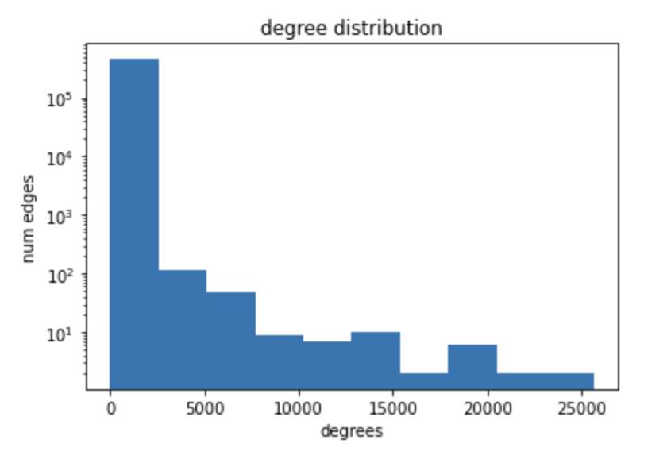
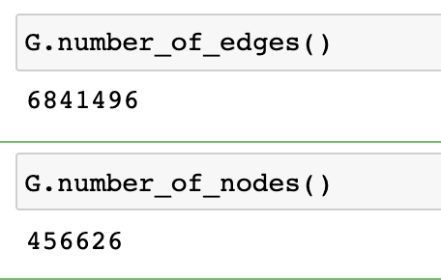
EDA
networkx

Slide 6
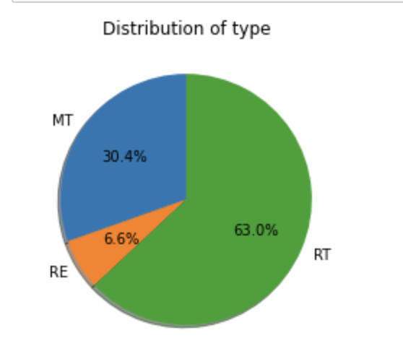
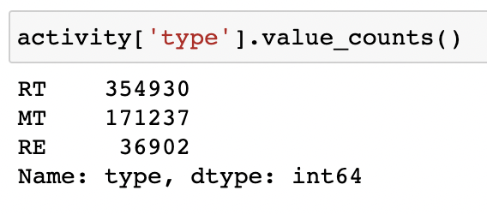
EDA

Slide 7
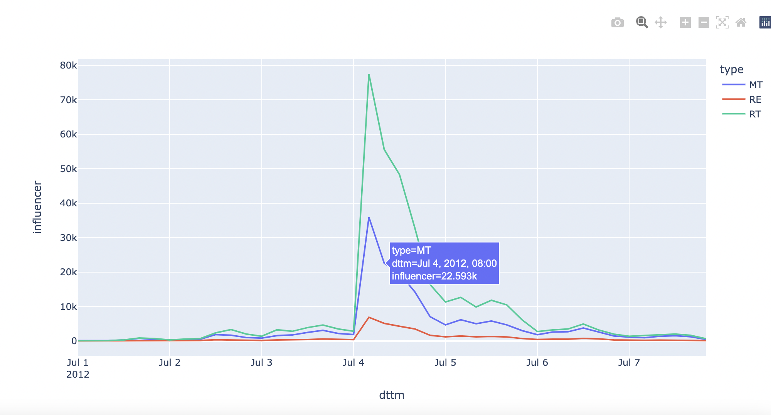
Plotly intearactive graph

Slide 8
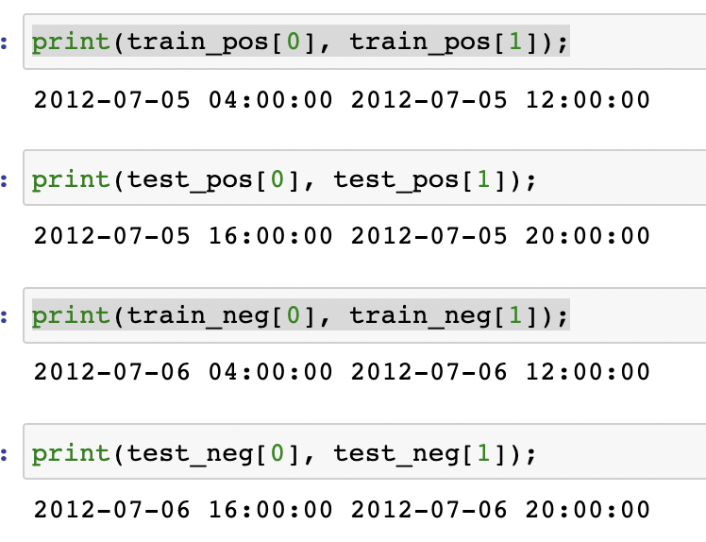
Predictive analytics methodology
We will predict probability of infection in certain time interval
1 – if person is infected in this time interval
0 – if infected later (1 day later)
Divide data on train – test:
Train contains first half of 7 July (positive examples)
and first half of 6 July (negative examples – infected later).
Test contains second half of 7 July (positive examples)
and second half of 6 July (negative examples – infected later).

Slide 9
Predictive analytics methodology
We use these features. They show how many neighbors are infected. So we want to investigate
influence of number of infected neighbors in close area determine fact of infection
 | number | Fraction mentioned | Fraction retweeted | Fraction replies
among followers
among follows

Slide 10
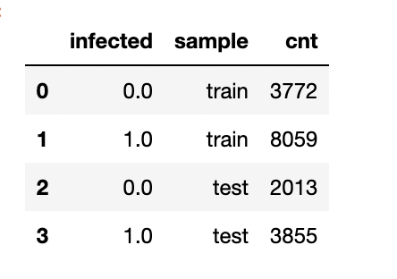
EDA with SQL
We determine train and test sets. In this section we will analyze this tables with SQL (all SQL queries are in jupyter)
1) How many objects in train and test samples?
Insight: through time number of samples decrease. It matches with plotly graph

Slide 11
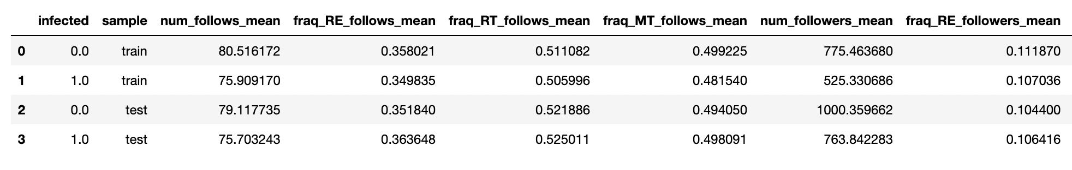
EDA with SQL
2) Mean of all features in samples
Insight: we see that average of infected neirhbors (different types) does not depend on class and sample,
but really depends on time of slice (train_1, test_1, train_0, test_0)

Slide 12
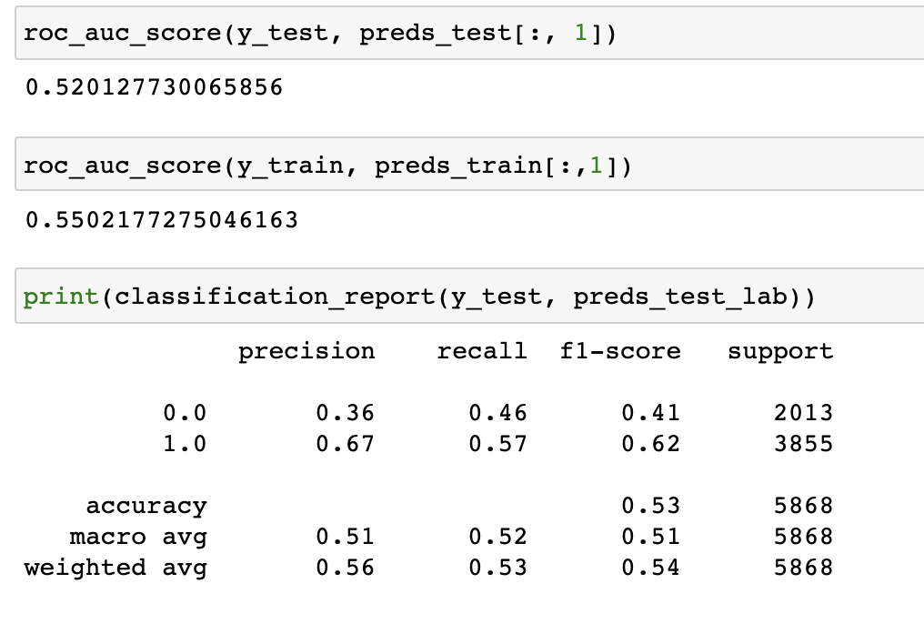
Results of predictive analytics
We use simple logreg without
hyperparametres tunning
Result: we get not very good performance
and metrics, but we can say that
Better performance on class 1

Slide 13
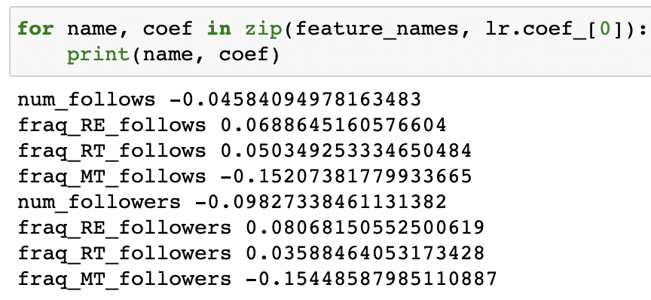
Results of predictive analytics
Yhe main and most interest result is on this slide
We can interpretate values of logreg weights.
coef_i > 0 => more value of feature_i leads
to increase probability of infection
What we see? 1) The higher number of neighbors,
the less probability of infection
2) The higher number of neighbors
that infected with mention,
The less probability of infection
3) Most strength indicator of fast infection is number of
Infection neighbors, infected with retweet

