Slide 1
There are some stages in this report about spreading rumors we can see
Collect data from website
Read, handle data from csv into pandas
Primal EDA and interactive dashboards
Build Xtrain, ytrain and Xtest, ytest samples
Predictive analytics
EDA with SQL

Slide 2
Higgs Twitter Dataset
We use data from https://snap.stanford.edu/data/higgs-twitter.html
It is information about how discovery Boson Higgs’ rumour is spreading through twitter.
In EDA we can see in what type rumor is spreading (retweet, motions, replies) throught time
In predictive analysis we can see what parametres influence on spreading

Slide 3
Collecting data
We use data from https://snap.stanford.edu/data/higgs-twitter.html
Data has text format, we use for report 2 tables:
social_network.edgelist.gz | Friends/follower graph (directed)*
higgs-activity_time.txt.gz | The dataset provides information about activity on Twitter during the discovery of Higgs boson
Methodology of getting data:
Download .txt files
Use pandas.read_csv
Use network to work with graphs
* Use only half of edges, because memory complexety

Slide 4
EDA methodology
The main goals of EDA analysis:
1) Brief peek of data
2) Understanding of data
3) Detection of outliers and misings
4) Cleaning and prepare data for modeling
The main goals of interactive EDA:
1) See how data changes through time
2) See how relationships between features change through time
3) Recognize changeable patterns
For these goals we use
1) For these goals we use Plotly Dash-related slides
For these goals we use
1) Plot of distribution: histogram
2) Bar or pie plots for categorial data

Slide 5
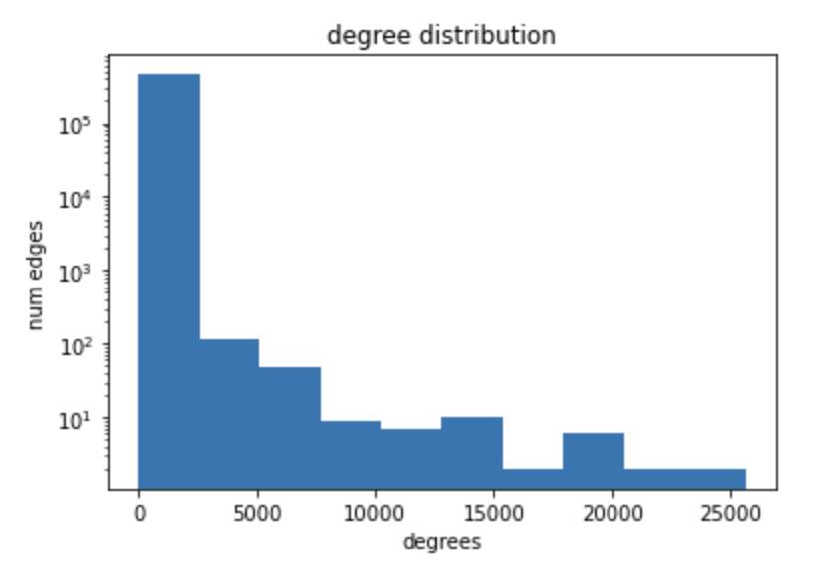
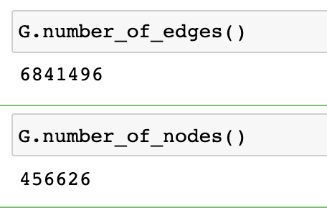
EDA
networkx

Slide 6
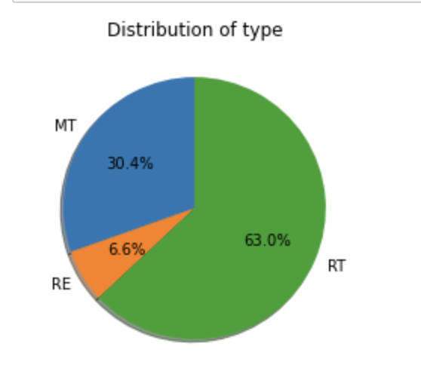
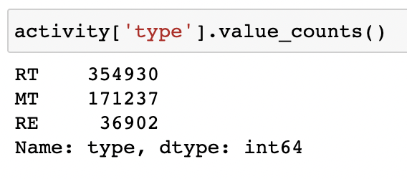
EDA

Slide 7
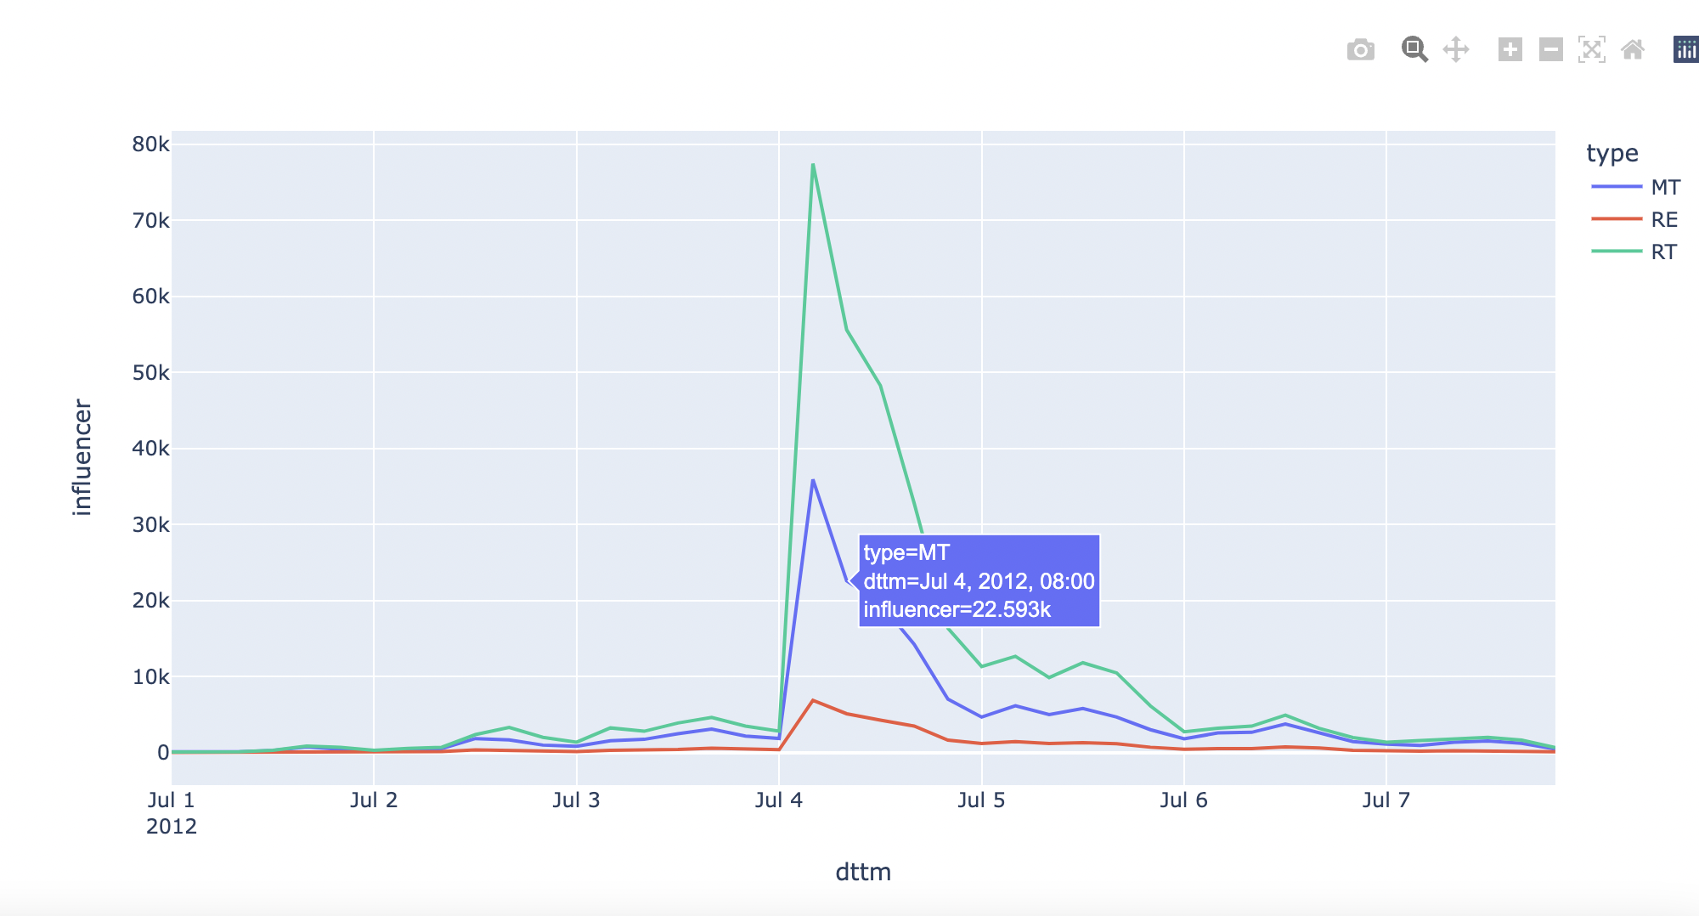
Plotly intearactive graph

Slide 8
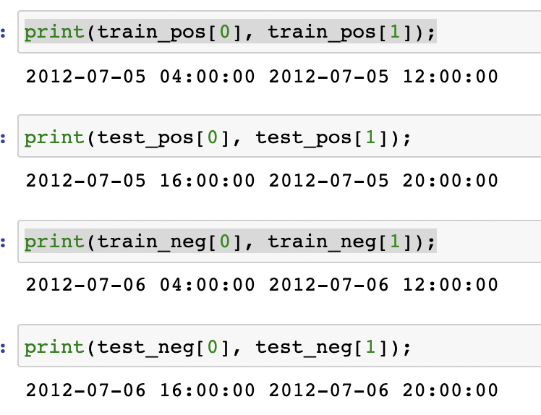
Predictive analytics methodology
We will predict probability of infection in certain time interval
1 – if person is infected in this time interval
0 – if infected later (1 day later)
Divide data on train – test:
Train contains first half of 7 July (positive examples)
and first half of 6 July (negative examples – infected later).
Test contains second half of 7 July (positive examples)
and second half of 6 July (negative examples – infected later).

Slide 9
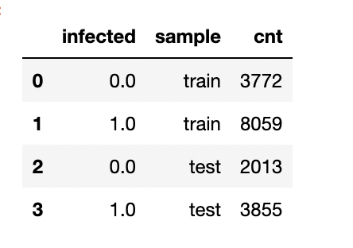
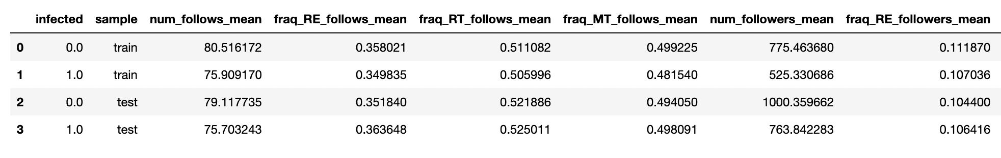
EDA with SQL
We determine train and test sets. In this section we will analyze this tables with SQL (all SQL queries are in jupyter)
1) How many objects in train and test samples?
2) Mean of all features in samples

Slide 10
Predictive analytics methodology
 | number | Fraction mentioned | Fraction retweeted | Fraction replies
among followers
among follows

