Slide 1

WRANGLER
Presentation
Authors:
Olszewska Małgorzata
Polnik Wojciech

Slide 2

What’s that?
WRANGLER?
I know it!

Slide 3

ReFActoring

Slide 4
Refactoring with wrangler
Renaming
Function extraction
Macro managing
Inlining or ‘un/folding’ a function application
Introduction of local variables

Slide 5
Generalisation
-module(test). -export([f/1,add_one/1]). add_one([H|T]) -> [H+1 | add_one(T)]; add_one([]) -> []. f(X) -> add_one(X).
-module(test). -export([f/1,add_one/2]). add_one([H|T],N) -> [H+N | add_one(T,N)]; add_one([],_) -> []. f(X) -> add_one(X,1).

Slide 6
Code Clone
loop_a() ->
receive
{msg, _Msg, 0} -> ok; {msg, Msg, N} -> io:format("ping!~n"), b ! {msg, Msg, N-1}, loop_a() end. loop_b() ->
receive {msg, _Msg, 0} -> ok;
{msg, Msg, N} -> io:format("pong!~n"), a ! {msg, Msg, N-1}, loop_b()
end.
new_fun(Msg,N,New_Var1,New_Var2) -> io:format(New_Var1), New_Var2 ! {msg, Msg, N-1}.
new fun(Msg,N,"ping!~n",b)
new fun(Msg,N,"pong!~n",a)

Slide 7
Features
Supports EUnit , QuickCheck i Common Test
Highlighting local ‘code smells’
Support multi-level ‘undo’
Define refactorings and code inspection functions
Create script composite refactorings
Introduction of process naming

Slide 8

Bugs code

Slide 9
SUMMARY
Target the full language
Produce readable results
Workflow integration
Support incomplete code
Support user decisions
Support user-driven extension
Integrate with other tools

Slide 10

Implementation

Slide 11
InstalLaTioN
Emacs
Eclipse
Load a .erl file.
Start/stop using Ctrl-C, Ctrl-R
To undo any refactoring type Ctrl-C, Ctrl-_
To configure the search directories, select the Customize Wrangler menu option.
Install... -> Search for new features to install
http://download.erlide.org/update/ as URL
Erlang IDE + Wrangler add-on

Slide 12
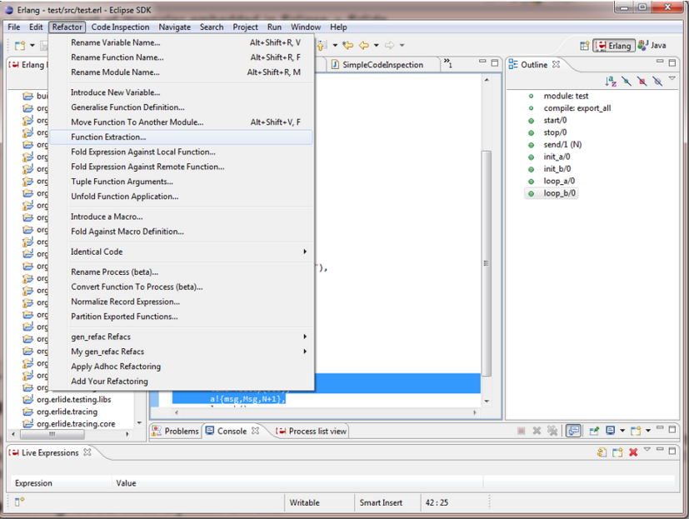

Slide 13
THE END
We appreciate Your attention ☺

