Slide 1


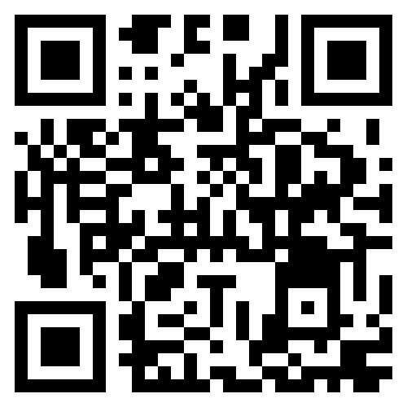
FOLLOW GOSIM
Interact with us on X & Mastodon!
FOLLOW GOSIM Foundation On X & Mastodon
Participate in voting on white paper topics
Become a contributor to GOSIM content think tank
More opportunities to win conference tickets, industry reports,
and exquisite peripheral gifts

Slide 2

Follow GOSIM
Interact with us on X & Mastodon!
FOLLOW GOSIM Foundation On X & Mastodon
Participate in voting on white paper topics
Become a contributor to GOSIM content think tank
More opportunities to win more conference tickets,
industry reports, and exquisite peripheral gifts

