Slide 1
Game AI – Project 01
Summer Semester 2014
Komninos Giorgos, Nikolaou Dimitrios
5 / 5 / 2014

Slide 2
Overview
Introduction to game strategies using tic-tac-toe.
Extension of the provided framework with:
    a probabilistic strategy.
    a decision-tree approach using the Negamax algorithm.
A randomized implementation of connect-four.

Slide 3
Probabilistic Approach
Let two players p1, p2 compete using random moves, over a long series of games.
For each board position, record the amount of wins it contributes to for either player.
After the tournament ends, compute the probability with which a board position contributes to a win.
Run a new tournament with p1 selecting the free board position with the highest winning probability.

Slide 4
EMPTY
Video / screenshot
Pie chart
comment for wins / draws

Slide 5
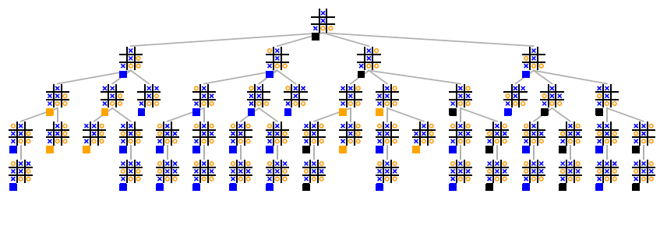
Decision Tree approach
tic-tac-toe is a simple turn-based game.
For such games, we may construct at any given turn a tree representing all possible future developments.
A "smart" player may search into this tree and decide the best move using some heuristic.

Slide 6
Simplifying MINIMAX
We chose to implement the Negamax algorithm.
Essentially the same as the Minimax algorithm, but offers the possibility for a simpler, more elegant implementation.
Considers a node's children from its' point of view by multiplying the nodes of alternating tree levels with -1.
Thus, instead of having a MIN and a MAX player, we have two MAX players that can use the same function.

Slide 7
Simplifying MINIMAX
We chose to implement the Negamax algorithm.
Essentially the same as the Minimax algorithm, but offers the possibility for a simpler, more elegant implementation.
Considers a node's children from its' point of view by multiplying the nodes of alternating tree levels with -1.
Thus, instead of having a MIN and a MAX player, we have two MAX players that can use the same function.

Slide 8
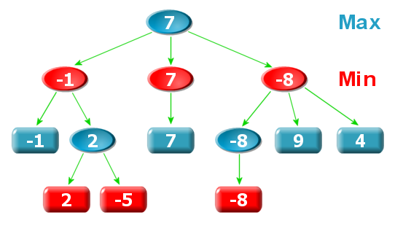
MINIMAX EXAMPLE

Slide 9

NEGAMAX SIMPLIFICATION

Slide 10
EMPTY
Video / screenshot . Maybe a video which shows that with 4-5 games to show that p1 wins
Pie chart for negamax versus randomized
Comment for wins draws losses, mention that p1 playsi optimally because it "looks" the tree until the bottom
Mention complexity to compute a game to show how expensive is the full depth search in the tree
ADD REFERENCES

