Slide 1
CaLender
Emanuil Gospodinov
https://github.com/gospodinove/calender

Slide 2
Инсталация

Slide 3
Използвани технологии

Slide 4
Front end
ReactJS
Material UI
React Router
Redux
Fullcalendar

Slide 5
Back end
ExpressJS
MongoDB
express-session
indicative
Още в документацията

Slide 6
Front end екрани
Day/:date
Week/:startDate/:endDate
Shared/:sharedConfigId
Modals
Login и register
Създаване и редактиране на събития
Потребителски настройки

Slide 7
REST API

Slide 8
POST - api/auth/login
POST - api/auth/register
GET - api/auth/session-user
GET - api/auth/logout
PUT - api/users/preferences
POST - api/events
GET - api/events
DELETE - api/events
PUT - api/event
POST - api/sharedConfig
GET - api/sharedConfig

Slide 9

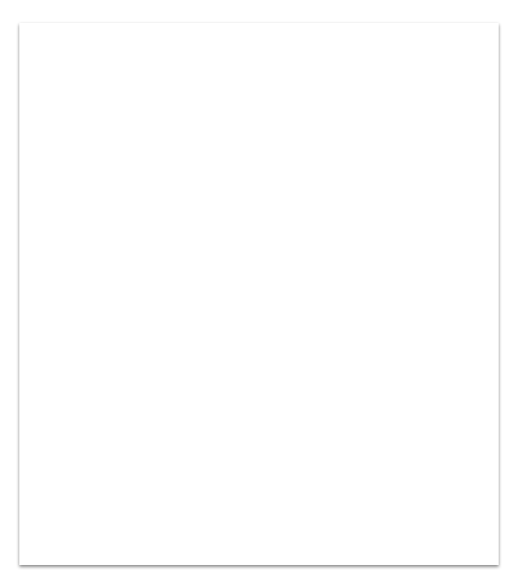
Demo!

