Slide 1
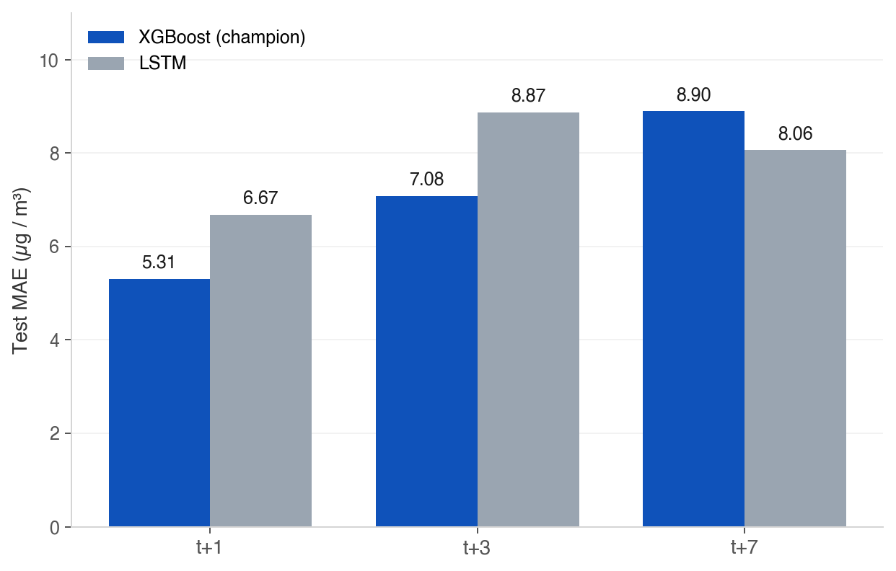
PERFORMANCE · MAE PER HORIZON
XGBoost is champion — 1.36–1.79 µg/m³ lower MAE than LSTM
CHAMPION · XGBOOST (45 features)
MAE t+1
MAE t+3
MAE t+7
5.31
7.08
8.90
Alert F1 0.844
Alert F1 0.723
Alert F1 0.584
WHY XGBOOST WON
• Lower MAE at every horizon (t+1: 5.31 vs 6.67)
• Higher alert F1 at t+1 (0.844 vs 0.753)
• Promoted via ≥5 % MAE gate on 2026-04-18
• Same 45-feature input — fair head-to-head
Test MAE, XGBoost vs LSTM, per forecast horizon
Source: 03_Data/results/xgboost_summary.json · lstm_summary.json

