Slide 1
CAPSTONE · AT82.9002
PRESENTED BY
CAAS
Supanut Kompayak
st126055
Shuvam Shrestha
ChiangMai Air
Quality Alert
System
st125975
COURSE
AT82.9002 Data Engineering and MLOps
PM2.5 forecasting at t+1 / t+3 / t+7 days
Asian Institute of Technology · 2026 cohort
ADVISORS
April 2026
Prof. Chaklam Silpasuwanchai · Prof. Chantri Polprasert
Notes:
Intro: CAAS forecasts PM2.5 at 3 horizons and auto-alerts.

Slide 2
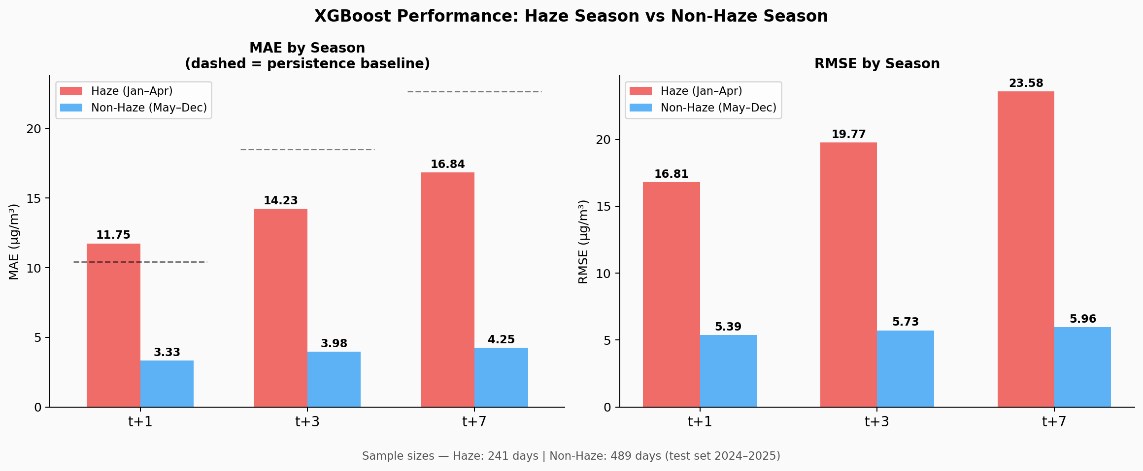
THE PROBLEM
Chiang Mai's PM2.5 crisis — an annual public-health emergency
Every dry season (Feb–Apr), Chiang Mai's air exceeds WHO safe limits by order of magnitude.
PEAK POLLUTION (2024 dry season)
241 µg/m³
PM2.5 — that's 16× the WHO 24-hour limit (15 µg/m³).
IMPACT
• 1.2 M residents in the Chiang Mai metro area
• +12 % all-cause mortality on high-PM days (Thai PCD, 2023)
• Existing air4thai.pcd.go.th publishes current levels only — no forecast
Source: Thai Pollution Control Dept. · WHO AQ guidelines 2021
2 / 14
Notes:
Problem: recurring health crisis, no forecasting today.

Slide 3
OBJECTIVES
Forecast, alert, operate — end-to-end, not just a model
01
02
03
Forecast
Alert
MLOps
Predict daily PM2.5 at t+1, t+3, t+7 days over Chiang Mai with leakage-free chronological validation.
Classify whether each horizon will exceed 50 µg/m³ (Thai PCD alert band) with operationally useful precision/recall.
Deploy the whole stack — ingest, train, serve, monitor — with automated drift detection and champion/challenger promotion.
Differentiator — multi-horizon forecast + fire-feature ablation + production MLOps on a low-budget EC2 footprint.
3 / 14
Notes:
3 objectives: forecast / alert / MLOps. Integration over novelty.

Slide 4
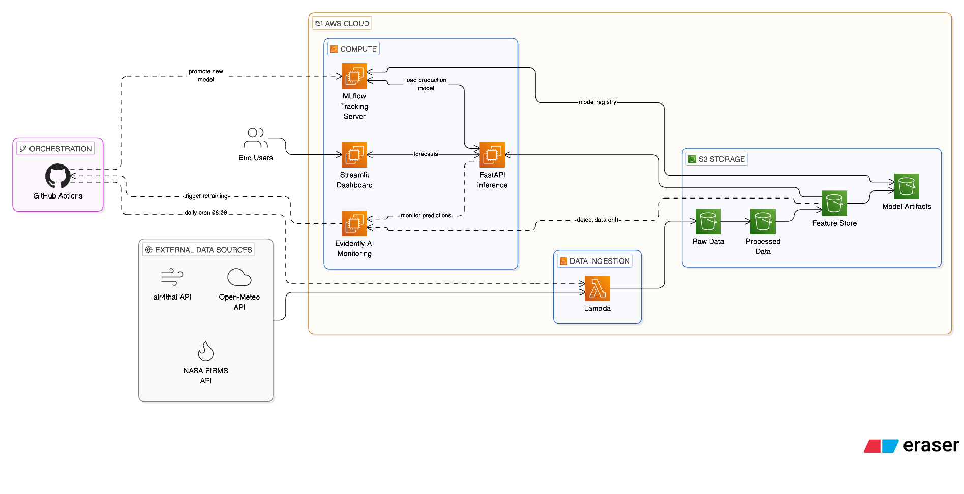
SYSTEM ARCHITECTURE
One ingest path, one feature store, one serving plane
LAYERS
INGEST
3 sources → S3 raw/ (PCD Excel, Open-Meteo, NASA FIRMS)
TRANSFORM
build_features.py → 45 chronological-safe features
TRAIN
XGBoost + LightGBM + LSTM, tracked in MLflow
SERVE
FastAPI /predict + Streamlit dashboard on EC2
MONITOR
Evidently PSI/KS drift + auto-retrain trigger
Infra: AWS S3 + EC2 t3.micro + Terraform IaC
4 / 14

Slide 5
DATA PIPELINE
Three heterogeneous sources → one 45-feature store
Daily cron pulls fresh data; build_features.py produces the training-identical feature vector for inference.
01 INGEST
02 TRANSFORM
03 SERVE
• Thai PCD PM2.5 — Excel archives (2011 → now)
• Open-Meteo — hourly weather JSON API
• NASA FIRMS — daily fire hotspots (MAP_KEY)
• S3 tiered: raw/ → processed/ → models/
• build_features.py — single source of truth
• Lag features: pm25_lag{1,3,7}
• Rolling windows: 3d / 7d / 14d aggregates
• Burn-load: firms_24h_count, brightness_max
• features.csv (45 cols) → XGBoost / LightGBM / LSTM
• FastAPI /predict returns t+1/3/7 in one call
• Alert decision via Scenario C PR thresholds
• Champion auto-promoted on ≥5 % MAE improvement
Features: 03_Data/processed/features.csv · build script: 04_Scripts/build_features.py
5 / 14

Slide 6
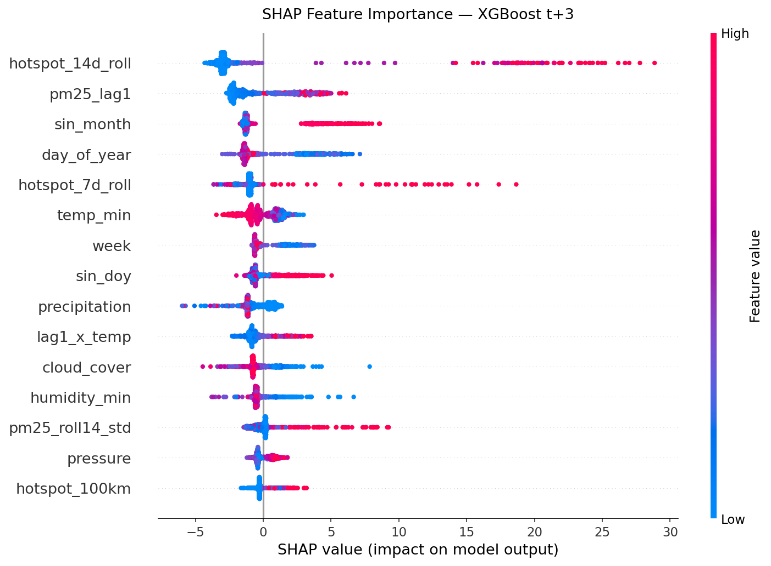
FEATURE ENGINEERING
Signal shifts from autocorrelation to weather as horizon grows
DOMINANT DRIVERS BY HORIZON
T+1 DAY
pm25_lag1, pm25_roll3_mean — same-day autocorrelation.
T+3 DAYS
firms_24h_count, brightness_max — burn-load climbs into top 5.
T+7 DAYS
wind_speed_7d, temperature_7d — atmospheric regime dominates.
Mirrors atmospheric physics — PM2.5 transport and boundary-layer evolution.
SHAP values: 03_Data/results/shap_summary.json
6 / 14

Slide 7
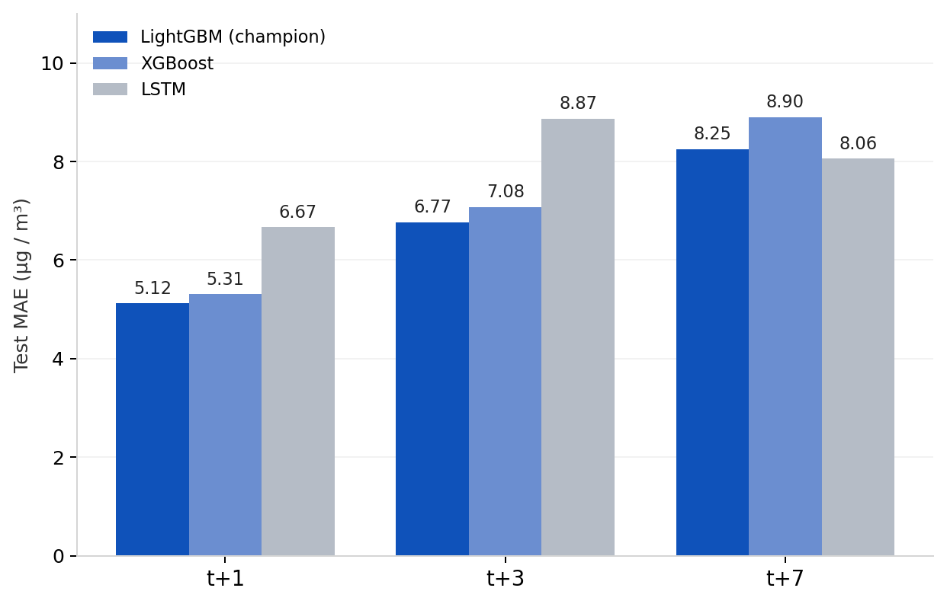
MODELS COMPARED
LightGBM is champion — lower MAE than XGBoost and LSTM at every horizon
CHAMPION · LIGHTGBM (45 features)
MAE t+1
MAE t+3
MAE t+7
5.12
6.77
8.25
Alert F1 0.852
Alert F1 0.747
Alert F1 0.713
WHY LIGHTGBM WON
• Lower MAE at every horizon (5.12 vs XGBoost 5.31 at t+1)
• Best alert F1 at t+1 (0.852) — operationally usable
• Same 45-feature input — fair head-to-head
• Promoted via ≥5 % MAE gate on 2026-04-18
Test MAE per horizon — LightGBM (champion), XGBoost, LSTM
Source: 03_Data/results/{lightgbm,xgboost,lstm}_summary.json
7 / 14
Notes:
Champion selection: LightGBM beats XGBoost at all horizons, beats LSTM except t+7 R².

Slide 8
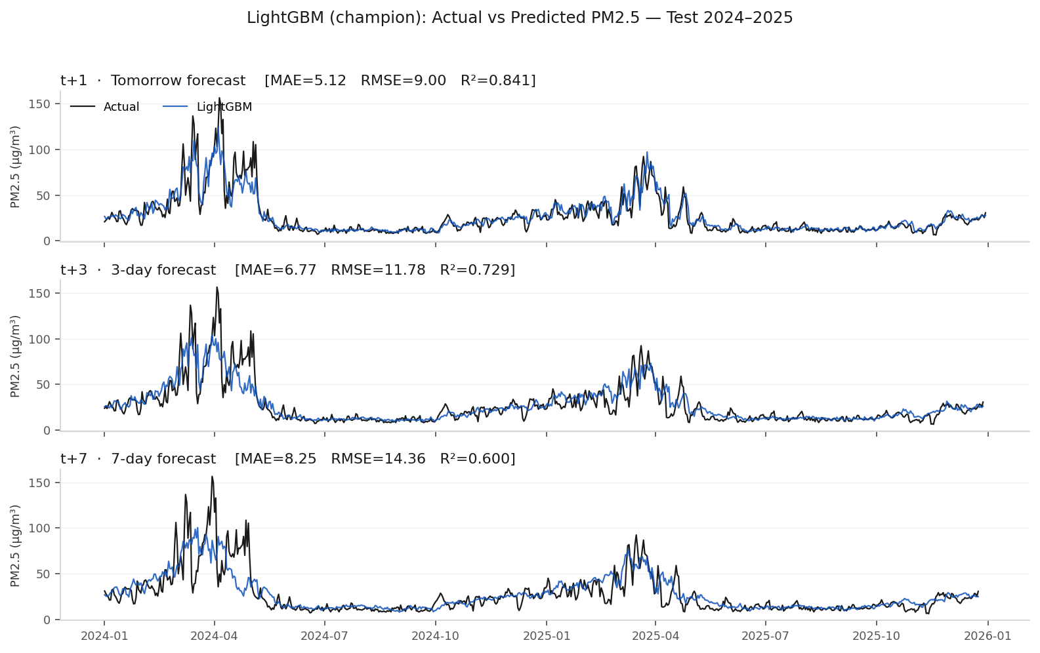
FORECAST QUALITY
LightGBM tracks observed PM2.5 — including the 2024 dry-season peaks
TEST-SET METRICS
R²
0.841
at t+1
RMSE
9.00
at t+1 (µg/m³)
AUROC
0.992
alert · t+1
Source: 03_Data/results/lightgbm_summary.json + predictions CSV
8 / 14

Slide 9
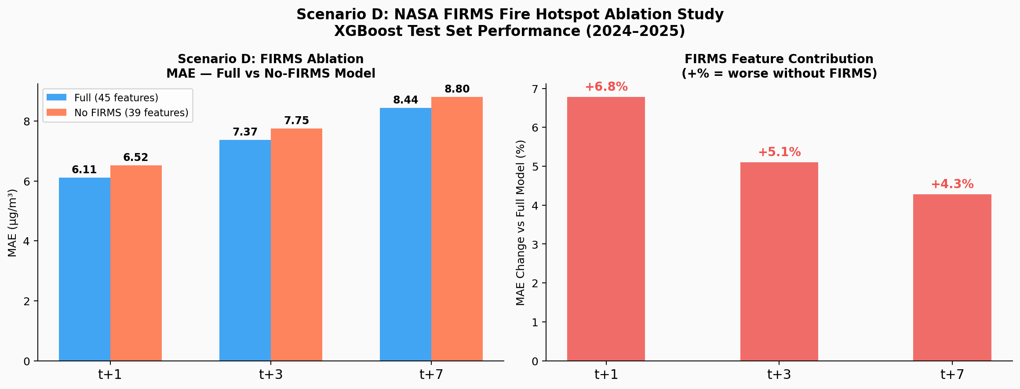
ABLATION & ALERT THRESHOLDS
Fire features matter — and PR-tuned thresholds sharpen the alert
SCENARIO C · PR-TUNED ALERT THRESHOLDS
Default 50 µg/m³ band tuned per horizon for F1-optimal precision/recall.
t+1
t+3
t+7
53.7
51.0
45.8
µg/m³ threshold
µg/m³ threshold
µg/m³ threshold
+4.0 % F1 gain
+0.2 % F1 gain
+1.1 % F1 gain
TAKEAWAYS
• Removing FIRMS degrades MAE by 4.3 – 6.8 % — fires are signal, not noise
• PR-tuned thresholds lift F1 up to 4.0 points at t+1
• Lower threshold at t+7 (45.8) captures early-warning regime
T+1 DAY
T+3 DAYS
T+7 DAYS
+6.8%
+5.1%
+4.3%
MAE worse w/o FIRMS
MAE worse w/o FIRMS
MAE worse w/o FIRMS
Source: ablation_summary.json · scenario_c_summary.json
9 / 14

Slide 10
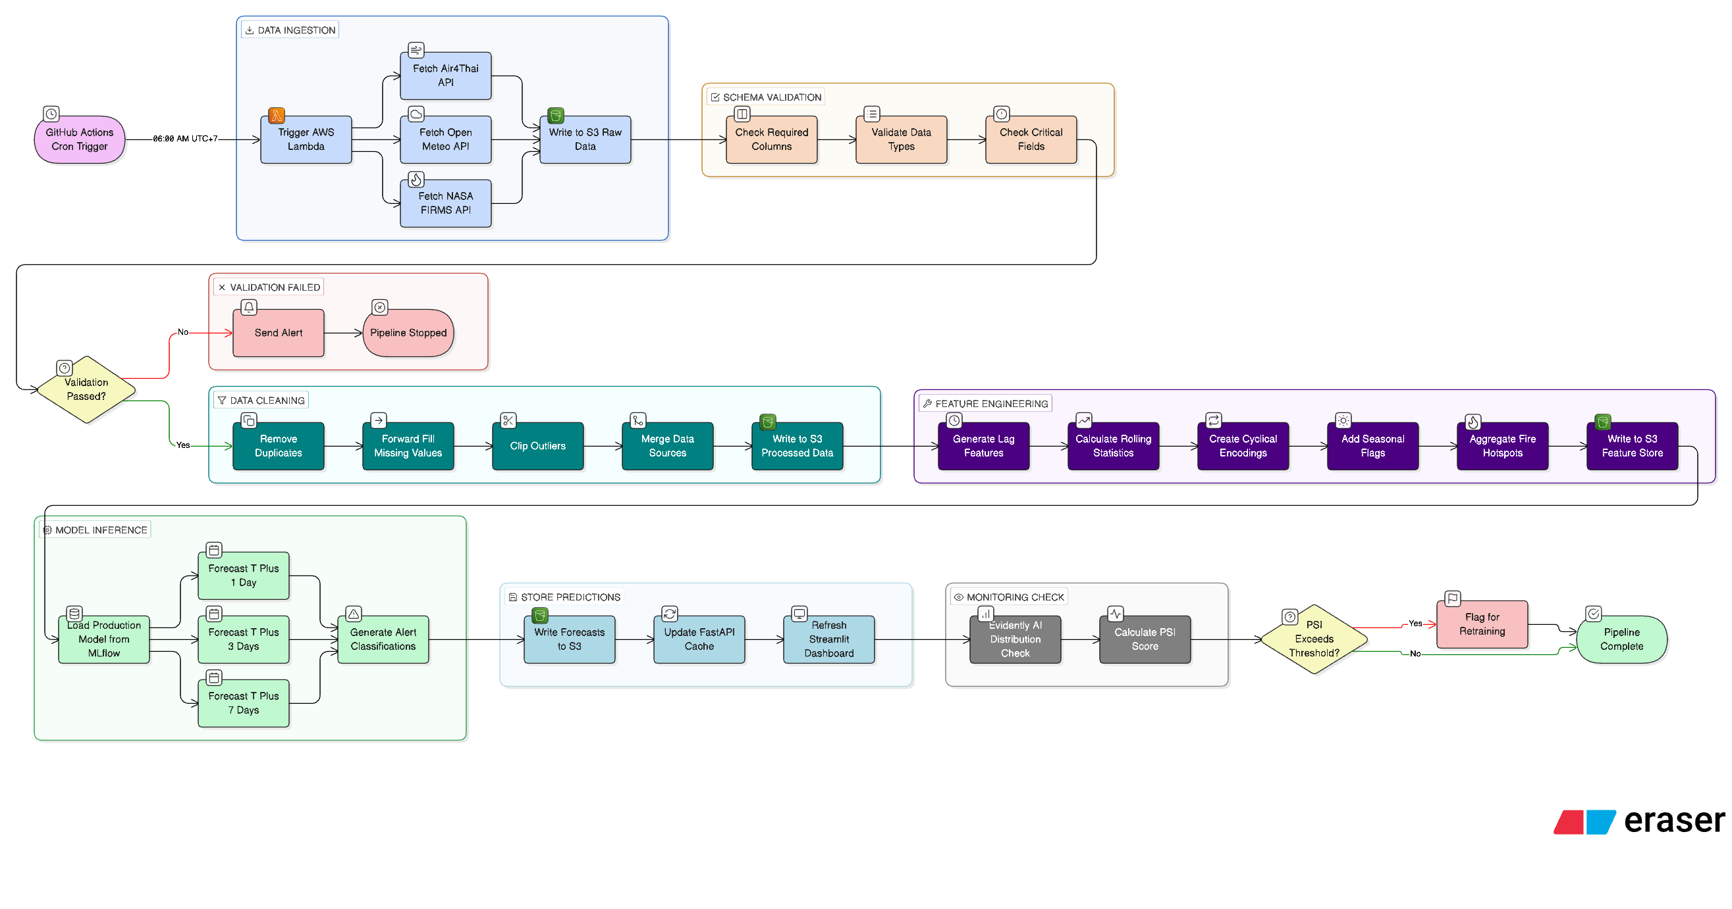
MLOPS STACK
Daily pipeline + retrain loop — zero-touch when drift stays below policy
GITHUB ACTIONS
test.yml
pytest · 45 tests · on every push
daily_pipeline.yml
every 3 h — ingest → predict → upload
drift_check.yml
PSI + KS on rolling 30-day window
retrain.yml
triggered when core_drift ≥ 2
🛑 validate_candidate.py blocks promotion
if challenger fails ≥5 % MAE gate
Workflows: .github/workflows/ · MLflow tracking: mlruns/
10 / 14

Slide 11
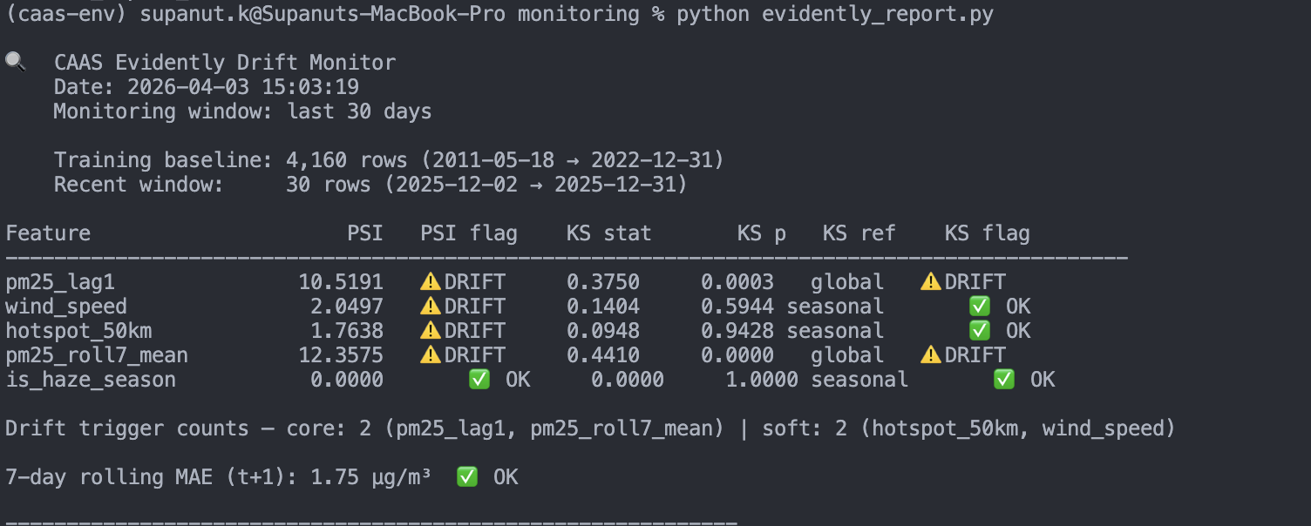
MONITORING & DRIFT
Seasonal-aware drift monitor — today's run flagged 2 core + 2 soft drifts
LATEST RUN · 2026-04-21 17:45 +07
retrain_needed = True
CORE DRIFTS
SOFT DRIFTS
MAE FLAG
2
2
0
DRIFTED FEATURES
• pm25_lag1, pm25_roll7_mean (core)
• hotspot_50km, wind_speed (soft)
RETRAIN POLICY
Trigger when core≥2 OR (core≥1 AND soft≥2). is_haze_season is a non-trigger feature — seasonal variation is expected, not drift.
Policy: 05_Reference/monitoring_drift_policy_update_2026-04-03.md
11 / 14

Slide 12
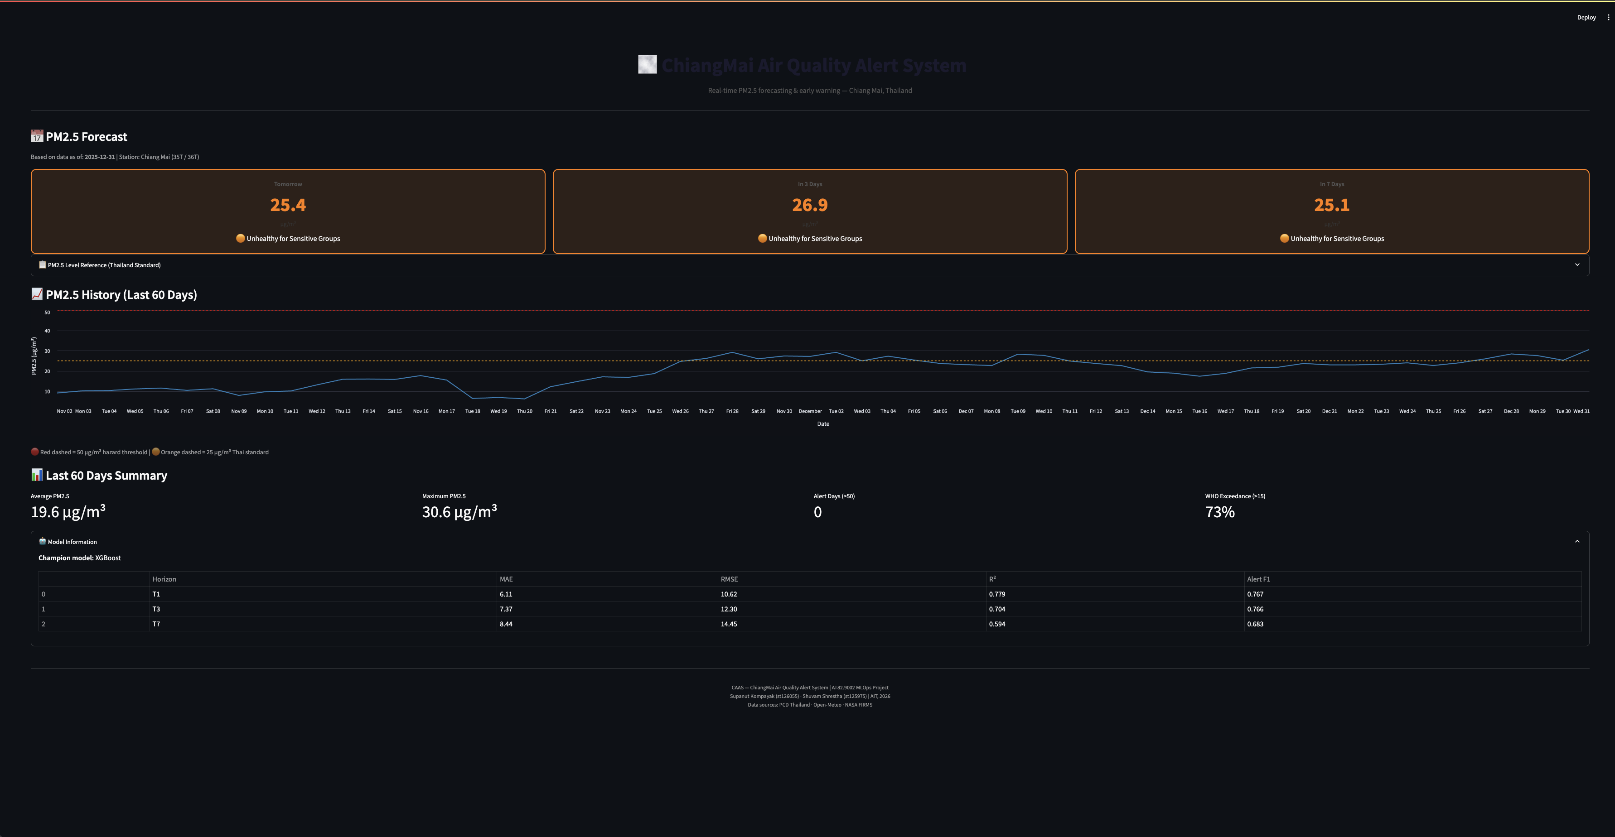
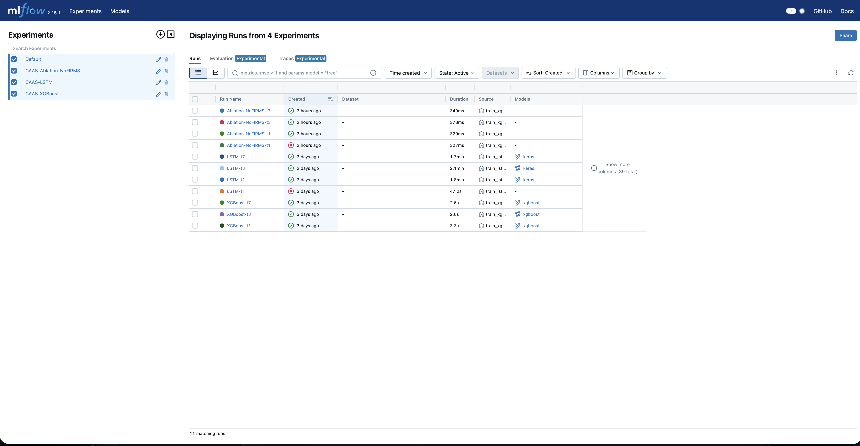
LIVE DEMO
From commit to forecast — every stage is observable
01 STREAMLIT
02 FASTAPI
$ curl -X POST 13.250.17.6:8000/predict
-d '{"date":"2026-04-22"}'
{ "t+1": 42.1, "alert_t1": false,
"t+3": 58.4, "alert_t3": true,
"t+7": 71.2, "alert_t7": true,
"model": "lightgbm", "version": "v3" }
03 MLFLOW
04 ACTIONS
test.yml · pytest 45/45 ✓
daily_pipeline.yml · ingest + predict + upload ✓
drift_check.yml · PSI / KS ✓
retrain.yml · challenger → promote ✓
Demo flow: Streamlit · FastAPI · MLflow · GitHub Actions (~3 min)
12 / 14

Slide 13
COST & SCALABILITY
End-to-end MLOps stack for about $0.55 per day
DAILY COST BREAKDOWN (AWS ap-southeast-1)
SCALABILITY PATH
COMPONENT
USD / DAY
NOTES
SPOT INSTANCE
EC2 spot can cut compute by ~70 % for retrain only
EC2 t3.micro (24 h)
$0.24
Host FastAPI + Streamlit + MLflow
S3 storage (~1 GB)
$0.03
raw/processed/models tiers
LAMBDA INFERENCE
Move /predict to Lambda when QPS > 10 k/day
S3 requests + egress
$0.05
Daily inference pulls
GitHub Actions minutes
$0.18
4 workflows, mostly cached
SCHEDULED SHUTDOWN
Only run MLflow UI on demand (dev credentials)
NASA FIRMS + Open-Meteo
$0.00
Free tiers, MAP_KEY only
MULTI-REGION
TOTAL
$0.55
~$16.50 / month
Replicate to BKK region for sub-50 ms p99 latency
Pricing: AWS ap-southeast-1, on-demand, April 2026
13 / 14

Slide 14
CONCLUSION
Integration over novelty — a production-shaped PM2.5 forecaster for Chiang Mai
01
02
03
Forecast delivered
Alert system deployed
MLOps end-to-end
LightGBM champion: MAE 5.12 / 6.77 / 8.25 µg/m³ at t+1 / t+3 / t+7 on 2-year chronological test set.
Scenario-C tuned thresholds give F1 0.88 (t+1) — operationally usable. FIRMS fire features contribute 4–7 % of MAE.
Daily pipeline + PSI/KS drift + champion/challenger promotion — all in CI for ~$0.55 / day.
FUTURE WORK
• Sub-daily ingest — swap PCD Excel for hourly stations (lower t+1 MAE further)
• Spatial extension — multi-station grid for provincial alert
• Probabilistic forecasts — quantile regression to expose uncertainty to the alert layer
THANK YOU · QUESTIONS? · github.com/gossbu666/MLOPS_CAAS
14 / 14

