Slide 1
NLP Project Progress Update
TempoRAG-KG
Temporal Knowledge Graph-Augmented Retrieval
for Multi-Hop Question Answering
Supanut Kompayak · Aphisit Jaemyaem · Dechathon Niamsa-ard · Kaung Hein Htet
Asian Institute of Technology
1 / 7
Notes:
Good Morning everyone today we are going to present progress update of TempoRAG-KG

Slide 2
From Wikipedia QA to SEC 10-K filings
 | Proposal round | Progress round
Dataset | HotpotQA + MuSiQue (Wikipedia multi-hop) | 25 × 10-K filings (5 tech mega-caps × 5 fiscal years)
Core limitation we hit | Facts lack explicit year anchors; Wikipedia spans decades with no canonical "as of" date | Every 10-K is filed for a specific fiscal year — year is metadata, not inference
Why it matters for us | Can't evaluate temporal filtering when ground-truth time itself is ambiguous | Temporal correctness is testable — filter right year, get right fact
Notes:
Before we dive into the progress report, let me quickly walk you through what changed once we started building.
In the proposal, our plan was to evaluate temporal retrieval on HotpotQA and MuSiQue — two standard multi-hop QA benchmarks built on Wikipedia.
But once we set up the evaluation, we hit a problem: the questions in these datasets don't really carry timestamps. A question like "Who is Apple's CEO?" doesn't specify when — and Wikipedia itself has no canonical "as-of" date, because the pages keep getting rewritten.
So we discussed this with our TA, Gun. He pointed out that these aren't really the right datasets for evaluating temporal question answering and he recommended we move to a corpus with a cleaner temporal signal: SEC 10-K filings, which are public financial disclosures from the tech sector.
That's what you see on the right. We're now working with 25 filings — five tech mega-caps over five fiscal years. Every 10-K is filed for a specific fiscal year, so the year lives in the filing metadata, not in the text. That means temporal correctness becomes testable: if the question asks about fiscal year 2022, the retriever should surface the 2022 filing, not 2019.
Everything else from the proposal stayed the same — the KG²RAG backbone, the validity-interval schema, the three-layer ablation. Only the corpus moved.
On the next slide, I'll show the research questions and where we stand today.

Slide 3
Research questions & experimental design
# | Question
RQ1 | Where does KG²RAG fail on temporal multi-hop QA?
RQ2 | Does TempoRAG-KG lift F1 over KG²RAG?
RQ3 | How accurate is temporal extraction?
RQ4 ★ | Can small-LM + temporal-KG ≈ large-LM alone?
RQ4 hypothesis: Temporal grounding closes the small-vs-large capability gap on temporal QA.
Test: 2 × 2 factorial · 7 models · 129 Qs
 | No KG | + KG
No Temporal | Vanilla | KG²RAG
+ Temporal | TimeFilter | TempoRAG-KG
Notes:
We have four research questions, RQ4 is new question after we have some change: can a small model paired with a temporal knowledge graph match what a large model does on its own? Our hypothesis is that temporal grounding closes the small-vs-large capability gap on temporal QA.
To test it, we run a 2 × 2 factorial design — with or without a knowledge graph on one axis, with or without a temporal filter on the other — across seven LLMs and 129 hand-vetted questions.
That gives us four conditions: Vanilla as the baseline, TimeFilter adds just the temporal filter, KG²RAG adds just the graph, and TempoRAG-KG is the full system combining both.
On the next slide, I'll show the pipeline that runs all four.

Slide 4
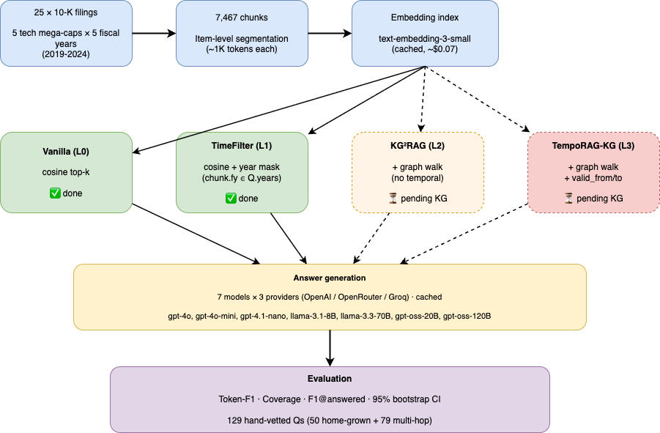
Pipeline
Notes:
Here's the full pipeline, left to right. We start with 25 10-K filings from 2019 to 2024, segmented at the item level into about 7,500 chunks of roughly 1,000 tokens each, then embedded with OpenAI's text-embedding-3-small. The whole index cost about seven cents and it's fully cached.
From there, we fan out into the four retrieval conditions from the previous slide. Vanilla and TimeFilter — the two "no-KG" branches in green — are both done. The two "+KG" branches, KG²RAG and TempoRAG-KG, are waiting on the knowledge-graph build, which is currently running.
Every retrieved context then goes through the same answer-generation step — seven models across three providers, all cached — and ends in the same evaluation: token-F1, coverage, and F1 on answered rows, each with a 95% bootstrap confidence interval, on 129 hand-vetted questions.
On the next slide, I'll show the results for the two conditions we've completed.

Slide 5
Temporal filtering lifts F1 on all 7 models (+5.6% to +24.7%)
Model | Vanilla F1 | +TimeFilter | Δ F1 % | Van cov | TF cov | Δ cov | F1@ans V→T
gpt-4.1-nano | 0.229 | 0.258 | +12.7% | 63.6% | 70.5% | +7.0pp | 0.360 → 0.366
gpt-4o-mini | 0.230 | 0.248 | +7.8% | 58.1% | 62.8% | +4.7pp | 0.396 → 0.395
gpt-4o | 0.183 | 0.221 | +20.9% | 47.6% | 56.6% | +9.0pp | 0.385 → 0.391
llama-70b | 0.145 | 0.179 | +23.7% | 43.4% | 53.5% | +10.1pp | 0.333 → 0.335
llama-8b | 0.145 | 0.180 | +24.7% | 48.1% | 57.4% | +9.3pp | 0.301 → 0.314
gpt-oss-120b | 0.131 | 0.138 | +5.6% | 35.7% | 38.8% | +3.1pp | 0.366 → 0.356
gpt-oss-20b | 0.120 | 0.145 | +21.0% | 37.2% | 42.6% | +5.4pp | 0.320 → 0.336
Universal lift — 7/7 models improved (+5.6% to +24.7% F1).
Coverage drives F1 — Δ cov +3 to +10pp; F1@answered stays flat ≈ 0.35. Bottleneck is retrieval, not answer quality.
Small-model benefit — llama-8b +24.7%, gpt-oss-20b +21.0% vs gpt-4o-mini +7.8%. Early signal for RQ4 capability parity.
Notes:
Here are our results so far — L0 Vanilla versus L1 TimeFilter, across 7 models and 129 questions.
The headline: adding a simple year-based temporal filter lifts F1 on every single model. The Δ-F1 column in green ranges from plus 5.6% at the low end to plus 24.7% at the high end. So the direction is unambiguous.
I want to call out three observations.
First — the lift is universal. Seven out of seven models improved. Not a single case where adding the filter hurt.
Second — coverage is what drives the F1 gain. The blue column shows coverage jumped 3 to 10 percentage points across the board, while F1 on answered rows stayed essentially flat around 0.35. That means the temporal filter isn't making answers more accurate — it's making more questions answerable. The bottleneck is retrieval, not answer quality. This is the first direct signal that a retrieval-level intervention is doing real work.
Third — small models benefit more than the mid-tier model. Llama-8B got plus 24.7%, GPT-OSS-20B got plus 21%, while GPT-4o-mini got only plus 7.8%. Small models were leaving the most on the table, and temporal filtering gives it back. That's the early directional signal for RQ4.
On the next slide: where we're still leaving performance on the table — which motivates adding the knowledge graph.

Slide 6
Where TimeFilter hits its ceiling
Hop count | Vanilla F1 | TimeFilter F1 | Δ | n
hop = 1 | 0.337 | 0.206 | -0.131 | 10
hop = 2 | 0.234 | 0.281 | +0.048 | 104
hop = 3 | 0.123 | 0.131 | +0.007 | 15
Scope | Vanilla F1 | TimeFilter F1 | Δ | n
inter_year | 0.220 | 0.276 | +0.055 | 53
cross_company | 0.264 | 0.315 | +0.051 | 24
intra | 0.216 | 0.216 | -0.001 | 45
fiscal_vs_calendar | 0.301 | 0.222 | -0.079 | 5
forward_looking | 0.138 | 0.157 | +0.019 | 2
TimeFilter shines on year-sensitive questions — inter_year +0.055, cross_company +0.051. Exactly where a year mask should help.
No lift on intra (same-year) questions — Δ ≈ 0. Year filter is a no-op when the question and all candidate chunks share one year.
hop = 3 barely moves — Δ = +0.007 (n=15). Multi-hop reasoning needs entity cross-linking, which metadata alone cannot provide.
→ This motivates KG²RAG and TempoRAG-KG — graph walks add the cross-chunk relations TimeFilter is blind to.
Notes:
This is the same gpt-4.1-nano data from the previous slide, but sliced by question type to show where the temporal filter helps and where it hits a ceiling.
On the left, sliced by hop count: two-hop questions, which are 104 of the 129, got a solid plus 0.048. But three-hop questions barely moved — plus 0.007. The hop-1 dip looks alarming at minus 0.131, but that's only 10 questions, and those are easy cases where vanilla already scores 0.34.
On the right, sliced by scope: inter-year questions got plus 0.055, cross-company got plus 0.051 — exactly where a year mask should help. But intra-year questions, where the question and all candidate chunks share the same year, are completely flat. The filter has nothing to filter.
The takeaway: a metadata-level year filter works when time is the discriminating signal — but it's blind to multi-hop entity chains. Three-hop reasoning needs cross-chunk entity linking, and metadata alone cannot provide that.
That's exactly what KG²RAG and TempoRAG-KG add: graph walks across the cross-chunk relations TimeFilter is blind to. On the next slide, I'll show the state of that work.

Slide 7
What's next — KG extraction and the L2 / L3 lanes
KG extraction (running)
Remaining work
Stage | Detail
Corpus | 7,467 chunks from 25 × 10-K filings
Extractor | gpt-4.1-nano, temporal-aware prompt
Schema | (subject, predicate, object, valid_from, valid_to)
Progress | Running (live + cached), mid-sweep
Budget | Well under $20 cap
1. Finish extraction — complete full 7,467-chunk pass.
2. Filter pass — drop noisy triples (e.g. object="true", comparative artifacts).
3. Build KG²RAG retriever — seed chunk → graph walk → expanded context.
4. Build TempoRAG-KG retriever — KG²RAG + hard mask on valid_from / valid_to.
5. Run L2 + L3 sweeps — same 7 models × 129 Qs.
6. Interaction analysis — hop × scope × condition, test whether L3 > L1 + L2.
Notes:
Now I will explain what we are doing next.
We are building a knowledge graph from our data.
For each text, we extract simple facts and also add time information.
This helps us answer time-based questions.
Right now, the process is still running.
After that, we will clean the data,
then build two systems:
one using the graph, and one using both graph and time.
Finally, we will test them and compare the results.

Slide 8
Takeaways
1. TimeFilter baseline proven — +5.6% to +24.7% F1 across 7 models; lift is universal, not model-specific.
2. Retrieval, not answer quality, is the bottleneck — F1@answered stays flat around 0.35 while coverage moves +3 to +10pp. Any further lift must come from better retrieval.
3. Small models benefit more than large — llama-8b +24.7% vs gpt-4o-mini +7.8%. Directional support for the RQ4 capability-parity story.
4. Multi-hop is next — TimeFilter cannot lift hop = 3 (+0.007). KG²RAG and TempoRAG-KG will target exactly this gap.
Notes:
To conclude, there are four main points.
First, adding a temporal filter improves all models
by around 5 to 25 percent.
Second, the main problem is retrieval, not the model itself.
The answer quality stays similar, but the model can answer more questions.
Third, small models improve more than large ones.
Last, multi-hop questions are still hard.
This is why we need the knowledge graph.
Thank you.

