Slide 1
NLP Project Proposal
TempoRAG-KG
Temporal Knowledge Graph-Augmented Retrieval
for Multi-Hop Question Answering
Supanut Kompayak · Aphisit Jaemyaem · Dechathon Niamsa-ard · Kaung Hein Htet
Asian Institute of Technology
1 / 7
Notes:
Our project is called TempoRAG-KG — Temporal Knowledge Graph-Augmented Retrieval for Multi-Hop Question Answering. The core idea is simple: we want KGs to be time-aware.

Slide 2
We noticed a gap in KG²RAG
(Soman et al., 2024)
What the Knowledge Graph stores:
System response:
Retrieves both facts
↓
CONFLICT
No way to decide
↓
✗ Hallucinates
Steve Jobs · CEO_of · Apple
Query:
"Who was CEO
of Apple
in 2005?"
Tim Cook · CEO_of · Apple
⚠ No temporal info — both look equally valid
Key observation: KG triples are stored as timeless facts. the retriever has no mechanism to resolve which is valid at query time.
2 / 7
Notes:
We were studying KG²RAG and noticed something fundamental. When you build a knowledge graph from text, you get triples like these — Steve Jobs, CEO_of, Apple. Tim Cook, CEO_of, Apple. Both stored exactly the same way, with no timestamp attached.
Now ask: Who was the CEO of Apple in 2005? The retriever pulls both facts. It has no way to decide which is valid in 2005. So it either hallucinates, or picks randomly.
This isn't a model capability problem. It's a structural problem — the KG itself has no concept of time.

Slide 3
Why It Matters
35.0%
38.3%
46.7%
HotpotQA questions
have temporal expressions
MuSiQue questions
have temporal expressions
in 4-hop questions
↑ harder = more temporal
The Research Gap
No existing KG-RAG system — including KG²RAG, GEAR, GraphRAG, or GoG — attaches temporal validity to KG triples or filters stale facts by time.
TempoRAG-KG is the first framework to do this on general-domain unstructured text.
3 / 7
Notes:
And this matters more than you'd think. We did EDA on both our target datasets — 35% of HotpotQA questions and 38% of MuSiQue questions contain temporal expressions. More importantly, for 4-hop questions, that number rises to 46.7%. The harder the question, the more temporal it gets — because temporal errors compound across hops.
We checked the literature: KG²RAG, GEAR, GraphRAG, GoG — none of them attach time to KG triples or filter by validity window. TempoRAG-KG is the first to do this on general-domain unstructured text.
This gap leads us to three research questions — can temporal filtering improve accuracy, does GoG fill-in help recover dead ends, and how well can we extract temporal context from queries? Our solution is designed to answer all three.

Slide 4
Our Solution: TempoRAG-KG
TempAgent [Xiong et al., NAACL 2025]
GoG [He et al., EMNLP 2024]
① Temporal Triple Tagging
② GoG Fill-in Mechanism
Attach [valid_from, valid_to] to every KG triple at construction time — enabling deterministic point-in-time filtering during retrieval.
When temporal filtering leaves dead ends in the graph, invoke LLM parametric knowledge to fill in missing facts (confidence threshold ≥ 0.7).
Temporal Filter (applied before GEAR graph expansion)
Keep edge e iff: ( valid_from = null OR valid_from ≤ y_q ) AND ( valid_to = null OR valid_to ≥ y_q )
Temporal Failure Taxonomy (4 types — all addressed by TempoRAG-KG)
Type 1
Type 2
Type 3
Type 4
Stale Fact
Conflicting Facts
Missing Context
Hop Failure
4 / 7
Notes:
So our solution has two key components, each borrowed from a different paper and extended for our setting.
First, temporal triple tagging — inspired by TempAgent from Xiong et al. We attach a valid_from and valid_to interval to every KG triple at construction time. This makes filtering deterministic: keep an edge only if the query year falls inside its validity window.
Second, the GoG fill-in mechanism from He et al. — because sometimes temporal filtering removes too many nodes and leaves dead ends in the graph. When that happens, we invoke the LLM's parametric knowledge as a fallback, with a confidence threshold of 0.7.
We also defined a taxonomy of 4 temporal failure types that our system targets — Stale Fact, Conflicting Facts, Missing Context, and Hop Failure.

Slide 5

System Architecture
OFFLINE
Chunking
512 tok, 100 overlap
LLM Extraction + valid_from / valid_to
Documents
Neo4j KG + FAISS
ONLINE
GEAR
Beam Search
MST → LLM → Answer
Query
Temporal Detect
Seed Retrieval
Temporal Filter
GoG Fill-in
Our additions
KG²RAG backbone
5 / 7
Notes:
The pipeline has two phases. Offline: we chunk documents, run LLM extraction to pull triples with valid_from and valid_to, then store them in Neo4j with a FAISS index alongside.
Online: when a query arrives, we first detect whether it's temporal and extract the query year. We retrieve seed chunks, apply the temporal filter before graph expansion, then run GEAR beam search. If the search hits a dead end, GoG fill-in kicks in. Finally, MST-based path extraction feeds the LLM to generate the answer.
Green boxes are our additions to the KG²RAG backbone.

Slide 6
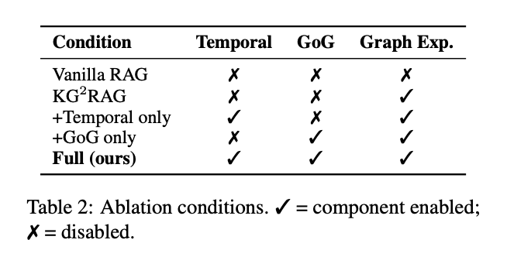
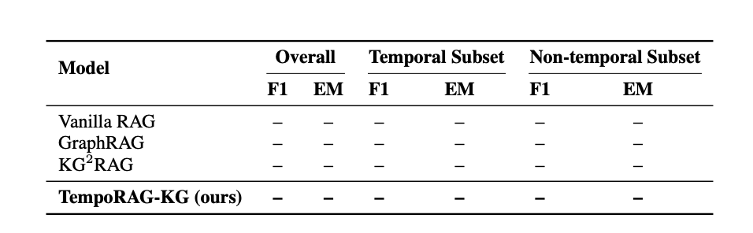
Evaluation Plan
Ablation Design
Datasets
HotpotQA
7,405 questions | 2-hop | 35.0% temporal
MuSiQue
2,417 questions | 2–4 hop | 38.3% temporal
Metrics
F1 & EM (overall + temporal / non-temporal subsets)
Retrieval Precision@5 (gold supporting facts retrieved)
Temporal Extraction F1 (RQ3, ±1 year tolerance)
Expected Results Table
6 / 7
Notes:
For evaluation, we'll use HotpotQA and MuSiQue. Our primary metrics are F1 and EM split across overall, temporal, and non-temporal subsets — because we need to verify we're improving temporal questions without hurting non-temporal ones.
The ablation table on the right shows how we'll isolate each component's contribution. The expected results table is placeholder for now — results will be filled after experiments complete.

Slide 7
Progress & Takeaway
✓ Completed
▶ In Progress
□ Remaining
Literature review (16 papers)
EDA: HotpotQA + MuSiQue
Temporal failure taxonomy (4 types)
Competitor analysis (EvoReasoner)
Neo4j schema + setup
Temporal extraction prompts
GitHub repository setup
KG²RAG baseline reproduction
Manual annotation (200 passages)
Full pipeline implementation
Ablation experiments
Streamlit demo
"Temporal validity should be a first-class property of KG edges — not an optional annotation."
7 / 7
Notes:
In terms of progress: literature review, EDA, taxonomy, and competitor analysis are done. We're currently setting up Neo4j and building the temporal extraction prompts.
Our core is this — temporal validity should be a first-class property of KG edges, not something we retrofit later. That's the gap we're closing.

