Slide 1
SMART S 2026
gostSIMBOX
Software-defined GSM/SIP infrastructure
for controllable telecom gateways
NativeMind Co., Ltd. • Qualification endorsement
Verified public commit history, current refactoring and a clearly separated Android roadmap.
2026
Notes:
[Sources]
- https://github.com/gostSIMBOX
- https://github.com/gostSIMBOX/simbox-desktop-v2014
- https://smart-visa.boi.go.th/smart/pages/smart_s.html

Slide 2
NATIVEMIND × gostSIMBOX
Public commit history verifies a product lineage beginning in March 2014
VERIFIED PUBLIC COMMIT HISTORY
141 commits
FOUNDER-REPORTED
Commercial operation for approximately two years for AltComTech LLC, London, managed by Gurgen Harapetyan.
First public commit: 20 March 2014
Public commits document active development in 2014 and 2017, followed by renewed refactoring and architecture work in 2026.
Deployed across multiple Ubuntu servers using Huawei E171, E173 and E1550 USB GSM dongles.
Customer records or a reference letter should accompany this claim when available.
SMART S 2026 • QUALIFICATION ENDORSEMENT DECK
02
Notes:
[Sources]
- https://github.com/gostSIMBOX/simbox-desktop-v2014
- https://github.com/gostSIMBOX/simbox-desktop-v2014/commits/master/

Slide 3
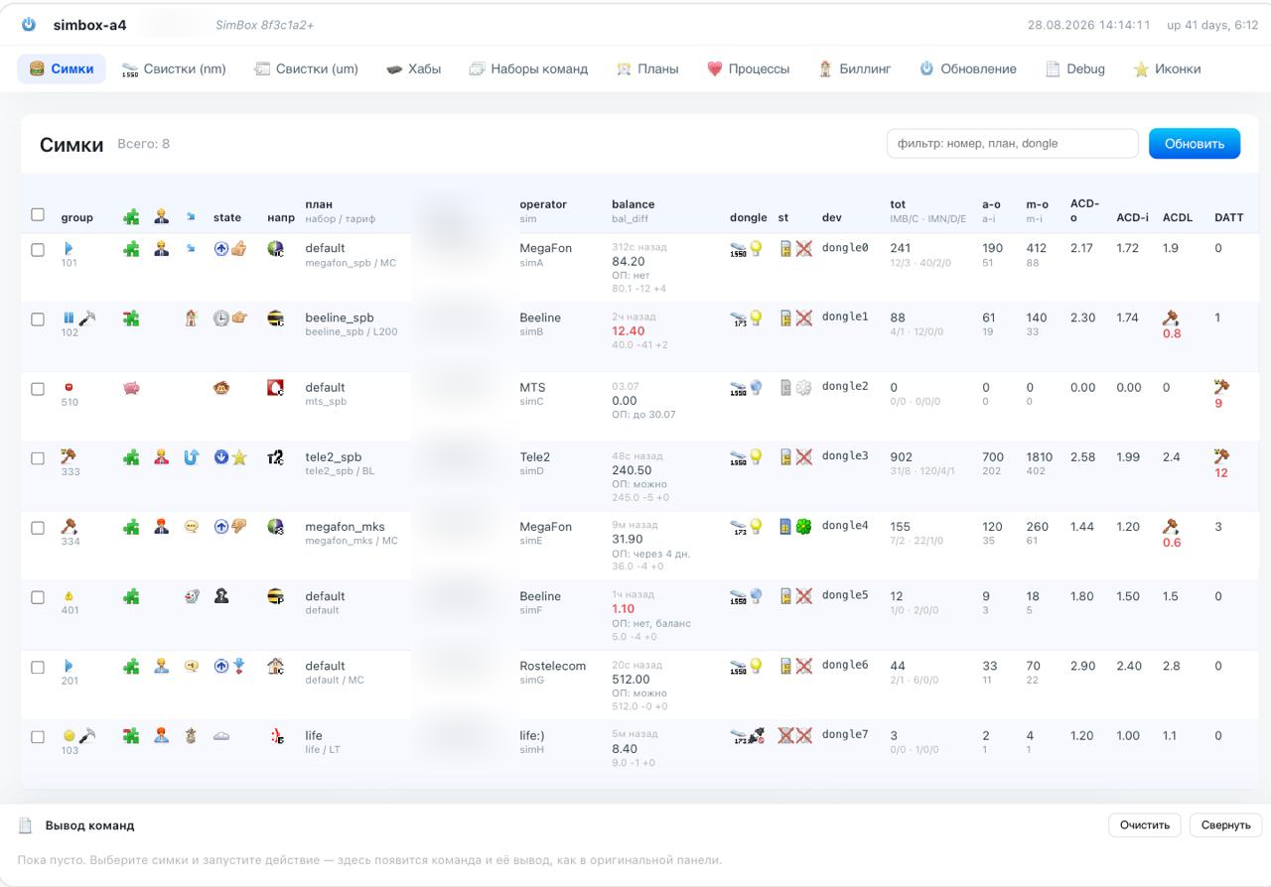
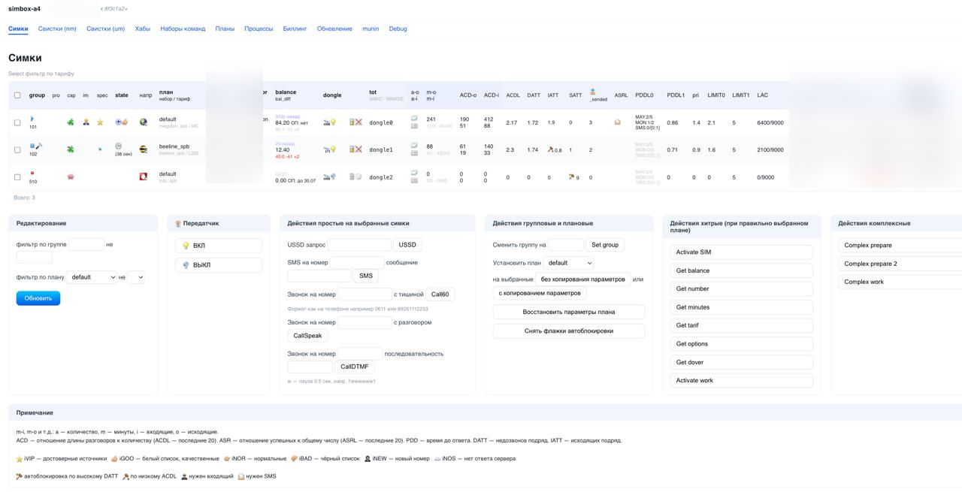
NATIVEMIND × gostSIMBOX
Historical operating data appears in a redesigned 2026 interface
EVIDENCE SHOWN
SIM inventory, carrier state, balance, dongle mapping, calls, SMS/USSD and operational controls are represented in the supplied interface snapshots.
PRIVACY-SAFE COPY • Phone numbers, private IP address, IMEI, IMSI and log identifiers are redacted.
SMART S 2026 • QUALIFICATION ENDORSEMENT DECK
03
Notes:
[Sources]
- Founder-supplied interface screenshots dated 28 August 2026; historical dataset displayed in a redesigned interface. Personal and device identifiers redacted for submission.

Slide 4
NATIVEMIND × gostSIMBOX
Telecom gateways remain fragmented across hardware, PBX and operations
01
02
03
DEVICE LAYER
TELEPHONY LAYER
OPERATIONS LAYER
USB GSM modems, SIMs and device-specific control
Asterisk/SIP routing, call state and audio
SMS, USSD, status, configuration and diagnostics
The startup opportunity is an orchestration layer that turns these separate components into a configurable gateway product.
SMART S 2026 • QUALIFICATION ENDORSEMENT DECK
04
Notes:
[Sources]
- https://github.com/gostSIMBOX/simbox-app/blob/master/README.md
- https://github.com/gostSIMBOX/simbox-desktop-v2014/blob/master/README.md

Slide 5
NATIVEMIND × gostSIMBOX
The innovation is orchestration—not an unsupported AI claim
DOCUMENTED DIFFERENTIATION
—
Bidirectional SIP ↔ GSM gateway behavior.
What we will not claim
—
SMPP-to-GSM SMS flow and USSD operations.
—
No generative AI product claim.
—
No market traction or customer claim.
—
A common Flutter-facing bridge over telephony services.
—
No production-scale reliability claim.
—
Linux path from Flutter through Dart FFI into libsimbox.
—
No ownership claim without documents.
Positioning: a software-defined telecom gateway platform with evidence-backed device, protocol and application integration.
SMART S 2026 • QUALIFICATION ENDORSEMENT DECK
05
Notes:
[Sources]
- https://github.com/gostSIMBOX/simbox-app/blob/master/README.md
- https://github.com/gostSIMBOX/simbox-desktop-v2014/blob/master/README.md

Slide 6
NATIVEMIND × gostSIMBOX
Current evidence and roadmap are explicitly separated
IMPLEMENTED / DOCUMENTED
2026 REFACTORING & ROADMAP
—
Operational Ubuntu lineage with Huawei USB dongles
—
Modular cross-platform architecture
—
Asterisk-based GSM routing components
—
Desktop targets: Ubuntu, macOS and Windows
—
Carrier configuration, SMS and USSD automation
—
Android device as an integrated GSM–SIP gateway
—
Current Flutter gateway status and control surfaces
—
Commercial fleet management and remote operations
—
Linux real-modem driver path documented
—
Thai pilot package and support model
SMART S 2026 • QUALIFICATION ENDORSEMENT DECK
06
Notes:
[Sources]
- https://github.com/gostSIMBOX/simbox-app/blob/master/README.md

Slide 7
NATIVEMIND × gostSIMBOX
A layered architecture connects telecom hardware to operator workflows
OPERATOR APP
GATEWAY BRIDGE
TELEPHONY SERVICES
NATIVE / PBX
GSM HARDWARE
Flutter UI • status • settings
SIP • SMPP • routing • events
Calls • SMS • USSD • configuration
Dart FFI • libsimbox • Asterisk
USB modems • SIM resources
Evidence basis: public README and repository structure. Exact production topology and deployment model require founder confirmation.
SMART S 2026 • QUALIFICATION ENDORSEMENT DECK
07
Notes:
[Sources]
- https://github.com/gostSIMBOX/simbox-app/blob/master/README.md
- https://github.com/gostSIMBOX/simbox-desktop-v2014/blob/master/README.md

Slide 8
NATIVEMIND × gostSIMBOX
The code is visible; the company’s IP position must be documented
PUBLIC EVIDENCE
Repositories, READMEs, architecture descriptions and a NativeMindNONC license reference are visible.
ATTRIBUTION EVIDENCE
The public README names Anton Dodonov and NativeMind.net.
DOCUMENTED AUTHORIZATION
Anton grants NativeMind Co., Ltd. a worldwide, royalty-free, non-exclusive right to use Anton-controlled materials for authorized services.
ACTION BEFORE SUBMISSION
Sign and attach the authorization letter; complete the contributor list, third-party licence schedule and company approval.
SMART S 2026 • QUALIFICATION ENDORSEMENT DECK
08
Notes:
[Sources]
- https://github.com/gostSIMBOX/simbox-app/blob/master/README.md
- https://github.com/gostSIMBOX/simbox-desktop-v2014/blob/master/README.md

Slide 9
NATIVEMIND × gostSIMBOX
The founder record supports execution credibility
ANTON DODONOV
—
Verified public commit history dates to 20 March 2014.
Technical founder / proposed SMART S applicant
—
The 141-commit record covers GSM devices, Asterisk routing and operational automation.
—
Current work documents Flutter gateway surfaces and Linux/native integration.
—
The 2026 objective modernizes a proven technical base—not an application-only prototype.
Submit CV, education and experience evidence alongside the GitHub technical record.
SMART S 2026 • QUALIFICATION ENDORSEMENT DECK
09
Notes:
[Sources]
- https://github.com/gostSIMBOX/simbox-desktop-v2014/commits/master/
- https://github.com/gostSIMBOX/simbox-desktop-v2014/blob/master/README.md
- https://github.com/gostSIMBOX

Slide 10
NATIVEMIND × gostSIMBOX
A repeatable model can combine software access, management and support
01
02
03
04
SOFTWARE
MANAGEMENT
ENTERPRISE
ECOSYSTEM
Per gateway / device subscription
Cloud or on-prem fleet management
Integration, SLA and deployment support
SDK/API access and qualified partners
Fastest path to early profit: sell fixed-scope technical audits and paid Ubuntu/Huawei gateway integrations now, with an upfront deposit; convert successful deployments into monthly support, monitoring and SLA contracts.
SMART S 2026 • QUALIFICATION ENDORSEMENT DECK
10
Notes:
[Sources]
- https://www.nia.or.th/segment/startup-social-enterprise
- https://smart-visa.boi.go.th/document/Checklist_Smart_S.pdf

Slide 11
NATIVEMIND × gostSIMBOX
Revenue can scale if the product becomes standardized and remotely managed
1
2
3
4
PACKAGE
REPEAT
MANAGE
EXPAND
Define supported hardware + installation
Reuse the same software across gateways
Operate multiple devices from one control plane
Add partners, countries and enterprise tiers
Scale thesis to validate: recurring revenue grows with managed gateways while deployment and support cost per gateway declines.
SMART S 2026 • QUALIFICATION ENDORSEMENT DECK
11
Notes:
[Sources]
- https://www.nia.or.th/segment/startup-social-enterprise
- https://smart-visa.boi.go.th/smart/pages/faq-en.html

Slide 12
NATIVEMIND × gostSIMBOX
Public evidence separates component forks, focused Android gateways and a broader stack
PROJECT / EVIDENCE
VERIFIED PUBLIC RECORD
BENCHMARK INTERPRETATION
pulpoff / asterisk-chan-dongle
Fork of bg111; Asterisk 20 support; public history begins in 2011.
Adjacent open-source component. Close technical contact with Anton is founder-reported.
pulpoff / gsm2sip
8 commits; first public commit 20 Feb 2026; Android path requires Magisk/root.
Focused Android bridge tied to a specific rooted-device configuration.
gostSIMBOX lineage
Desktop history begins 20 Mar 2014; Android gateway repository begins 8 Jan 2020.
Broader evidence across USB modems, Asterisk, Android and cross-platform refactoring.
Passive jack loopback designs
Stereo: 4 resistors + 47nF capacitor. Mono: 2 resistors. Public requirements committed by Anton.
Could reduce reliance on rooted audio capture; verify on target devices before claiming no-root operation.
Date clarification: the verified 2014 lineage belongs to simbox-desktop-v2014—not the React Native repository.
SMART S 2026 • QUALIFICATION ENDORSEMENT DECK
12
Notes:
[Sources]
- https://github.com/pulpoff/asterisk-chan-dongle
- https://github.com/pulpoff/gsm2sip
- https://github.com/pulpoff/gsm2sip/commits/main/
- https://github.com/gostSIMBOX/simbox-desktop-v2014/commits/master/
- https://github.com/gostSIMBOX/react-native-gsm-sip-gateway
- https://github.com/gostSIMBOX/simbox/blob/main1/flows/adapter/sdd-dongle-type-nm-stereo-loopback/01-requirements.md
- https://github.com/gostSIMBOX/simbox/blob/main1/flows/adapter/sdd-dongle-type-nm-mono-loopback/01-requirements.md

Slide 13
NATIVEMIND × gostSIMBOX
Go-to-market should begin with a narrow, compliant Thai pilot
0–3 MONTHS
Customer discovery
Interview telecom integrators and legitimate enterprise gateway users.
4–9 MONTHS
Pilot package
Freeze supported hardware, deployment guide, support boundary and security controls.
10–18 MONTHS
Paid validation
Convert selected pilots to subscriptions or enterprise support contracts.
19–24 MONTHS
Channel expansion
Train partners and expand only after repeatability is proven.
SMART S 2026 • QUALIFICATION ENDORSEMENT DECK
13
Notes:
[Sources]
- https://smart-visa.boi.go.th/document/Checklist_Smart_S.pdf
- https://www.nia.or.th/segment/startup-social-enterprise

Slide 14
NATIVEMIND × gostSIMBOX
Thailand can be the operating base for telecom software and technical capability
DIRECT BENEFIT
—
Thai company commercializes a technical product.
Guardrail
The business must demonstrate lawful telecom use, data/security controls and compliance with Thai regulations. The deck does not claim regulatory approval.
—
Local software, integration and support capability.
—
Potential demand for Thai engineering and partner training.
—
Exportable digital product and regional service revenue.
FOUNDER + LEGAL REVIEW
SMART S 2026 • QUALIFICATION ENDORSEMENT DECK
14
Notes:
[Sources]
- https://smart-visa.boi.go.th/document/Checklist_Smart_S.pdf
- https://smart-visa.boi.go.th/smart/pages/smart_s.html

Slide 15
NATIVEMIND × gostSIMBOX
The first 24 months convert technical evidence into commercial proof
M0–3
M4–6
M7–12
M13–18
M19–24
Confirm IP and scope
Complete modular core
Prototype Android gateway
Validate paid pilot
Scale selectively
IP documents • legacy evidence • compliance review
Linux package • interfaces • test coverage
Radio integration • SIP bridge • controlled tests
Pricing • support metrics • deployment evidence
Desktop targets • partner playbook • regional plan
Milestones are proposed and require founder approval before submission.
SMART S 2026 • QUALIFICATION ENDORSEMENT DECK
15
Notes:
[Sources]
- https://smart-visa.boi.go.th/document/Checklist_Smart_S.pdf

Slide 16
NATIVEMIND × gostSIMBOX
Financial projections remain placeholders until founders confirm assumptions
INPUT
YEAR 1
YEAR 2
SOURCE / CONFIRMATION
Managed gateways
[TBD]
[TBD]
Pilot + sales plan
Average recurring revenue / gateway
[TBD]
[TBD]
Pricing interview
Implementation & support revenue
[TBD]
[TBD]
Service scope
Engineering / cloud / support cost
[TBD]
[TBD]
Hiring + infrastructure
Gross margin / cash requirement
[CALCULATE]
[CALCULATE]
Derived after inputs
No revenue, funding, valuation, customer count or break-even claim is made in this draft.
SMART S 2026 • QUALIFICATION ENDORSEMENT DECK
16
Notes:
[Sources]
- https://smart-visa.boi.go.th/document/Checklist_Smart_S.pdf

Slide 17
NATIVEMIND × gostSIMBOX
gostSIMBOX fits the SMART S narrative—subject to four confirmations
01
STARTUP CERTIFICATION
02
APPLICANT
Innovation + technology + revenue scale-up
≥25% shareholding or director status
03
FINANCIAL / INSURANCE
04
COMPANY–PRODUCT LINK
THB 600,000 held ≥3 months + full-period insurance
Documented ownership, license and active commercialization
NEXT DECISION • Confirm IP + product scope, then complete market, pricing and finance evidence.
SMART S 2026 • QUALIFICATION ENDORSEMENT DECK
17
Notes:
[Sources]
- https://smart-visa.boi.go.th/smart/pages/smart_s.html
- https://smart-visa.boi.go.th/smart/pages/faq-en.html
- https://smart-visa.boi.go.th/document/Checklist_Smart_S.pdf

