Slide 1
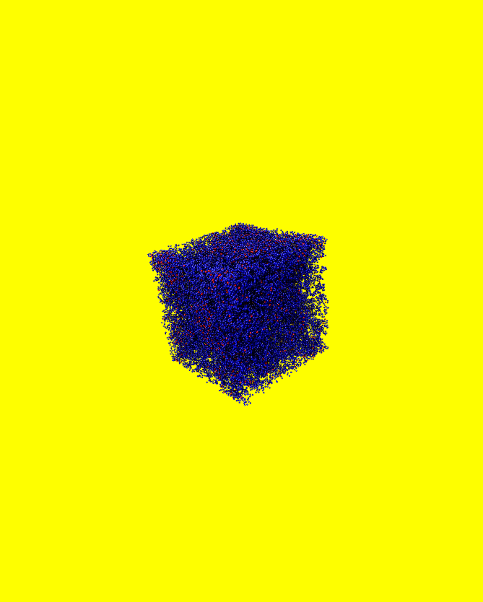
CATCHY
Catching Enzymes in Action
Coarse-grained MD simulations of enzyme–polymer systems
https://github.com/gosthak/Interview
Notes:
1 min. Greet jury. CATCHY = ANR project, 18 months, IATE Montpellier.

Slide 2
Starting Point: Sorichetti, Hugouvieux & Kob (2021)
Sorichetti, Hugouvieux, Kob model
Our extension
Kremer-Grest bead-spring polymer network
Passive nanoparticles (NPs) diffusing through the network
Confinement C = σ_N / λ controls dynamics
Three regimes:
C ≲ 1 → free diffusion (Cai–Rubinstein)
1≲C≲3 → activated hopping
C ≳ 3 → extreme confinement
NPs → Enzymes
that actively cleave network bonds upon contact
Same physics, same potentials, but
Novelty:
Stochastic bond cleavage
p = 1 − exp(−k_cat · dt · Δt_check)
Active vs Passive runs isolate
the enzymatic enhancement D_active / D_passive
Notes:
2 min. Virginie Hugouvieux is co-author of Paper 1 — natural link to CATCHY.

Slide 3
Key Differences vs Paper 1
Aspect | Sorichetti et al., 2021 | This try for CATCHY
Network construction | Patchy-particle self-assembly (MD run) | Cubic lattice a = 0.8 R₀ + Flory-Stockmayer
System size | N ≈ 4×10⁵ | N ≈ 57 000 (after pruning)
Diffusing particle | Passive NP (no chemistry) | Active enzyme k_cat > 0
Cleavage site | — | Cross-link bonds only
Cleavage probability | — | Poisson process p=1−exp(−k_cat·dt·Δt)
Notes:
2.5 min. Be transparent about approximations — interviewers appreciate honesty.

Slide 4
Equilibrated Network — Data
57 491
56.4 σ
0.290
N_m — monomers (after pruning)
L — box side length
ρ — monomer density
59 627
2.653 σ
0.961 σ
bonds — total (39 229 bb + 20 398 cl)
λ measured — vs Manuscript: 2.01 σ
r_eq — bond length at equilibrium
Notes:
1.5 min. λ=2.65 vs Paper 1 λ=2.01 — slightly larger because ρ_eff differs slightly from target. Bond distribution peaks at r_eq=0.961 — KG equilibration confirmed.

Slide 5
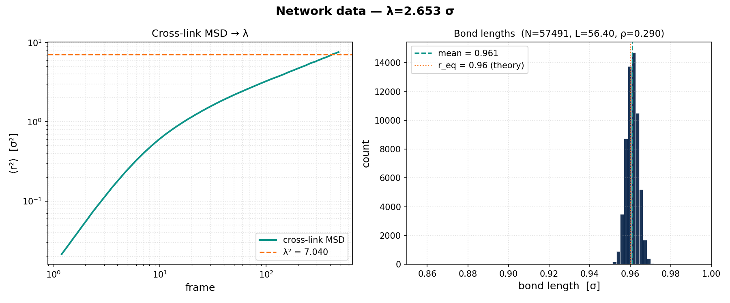
Equilibrated Network — Data
Notes:
1.5 min. λ=2.65 vs Paper 1 λ=2.01 — slightly larger because ρ_eff differs slightly from target. Bond distribution peaks at r_eq=0.961 — KG equilibration confirmed.

Slide 6
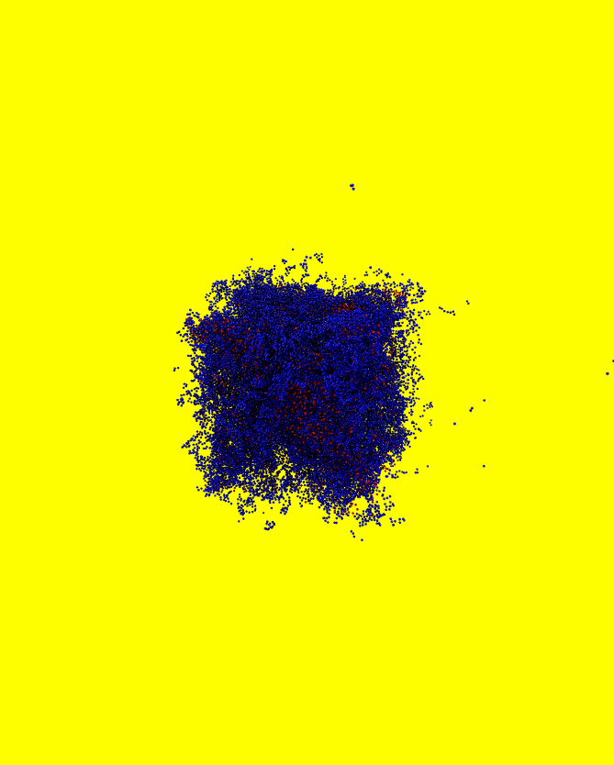
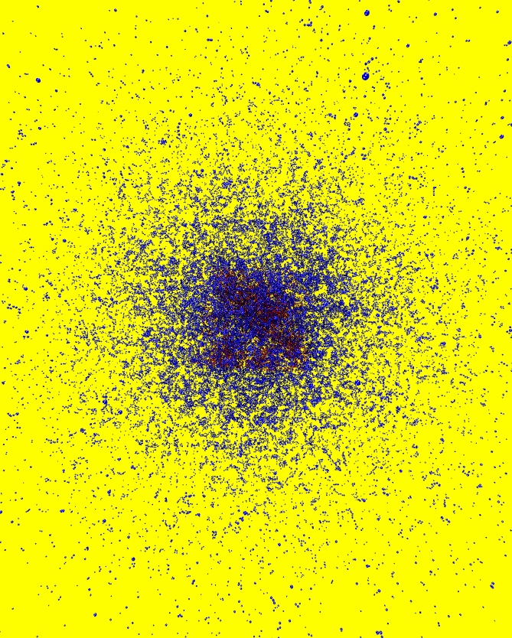
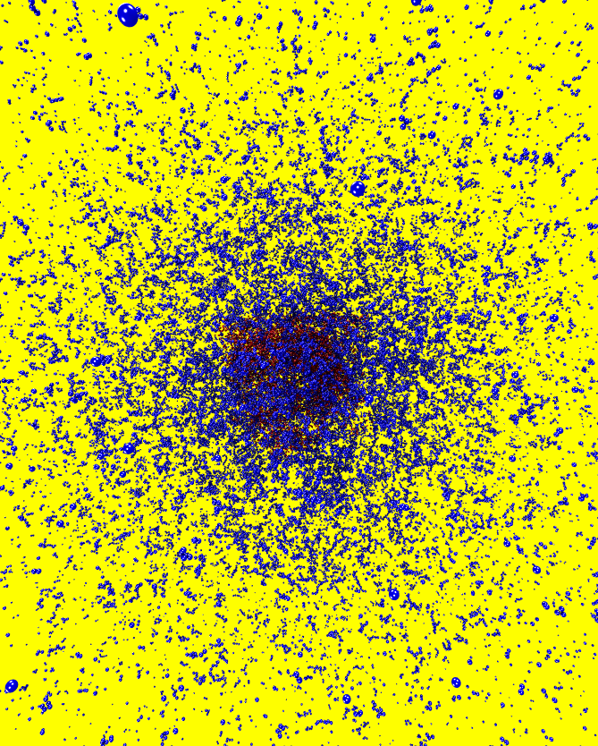
Active Simulation — Network Degradation (σ_E = 1.0)
t = 0 (initial)
1
2
3
Blue = monomers · Red = enzymes · Network dissolves as cross-links are cleaved
Notes:
1.5 min. Show the 4 VMD frames — network starts compact, enzymes (red) diffuse, bonds break, network swells. This is the gel-to-sol transition.

Slide 7
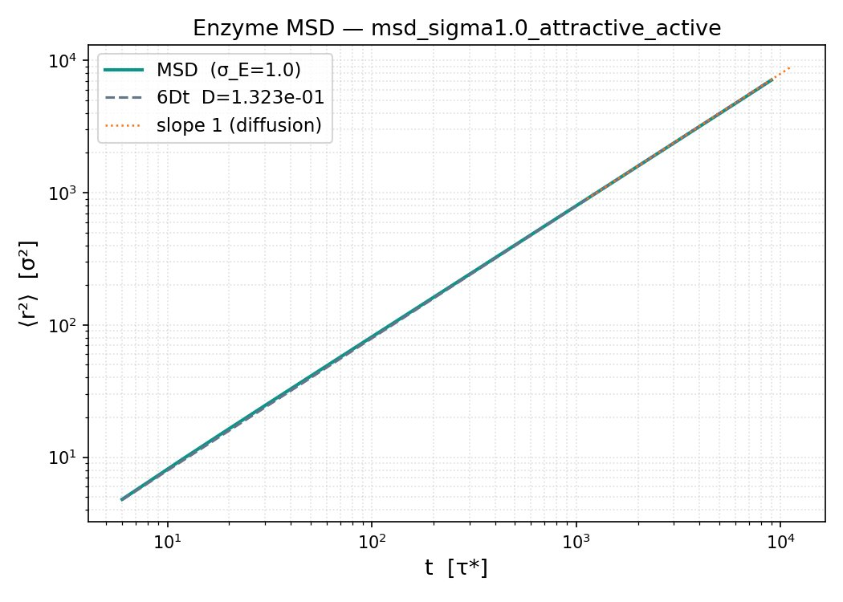
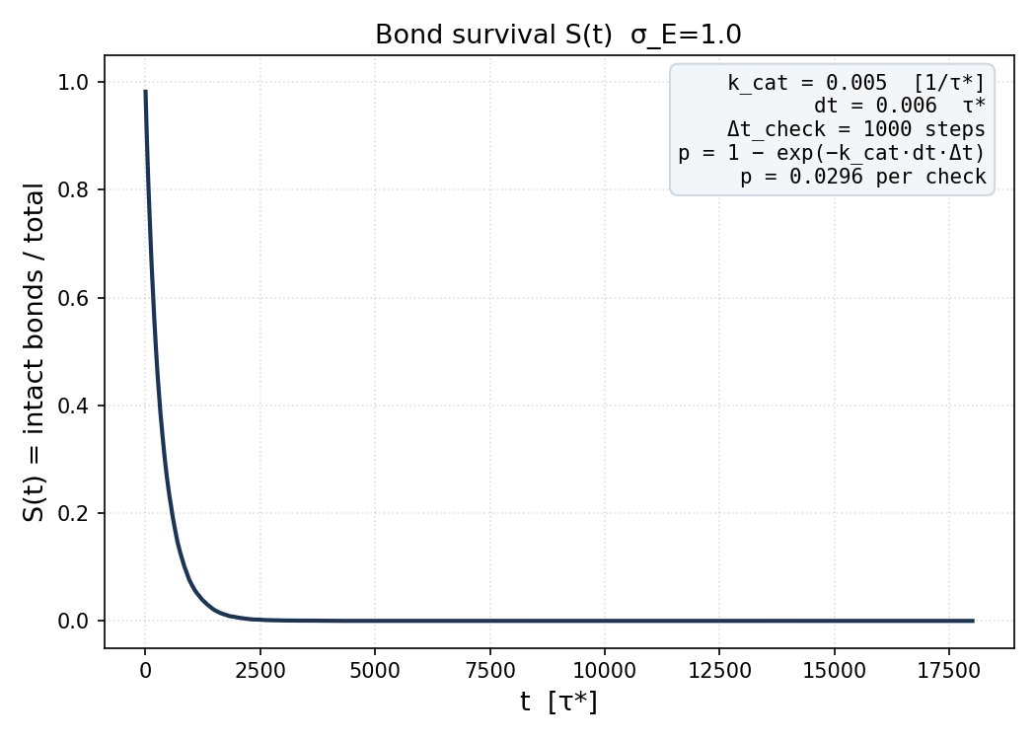
Results — σ_E = 1.0, Attractive, Active
MSD: D = 0.132 σ²/τ* — enzyme (σ_E=1, C≈0.5) diffuses freely, slope 1 from t=6 τ* onwards. S(t): all cross-links cleaved by t ≈ 2500 τ* — fast degradation at small C (high contact frequency).
Notes:
2 min. MSD is perfectly diffusive — C=0.5 means enzyme barely confined. S(t) decays fast: at small σ_E enzyme fits everywhere and contacts bonds often. Next: run larger σ_E to enter hopping regime.

Slide 8
Next Steps
1. Run σ_E = 2–5
Cover hopping and extreme-confinement regimes. Compute D(C) active vs passive.
2. D_active / D_passive vs C
Enhancement diverges at C ≳ 3 where cleavage is the only escape?
3. Larger system (GPU cluster)
4. Backbone cleavage
Extend to endo-acting enzymes (cellulases cut backbone, not cross-links).
5. Experiment link
Compare ξ(t) and degradation front with photon correlation data.
Notes:
1.5 min. Close with the GitHub link. Emphasise the pipeline is reproducible and documented.

Slide 9
Thank you for your attention!
Notes:
1.5 min. Close with the GitHub link. Emphasise the pipeline is reproducible and documented.

