Slide 1
Introduction to Machine Learning
INTRODUCTION
Andreu Arderiu
NORTHIN SUMMER SCHOOL
Barcelona, July 2022

Slide 2
Course structure
Introduction, regression and classification methods
Fundamental Machine Learning concepts: Loss functions, optimization, cross-validation, overfitting
Supervised learning: random forests, support-vector machines
Unsupervised learning: clustering, dimensionality reduction.
Introduction to Deep Learning

Slide 3
What is Machine learning?
Machine Learning is the science of getting computers to learn and act like humans do, and improve their learning over time in autonomous fashion, by feeding them data and information in the form of observations and real-world interactions
Machine learning algorithms seek to provide knowledge to computers through data, observations, and interaction with the world. It is then used to make accurate predictions given new observations.
Machine learning is applied statistics!

Slide 4

Machine Learning/Deep Learning/ AI
Buzzwords, a lot of confusion. What are the differences?

Slide 5
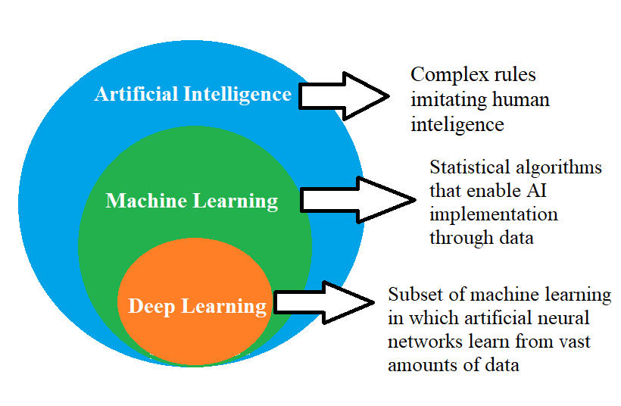
Machine Learning/Deep Learning/ AI
Buzzwords, a lot of confusion. What are the differences?

Slide 6
Machine learning algorithms
Supervised: Models are trained with input data that has been labeled. It is used to output predictions. Examples are Classification and regression.
Unsupervised: Only input data and no labels are given. It is used to find all kind of unknown patterns in data. Examples are clustering.
Others: Rainforcement Learning,…

Slide 7
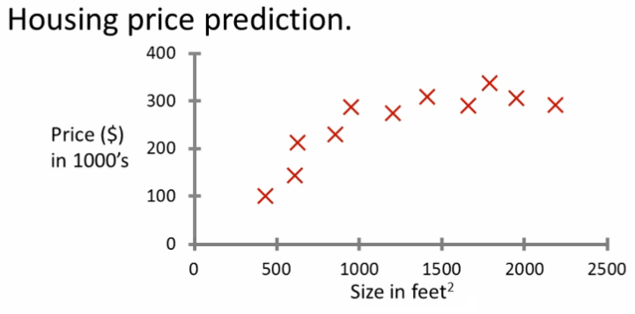
Supervised Learning: Regression
Predict continuous valued output. Ex: Housing price prediction.
Source: Coursera

Slide 8
Supervised Learning: Regression
Predict continuous valued output. Ex: Housing price prediction.
Source: Coursera

Slide 9
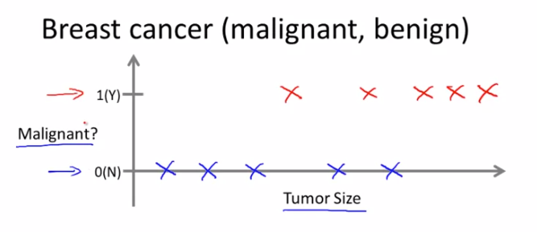
Supervised Learning: Classification
Predict discrete valued output. Ex: Breast cancer diagnose.

Slide 10
Supervised Learning: Classification
Predict discrete valued output. Ex: Breast cancer diagnose.

Slide 11
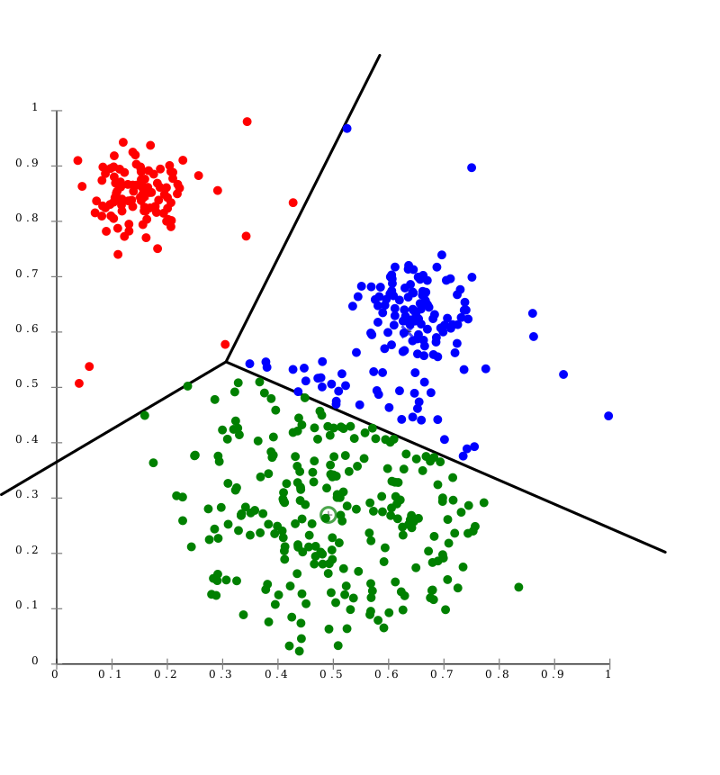
Unsupervised Learning: Clustering
Customer segments
Find natural clusters or groups that share similar features. Ex: customer segmentation
Money spent by the customer
Income customer

Slide 12
Quiz: Supervised/Unsupervised
Imagine a Telecomm company wants to automatically detect outages or failures in the network by identifying when there is a drop or spike in the network traffic.
Should we use a Supervised or Unsupervised algorithm?

Slide 13
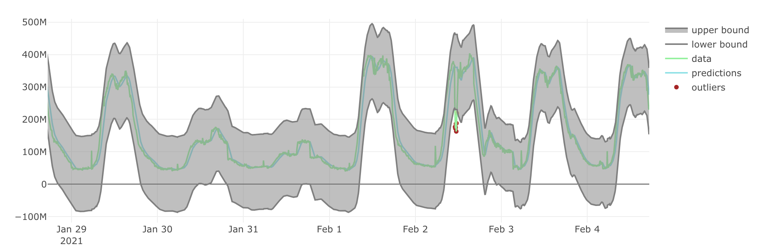
Quiz: Supervised/Unsupervised
Imagine a Telecomm company wants to automatically detect outages or failures in the network by identifying when there is a drop or spike in the network traffic.

Slide 14
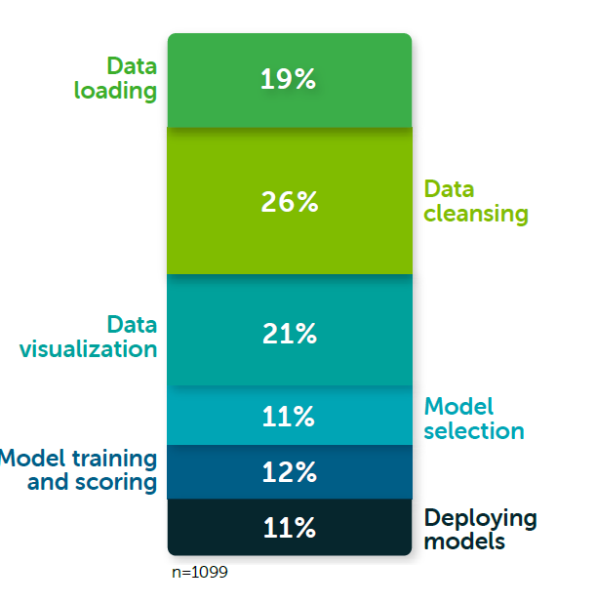

Data preparation
Data is the oil of machine learning
Prepare and analyse the data before applying machine learning!
66% Data preparation
Source: Anaconda

Slide 15
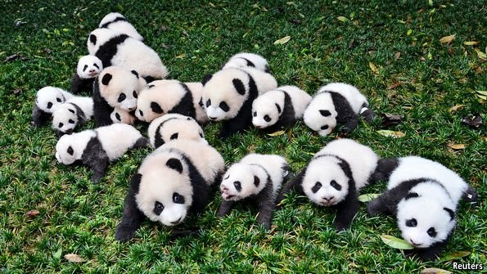
Data preparation with Python: Pandas
Pandas is a fast, powerful, flexible and easy to use data analysis and manipulation tool, built on top of Python

Slide 16
Python working environment
Option 1: Local Python installation (Anaconda + JupyterLab)
Option 2: Google Colab, online notebooks hosted by Google
Libraries for Machine Learning/Data Science: Pandas, NumPy, Scipy, Matplotlib

Slide 17
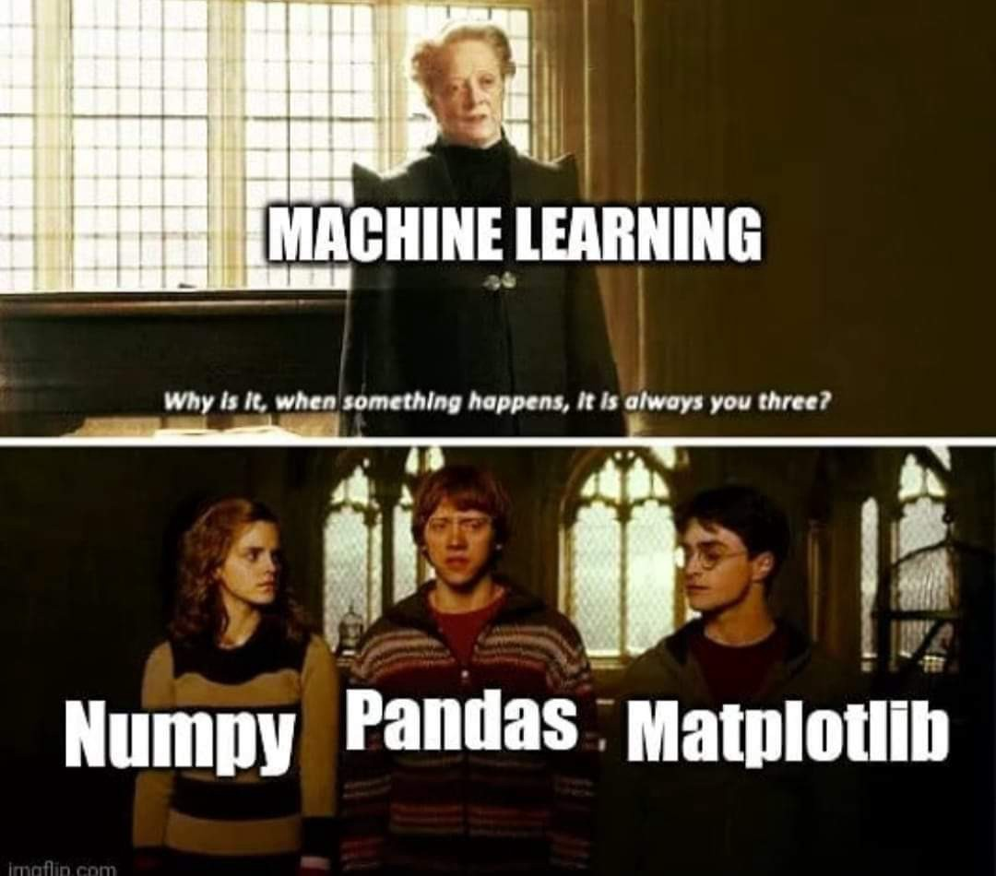
Python working environment
Option 1: Local Python installation (Anaconda + JupyterLab)
Option 2: Google Colab, online notebooks hosted by Google
Libraries for Machine Learning/Data Science: Pandas, NumPy, Scipy, Matplotlib
Source: Imgflip

Slide 18
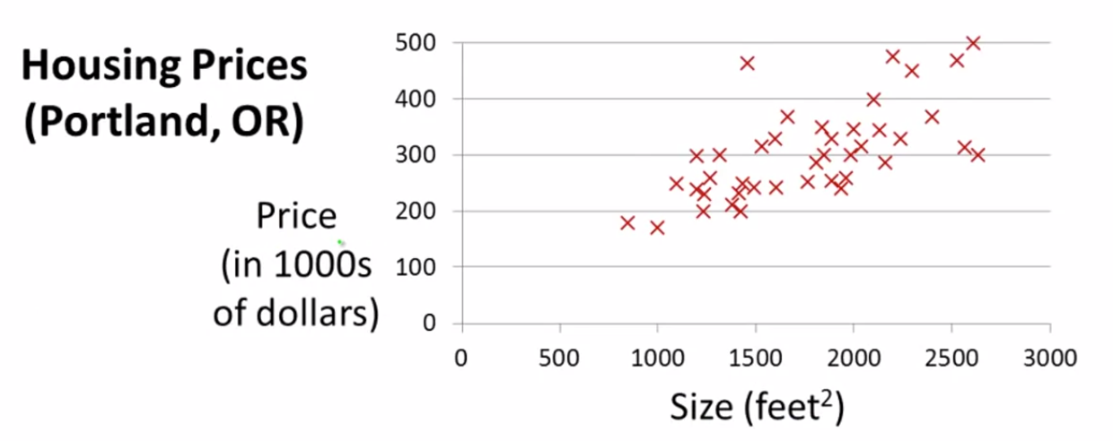
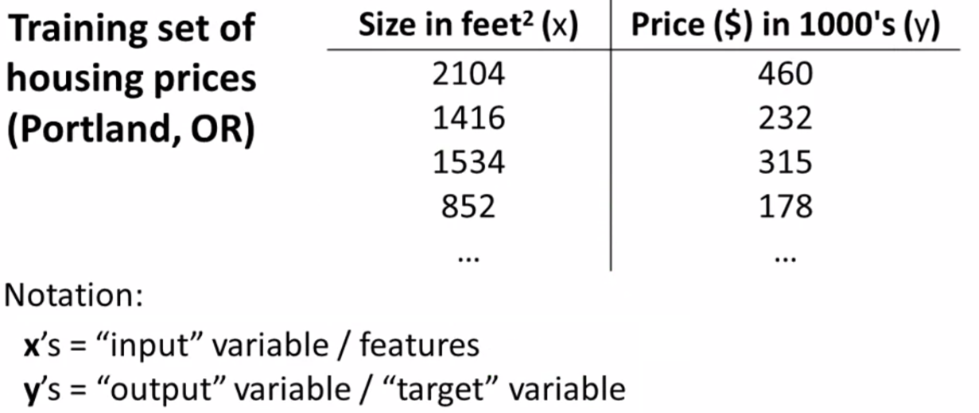
Linear regression: overview
Predict continuous-valued output
Given the size of the house, predict its price
Source: Coursera
Source: Coursera

Slide 19
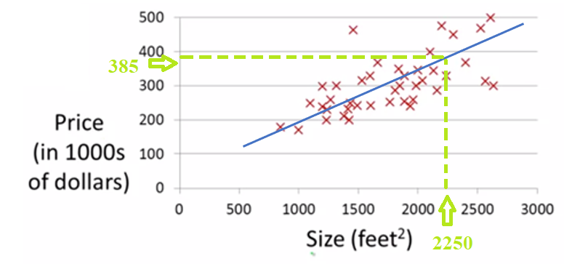

Linear regression: overview
Predict continuous-valued output
Given the size of the house, predict its price
$$h_{β}(x)=β_{0}+β_{1}x$$
Source: Coursera

Slide 20
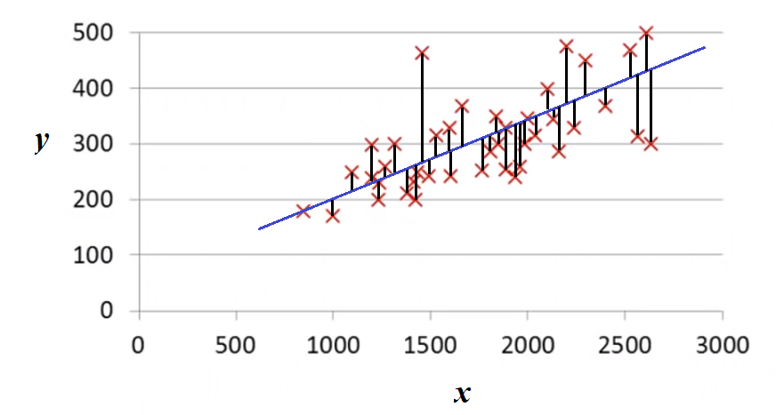
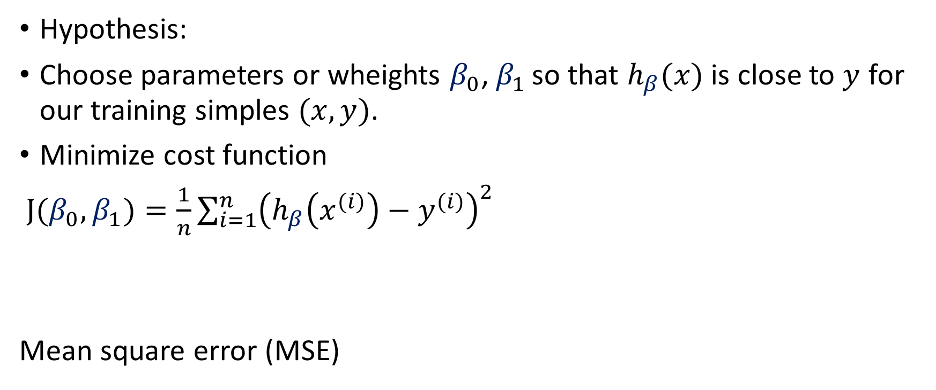

Linear regression: cost function
Hypothesis:
Choose parameters or wheights $β_{0}$, $β_{1 }$so that $h_{β}(x)$ is close to $y$ for our training simples $(x,y)$.
Minimize cost function
$J(β_{0},β_{1})=\frac{1}{n}\sum_{i=1}^{n}{{\left(h_{β}\left(x^{(i)}\right)−y^{(i)}\right)}^{2}}$
Mean square error (MSE)
$$h_{β}(x)=β_{0}+β_{1}x$$

