Slide 1
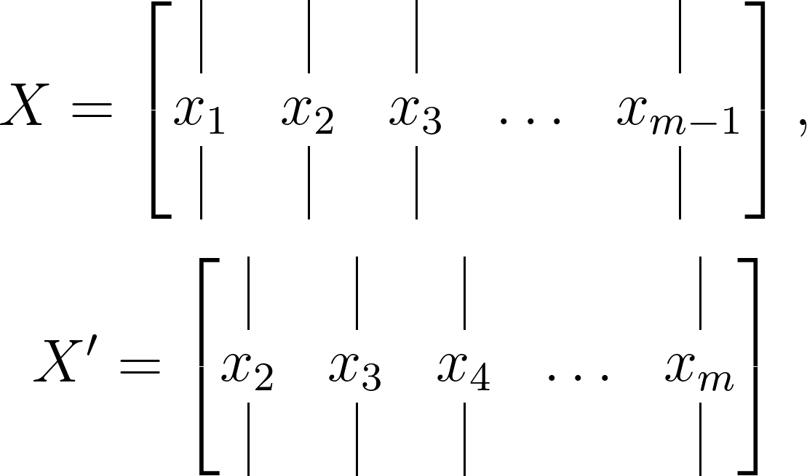
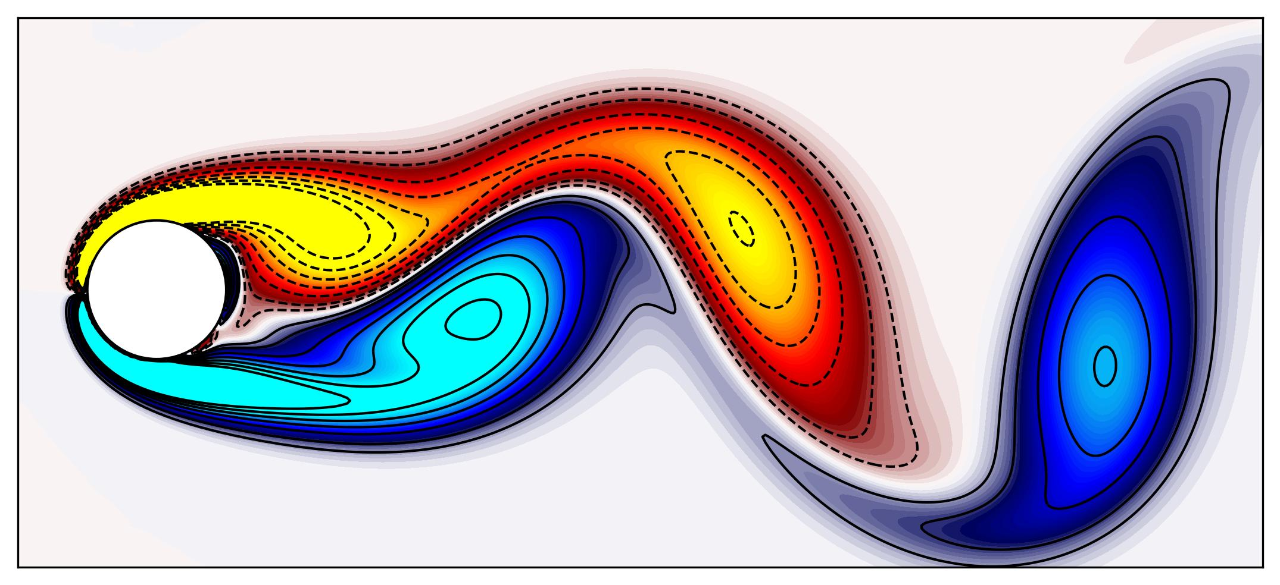
Snapshots
Time

Slide 2
Time-Shifted
Snapshots
Time

