Slide 1

Adversary
Us
Multiplicative Regret:

Slide 2
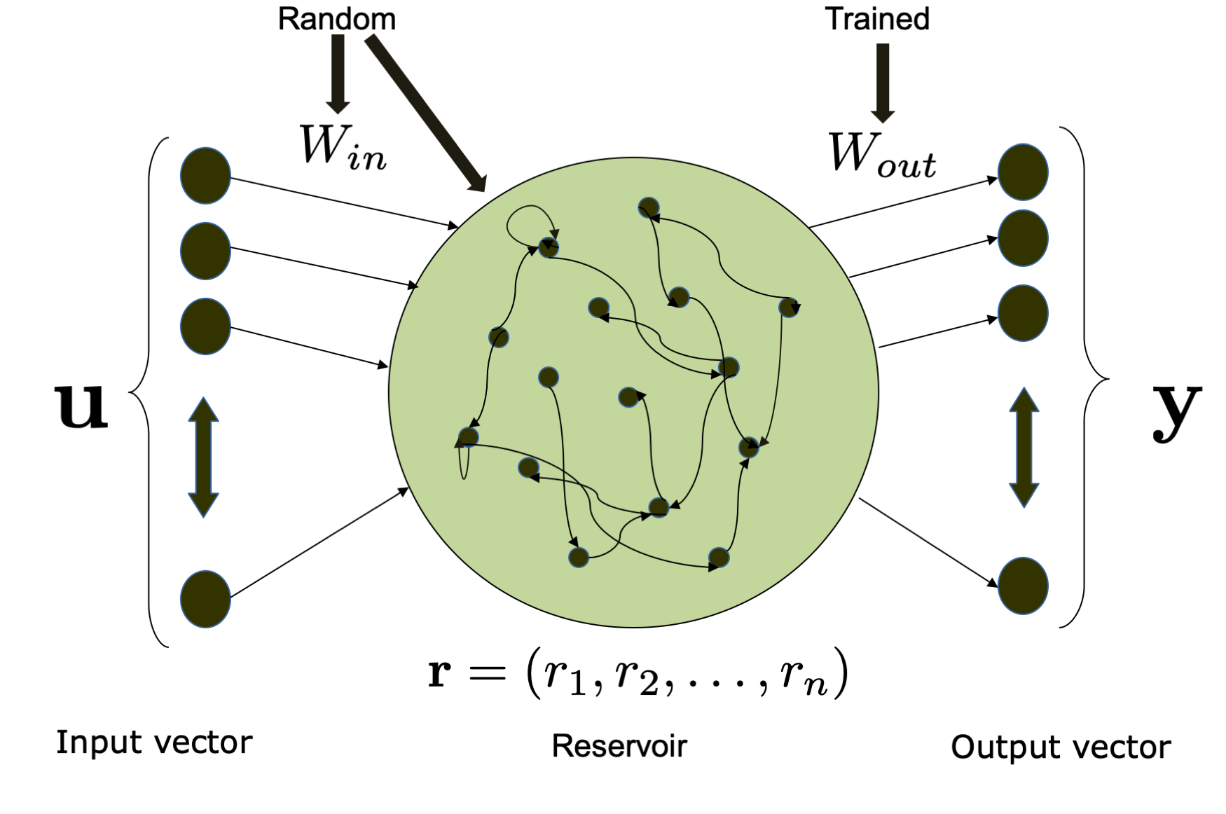
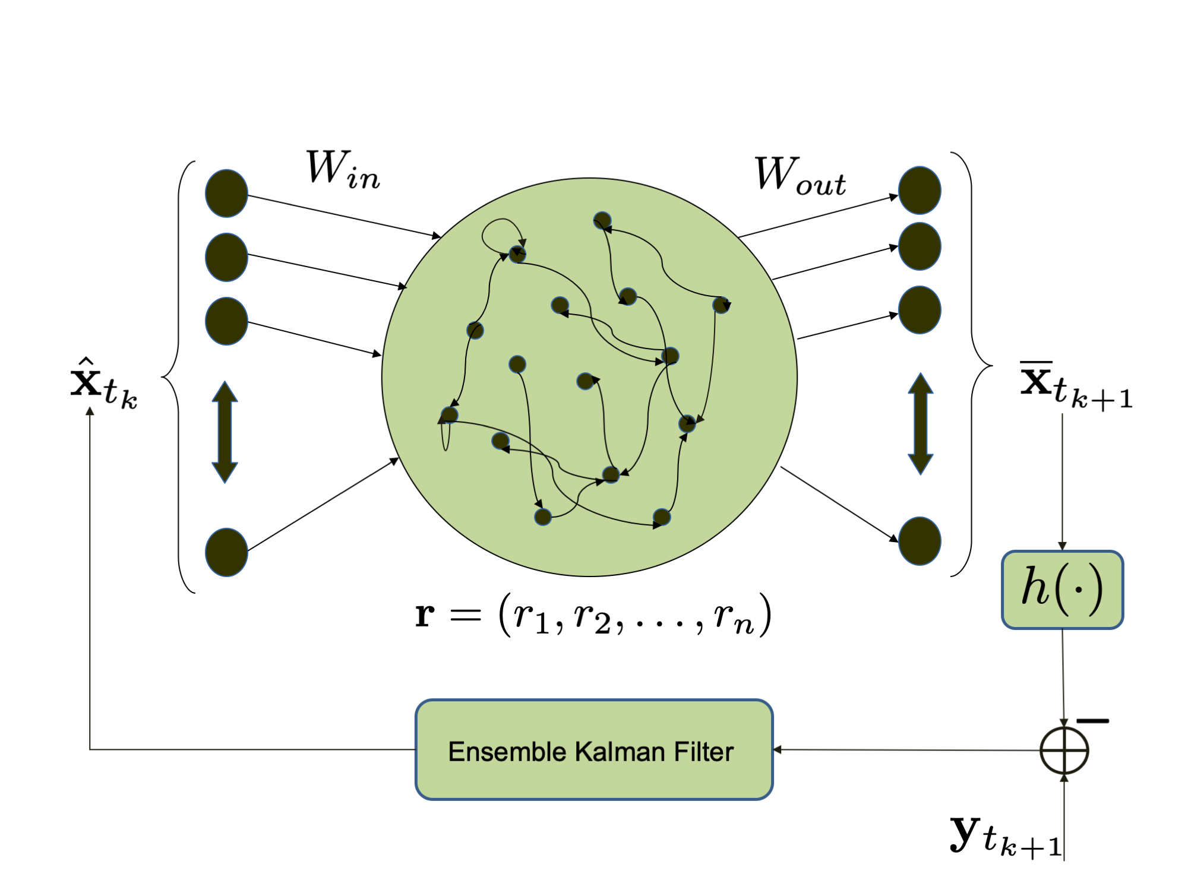
Trip origin data
Trip origin and destination data
ESN
CU-DMD
Trained ESN
Approximate PF matrix
ESN-EnKF
Observation
Predicted trip origin volume
Predicted trip destination volume
Initial condition
Notes:
\mathbf{x}_d(t_k),\, k=1,\cdots,n
\mathbf{x}_o(t_{n+1})
\hat{\mathbf{x}}_o(t_{n+1}),\, \hat{\mathbf{x}}_o(t_{n+2}),\ldots
\hat{\mathbf{x}}_d(t_{n+1}),\, \hat{\mathbf{x}}_d(t_{n+2}),\ldots

Slide 3
Ensemble Kalman Filter

Slide 4
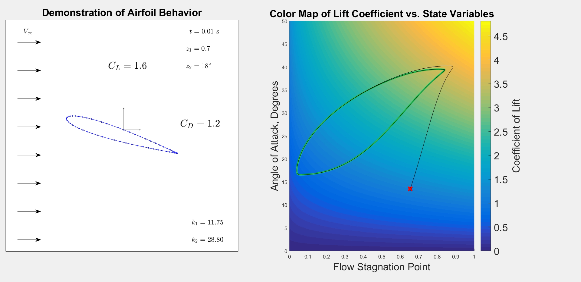

Slide 5
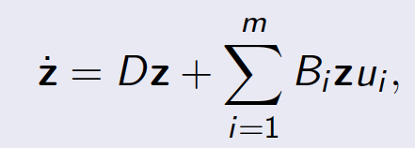
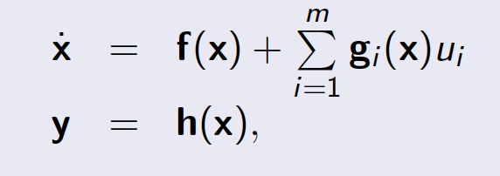
Koopman Canonical Transform + Least Squares
Koopman Bilinear Form (KBF)

Slide 6
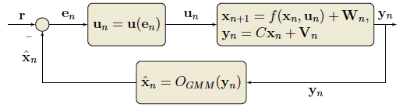
Gaussian #1
EKF/UKF
Weight Updates
EM & BIC
∑
Posterior PDF
Ensemble realization
Gaussian #2
EKF/UKF
.
.
.
.
.
.
Gaussian #M
EKF/UKF
Expectation Maximization & Bayesian Information Criterion

