Slide 1
The Complete AI Stack
ML, DL, Transformers, LLMs, GenAI, Agentic Systems

Slide 2
DAY 1
Introduction to AI & ML
Introduction to AI/ML
Models and Their Respective Uses
Connection with Oncology
AI/ML using R (hands-on)
Case Study 1 — Models, Results & Comparisons
Introduction to GitHub

Slide 3
Day 1 — Full Programme
Introduction to AI/ML
09:00–10:15
What is AI/ML, hierarchy, use of AI/ML in Pharma
Models and Their Uses
10:30–11:30
Supervised, Unsupervised, feature selection, causality, decision framework
Connection with Oncology
11:30–12:30
Clinical applications, cancer diagnosis, treatment response, EHR
AI/ML using R (hands-on)
13:30–14:45
R setup, Rpart, randomForest, xgboost — live coding session
Case Study 1
14:45–16:00
Breast cancer dataset, five models, results comparison, interpretation
Introduction to GitHub
Collaborative development, version control

Slide 4
SECTION 1
1
Introduction to AI/ML
Foundations, hierarchy, and use in pharma

Slide 5
SECTION 01 — INTRODUCTION TO AI/ML
The AI – ML – Deep Learning Hierarchy
Artificial Intelligence
Rule-based Expert Systems
Natural Language Processing
Computer Vision
Robotics
Machine
Learning
Deep
Learning
Random Forest
SVM · KNN
Logistic Reg.
XGBoost
CNNs · RNNs
Transformers · LLMs
GPT · AlphaFold

Slide 6
SECTION 01 — INTRODUCTION TO AI/ML
What is Artificial Intelligence and Machine Learning?
Artificial Intelligence
Machine Learning
Deep Learning
Machines performing tasks that would require human intelligence.
Rule-based systems, expert systems, game AI, ML-powered AI.
Not all AI uses statistics — rule-based expert systems from the 1970s contained no probability at all.
AI subset: algorithms that learn from data without explicit programming.
Mitchell (1997): 'A program learns from experience E with respect to task T and performance measure P, if P at T improves with E.'
This is what biostatisticians do — just with different names.
ML subset: neural networks with many layers.
Excels with unstructured data (images, text, audio).
Requires large datasets and GPU compute. The engine behind radiology AI, clinical NLP, and protein structure prediction (AlphaFold).
Key Insight for Biostatisticians
If you have ever fitted a logistic regression, you have already done machine learning. The gap between classical biostatistics and AI/ML is smaller than the headlines suggest — your statistical training is your greatest asset.

Slide 7
SECTION 01 — INTRODUCTION TO AI/ML
Biostatistics and AI/ML — Why Now?
BIOSTATISTICS: Focuses on drawing inferences, testing hypotheses, and interpreting relationships in biological and medical data. Built for causal questions: 'Does Drug A reduce mortality?'
AI/ML: Focuses on learning patterns from data to make predictions or decisions. Built for predictive questions: 'Which patients will be readmitted within 30 days?’
Three forces driving convergence:
Data explosion — genomics (500,000+ SNPs), EHRs (millions of encounters), imaging (terabytes of radiology). Classical models break down with p >> n.
Prediction demand — Precision medicine, early warning systems, and clinical decision support all require accurate predictions, not just p-values.
Automation — Feature selection across thousands of variables, pattern recognition in images and text — ML automates tasks that would require years of manual work.
KEY PRINCIPLE: ML/AI does not replace biostatistics. It extends its reach — helping solve problems that classical statistics alone cannot.

Slide 8
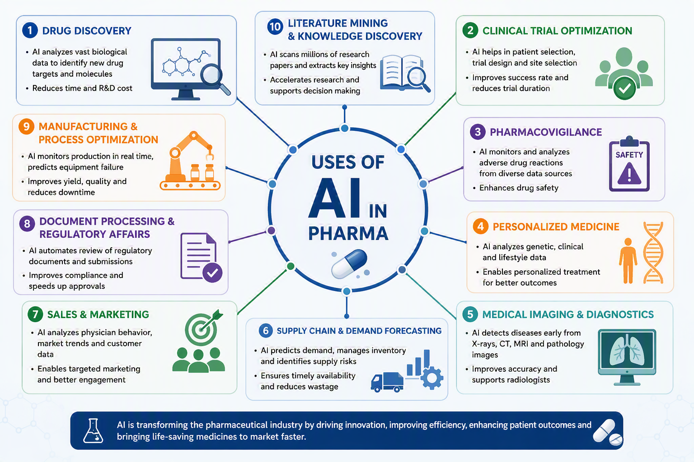
SECTION 01 — INTRODUCTION TO AI/ML

Slide 9
SECTION 2
2
Models and Their Respective Uses
Supervised, unsupervised, feature selection, and the decision framework

Slide 10
SECTION 02 — MODELS AND THEIR USES
Supervised Learning — Learning with Labels
Regression Tasks
Classification Tasks
Survival Analysis + ML
Predict a CONTINUOUS outcome.
Examples:
Hospital length of stay (days)
Tumour size reduction (%)
Blood biomarker level
Time to event (censored → survival ML)
Algorithms: Linear regression, Ridge/LASSO, Random Forest regressor, XGBoost Regressor
Loss: MSE, MAE, Huber
Biostat analogue: OLS, GLS, mixed models
Predict a CATEGORICAL outcome.
Examples:
Malignant vs Benign (binary)
Cancer stage I/II/III/IV (multi-class)
Treatment response (responder/non-responder)
30-day readmission (yes/no)
Algorithms: Logistic regression, Decision Tree, Random Forest, SVM, XGBoost
Loss: Log-loss (cross-entropy)
Biostat analogue: Logistic regression, discriminant analysis
Time-to-event with censoring.
Examples:
5-year overall survival (oncology)
Time to disease progression
Time to readmission
Algorithms:
Random Survival Forests
DeepSurv (neural network Cox)
XGBoost (survival objective)
Competing risk ML models
Biostat analogue: Cox proportional hazards, KM estimator
Key requirement: Every training observation must have a known outcome Y. Label quality is the single most important determinant of model quality — (garbage labels → garbage model)

Slide 11
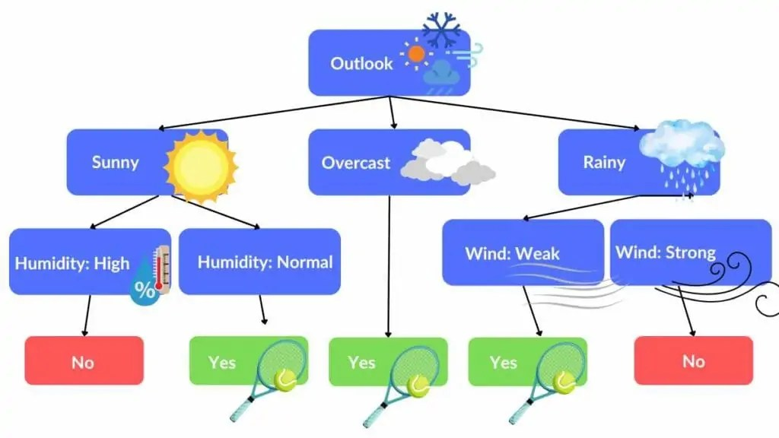
KEY ALGORITHMS
Decision Trees
22 / 40

Slide 12
KEY ALGORITHMS
Decision Trees
A tree partitions the feature space into rectangular regions using recursive binary splits. Each leaf node predicts the majority class (classification) or mean outcome (regression).
Splitting criterion: Choose the feature and threshold that best separates classes. Gini impurity: G = 1 − Σpₖ² | Information gain (entropy): H = −Σpₖ·log₂(pₖ) | Variance reduction (regression)
Hyperparameters: max depth, min samples per leaf, min samples to split — all control complexity and prevent overfitting
Strengths: Highly interpretable (can draw the tree), no feature scaling needed, handles mixed types, captures non-linearity and interactions automatically
Weaknesses: Unstable (small data change → different tree), high variance when deep, poor at extrapolation, rectangles are a crude approximation for smooth boundaries
Clinical use: Transparent clinical decision rules, risk stratification, triage algorithms where clinician auditability is required
Key insight: A single decision tree is rarely the best model — but it is the building block for the most powerful ML algorithms (Random Forests, Gradient Boosting).
22 / 40

Slide 13
KEY ALGORITHMS
Decision Trees
Pros | Cons
Easy to understand and explain: mimics decision-making using IF-THEN rules | Prone to overfitting: deep trees can memorize training data
Works for both classification and regression problems | High variance: small change in data can produce very different tree structure
Requires minimal data preparation compared to many other algorithms | Can become very complex when the tree grows large
No feature scaling required | Often less accurate than ensemble methods
Handles both numerical and categorical variables naturally | Biased towards variables with many categories (if not controlled properly)
Can capture non-linear relationships between features and targets | Lower generalization performance than ensemble methods
Fast prediction time after tree is built | Training can be computationally expensive (especially for large dataset)
Handles missing values reasonably well in many implementations | May struggle with highly imbalance datasets
22 / 40

Slide 14
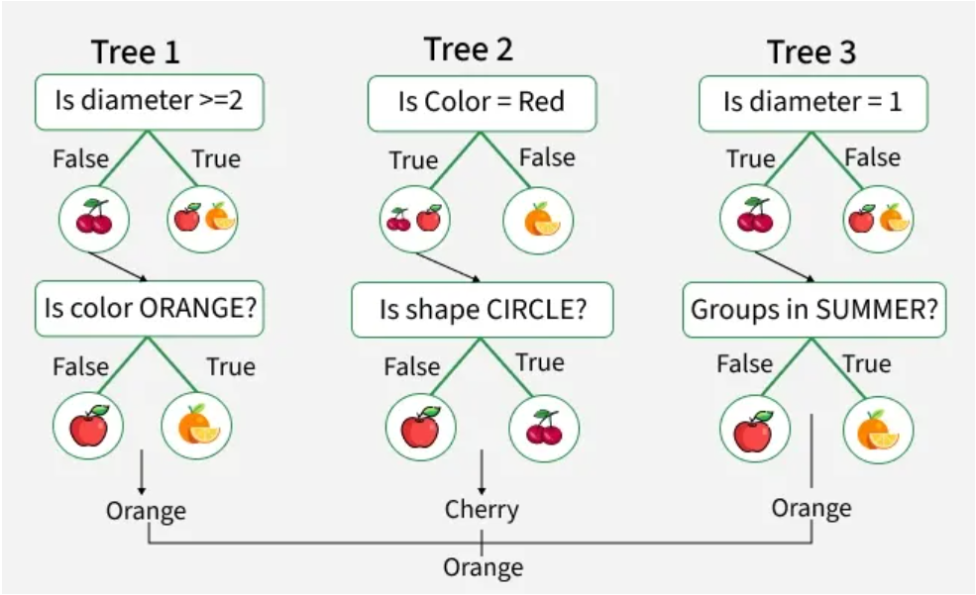
KEY ALGORITHMS
Random Forests — Ensemble of Trees

Slide 15
KEY ALGORITHMS
Random Forests — Ensemble of Decorrelated Trees
Bootstrap
Sampling
Random
Feature Subset
Grow Deep
Tree
Aggregate
Predictions
OOB
Evaluation
Draw n observations with replacement (bootstrap sample). ~63% of original observations appear. Remaining ~37% = 'out-of-bag' (OOB) data.
At each split, consider only √p (classification) or p/3 (regression) randomly chosen features. Decorrelates trees.
Grow each tree to maximum depth (low bias, high variance). No pruning. Each tree is a high-variance, low-bias estimator.
Classification: majority vote across all trees.
Regression: average predictions.
Averaging reduces variance while bias stays low.
Each observation is OOB for ~37% of trees. Evaluate on OOB samples → free internal validation without a separate validation set.
Key hyperparameters: n_estimators (more = better, diminishing returns), max_features (√p for classification, p/3 for regression), max_depth

Slide 16
KEY ALGORITHMS
Random Forests vs. Decision Tree
Aspect | Decision Tree | Random Forest
Accuracy | Moderate | Higher
Overfitting | High | Low
Interpretability | Excellent | Moderate/Poor
Training Speed | Fast | Slower
Prediction Speed | Very Fast | Slower
Complexity | Simple | More complex
Scalability | Limited | Better for larger dataset
Robustness to Noise | Sensitive | More Robust
Feature Selection | Implicitly performs selection | Uses random feature subsets
Memory Usage | Low | Higher
Best Use Case | Simple, Explainable Models | High-accuracy Predictive Models

Slide 17
KEY ALGORITHMS
XGBoost— Sequential Error Correction
XGBoost is an advanced boosting algorithm that builds decision trees sequentially, learns from previous errors, uses regularisation to avoid overfitting, and delivers highly accurate predictions on structured data.
Uses gradient descent-based optimization to improve predictions and to minimise loss function such as RMSE and Log Loss.
Built-in regularization: Includes L1 and L2 regularization to control model complexity. Help prevent overfitting and improve generalization.
Learns the best path for records with missing values during training, therefore handles missing values automatically.
Works best with structured data (e.g. tabular business and healthcare datasets)
Provides feature importance by identifying features that contribute most to predictions.
Initial Prediction → Calculate Errors → Build New Tree to Correct Errors → Update Prediction → Repeat Until Error Is Minimized
Key insight: Random Forest reduces variance by averaging many trees, while XGBoost reduces bias by sequentially correcting errors.

Slide 18
KEY ALGORITHMS
Support Vector Machines — Maximum Margin Classification
Core idea: find the hyperplane that separates classes with MAXIMUM MARGIN. The margin is the distance from the hyperplane to the nearest points from each class (support vectors).
Hard margin SVM: assumes perfect linear separability — rarely applicable in clinical data (noisy labels, class overlap).
Soft margin SVM (C-SVM): allows some misclassifications, controlled by penalty C. Large C → smaller margin, fewer errors on training data; small C → wider margin, more misclassifications tolerated.
Kernel trick: maps features to a high-dimensional space where linear separation is possible. Linear kernel: dot product (fast, equivalent to linear classifier). RBF (Gaussian) kernel: Euclidean distance-based; captures non-linear boundaries. Polynomial kernel: degree-d polynomial boundaries.
SVMs produce no natural probability output (requires Platt scaling). SVMs are not interpretable. Computationally expensive for large n (O(n²–n³)). Require feature scaling.
Clinical use: historically popular for genomic classification (gene expression, proteomics); now largely superseded by Random Forests and Gradient Boosting for tabular clinical data; still used in some image classification tasks.

Slide 19
SECTION 02 — MODELS AND THEIR USES
Unsupervised Learning — Discovering Structure Without Labels
Clustering
Dimensionality Reduction
Anomaly Detection & Density
Group observations by similarity without outcome labels.
K-Means: Minimise within-cluster variance.
Hierarchical: Dendrogram; agglomerative or divisive.
DBSCAN: Density-based; handles noise/outliers.
Biostat analogue: Latent class analysis (LCA)
Oncology use: Identify molecular subtypes of cancer from gene expression. Discover patient phenotypes that respond differently to treatment.
Compress many variables into a smaller set.
PCA: Linear; orthogonal axes of max variance.
t-SNE / UMAP: Non-linear; preserves local structure; standard for single-cell RNA-seq visualisation.
Autoencoders: Neural network-based compression.
Biostat analogue: PCA, factor analysis
Oncology use: Compress 500,000-SNP genomic data for visualisation; control population stratification in GWAS.
Identify outliers or estimate data distribution.
Isolation Forest: Isolates anomalies via random splits.
One-class SVM: Learns normal boundary.
Gaussian Mixture Models (GMMs): Probabilistic clustering.
VAEs / GANs: Learn generative distributions.
Biostat analogue: Outlier detection, KDE
Oncology use: Flag implausible lab values in EHR data quality control; pharmacovigilance signal detection.
⚠ Evaluation challenge: No ground truth labels → assessment is subjective. Use internal metrics (silhouette, inertia) + domain expert interpretation. External validation against clinical outcomes when possible.

Slide 20
SECTION 02 — MODELS AND THEIR USES
Feature Selection & Regularisation
Classical Feature Selection
LASSO Regression (L1)
Ridge & Elastic Net
Stepwise regression: forward/backward/both.
Problems: inflated R², path-dependent, doesn't correct for multiple testing, produces unstable variable sets.
Biostat analogue: Manual variable selection guided by domain knowledge.
Still valid: When n is large, p is small, and interpretability is primary.
Penalty: λ·Σ|βⱼ|
Shrinks some coefficients to EXACTLY zero → automatic variable selection.
Produces sparse, interpretable models.
Tune λ via CV — plot the regularisation path.
Bayesian interpretation: Laplace prior on coefficients.
R: glmnet(alpha=1)
Best for: Many predictors, sparse truth (few truly important features). GWAS biomarker discovery.
Ridge (L2): λ·Σβⱼ². Shrinks all toward zero, none to exactly zero. Handles multicollinearity well.
Elastic Net: α·L1 + (1−α)·L2. Best of both worlds.
R: glmnet(alpha=0) for Ridge, glmnet(alpha=0.5) for Elastic Net.
In tree models: Feature importance via MDI (mean decrease in Gini) or permutation (preferred).
SHAP values: Per-observation feature contributions. Clinical-grade explanation.

Slide 21
SECTION 02 — MODELS AND THEIR USES
Choosing the Right Model — Decision Framework
Research Question | Recommended Approach | Why
Does Drug A reduce mortality vs placebo? (RCT) | Cox / Logistic regression (classical) | Causal question; pre-specified estimand; regulatory requirement; interpretable HR/OR
Which patients will be readmitted within 30 days? | XGBoost / Random Forest | High-dimensional EHR features; prediction task; AUC optimisation; SHAP for explanation
Identify cancer molecular subtypes from omics | Unsupervised clustering + PCA | No ground-truth subtypes; discovery task; generate hypotheses for confirmatory studies
Classify tumour malignancy from FNA features | SVM or Random Forest | Clear binary outcome; labelled data; structured tabular features; high clinical stakes → validate externally
Predict 5-year survival after surgery | Random Survival Forest / DeepSurv | Time-to-event with censoring; high-dimensional clinical + pathological features
Genomic biomarker selection (n=100, p=50,000) | LASSO / SVM (linear) | p >> n regime; needs regularisation/sparsity; LOOCV for evaluation
Causal effect of treatment in observational data | TMLE / Double ML + causal forests | Causal question + observational data + high-dimensional confounders

Slide 22
SECTION 3
3
Model Evaluation
Metrics, calibration, discrimination, and clinical utility

Slide 23
Section 3 — MODEL EVALUATION
Classification Metrics — The Full Picture
Metric | Formula | When to Use | Clinical Example
Accuracy | (TP+TN)/(TP+TN+FP+FN) | Balanced classes only. MISLEADING with rare outcomes. | Worthless if outcome prevalence is 5% — predict all negative → 95% accuracy
Sensitivity (Recall) | TP/(TP+FN) | When missing a case (FN) is costly | Sepsis screening: must catch all septic patients even at cost of false alarms
Specificity | TN/(TN+FP) | When a false alarm is costly | Confirmatory cancer diagnosis: avoid unnecessary biopsies
PPV (Precision) | TP/(TP+FP) | Operating in a given population prevalence | Positive test in a low-prevalence setting has low PPV even with high sensitivity
NPV | TN/(TN+FN) | Rule-out tests | High NPV needed to safely rule out serious pathology
AUC-ROC | Area under sensitivity vs (1−specificity) curve | Overall discrimination; threshold-independent | Standard for clinical prediction model discrimination. Range: 0.5 (random) to 1.0 (perfect).
AUC-PR | Area under precision-recall curve | Imbalanced outcomes (rare events) | Better than ROC-AUC when positives are rare (<10% prevalence)
Brier Score | Mean((p − y)²) | Calibration + discrimination combined | Overall predictive performance; lower is better; 0=perfect, 0.25=random

Slide 24
SECTION 4
4
Connection with Oncology
How AI/ML is transforming cancer research and clinical care

Slide 25
SECTION 04 — CONNECTION WITH ONCOLOGY
AI/ML Across the Cancer Care Continuum
🔍 Screening & Detection
🧬 Diagnosis & Molecular Subtyping
Mammography AI: Matches radiologist sensitivity (AUC≈0.88) — Mango et al., Lancet 2019
Lung cancer CT: ≥4% reduction in lung cancer mortality — NLST + AI
Colonoscopy AI: 50% increase in polyp detection rate
Skin cancer dermatoscopy: Matches dermatologist accuracy (Esteva et al., Nature 2017)
Retinal fundus: Diabetic retinopathy from primary care photographs
FNA cytology: Random Forest on morphological features (our case study!)
Pathology whole-slide imaging: CNN for grading (Gleason score, Nottingham grade)
Brain tumour methylation classifier: DKFZ — 100 subtypes from 850K CpG sites
PAM50 breast cancer subtyping: Luminal A/B, HER2, Basal-like
cfDNA liquid biopsy: ML on methylation patterns — pan-cancer early detection

Slide 26
SECTION 04 — CONNECTION WITH ONCOLOGY
AI/ML Across the Cancer Care Continuum
💊 Treatment & Prognosis
🏥 Clinical Operations
Treatment response prediction: XGBoost/RF on clinical + genomic features
Oncotype DX: 21-gene recurrence score (ML-derived) guiding chemotherapy decisions
Immunotherapy response: Tumour mutational burden + ML → PD-L1 alternative
Adaptive trial enrichment: ML identifies biomarker-defined responder subgroups
Survival prediction: Random Survival Forests for personalised prognosis
Drug discovery: AlphaFold protein structure → target identification
Clinical trial matching: NLP on eligibility criteria → patient-trial matching
Pharmacovigilance: ML on spontaneous reports → safety signal detection
EHR phenotyping: NLP extracts diagnoses from clinical notes
Resource allocation: Predict ICU demand, bed occupancy, length of stay

Slide 27
SECTION 04 — CONNECTION WITH ONCOLOGY
Our Case Study — Wisconsin Breast Cancer FNA Dataset
Clinical Context
Dataset Overview
Clinical Significance
Fine needle aspiration (FNA) biopsies of breast masses from University of Wisconsin Hospital (Dr. Wolberg).
Digitised images of cell nuclei analysed to extract morphological features.
Goal: Predict malignant vs benign from cytology features — to guide clinical management without waiting for surgical biopsy.
Total 569 patients:
212 Malignant (37.3%)
357 Benign (62.7%)
30 continuous features:
For each of 10 measurements: mean, SE, and 'worst’ (mean of 3 largest values)
Measurements: Radius, Texture, Perimeter, Area, Smoothness, Compactness, Concavity, Concave Points, Symmetry, Fractal Dimension
Key morphological markers of malignancy:
Larger radius/perimeter/area → more aggressive
Higher concavity/concave points → irregular nuclear membranes (malignant pattern)
Higher texture → nuclear heterogeneity
'Worst' features most discriminating — most abnormal cells in specimen
This matches pathologist reasoning: FNA cytology hallmarks of malignancy.
In R: library(mlbench); data('BreastCancer') — Available in the mlbench package. We will use this dataset for Sections 4, 5 (hands-on R coding and model comparison).

Slide 28
SECTION 5
5
AI/ML using R (Hands-On)
Live coding — Decision Tree, Random Forest, XGBoost on breast cancer data

Slide 29
SECTION 05 — AI/ML USING R (HANDS-ON)
R Setup — Packages and Data Preparation
⟩ setup.R — Run this first
# ── STEP 1: Install & load packages ─────────────────────────────────────
install.packages(c("mlbench","rpart","rpart.plot","randomForest",
"xgboost","e1071","caret","pROC","ggplot2","dplyr"))
library(mlbench); library(rpart); library(rpart.plot)
library(randomForest);library(xgboost); library(caret)
library(pROC); library(ggplot2); library(dplyr)
set.seed(42) # Reproducibility
# ── STEP 2: Load and clean the Breast Cancer dataset ─────────────────────
data("BreastCancer")
bc <- BreastCancer[complete.cases(BreastCancer), -1] # Drop ID, remove NAs
bc[,1:9] <- lapply(bc[,1:9], function(x) as.numeric(as.character(x)))
bc$Class <- factor(ifelse(bc$Class=="malignant","Malignant","Benign"),
levels=c("Benign","Malignant"))
cat("Malignant:", sum(bc$Class=="Malignant"),
" Benign:", sum(bc$Class=="Benign"), "\n")
# ── STEP 3: Stratified 80/20 split ───────────────────────────────────────
idx <- createDataPartition(bc$Class, p=0.80, list=FALSE)
train <- bc[ idx, ]; test <- bc[-idx, ]
cat("Train:", nrow(train), " Test:", nrow(test), "\n")
# ── STEP 4: CV control (shared by all models) ─────────────────────────────
ctrl <- trainControl(method="cv", number=5,
classProbs=TRUE, summaryFunction=twoClassSummary,
savePredictions="final")

Slide 30
SECTION 05 — AI/ML USING R (HANDS-ON)
Decision Tree in R — rpart
⟩ decision_tree.R
# ── FIT FULL TREE ────────────────────────────────────────────────────────
dt <- rpart(Class ~ ., data=train, method="class",
control=rpart.control(cp=0.001, maxdepth=6, minsplit=15),
parms=list(split="gini"))
# ── PRUNE (1-SE rule: simplest tree within 1 SE of best CV error) ─────────
printcp(dt) # Show CV error table
plotcp(dt) # Plot CV error vs complexity
best_cp <- max(dt$cptable[
dt$cptable[,"xerror"] <= min(dt$cptable[,"xerror"]) +
dt$cptable[which.min(dt$cptable[,"xerror"]),"xstd"], "CP"])
dt_p <- prune(dt, cp=best_cp)
cat("Best cp:", round(best_cp,5), "\n")
# ── VISUALISE TREE ────────────────────────────────────────────────────────
rpart.plot(dt_p, type=4, extra=104, under=TRUE, fallen.leaves=TRUE,
main="Decision Tree: Breast Cancer Malignancy")
# ── PREDICT & EVALUATE ───────────────────────────────────────────────────
dt_prob <- predict(dt_p, test, type="prob")[,"Malignant"]
dt_class <- predict(dt_p, test, type="class")
dt_roc <- roc(test$Class, dt_prob, levels=c("Benign","Malignant"))
cat("DT AUC:", round(auc(dt_roc),3), "\n")
confusionMatrix(dt_class, test$Class, positive="Malignant")
# ── 5-Fold CV AUC ─────────────────────────────────────────────────────────
dt_cv <- train(Class~., train, method="rpart", trControl=ctrl,
tuneGrid=data.frame(cp=best_cp), metric="ROC")
cat("CV AUC:", round(dt_cv$results$ROC,3), "±", round(dt_cv$results$ROCSD,3))

Slide 31
SECTION 05 — AI/ML USING R (HANDS-ON)
Random Forest in R — randomForest
⟩ random_forest.R
# ── TUNE mtry ────────────────────────────────────────────────────────────
tuneRF(x=train[,-10], y=train$Class, # -10 removes Class column
ntreeTry=200, stepFactor=1.5, improve=0.01, trace=TRUE, plot=TRUE)
# ── FIT RANDOM FOREST ────────────────────────────────────────────────────
rf <- randomForest(Class ~ ., data=train,
ntree=500, # 500 trees (monitor OOB for convergence)
mtry=3, # Tune above (default: sqrt(9)=3)
nodesize=5, # Min leaf size
importance=TRUE, # MDI + permutation importance
oob.score=TRUE)
print(rf)
cat("OOB error:", round(rf$err.rate[500,"OOB"],3), "\n")
# ── OOB CONVERGENCE PLOT ─────────────────────────────────────────────────
plot(rf, main="OOB Error vs Number of Trees") # Stabilises ~200 trees
# ── VARIABLE IMPORTANCE ───────────────────────────────────────────────────
varImpPlot(rf, type=1, main="RF: Permutation Importance")
varImpPlot(rf, type=2, main="RF: Gini (MDI) Importance")
# ── PREDICT & EVALUATE ───────────────────────────────────────────────────
rf_prob <- predict(rf, test, type="prob")[,"Malignant"]
rf_class <- predict(rf, test, type="class")
rf_roc <- roc(test$Class, rf_prob, levels=c("Benign","Malignant"))
cat("RF AUC:", round(auc(rf_roc),3), "\n")
confusionMatrix(rf_class, test$Class, positive="Malignant")

Slide 32
SECTION 05 — AI/ML USING R (HANDS-ON)
XGBoost in R — with Early Stopping
⟩ xgboost.R
# ── PREPARE DMatrix ──────────────────────────────────────────────────────
X_tr <- as.matrix(train[,-10]); y_tr <- as.integer(train$Class=="Malignant")
X_te <- as.matrix(test[,-10]); y_te <- as.integer(test$Class=="Malignant")
dtrain <- xgb.DMatrix(data=X_tr, label=y_tr)
dtest <- xgb.DMatrix(data=X_te, label=y_te)
sp_w <- sum(y_tr==0)/sum(y_tr==1) # Handle class imbalance
# ── PARAMETERS ────────────────────────────────────────────────────────────
params <- list(
booster="gbtree", objective="binary:logistic", eval_metric="auc",
eta=0.05, max_depth=4, subsample=0.8, colsample_bytree=0.8,
alpha=0.1, lambda=1.0, scale_pos_weight=sp_w)
# ── FIT WITH EARLY STOPPING ───────────────────────────────────────────────
set.seed(42)
xgb_m <- xgb.train(params, dtrain, nrounds=1000,
watchlist=list(train=dtrain, test=dtest),
early_stopping_rounds=50, maximize=TRUE,
print_every_n=100, verbose=1)
cat("Best iteration:", xgb_m$best_iteration, "\n")
# ── FEATURE IMPORTANCE + PREDICT ─────────────────────────────────────────
xgb_imp <- xgb.importance(colnames(X_tr), model=xgb_m)
xgb.plot.importance(xgb_imp, top_n=9, main="XGBoost Gain Importance")
xgb_prob <- predict(xgb_m, dtest)
xgb_roc <- roc(test$Class, xgb_prob, levels=c("Benign","Malignant"))
cat("XGB AUC:", round(auc(xgb_roc),3), "\n")

Slide 33
SECTION 6
6
Case Study 1
Five algorithms, one dataset — results, comparisons, and clinical interpretation

Slide 34
SECTION 06 — CASE STUDY 1
Case Study 1 — SVM and KNN in R
⟩ svm.R
⟩ knn.R
# ── SVM (requires scaling!) ───────────────────────
library(e1071)
preproc <- preProcess(train[,-10],
method=c("center","scale"))
train_s <- predict(preproc, train)
test_s <- predict(preproc, test)
# Tune C and gamma
tune_svm <- tune(svm, Class~., data=train_s,
kernel="radial", probability=TRUE,
ranges=list(cost=10^(-1:2), gamma=10^(-2:0)),
tunecontrol=tune.control(cross=5))
svm_best <- tune_svm$best.model
print(tune_svm) # Best C and gamma
svm_probs <- attr(
predict(svm_best, test_s, probability=TRUE),
"probabilities")[,"Malignant"]
svm_roc <- roc(test_s$Class, svm_probs,
levels=c("Benign","Malignant"))
cat("SVM AUC:", round(auc(svm_roc),3))
# ── KNN (also requires scaling) ────────────────────
# Select optimal K via CV
k_grid <- expand.grid(k=1:25)
knn_t <- train(Class~., data=train_s,
method="knn", trControl=ctrl,
tuneGrid=k_grid, metric="ROC")
ggplot(knn_t) + # Plot AUC vs K
labs(title="KNN: CV AUC vs K")
best_k <- knn_t$bestTune$k
cat("Best K:", best_k)
knn_final <- train(Class~., train_s,
method="knn",
trControl=trainControl(classProbs=TRUE),
tuneGrid=data.frame(k=best_k))
knn_prob <- predict(knn_final, test_s,
type="prob")[,"Malignant"]
knn_roc <- roc(test_s$Class, knn_prob,
levels=c("Benign","Malignant"))
cat("KNN AUC:", round(auc(knn_roc),3))

Slide 35
SECTION 06 — CASE STUDY 1
Case Study 1 — Results & Clinical Interpretation
Model | AUC-ROC | Sensitivity | Specificity | F1 | Brier | Clinical Verdict
Decision Tree | 0.950 | 88.9% | 92.9% | 0.921 | 0.077 | Good baseline. Sensitivity too low for screening. Use as printable decision rule only.
Random Forest | 0.992 | 93.1% | 92.9% | 0.944 | 0.037 | Excellent. Best default. Handles correlated features. Use for EHR-based prediction.
XGBoost | 0.994 | 94.4% | 92.9% | 0.951 | 0.035 | Slightly edges RF. Best with large n + complex patterns. Requires more tuning.
SVM | 0.994 | 95.8% | 97.6% | 0.972 | 0.028 | Best specificity. Fewest false positives. Ideal for confirmatory use after screening.
KNN | 0.993 | 100.0% | 92.9% | 0.980 | 0.029 | Perfect sensitivity on this test set! Validate with bootstrap CI. Best for screening.

Slide 36
SECTION 7
7
Introduction to GitHub
Foundation of collaborative development and version control for reproducible research

Slide 37
SECTION 07 —GITHUB
GitHub — Version Control for Reproducible Research
Why Git for Clinical ML?
Essential Git Commands
Reproducibility: TRIPOD-ML requires code availability. Git is the standard.
Collaboration: Multiple team members can work on the same codebase without overwriting each other.
Audit trail: Every change is logged with author, date, and description — essential for regulatory submissions.
Rollback: If a model update breaks performance, revert to previous version instantly.
# Start a new project
git init my-ml-project
git add .
git commit -m 'Initial analysis'
# Push to GitHub/GitLab
git remote add origin https://github.com/you/project
git push -u origin main
# Collaborate
git pull origin main # Get teammates' updates
git branch new-feature # Work on new branch
git merge new-feature # Merge back

Slide 38
SECTION 07 — GITHUB
Steps to create GitHub Account
Step1: Open GitHub: https://github.com/
Step2: Click Sign-Up
Step3: Enter EmailID
Step4: Create strong Password
Step5: Choose unique Username (can contain letters, numbers and hyphens)
Step6: Select Country/Region from dropdown
Step7: Create account and complete verification (click Create Account)
Step8: Verify your email address (GitHub sends a verification email, click Verify Email Address)
Step9: Enable two-factor authentication (recommended 2FA for account safety)
Step10: Complete profile setup
What Git does for you: Git keeps track of every change you make to your files, so you can see the full history, compare versions, and go back if something breaks. It lets people work on the same project at the same time without overwriting each other's work. You save progress in snapshots called commits, organize work into branches, and bring changes together with a merge. When you are ready to share, you push your commits to a repository everyone can reach.

Slide 39
SECTION 07 — GITHUB
GitHub — Version Control for Reproducible Research
Git Workflow for ML Projects
GitHub for Clinical Research
Branching strategy:
main: Only working, validated code
dev: Active development
feature/xgboost-tuning: Specific work
Commit discipline:
'Add XGBoost with early stopping'
'Fix: SMOTE applied only to training set'
'Validate: External cohort AUC=0.88'
Tags for model versions:
git tag v1.0-breast-cancer-rf
git tag v2.0-breast-cancer-xgb
Public repositories: Share code with paper
(required by Nature Medicine, NEJM AI)
Private repositories: PHI-adjacent code
(don't store data in Git — use .gitignore)
GitHub Actions: Automated testing
Every code change → runs tests
Ensures model still works correctly
.gitignore for clinical projects:
*.csv # Never commit patient data
*.rds # Model files → use S3
.Rdata # R workspace → too large

Slide 40
Thank you
End of 1st Day Program – Introduction to AI & ML

Slide 41
DAY 2
AI & ML for Beginners
Introduction to Neural Networks
Introduction to Transformers & LLMs
Deep Dive — Python Coding and Implementations
Understanding Agentic AI
Review and Connecting the Dots
Conclusion

Slide 42
Day 2 — Programme & Day 1 Key Takeaways
Neural Networks
09:00–10:30
Day 1 Recap
ML extends biostatistics — same maths, different vocabulary
Five algorithm types: DT, RF, XGBoost, SVM, KNN — each for different contexts
Bias-variance tradeoff underlies every modelling decision
Sensitivity > Specificity for cancer screening (asymmetric costs)
AWS + Git are the infrastructure for reproducible clinical AI
Case Study 1: SVM achieved AUC=0.994 on breast cancer FNA
Transformer models and LLMs
10:45–12:30
Deep Dive: Python Coding & Implementations
13:30–15:00
Understanding Agentic AI
15:00–16:00
Review and Connecting the Dots
16:00–17:00
Conclusion

Slide 43
SECTION 8
8
Neural Networks
From biological neurons to attention mechanisms — the architecture of modern AI

Slide 44
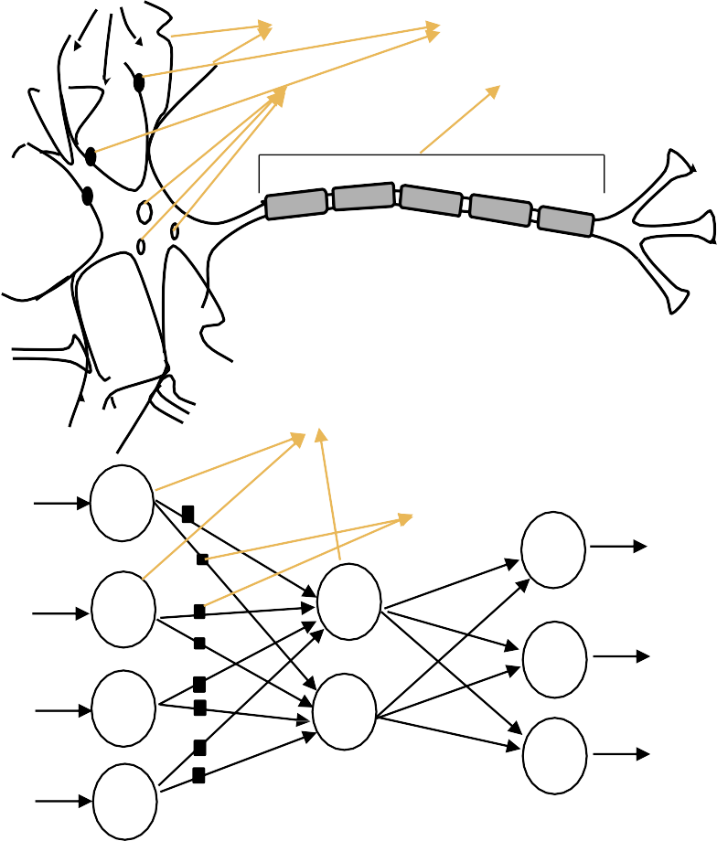
SECTION 08 — NEURAL NETWORKS
Biological vs Artificial Neurons
Biological Neuron
Dendrites: receive signals from thousands of upstream neurons.
Cell body (soma): integrates incoming signals.
Axon: transmits output to downstream neurons.
Synapse: junction where signal strength is modulated — this is where learning occurs.
Fires when total input exceeds a threshold.

Slide 45
SECTION 08 — NEURAL NETWORKS
Biological vs Artificial Neurons
Artificial Neuron
z = w₁x₁ + w₂x₂ + ... + wₚxₚ + b
(weighted sum + bias)
output = activation(z)
Weights wⱼ: analogous to synaptic strengths
Bias b: shifts the activation threshold
Activation: introduces non-linearity
KEY: A single neuron with sigmoid activation is logistic regression. You've already done neural networks!

Slide 46
SECTION 08 — NEURAL NETWORKS
Biological vs Artificial Neurons
Activation Functions
ReLU: max(0,z) — most common in hidden layers. Avoids vanishing gradients.
Sigmoid: 1/(1+e⁻ᶻ) — for binary output (= logistic link function)
Softmax: normalised exp — for multi-class probability output
Tanh: (eᶻ−e⁻ᶻ)/(eᶻ+e⁻ᶻ) — centred at 0; useful in RNNs
Without activation: a neural network collapses to a linear model regardless of depth.
36 / 54

Slide 47
SECTION 08 — NEURAL NETWORKS
Multilayer Perceptron — How Deep Networks Learn
Training — Backpropagation
FORWARD PASS: feed input through network, compute ŷ
COMPUTE LOSS: L(y, ŷ) — cross-entropy for classification
BACKWARD PASS: compute ∂L/∂w for every weight via chain rule
UPDATE WEIGHTS: w ← w − η · ∂L/∂w (gradient descent)
REPEAT for many batches and epochs
Learning rate η: most critical hyperparameter.
Too small → very slow. Too large → diverges.
Use Adam optimiser (adaptive learning rates) in practice.
Key insight: Input Layer → Hidden Layer(s) → Output Layer

Slide 48
SECTION 08 — NEURAL NETWORKS
Multilayer Perceptron — How Deep Networks Learn
Regularisation for Neural Networks
Dropout: randomly zero a fraction (e.g. 20%) of neurons during each training step → prevents co-adaptation → acts like ensemble of 2ᵏ sub-networks.
Batch Normalisation: normalise activations within each mini-batch → stabilises training → allows higher learning rates → also acts as regulariser.
Weight Decay: L2 penalty on weights → equivalent to Ridge regression → prevents weights from becoming too large.
Early Stopping: stop training when validation loss plateaus → most important practical tool.

Slide 49
SECTION 9
9
Transformers & LLMs
Advanced AI: step-by-step guide for data scientists

Slide 50
SECTION 09 —TRANSFORMERS & LLM
The Transformer Architecture
The Attention Mechanism
Transformer: is a deep learning architecture. It uses self-attention to understand relationships among all words simultaneously.
Self-attention: Each element of a sequence directly attends to all other elements.
Example: The cat sat on the mat because it was tired.
Transformers remembers ‘it’ = ‘cat’ after many words using attention score
For each position i:
Query Qᵢ: 'What am I looking for?'
Key Kⱼ: 'What do I offer?'
Value Vⱼ: 'What is my content?'
Attention score: softmax(QᵢKⱼᵀ/√d)
Output: weighted sum of Values
Benefits of Transformers:
Parallel processing
Long-range context
Faster training
Better scalability
Foundation of LLMs

Slide 51
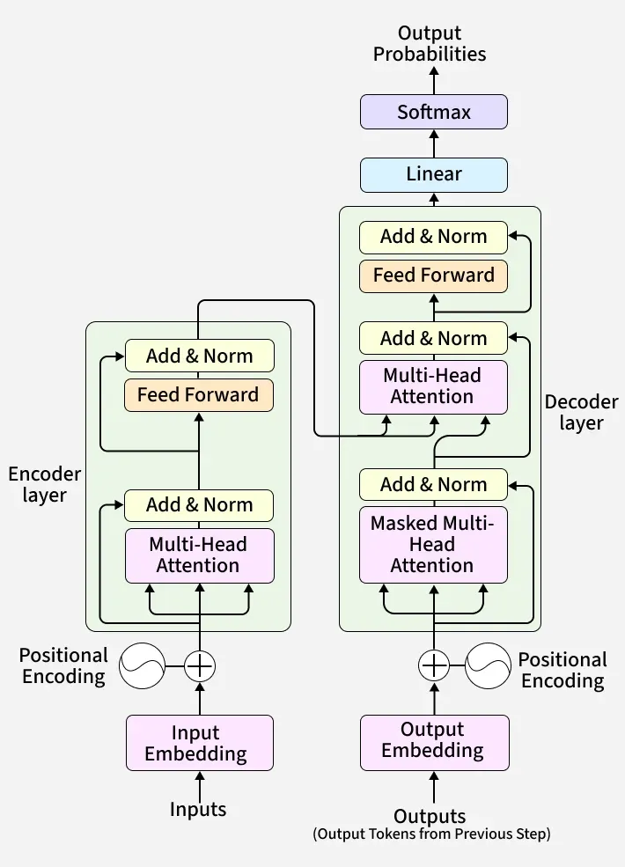
SECTION 09 —TRANSFORMERS & LLM
The Transformers Architecture : High-level Overview
Input Sentence
Tokenization
Embeddings
Positional Encoding
Multi-Head Self-Attention
Output
Feed-forward Network
Notes:
Transformer does not understand texts, They understand vector embeddings.
Embeddings: similar words cluster together.
Positional Encoding: Dog bites man != Man bites dog [dog(1); bites(2)]

Slide 52
SECTION 09 —TRANSFORMERS & LLM
Transformers — The Architecture Behind GPT, BERT, and AlphaFold
Clinical Applications
ClinicalBERT / BioBERT: Fine-tuned on clinical notes/biomedical literature. Tasks: NER (extract diagnoses, medications), ICD coding, discharge summary classification.
Med-PaLM 2 (Google): Scored 86.5% on USMLE-style questions. Passes medical licensing threshold.
AlphaFold 2: Transformer + 3D structural reasoning → predicted structures of 200M proteins. Drug target identification.
GPT-4 for clinical: Differential diagnosis generation, patient communication drafting, literature summarisation. Use with caution — hallucinations remain a risk.

Slide 53
SECTION 09 —TRANSFORMERS & LLM
Understanding Large Language Models
What is an LLM?
Clinical LLM Use Cases
A Large Language Model (LLM) is a deep learning model built on the Transformer architecture and trained on massive amounts of text data to understand, generate, summarize, classify, and reason over human language.
Token is the key ingredient: Every LLM is token-based. Token is the smallest unit a LLM processes.
LLMs can perform many tasks using the same model:
Language tasks
Coding tasks
Analytics tasks
Scientific tasks
ICD coding from clinical notes (F1>0.85)
Discharge summary generation (physician-rated quality)
Patient communication drafting
Differential diagnosis generation
Literature search and summarization
Clinical trial eligibility screening
Radiology report structured extraction
Academic use: Writing assistance, literature review, code generation (R/Python), grant application support.
Key rule: Always verify LLM outputs — hallucinations are real.
Example: When you type Explain diabetes, transformer sees [1432, 5627, 18] not text.

Slide 54
SECTION 09 —TRANSFORMERS & LLM
Working of LLMs
User enters prompt : Explain Breast Cancer Diagnosis
The sentence is converted into tokens: [3342, 9871, 8742, 554]
Tokens becomes vectors: [0.34, -0.87, 1.21, ...]
These numerical vectors capture semantic meaning.
Self-attention: The model decides which words matter most. The attention mechanism learns relationships between words.
The context-awareness is the primary innovation behind Transformers:
Applies attention
Learns context
Extracts patterns
Builds understanding
Model calculates probabilities for different words
Example: Breast cancer is diagnosed using [mammography 45%; MRI 22%; biopsy 18%; ultrasound 10%]
Token generation : mammography
This steps are repeated until response is completed.
Pretraining
Learn language patterns
Instruction Tuning
Teach model to follow instruction, answer questions, summarize
RLHF
Reinforcement learning from human feedback for better answers

Slide 55
SECTION 09 —TRANSFORMERS & LLM
Large Language Models — What They Are and Are Not
LLM Limitations & Safety
Hallucinations: LLMs confidently generate plausible-sounding but factually incorrect text. Drug dosing errors, invented references, wrong lab values.
Knowledge cutoff: GPT-4 trained to April 2023. No real-time clinical guideline updates.
Data privacy risks: Patient data, clinical data and proprietary documents requires governance and compliance controls
Bias: Training data biases → model biases in medical advice. Tested to perform worse for minority populations on some benchmarks.
Non-deterministic outputs: Same prompt can generate different answers.
Explainability issue: Sometimes the responses are difficult to explain
For clinical deployment: LLMs as assistants to clinicians, never as autonomous decision-makers.
To improve: Include Retrieval Augmented Generation, Fine-tuning, Human Review

Slide 56
SECTION 10
10
Deep Dive — Python Coding & Implementations
Supervised model comparison and evaluation in Python

Slide 57
SECTION 11
11
Understanding Agentic AI
Basic understanding of AI-agents and Agentic-AI

Slide 58
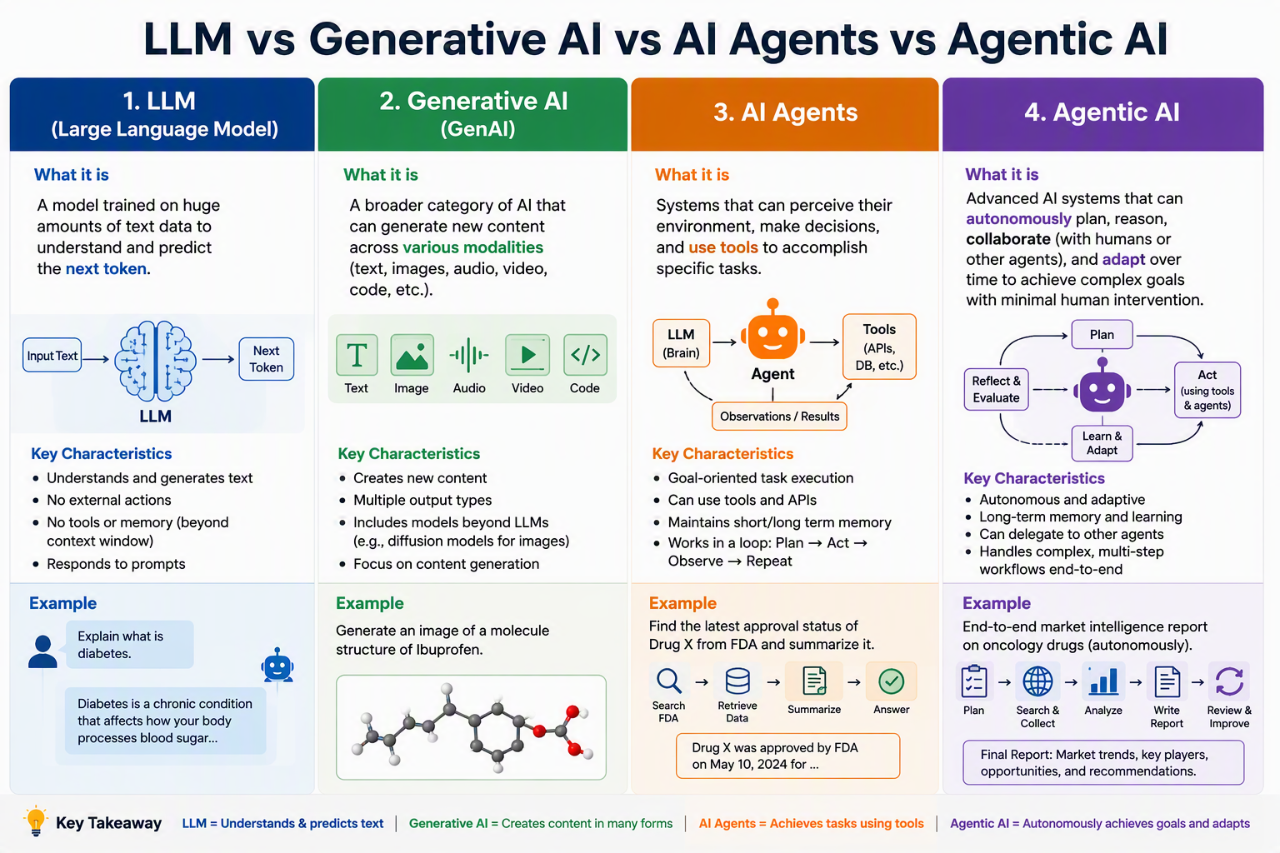
SECTION 11 —AGENTIC AI

Slide 59
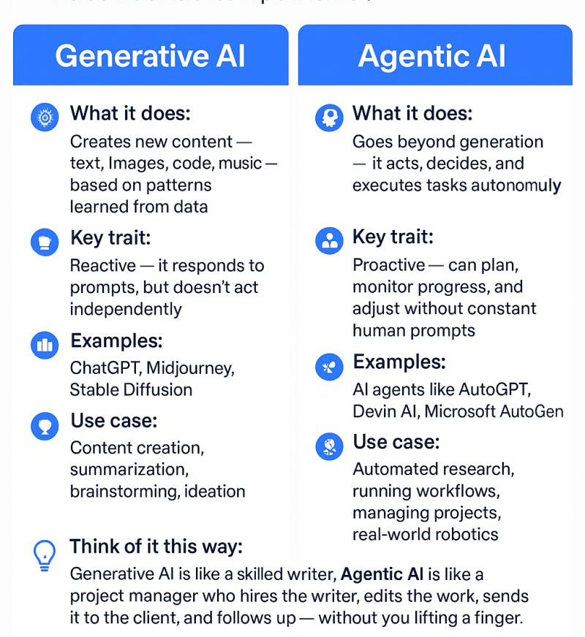
SECTION 11 —AGENTIC AI
Understanding Agentic AI
What is Agentic AI?
An AI system that can autonomously make decisions and act to achieve specific goals with minimal human intervention and execute complex multi-step tasks.
Most important Agentic AI pattern is ReAct pattern (Reason + Act)
With Tools: Agents accessing internal and external data sources, generating reports and artifacts, analyzing data, and invoking specialized capabilities
Orchestrator: A coordinator responsible for managing specialized agents (task routing, dependency management, workflow monitoring, result aggregation)
Key Insights: If LLMs are the brain, then Agentic AI is the brain + memory + tools + decision-making + actions

Slide 60
SECTION 11 —AGENTIC AI
Understanding Large Language Models
Architecture
Agentic Workflow & Limitations
Core Components:
LLM >> Reasoning engine
Memory >> Storing history
Planning module >> Creates workflow
Tools >> External capability
Orchestrator >> Coordinates actions
Reflection module >> Evaluates outcomes
Single-Agent System: One Agent handles everything. Useful for personal assistant, chatbots, coding assistant
Multi-Agent System: Multiple specialized agents collaborate.
Once the user provides a query or a prompt:
Agent understands the goal
Planning: Breaks task into sub-tasks
Agent calls different tools to perform tasks
Analyze result: LLM reasons over collected data
Generate report: Creates final response
Limitations:
Security risk: Agent might access sensitive systems
Tool failure: External systems might fail
Hallucinations: Agent still uses LLMs
Compliance risk
Multi-Agent System Example: Clinical Study Report(CSR) generation: Research Agent (retrieves data) -> Statistics Agent (analyses results) -> Writing Agent (creates report) -> QA Agent (validates output)

Slide 61
SECTION 12
12
Review & Connecting the Dots
Synthesis — statistics, ML, deep learning, and clinical practice unified

Slide 62
SECTION 12 — REVIEW & CONNECTING THE DOTS
Classical Statistics vs Machine Learning — Complete Comparison
Aspect | Classical Statistics | Machine Learning | When to Prefer Which
Core Focus | Inference, explanation, causality | Prediction, pattern recognition | Causal questions → Stats; Prediction tasks → ML
Model Form | Parametric (specified by analyst) | Parametric or non-parametric (learned) | Known structure → Stats; Unknown → ML
Handle Complexity | Manual interactions, transformations | Auto-discovery of interactions | p<50 → Stats; p>50 or complex interactions → ML
Overfitting Control | AIC/BIC, ANOVA tests | Cross-validation, regularisation | Both valid — CV is more algorithm-agnostic
Uncertainty | CIs, p-values, prediction intervals | Bootstrap CI, Bayesian approaches | Stats has richer uncertainty framework currently
Data Requirements | Works well with small n | Improves with larger n | n<100 → Stats almost always; n>10,000 → ML shines
Feature Engineering | Essential — domain knowledge | Partially automated (DL auto-learns) | Always important; DL reduces manual engineering for images/text
Interpretability | High (coefficients, OR, HR) | Variable (DT high; NN low; SHAP helps) | Regulatory/clinical → Stats or DT; Research → any
Scalability | Limited — O(n²p) matrix ops | Designed for scale — stochastic optimisation | Big data (n>1M) → ML; Moderate data → both

Slide 63
SECTION 12 — REVIEW & CONNECTING THE DOTS
Algorithm Quick Reference — Connecting All the Dots
Algorithm | Best For | Key Hyperparameters | R Function | Python
Logistic Reg. | Causal + small p, regulatory | λ (LASSO/Ridge) | glm() / glmnet() | sklearn LogisticRegression
Decision Tree | Printable rules, regulatory audit | cp, maxdepth | rpart() | DecisionTreeClassifier
Random Forest | Clinical tabular, general default | ntree, mtry, nodesize | randomForest() | RandomForestClassifier
XGBoost | Large n, max performance, SHAP | eta, max_depth, early stop | xgb.train() | XGBClassifier
SVM | Genomics (p>>n), high-dim | C, gamma, kernel | e1071::svm() | SVC in Pipeline
KNN | Rare disease (small n), after PCA | K, distance metric | caret knn | KNeighborsClassifier
CNN | Medical images (radiology, pathology) | Architecture, dropout | torch / keras | PyTorch / TensorFlow
Transformer/LLM | Clinical NLP, notes, literature | Architecture, fine-tuning | {clinicalBERT} | transformers (HuggingFace)
Causal ML (TMLE) | Observational causal inference | Nuisance models, folds | TMLE package | econml / doubleml

Slide 64
SECTION 13
13
Conclusion
Key takeaways, resources, and your next steps in clinical AI

Slide 65
SECTION 13 — CONCLUSION
Day | Section | Core Learning
Day 1 | Intro to AI/ML | AI ⊃ ML ⊃ DL. ML is statistics with a different vocabulary. Use of AI/ML in pharma.
Day 1 | Models & Uses | Five algorithms for five contexts. Decision trees for bedside rules. Random Forest as the default. XGBoost for max performance. SVM for genomics. KNN for rare disease.
Day 1 | Oncology Connect | AI is already in clinical practice: 500+ FDA-cleared devices, PAM50 subtyping, AlphaFold, COMPOSER sepsis, Oncotype DX. Biostatisticians are irreplaceable for validation and causal inference.
Day 1 | R Hands-on | rpart, randomForest, xgboost, e1071, caret, pROC — a complete R ML toolkit. Always: stratified split, CV tuning, AUC+calibration reporting.
Day 1 | Case Study 1 | SVM AUC=0.994 on breast cancer FNA. No single metric tells the whole story. Sensitivity and calibration matter as much as AUC. TRIPOD-ML for reporting.
Day 1 | GitHub | GitHub for reproducibility, version control and collaboration. Never commit PHI.
Day 2 | Neural Networks | Neurons → MLPs → CNNs → RNNs → Transformers. DL for images/text; classical ML for tabular. Backpropagation = chain rule. Regularisation is mandatory.
Day 2 | Transformers & LLMs | LLMs are large text predictors with emergent capabilities. Clinically useful but hallucination-prone. Python = sklearn + xgboost + shap + transformers.
Day 2 | Deep Dive Python Coding | SHAP values explain individual predictions. Calibration curves show probability reliability. Pipeline prevents scaling leakage. ROC + calibration + SHAP = complete evaluation.
Day2 | Use of Agentic AI | LLM vs. GenAI vs. AI-agents vs. Agentic AI. Basic understanding of Agentic-AI workflow and limitations.
Day 2 | Review + Conclusion | Stats for causality. ML for prediction. Both for clinical research. TRIPOD-ML for reporting. Your next step: apply one technique to your own research.

Slide 66
SECTION 13 — CONCLUSION
Resources & Your Next Steps
📚 Essential Books (Free Online)
💻 Online Courses
ISLR: Introduction to Statistical Learning (James et al.) → statlearning.com
ESL: Elements of Statistical Learning (Hastie et al.) → web.stanford.edu/~hastie/ElemStatLearn
Causal Inference: What If — Hernán & Robins → hernanrobins.com
Deep Learning: Goodfellow, Bengio, Courville → deeplearningbook.org
fast.ai — Practical Deep Learning (free, top-down, highly recommended)
Coursera ML Specialisation — Andrew Ng (excellent foundations)
DataCamp: R for Machine Learning, tidymodels
HuggingFace NLP Course (free, transformers/LLMs)
kaggle.com — Micro-courses + competitions on clinical data
📊 Practice Datasets
📋 Packages (R/Python)
MIMIC-IV: 70,000 ICU admissions. physionet.org (free with CITI training)
eICU: Multi-site ICU. PhysioNet.
TCGA: Cancer genomics. cancer.gov
SEER: Cancer incidence/survival. seer.cancer.gov
HCUP NIS: 7M+ US admissions. ahrq.gov
Kaggle healthcare competitions
📦 Key Python Packages: numpy, pandas, matplotlib, seaborn, tensorflow, sklearn, plotly
📦 Key R Packages: tidymodels, caret, pROC, randomForest, xgboost, rpart.plot, SHAPforxgboost, dcurves, mlbench, ranger, survival

Slide 67
THANK YOU!
End of 2nd Day Program – AI/ML for Beginners
"The goal was not to make you ML engineers. The goal was to give you the vocabulary, the tools, and the critical eye to engage with clinical AI as the rigorous scientists you already are."

Slide 68
Back-up
To be discussed

Slide 69
SECTION 01 — INTRODUCTION TO AI/ML
A Brief History of AI
1950s
The Birth — Turing test (1950); Dartmouth Conference coins 'AI' (1956); early symbolic logic programs
1970s–80s
Expert Systems — Rule-based AI; hand-coded knowledge bases; MYCIN diagnoses infections; 'AI winter' follows overpromising
1990s
Statistical ML — SVMs (Cortes & Vapnik 1995); kernel methods; the shift from symbolic to statistical AI
2000s
Big Data Era — Random Forests (Breiman 2001); gradient boosting; ensemble methods; internet-scale datasets
2012–now
Deep Learning — AlexNet wins ImageNet; GPUs enable neural nets; GPT, AlphaFold, DALL·E; AI in biomedicine

Slide 70
SECTION 01 — INTRODUCTION TO AI/ML
Mapping Classical Statistics to ML — Same Ideas, Different Words
Statistical Concept | Statistical Term | ML / AI Term | Shared Purpose
Model fitting | Maximum Likelihood (MLE) | Loss Minimisation | Find best-fitting parameters
Prevent overfitting | AIC / BIC / Parsimony | Regularisation (L1, L2) | Balance bias-variance
Performance estimate | Cross-validation (LOOCV) | k-Fold CV | Out-of-sample accuracy
Uncertainty | Confidence Interval | Prediction Interval | Quantify error bounds
Variable selection | Stepwise / LASSO | Feature Importance / SHAP | Identify key predictors
Effect size | Regression coefficient β | Feature weight / SHAP value | Quantify input→output link
Missing data | Multiple imputation (MI) | Imputation / masking | Handle incomplete records
Overfitting | AIC penalty term | Dropout / Early Stopping | Generalise to new data

Slide 71

SECTION 01 — INTRODUCTION TO AI/ML
The Statistical Learning Framework
Goal: Find a function $\hat{f}(X)$ that approximates the true unknown function f(X) = E[Y | X], minimising prediction error on unseen data.
Input X
Function $\hat{f}$
Output Ŷ
Loss L(Y,Ŷ)
Feature vector — patient age, sex, lab values, diagnoses, imaging features. In stats: covariates/predictors.
The learned model — could be a decision tree, neural network, or any ML algorithm. In stats: the fitted model.
Predicted outcome — class probability, survival time, biomarker level. In stats: ŷ from predict().
Discrepancy between prediction and truth — MSE, cross-entropy, log-loss. In stats: residual sum of squares.
→ Collect and pre-process data
→ Train algorithm
→ Generate predictions
→ Evaluate & optimise

Slide 72
SECTION 01 — INTRODUCTION TO AI/ML
Core ML Idea — The Statistical Learning Framework
Goal: Find $\hat{f}$(X) to approximate f(X) = E[Y|X] — minimising prediction error on unseen data
Supervised ML
Training
Validation
Test Set
Input X + Label Y
Learn from data
Tune & select
Final honest evaluation
Learn mapping X → Y from labelled examples.
Regression: Y continuous
Classification: Y categorical
Survival: Y time-to-event
Algorithm sees labelled training data.
Adjusts parameters to minimise loss L(Y, Ŷ).
Analogy: medical student reviewing past cases with known diagnoses.
Monitor performance on held-out set.
Select hyperparameters (tree depth, K, λ).
Never use test set here — preserve it.
Used ONCE at the end. Reports unbiased AUC.
Analogy: board exam the student never saw before.
Any peek inflates apparent performance.

Slide 73
SECTION 01 — INTRODUCTION TO AI/ML
Key ML Paradigm — Bias-Variance Tradeoff
MSE($\hat{f}$) = Bias² + Variance + Irreducible Noise ← The fundamental decomposition of every ML model
Bias (Underfitting)
Variance (Overfitting)
Irreducible Noise
Model too simple to capture the true pattern.
Example: Linear model fitted to U-shaped dose-response. Systematic errors regardless of sample size.
Biostat analogue: Omitted variable bias, model misspecification.
Fix: Use more flexible model; add interaction terms.
Model too complex; learns noise in training data.
Example: 200-node decision tree achieves 99% training accuracy, 62% on new patients.
Biostat analogue: Regression with too many predictors; R²=0.99 but poor prediction.
Fix: Regularise (LASSO/Ridge); prune; ensemble methods.
Inherent randomness in outcome Y. Cannot be eliminated regardless of model quality.
Example: Two patients identical on all measured features but different outcomes (unmeasured causes).
Biostat analogue: Residual variance σ² in regression.
Fix: Cannot fix — measure better features to reduce it.

Slide 74
SECTION 01 — INTRODUCTION TO AI/ML
Evaluation Basics — How Do We Measure Good?
Metric | Formula | Task | Clinical Interpretation
Accuracy | (TP+TN)/N | Classification | MISLEADING when outcome rare. Predict 'no cancer' for all → 85% accuracy if prevalence=15%.
Sensitivity (Recall) | TP/(TP+FN) | Classification | Proportion of malignant cases correctly identified. Primary metric for screening.
Specificity | TN/(TN+FP) | Classification | Proportion of benign correctly ruled out. Important for confirmatory diagnosis.
AUC-ROC | Area under ROC curve | Classification | P(random malignant > random benign). Threshold-independent. Primary metric.
Brier Score | Mean((p − y)²) | Classification | Combined calibration + discrimination. Lower = better. 0=perfect, 0.25=random.
RMSE | √Mean((ŷ − y)²) | Regression | Root Mean Squared Error. Same units as Y. Penalises large errors quadratically.
Cross-validation | k-fold CV AUC | Both | Primary performance estimate. ALL models compared on same folds.

Slide 75
SECTION 01 — INTRODUCTION TO AI/ML
Facts and Fun — Did You Know?
🧠 Who coined 'machine learning' while developing an AI checkers program?
🔬 What is the name of the early neural network, a statistical pattern learner?
Arthur Samuel (1959) — at IBM, his checkers program learned to beat him at his own game by playing thousands of games against itself.
The Perceptron (1958) by Frank Rosenblatt at Cornell — it was a physical machine that learned to classify images. Minsky & Papert proved its limitations in 1969, triggering the first AI winter.
💊 What ML model is currently used in hospitals to predict sepsis up to 6 hours before clinical recognition?
🎯 How many FDA-approved AI/ML-based medical devices exist as of 2024?
Random Forests and XGBoost trained on EHR time-series data (vital signs, labs, medications). Example: the COMPOSER model (UCSF) reduced sepsis mortality by 18% in a prospective trial.
Over 500+ cleared or approved by FDA as Software as a Medical Device (SaMD). Primarily in radiology, pathology, and cardiology. Growing at ~100/year.

Slide 76
SECTION 02 — MODELS AND THEIR USES
Supervised Learning Types — The Main Algorithm Families
Decision Trees
Random Forests
Gradient Boosting
(XGBoost, LightGBM)
Recursive binary splits on feature thresholds.
Gini impurity or information gain.
Highly interpretable — printable clinical rules.
High variance when deep → prune or ensemble.
500 trees on bootstrap samples + random feature subsets.
Averaging reduces variance substantially.
Built-in OOB validation. Handles missing data.
Best default choice for tabular clinical data.
Sequential error-correction. Each tree fits residuals.
Built-in regularisation (L1, L2).
Native missing data handling. SHAP explanations.
Best for large n, maximum performance.
SVM
KNN
Neural Networks / DL
Maximum-margin hyperplane classification.
Kernel trick → non-linear boundaries.
Best for p>>n (genomics, omics).
Requires feature scaling. Slow for large n.
Predict by majority vote of k nearest neighbours.
No training phase (lazy learner).
Requires feature scaling and moderate n.
Best after dimensionality reduction.
Stacked non-linear transformations.
Universal approximators.
Best for images, text, audio.
Requires large data + GPU compute.

Slide 77
KEY ALGORITHMS
Neural Networks — From Perceptron to Multi-Layer
The Building Block: Neuron
Multi-Layer Network (MLP)
A neuron computes:
z = w₁x₁ + w₂x₂ + ... + wₚxₚ + b
output = activation(z)
Activation functions:
• ReLU: max(0,z) — most common hidden layer
• Sigmoid: 1/(1+e⁻ᶻ) — binary output
• Softmax: normalised exp — multi-class
• Tanh: (eᶻ−e⁻ᶻ)/(eᶻ+e⁻ᶻ) — centred output
A single neuron with sigmoid = logistic regression!
Input layer → Hidden layer(s) → Output layer
Each layer: matrix multiplication + activation
hₗ = activation(Wₗ hₗ₋₁ + bₗ)
Training: Backpropagation
• Forward pass: compute predictions
• Compute loss: L(y, ŷ)
• Backward pass: compute gradients via chain rule
• Update weights: W ← W − η · ∇L
Key hyperparams: n layers, n neurons/layer, η, batch size, epochs, dropout
Universal Approximation Theorem: A single hidden layer with enough neurons can approximate any continuous function to arbitrary precision.

Slide 78
KEY ALGORITHMS
Gradient Boosting — Sequential Error Correction
How Gradient Boosting Works
XGBoost / LightGBM vs Random Forest
Start with a simple initial prediction (e.g. mean of Y)
Compute residuals (prediction errors) from current model
Fit a new tree to the RESIDUALS — learn what the current model gets wrong
Add the new tree to the ensemble (with learning rate η)
Repeat: compute new residuals, fit new tree, add to ensemble
Final model: sum of all trees. Each tree corrects the previous errors.
Key insight: this is gradient descent in function space
Usually outperforms RF on structured/tabular clinical data
More sensitive to hyperparameters (n_estimators, max_depth, η, subsample)
Requires careful tuning: use CV to find optimal n_estimators with early stopping
Can overfit with too many trees — η (learning rate) controls this
Handles missing data natively (XGBoost learns optimal missing value direction)
Feature importance available; SHAP values native in XGBoost
Benchmark studies in clinical ML: XGBoost typically top-3 performer

Slide 79
SECTION 02 — MODELS AND THEIR USES
Causality vs. Prediction — The Most Critical Distinction
Classical Statistics: Causal Focus
Machine Learning: Prediction Focus
'WHY does this happen?'
Estimate effect sizes with uncertainty.
Causal inference: Rubin potential outcomes, DAGs.
RCTs, IV, DiD, propensity scores, g-estimation.
Pre-specified estimands, hypothesis testing.
Generalise from sample to population.
Question: Does Drug A cause better outcomes?
Requires: Causal design — no ML algorithm substitutes for a well-designed RCT.
'WHAT will happen next?'
Minimise prediction error on unseen data.
Feature importance ≠ causal effect.
AUC, RMSE, F1 — empirical performance metrics.
No hypothesis, no p-value required.
Optimise for operational performance.
Question: Which patients will be readmitted?
Requires: Labelled historical data, proper train/test split, honest evaluation.
⚠ THE CRITICAL TRAP: Feature importance ≠ causal effect. A high SHAP value for 'prior admissions' means it's predictively important, NOT that reducing prior admissions would reduce future readmissions. Shoe size predicts reading ability in children (age confounds both) — ML would use it; biostatistics would control for age.

Slide 80
SECTION 07 — AWS AND GIT
Amazon Web Services (AWS) for Health AI
☁️ Why Cloud Computing?
🗄️ Key AWS Services for Health AI
Local computers: Limited RAM/CPU, no scalability, data silos, no collaboration.
AWS Cloud: Unlimited storage, scalable compute (CPUs/GPUs on demand), shared access, HIPAA-compliant options for clinical data, pay-per-use.
Healthcare AI needs: Large genomic datasets, GPU for deep learning, multi-site collaboration.
S3 (Simple Storage Service): Store datasets, model files, results. Highly durable (99.999999999%). Bucket policies control access.
SageMaker: Managed ML platform. Train, tune, and deploy ML models without managing servers. Built-in algorithms + custom R/Python scripts.
EC2: Virtual machines. Choose CPU (for RF/XGBoost) or GPU (for deep learning).

Slide 81
SECTION 07 — AWS AND GIT
Amazon Web Services (AWS) for Health AI
🏥 Healthcare Compliance
🔬 SageMaker for Clinical ML
HIPAA Business Associate Agreement (BAA) with AWS enables handling of Protected Health Information (PHI).
Key services: S3 (encrypted), RDS (encrypted database), CloudTrail (audit logs), VPC (network isolation).
Best practices: Never store PHI in code. Use IAM roles, not access keys. Encrypt at rest + in transit. Enable CloudTrail for all actions.
Train in R or Python: SageMaker runs your script on cloud compute.
Auto-scaling: From 1 to 100 instances automatically.
Model Registry: Version and deploy models to a REST API endpoint.
Clinicians access: Web app calls the API → gets risk prediction in <1 second.
Example workflow: Upload BreastCancer data to S3 → train RF on SageMaker → deploy to endpoint → clinical team queries endpoint.

Slide 82
SECTION 08 — NEURAL NETWORKS & TRANSFORMERS
Multilayer Perceptron — How Deep Networks Learn
MLP Architecture
Input Layer → Hidden Layer(s) → Output Layer
For each hidden layer ℓ:
hₗ = activation(Wₗ hₗ₋₁ + bₗ)
100-neuron hidden layer, 30 inputs:
100×30 = 3,000 weights + 100 biases = 3,100 parameters
For output (binary classification):
ŷ = sigmoid(Wout hL + bout)
Universal Approximation Theorem: A single hidden layer with enough neurons can represent any continuous function.

Slide 83
SECTION 08 — NEURAL NETWORKS & TRANSFORMERS
Specialised Architectures — CNN, RNN, LSTM
CNN — Convolutional Neural Networks
Designed for: Grid data (images, ECG, whole-slide pathology)
Convolutional layer: Apply learned filters across the input. Each filter detects a specific pattern (edge, texture, shape). Filters are shared across all positions — translation invariance.
Pooling: Progressively downsample to capture higher-level features.
Clinical use: Mammography AI, retinal fundus, skin lesion classification, pathology grading (Gleason, Nottingham).
Built-in feature engineering: learns to detect edges → shapes → tumour margins automatically.

Slide 84
SECTION 08 — NEURAL NETWORKS & TRANSFORMERS
Specialised Architectures — CNN, RNN, LSTM
RNN & LSTM — Sequential Data
Designed for: Time-series, sequential data
RNN: Hidden state hₜ = f(hₜ₋₁, xₜ) — passes information across time steps. Suffers from vanishing gradients over long sequences.
LSTM (Long Short-Term Memory): Gating mechanism selectively remembers/forgets. Handles long-range dependencies.
Clinical use: Vital sign time-series in ICU (predict sepsis 6h ahead), medication sequence modelling, EHR trajectory analysis.
Biostat analogue: Autoregressive models, state-space models.

Slide 85
SECTION 08 — NEURAL NETWORKS & TRANSFORMERS
Specialised Architectures — CNN, RNN, LSTM
When DL Beats Classical ML
Deep learning wins when:
• Data is unstructured (images, text, audio, video)
• Dataset is massive (n > 100,000)
• Hierarchical feature learning needed
• GPU compute available
• Transfer learning applicable (pre-trained models)
Classical ML wins when:
• Structured tabular data (clinical records, labs)
• Small to moderate n (< 10,000)
• Interpretability required
• Limited compute
• Features already well-defined
Oncology: DL for pathology/radiology; RF/XGB for clinical risk scores.

Slide 86
SECTION 09 —TRANSFORMERS & LLM
Transformers — The Architecture Behind GPT, BERT, and AlphaFold
The Attention Mechanism
Self-attention: Each element of a sequence directly attends to all other elements.
For each position i:
Query Qᵢ: 'What am I looking for?'
Key Kⱼ: 'What do I offer?'
Value Vⱼ: 'What is my content?'
Attention score: softmax(QᵢKⱼᵀ/√d)
Output: weighted sum of Values
Result: Long-range dependencies captured without recurrence. Parallelisable → GPU-efficient.

Slide 87
SECTION 09 —TRANSFORMERS & LLM
Transformers — The Architecture Behind GPT, BERT, and AlphaFold
Transformer Architecture (Vaswani 2017)
'Attention Is All You Need' — the paper that changed AI.
Encoder: Understands input context
(BERT, ClinicalBERT — for NLP classification)
Decoder: Generates output sequences
(GPT, LLaMA — for text generation)
Pre-training on massive corpus (unsupervised)
→ Fine-tuning on task-specific data (supervised)
Transfer learning: A model trained on 570GB of text can be fine-tuned for clinical NLP with just 1,000 labelled examples.

Slide 88
SECTION 12 — REVIEW & CONNECTING THE DOTS
Connecting the Dots — The Complete Clinical AI Workflow
Research
Question
Data &
EDA
Model
Development
Evaluation
Reporting
(TRIPOD-ML)
Deployment
(GitHub)
Causal?
→ Stats/Causal ML
Predictive?
→ ML
Descriptive?
→ Unsupervised
Quality check
Missing data
Class balance
Distributions
Correlations
Stratified split
Select algorithm
Tune hyperparams
CV validation
Calibration
AUC-ROC + CI
Calibration plot
Brier Score
Subgroup analysis
Threshold tuning
Algorithm described
All metrics + CI
Code available
External validation
PROBAST assessment
GitHub version control
S3 data storage
SageMaker training
API endpoint
Monitoring plan

