Slide 1
SAP S/4HANA CLOUD PUBLIC EDITION 2602 · PROCUREMENT PROCESS DOCUMENTATION
Procure-to-Pay
Process Documentation
BKR-100 Frame · Steel & More Inc. · Plant 1 US (1710)
Velotics Inc. · Company Code 1710
Prepared by: Adarsh Puri Goswami
Notes:
Introduce the project briefly. State this is a complete, live SAP execution — every document number shown is real and was created in SAP S/4HANA Cloud Public Edition 2602 on 19 June 2026.

Slide 2
EXECUTIVE SUMMARY
Business Case & Project Overview
Velotics Inc. manufactures premium bicycles including the R100 Racing Bike. Production scheduling for Q3 2026 identified a shortfall of 50 BKR-100 Frame components at Plant 1 US (1710), required to fulfil Production Order 1036845. This document records the complete end-to-end Procure-to-Pay cycle executed in SAP S/4HANA Cloud to source those frames from approved supplier Steel & More Inc. — from initial purchase requisition through to posted supplier invoice.
$4,250
4
$0.00
43.6%
Total PO Value
SAP Documents Created
3-Way Match Balance
Below Standard Cost
50 frames @ $85.00 USD
PR · PO · GR · Invoice
PO + GR + Invoice aligned
$85.00 vs $150.68 standard
System: SAP S/4HANA Cloud Public Edition 2602 · Company Code: 1710 (Velotics Inc.)
Notes:
Headline numbers first, then the business case narrative. The 43.6% below standard cost is the standout figure — it shows SAP flagged a negotiation outcome as a price variance.

Slide 3
COMPANY & SCENARIO CONTEXT
Who We Are & What We're Procuring
VELOTICS INC.
PROCUREMENT SCENARIO
Company
Velotics Inc.
Material
BKR-100 Frame
Code
1710
Material No.
MZ-RM-R100-01
Industry
Premium Bicycle Manufacturing
Type
Raw Material (ROH)
Plant
Plant 1 US (1710)
Quantity
50 PC
Storage
Std. Storage 1 (171A)
Unit Price
$85.00 USD
Product Lines
Racing · Mountain · E-Bike · Youth
Total Value
$4,250.00 USD
System
SAP S/4HANA Cloud 2602
Supplier
Steel & More Inc. (17300034)
Used In
R100 Racing Bike — Prod. Order 1036845
Notes:
Contextualise before diving into the process. The production order link (1036845) grounds this in a real business need — not a test transaction.

Slide 4
END-TO-END P2P PROCESS FLOW
From Requisition to Payment — All Documents Live in SAP
01
02
03
04
05
Purchase
Requisition
PO
Approval
Purchase
Order
Goods
Receipt
Invoice
Verification
PR 0010002749
Workflow Triggered
PO 4500064292
Mat Doc 5000064835
Inv 5105663963
Operations
Proc. Manager
Proc. Coordinator
Warehouse
Accounts Payable
3-Way Match: Purchase Order · Goods Receipt · Supplier Invoice → Balance: $0.00 ✓
Notes:
Refer to each step number and connect it to the SAP document shown. The 3-way match note at the bottom is key — it's the core control mechanism.

Slide 5
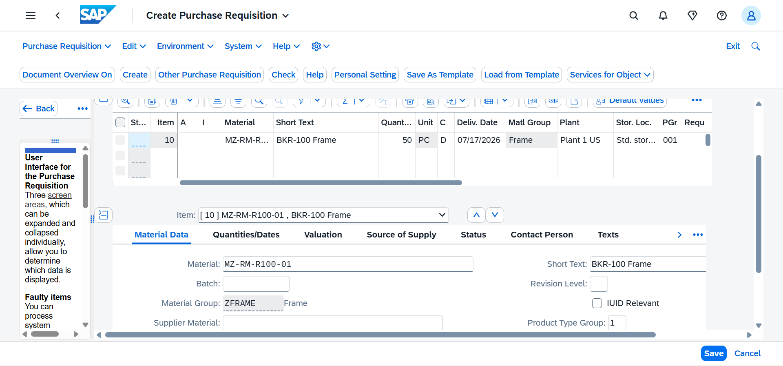
STEP 01 · PURCHASE REQUISITION
PR 0010002749 — BKR-100 Frame Replenishment
PR DETAILS
PR Number
0010002749
Material
MZ-RM-R100-01
Description
BKR-100 Frame
Quantity
50 PC
Delivery
17.07.2026
Plant
Plant 1 US (1710)
Storage
Std. Storage 1 (171A)
Purch. Group
Group 001
Matl. Group
ZFRAME — Frame
In a live environment this PR would be auto-generated by an MRP run — not raised manually.
Notes:
Note the Material Group ZFRAME and the Purchasing Group 001 — both pulled correctly from the material master. Delivery date set 4 weeks out, consistent with supplier lead time.

Slide 6
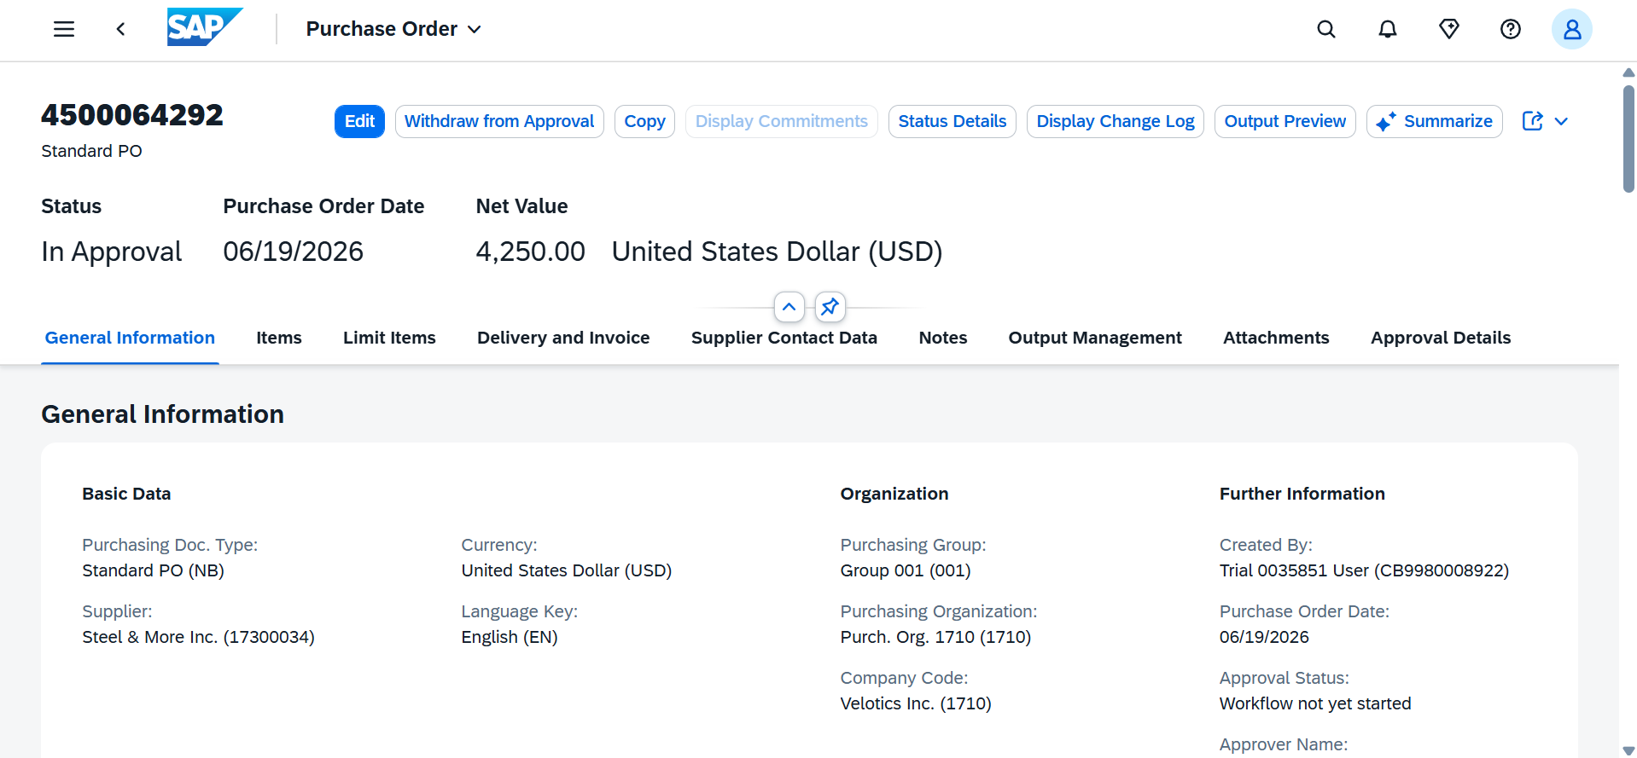
STEP 02–03 · APPROVAL & PURCHASE ORDER
PO 4500064292 — Steel & More Inc. — $4,250.00 USD
PO DETAILS
PO Number
4500064292
PO Type
Standard PO (NB)
Supplier
Steel & More Inc.
Supp. No.
17300034
Net Value
$4,250.00 USD
PO Date
19.06.2026
Status
In Approval
Purch. Org.
Purch. Org. 1710
Company Code
Velotics Inc. (1710)
Status 'In Approval' confirms SAP triggered the procurement approval workflow automatically on PO submission.
Notes:
The 'In Approval' status is important — it shows SAP's internal workflow fired correctly. Net value of $4,250 is confirmed: 50 x $85.00.

Slide 7
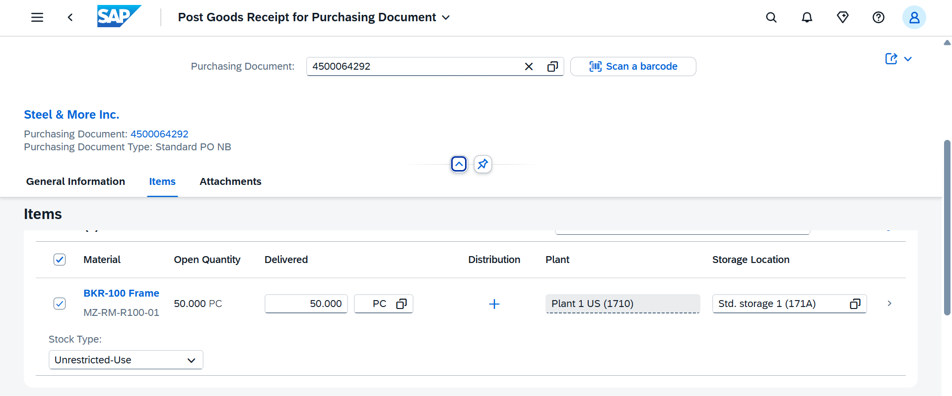
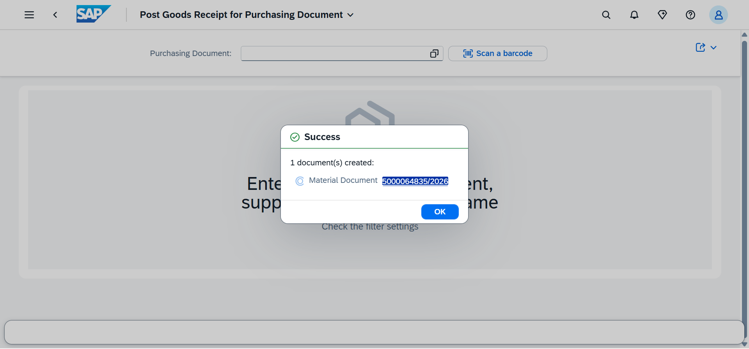
STEP 04 · GOODS RECEIPT
Material Document 5000064835/2026 — 50 Frames Into Stock
GR DETAILS
Material Doc.
5000064835/2026
Mvt. Type
GR for PO (101)
Material
BKR-100 Frame
Qty Received
50 PC
PO Reference
4500064292
Plant
Plant 1 US (1710)
Storage
Std. Storage 1 (171A)
Stock Type
Unrestricted-Use
Post Date
19.06.2026
Notes:
Movement type 101 = standard GR against a PO. Stock posted as Unrestricted-Use means it is immediately available for production consumption in the R100 production order.

Slide 8
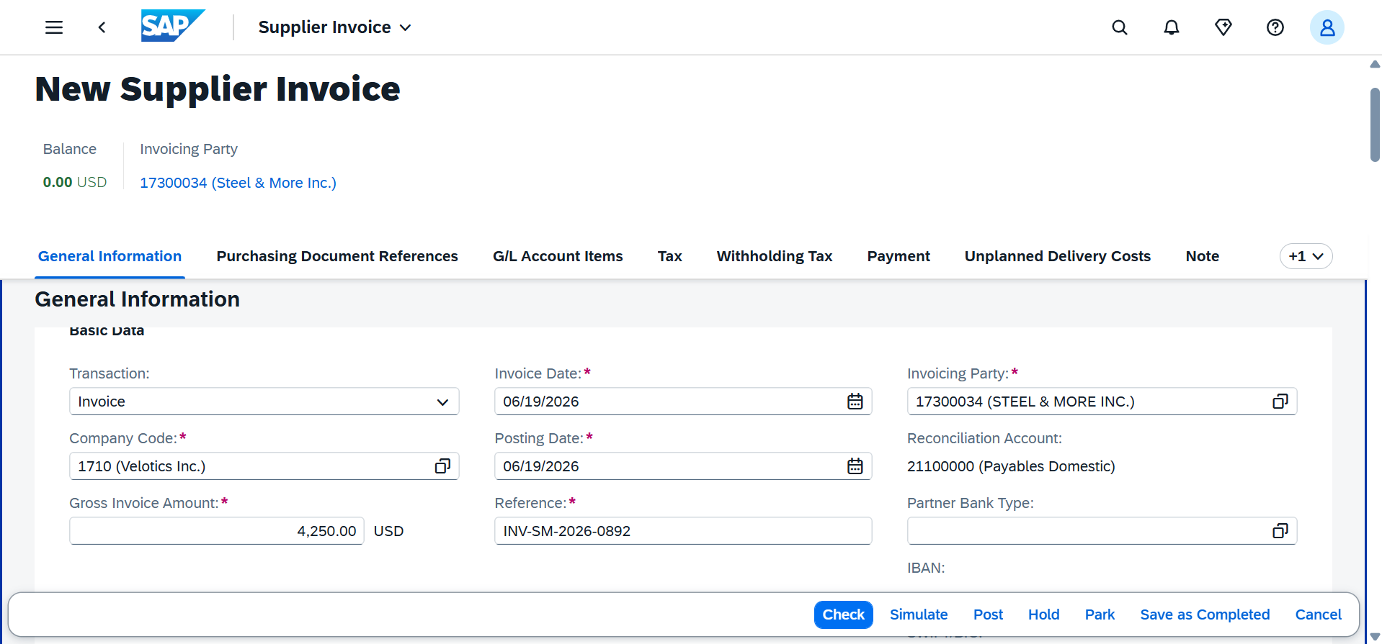
STEP 05 · INVOICE VERIFICATION & 3-WAY MATCH
Invoice 5105663963/2026 — Balance $0.00 — 3-Way Match Passed
3-WAY MATCH
Purchase Order
$4,250.00 · PO 4500064292
Goods Receipt
50 PC · Mat Doc 5000064835
Supplier Invoice
$4,250.00 · Inv 5105663963
INVOICE DETAILS
Balance: $0.00 USD ✓
Invoice Doc.:
5105663963/2026
3-way match passed — posted to Payables Domestic (21100000)
Invoice Ref.:
INV-SM-2026-0892
Gross Amount:
$4,250.00 USD
Invoicing Party:
Steel & More Inc.
Recon. Account:
21100000 Payables Dom.
Notes:
The green $0.00 balance is the key takeaway. SAP verified: PO price = Invoice price, and PO quantity = GR quantity = Invoice quantity. Payment can now be released.

Slide 9
PROCESS PERFORMANCE
KPIs & Metrics — P2P Cycle Analysis
1 Day
$65.68
100%
$3,284
PR-to-PO Lead Time
Saving Per Unit
3-Way Match Rate
Total Cost Saving
NEGOTIATED PRICE vs. STANDARD COST (USD)
DOCUMENT REGISTER
Document Type | Number | Date
Purchase Requisition | 0010002749 | 19.06.2026
Purchase Order | 4500064292 | 19.06.2026
Goods Receipt | 5000064835/2026 | 19.06.2026
Supplier Invoice | 5105663963/2026 | 19.06.2026
Notes:
$3,284 total saving = (150.68 - 85.00) x 50. This is the measurable commercial impact of the procurement cycle. 1 Day PR-to-PO reflects a same-day execution.

Slide 10
RECOMMENDATIONS & NEXT STEPS
Process Improvement Observations
01
Formalise Pricing via Purchase Info Record (PIR)
The $85.00 negotiated price with Steel & More Inc. should be stored in SAP as a Purchase Info Record (ME11). This locks agreed pricing and conditions, auto-populates future POs, and eliminates manual price entry — reducing approval delays on repeat orders for BKR-100 Frames.
02
Transition to MRP-Driven Requisitioning
PR 0010002749 was raised manually in this cycle. In production, the BKR-100 Frame requirement should be generated automatically by an MRP run (MD01) reading the R100 Bill of Materials against the production schedule — eliminating reactive buying and reducing stockout risk.
03
Introduce Supplier Performance Tracking
With Steel & More Inc. now established as the sourced supplier, on-time delivery rate, quality acceptance rate, and lead time should be tracked against agreed SLAs. This data strengthens Velotics' position in the next contract negotiation and supports future sourcing decisions.
SAP S/4HANA Cloud 2602 · Velotics Inc. (1710) ·
Notes:
These three recommendations show systems thinking beyond the transaction — you understand what should happen before and after this cycle in a real organisation.

Slide 11
ABOUT THIS WORK
Portfolio Evidence Statement
Live SAP Execution
Every screenshot in this document was taken from a live SAP S/4HANA Cloud Public Edition 2602 system (my426318.s4hana.cloud.sap). Every document number — PR, PO, GR, and Invoice — is real and traceable.
What This Demonstrates
End-to-end P2P competency: raising a purchase requisition, converting to a purchase order, posting a goods receipt, processing a supplier invoice, and confirming 3-way match in SAP. These are core daily tasks in a Junior Buyer or Procurement Coordinator role.
Beyond the Transaction
This document also demonstrates understanding of where the process connects to MRP, Bills of Materials, Purchase Info Records, and supplier performance management — the broader procurement ecosystem that a buyer operates within.
Built by Adarsh Puri G. · SAP S/4HANA Cloud 2602 ·
Notes:
This slide closes the deck and frames everything the hiring manager has just seen. It answers the implicit question: 'why did you build this?' The answer is evidence, not description.

