Slide 1
A Movie Recommender System
By Krishna Kanhaiya, Gautam Kumar
Networks And Data Mining
Stony Brook University

Slide 2
Data attributes post processing
Once the preprocessing of data is done, we are left with the following attributes from the data set
Age
Gender
Occupation
Title of the movie
Genre of the movie
The rating he gave to the movie after watching it.
The data set was divided into train dataset and the test one, each comprising of ninety and ten percent of the original data.

Slide 3
K-Mean Clustering
With the motive that people of a particular age group, gender, and having similar occupation, have some sort of commonness in the type of movie they prefer, the data set was divided into five clusters.
The other reason that, k-mean clustering of the data was done, because in the next step we will be applying k-nearest neighbor of the new data entry. So, as such it helps to reduce the computation and thus improves the computational efficiency of the process.

Slide 4
The issue of k in k-means
We took a small random sample from the train data set.
We applied the k-mean clustering over it, with the value of k in an increasing order. That is the algorithm is started with k=1, then with k=2 and so on.
Each time we calculated the objective function. That is once the clustering has converged, we calculated the distance of each point from it's respective centroid and then took the sum of all.
∑_{i}∑_{j}(x_{ij}-µ_{i})²
We found that after k=5, the change in objective function was negligible.

Slide 5
Initial seed and the k-mean
The initial seeds value for centroid were taken so that they are as far as possible.
The distance of the each point from all the centroids were calculated.
Then the points were assigned to the cluster, whose centroid was closest to that point.
After that, we recalculate the centroid of each cluster by taking the mean of the points assigned to that particular cluster.
We repeat this, until the change in all k centroid's position is negligible.

Slide 6
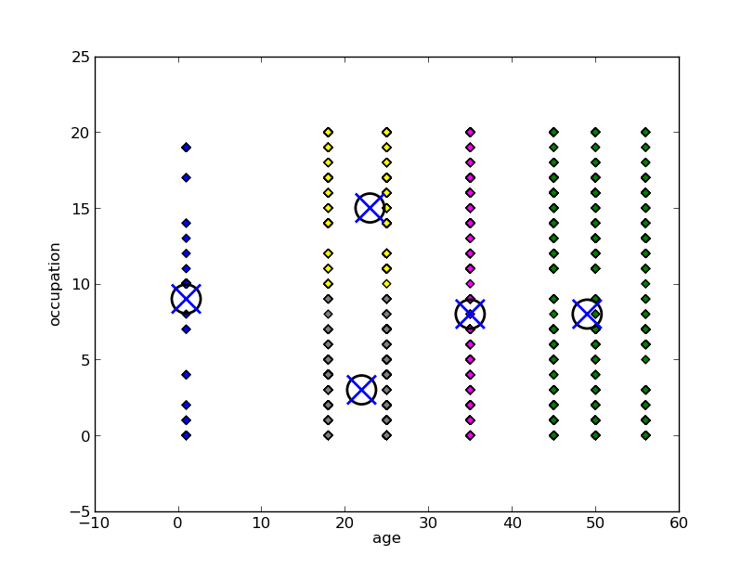
K-Mean clustering

Slide 7
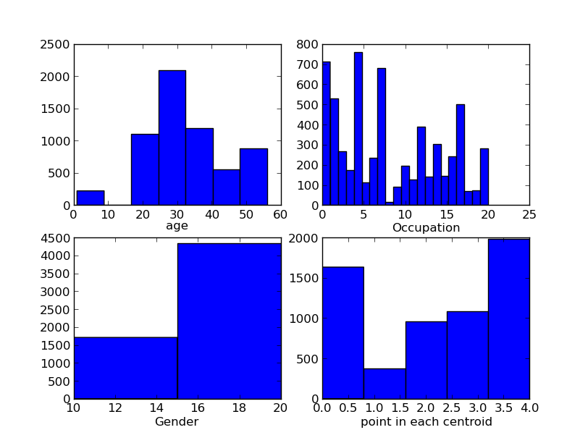
K-nearest neighbor

Slide 8
K-nearest Neighbor
Once we got the clusters with their centroid, we then assign any new point to a cluster based on the distance from each centroid. The one which is nearest to it, is the one with which it is associated.
Now, If a person wants some recommendation on the movie he should see, he/she is asked about his/her age, gender, occupation and the genre of the movie he/she prefers.
Then based of his/her age, gender and occupation, he/she is associated with a cluster.

Slide 9
K-nearest neighbor
Now in that cluster, k-nearest neighbor of the new point is calculated using euclidean distance measure, such that all the k-neighbors have the same genre as this new one, and have rated the movie with value greater than equal to four, on a scale of five.
Thus, the movie associated with these k neighbors becomes the recommendation for the new guy.

Slide 10
Issue of K in KNN
The value of k, in k-nearest neighbor is remains a issue as with k-means.
We resolved it by experimenting a small set of test data set over different value of k in k-nearest neighbor.
We found that initially the result accuracy increased with increase in k value.
Then it became almost constant.
That point was with k=10.

Slide 11
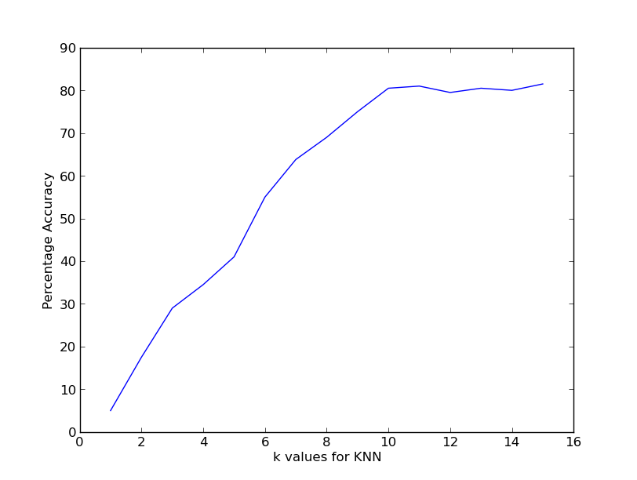
Accuracy as a function of k

Slide 12
Performance of the recommender system
The test data which constitute the ten percent of the original data set, is tested.
The input value of age, gender, occupation, and genre is fed into the recommender system.
And based on the first three attribute they get associated with a cluster.
Then based on the genre and the initial three attributes, the k nearest neighbor is calculated.
The movie associated with those neighbor is the recommended movie for the client.
Then the movie that is watched by the client is seen whether it is there in the recommended list or not.
If it is present in the list, it is counted as success else a failure.
On applying this process over the test data we got a success accuracy of 84.6%.

