Slide 1

Should you trust 68%?
A rebuild you can inspect, test and explain yourself
Briefing for the interim VP, ahead of the commercial leadership review
The dot is the number on trial: 68.2% at month 6
Synthetic pharmacy claims, 6,000 patients, seed 42
Notes:
[30 sec] Your predecessor left a number and a note asking you to trust it. You should not have to. For the next few minutes I will ask the questions a sceptic would ask, and answer each one with evidence you can check yourself afterwards. One thing up front: everything here runs on synthetic data, because this rebuild tests the method. It shows what each rule can do. The real sizes come when we run the same code on the client's claims.

Slide 2



68% and the field can both be right, because they describe different patients
“Give me the short version. Is 68% right?”
68.2%
The method holds up
Exhibit 1 is rebuilt as eight named rules, with 19 passing tests. It reproduces 68.2% on data tuned to match.
of 3,010 patients, 95% interval 66.5 to 69.8%
The question is narrow
The exact question it answers
It counts only patients insured for a full year either side of their first fill. Half of the patients with a fill are not in it.
Of continuously insured new starters, how many had no break longer than 60 days by month 6?
The field can be right too
Reps can see early stoppers and people the claims never show, such as prescriptions that were never filled.
Notes:
[1 min] Here is the answer before the evidence. 68 is a correct answer to one narrow question, and I would read that question aloud. The risk is that leadership hears something else: 68 percent of all patients keep going. Be honest about what the rebuild proves. We tuned the synthetic data to land near 68, so matching it shows the logic is coherent and testable. It does not independently prove the original figure. The rest of this deck shows why the field's view and this number can both be true.

Slide 3
Half of the patients with a fill are counted, and one exclusion flatters the result
“Who is actually in that number?”
−1,584
Timing (R2)
First fill before 2022 (631) or too late for 12 months of follow-up (953). A data-window rule.
−571
Look-back (R3)
88% were already on the drug when they joined. This filter protects the number.
−833
Look-forward (R4)
People who lost coverage. Only 35.5% truly persist at 6 months, so removing them lifts the figure.
Notes:
[1 min] Follow the bars down. We start with 5,998 patients who have a fill and finish with 3,010, about half. Not all exclusions are equal. The timing rule is about having a full data window. The look-back rule protects us from counting existing users as new: 88 percent of those it removes were already on the drug. The one to watch is the look-forward rule, shown in orange. It removes 833 people because they lost coverage within a year, and in this data only 35.5 percent of them truly persist to month 6, against 68.2 percent of those we keep. If you are asked: removing the rule grows the cohort by 1,436 and not by 833, because it also lets later index dates into the intake window.

Slide 4
More than half of the 6-month drop-off has already happened by month 3
“What does one 6-month number hide?”
83.3%
still on therapy at month 3
68.2%
at month 6, the reported figure
48.4%
at month 12, median 348 days
Notes:
[1 min] This is the same cohort, drawn over time. By month 3, about 17 patients in 100 have already stopped. That is about 53 percent of all the stopping seen by month 6. So a rep who says patients stop early and a dashboard that says 68 at month 6 are looking at the same curve. From now on I would suggest we show this curve and not a single point. Kaplan-Meier also lets us keep patients who lose coverage, which is the next question.

Slide 5
The 60-day gap moves the number more than every other rule combined
“Which choices actually move it?”
39.7
point swing from the gap rule alone
41.5%
at 30 days
68.2%
at 60 days
Each bar spans the lowest to highest 6-month persistence as that one rule changes. Look-forward low end counts everyone lost to coverage as stopped.
81.2%
at 90 days
Notes:
[1 min] We ran 27 rule combinations. Most of the movement comes from one definition: how long a patient can go without supply before we call them stopped. Thirty days gives about 42 percent, ninety gives about 81. The first-fill definition hardly matters here, because the 12-month look-back already blocks existing users. The takeaway: 68 is mostly a statement about how forgiving the 60-day definition is. Medical and commercial should agree that definition deliberately. Nobody on the team should treat it as a technical detail. The size of this swing depends on the refill patterns we built into the synthetic data. The direction is mechanical: a looser gap can only keep more patients on therapy.

Slide 6



Three gaps separate the reported figure from what the field sees
“So why does my field team say patients stop much sooner?”
Who is removed
Keeping people who lost coverage gives 64.5%, or 57.8% if they all stopped. Claims go silent when coverage ends.
What “stopped” means
A rep may count a month without the drug as stopping. At a 30-day gap the figure is 41.5%.
What claims never see
Prescriptions never filled, cash payments and free samples. No rule change recovers these patients.
Notes:
[1.5 min] This is the slide to linger on. First, who is removed: keep the people who lost coverage and the figure falls to 64.5, or to 57.8 if we assume they all stopped. Because this data is synthetic we know the truth, 61.3, and it sits inside that range. On real data nobody can see that purple bar. This effect also depends on an assumption: when we re-ran the data with coverage loss unrelated to patient risk, the look-forward effect disappeared, 63.3 versus 63.6. So the real claims must test whether people who lose coverage really do stop more often. Second, what counts as stopped: the field may use a stricter idea than a 60-day break. I cannot prove which definition reps use, so that is worth asking them. Third, and most important, what claims never see. No slider can recover patients who never appear in claims. So the honest position is that the field's view and this number describe overlapping groups of patients.

Slide 7
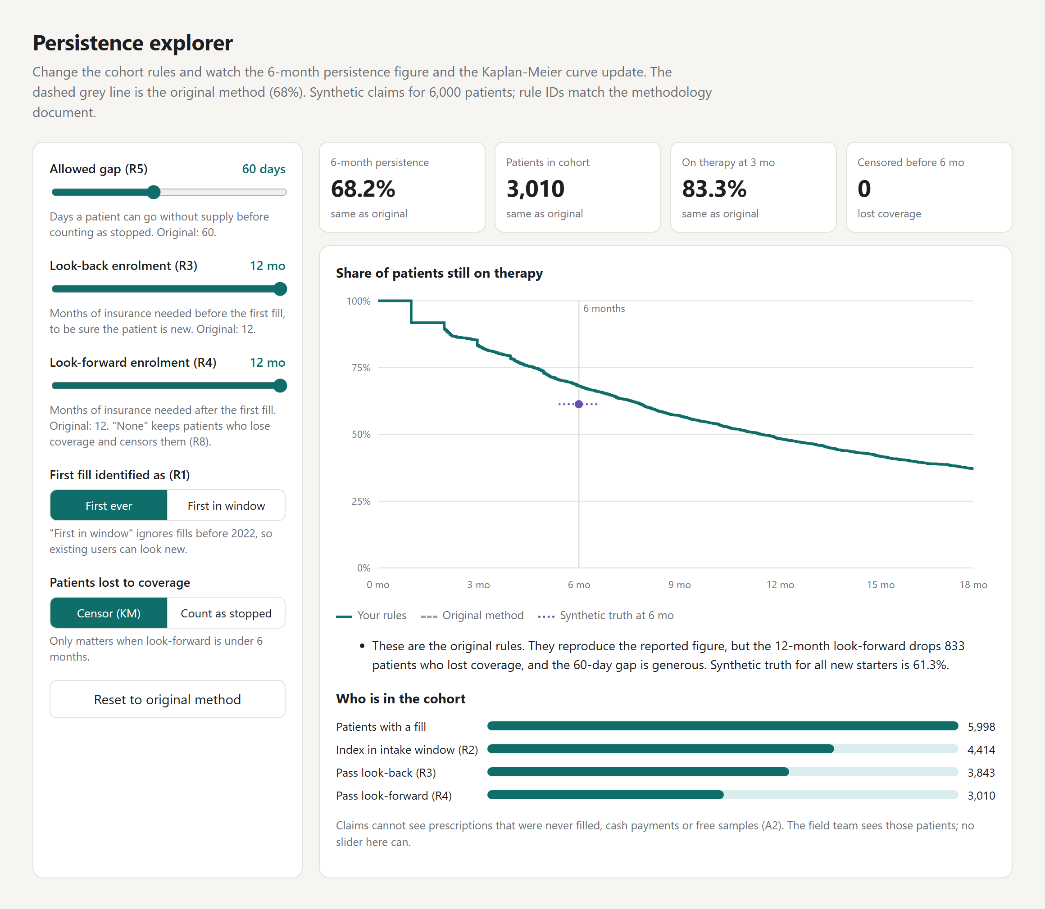
You don’t have to: move the rules yourself, or ask the assistant
“Why should I take your word for any of this?”
Ask a rule question
Why does the look-forward rule matter?
“It removes patients who lost or changed their insurance [O2]. Patients who lose coverage stop therapy more often… [O4]”
Ask something out of scope
What dose of the drug should a patient take?
“I can’t answer that from the methodology or the analysis outputs.”
Retrieval baseline: 20 of 21 test questions passed, 7 of 7 out-of-scope declined. The Gemini mode has been spot-checked; its full run is still to do.
Notes:
[1 min, live demo if possible] Switch to the explorer. Drag the gap to 30, then look-forward to none, and watch the curve and the number change. Press reset to return to 68.2. It runs entirely in the browser with no server or login, and its numbers are tested against the Python code. Then the assistant. It only answers from the written method and the analysis outputs, and every answer cites a rule or result ID. The LLM writes the wording; all numbers come from tested code. It declines clinical, pricing, competitor and forecast questions. Be straight about the evaluation: 20 of 21 is the retrieval-only baseline, and the question set was written by the same person who wrote the decline rules, so we would want a held-out set before relying on it. Backup if the API quota has run out: run the assistant with --mode offline.

Slide 8

“What do I actually say to leadership?”
“68% is the persistence of continuously insured new starters under a 60-day rule. It is not the share of all patients who keep going. Here is the curve, and here is what we are doing to size the difference.”
For this meeting
Next
Then
Show the curve and the exact definition next to 68%. Say the true figure could be materially lower, and don’t quote 58% yet: it comes from synthetic data.
Run this same code on the client’s claims to get the real range. Ask the field what they count as stopping.
Agree one gap definition with medical and commercial. Size the never-filled patients from a prescription-level source.
Decision needed today: approve access to the client’s claims for the rerun.
Notes:
[1 min] This sentence is yours to use word for word. Notice what it does not say: it does not quote a corrected number. Every lower figure on the earlier slides comes from synthetic data, so quoting 58 or 64 percent to leadership as if it described the brand would repeat the problem we are trying to fix. The honest position is that 68 is defined narrowly and the true figure could be materially lower, and we are sizing that. The decision I need from you today is approval to run this on the real claims. Same code, same tests, same explorer, and then you will have a real range to present.

